Slide 1
Employee Data Analysis using Excel
STUDENT NAME:AKSHAYA.S
REGISTER NO:122202135
DEPARTMENT:BCOM.CS
COLLEGE:ANNA ADARSH COLLEGE FOR WOMEN

Slide 2
PROJECT TITLE
Employee Performance Analysis using Excel

Slide 3


AGENDA
Problem Statement
Project Overview
End Users
Our Solution and Proposition
Dataset Description
Modelling Approach
Results and Discussion
Conclusion
3/21/2024 Annual Review

Slide 4

PROBLEM STATEMENT
Employee performance analysis is important because it helps improve how well employees work. This information allows managers to make fair decisions about promotions and rewards.

Slide 5

PROJECT OVERVIEW
This project enhances workforce productivity and effectiveness by analyzing performance data, removing of duplicates, ratings to employee performance, using of pivot table to summarize the data, analyzing trends and providing actionable insights for improving employee and organization performance.

Slide 6

WHO ARE THE END USERS?
Employer
Employee
HR teams
Team leaders
Supervisors
Senior executives
Training and development teams
Recruitment teams

Slide 7

OUR SOLUTION AND ITS VALUE PROPOSITION
Conditional formatting- for finding blank values
Filtering –for removing missing values
Formula-to see the performance level of employee
Pivot table- summary of employee data
Chart-for data visualization

Slide 8
Dataset Description
Employee ID: unique code assigned to each employee to identify them
First name: the first name of employee
Last name: the last name of employee
Business unit: an employee related to a particular department
Employee status: the current employment status of employee(active, on leave or terminated)
Employee type: the classification of employee like full time, part time or intern
Gender code: a code or value representing employee gender
Performance score: a numerical score reflecting the employee performance
Current employee rating: quantitative scores reflecting employee performance from appraisals or reviews.

Slide 9

THE "WOW" IN OUR SOLUTION
=IFS(Z8>=5,"VERY HIGH",Z8>=4,"HIGH",Z8>=3,"MED",TRUE,"LOW")
3/21/2024 Annual Review
9

Slide 10
MODELLING
Data collection:
a)employee dataset information are gathered from Kaggle
b)Information about employee performance analysis
Data cleaning:
removing of duplicates using conditional formatting
removing of missing values using filters
Techniques:
a)comparison of data using slicers
b)using of formula to check the performance level of employees
Results: summarize the performance metrics by department, role or time.
Pivot table:
a)create to summaries and organize the data
b)Showing of data according to performance level
Chart: use bar chart to visualize performance level of employees
10

Slide 11
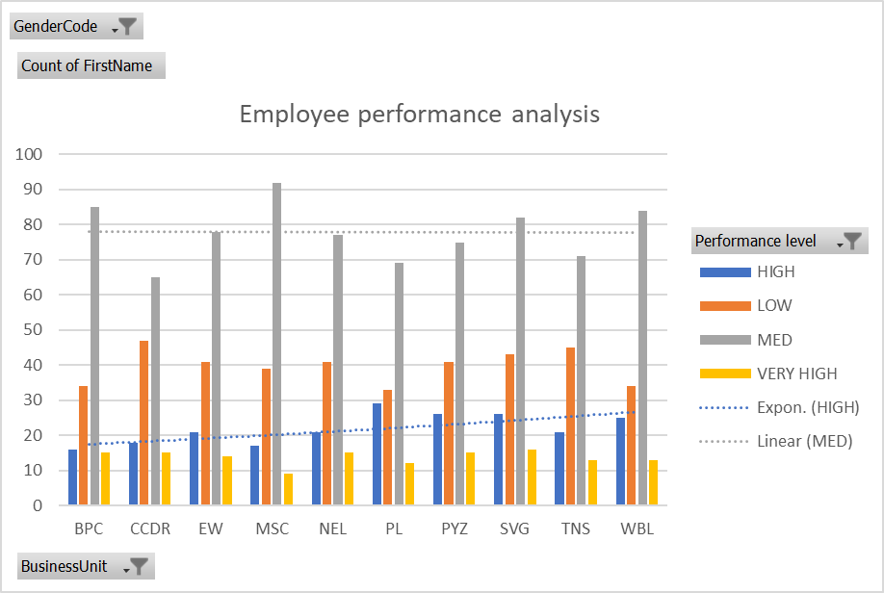
RESULTS
11

Slide 12
conclusion
Conducting an employee performance analysis provides valuable insights. By collecting, cleaning and analyzing of data, organization can make decisions regarding the resource allocation, promoting an employee and take initiatives to improve employee's performance level and organizational performance.

