Slide 1
Unit-2
Accounting and Economics

Slide 2
Meaning and Definition of Accounting.
The Committee on Terminology set up by the American Institute of Certified Public Accountants formulated the following definition of accounting in 1961:
“Accounting is the art of recording, classifying, and summarizing in a significant manner and in terms of money, transactions and events which are, in part at least, of a financial character, and interpreting the result thereof.”
Accounting may be defined as the process of recording, classifying, summarizing, analyzing and interpreting the financial transactions and communicating the results thereof to the persons interested in such information.

Slide 3
History & Development of Accounting
Accounting finds its roots as early as around 4000 BC, where Egyptians used some form of accounting for their treasuries. The in-charge of treasuries had to send day wise reports to their superiors known as Wazirs and monthly reports were sent to kings.
Babylonia, known as the city of commerce, used accounting for business to identify the losses that took place due to frauds and lack of efficiency.
Greece used accounting to divide the revenues received among treasuries, maintaining receipts, payments and balance of government financial transactions.
Romans used memorandum or daybook where in receipts and payments were recorded. (700 B.C to 400 A.D).
China used sophisticated form of government accounting as early as 2000 B.C.
Accounting practices in India could be traced back to a period where, Kautilya, a minister in Chandragupta’s kingdom wrote a book named Arthashasthra, which also described how accounting records had to be maintained.( 350-275 BCE)
Luca Pacioli’s, a Franciscan friar (merchant class), book Summa de Arithmetica, Geometria, Proportion at Proportionality (Review of Arithmetic and Geometric proportions) in Venice (1494) is considered as the first book on double entry bookkeeping.

Slide 4
In the second phase, the idea of financial accounting emerged with the concept of joint stock company and divorce of ownership from the management. To safeguard the interest of the shareholders and investors, disclosure of financial statements (mainly, profit and loss account and balance sheet) and other accounting information was moulded by law.
Financial statements give periodic performance report by way of profit and loss account and financial position at the end of the period by way of Balance Sheet.
Lastly, Social Responsibility Accounting is in the formative process, which aims at accounting for the social cost incurred by business as well as the social benefit, created by it.
It emerges from the growing social awareness about the undesirable by-products of economic activities. While earning profit, an enterprise incurs numerous social costs like pollution, using the resources of society like materials, land, labour etc.

Slide 5
Procedural aspects of accounting
On the basis of the above definitions, procedure of accounting can be basically divided into two parts:
Generating financial information and
Using the financial information.

Slide 6
Generating Financial Information
Recording –Recording is done in a book called “Journal.” This book may further be divided into several subsidiary books according to the nature and size of the business.
Classifying – Classification is concerned with the systematic analysis of the recorded data, with a view to group transactions or entries of one nature at one place so as to put information in compact and usable form. The book containing classified information is called “Ledger”. This book contains on different pages, individual account heads under which, all financial transactions of similar nature are collected. For example, there may be separate account heads for Salaries, Rent, Printing and Stationeries, Advertisement etc. All expenses under these heads, after being recorded in the Journal, will be classified under separate heads in the Ledger. This will help in finding out the total expenditure incurred under each of the above heads.
Summarizing – It is concerned with the preparation and presentation of the classified data in a manner useful to the internal as well as the external users of financial statements. This process leads to the preparation of the financial statements.

Slide 7
4. Analysing – The term ‘Analysis’ means methodical classification of the data given in the financial statements. The figures given in the financial statements will not help anyone unless they are in a simplified form. For example, all items relating to fixed assets are put at one place while all items relating to current assets are put at another place. It is concerned with the establishment of relationship between the items of the Profit and Loss Account and Balance Sheet i.e. it provides the basis for interpretation.
5. Interpreting – This is the final function of accounting. It is concerned with explaining the meaning and significance of the relationship as established by the analysis of accounting data. The recorded financial data is analysed and interpreted in a manner that will enable the end-users to make a meaningful judgment about the financial condition and profitability of the business operations. The financial statement should explain not only what had happened but also why it happened and what is likely to happen under specified conditions.
6. Communicating – It is concerned with the transmission of summarized, analyzed and interpreted information to the end-users to enable them to make rational decisions. This is done through preparation and distribution of accounting reports, which include besides the usual profit and loss account and the balance sheet, additional information in the form of accounting ratios, graphs, diagrams, fund flow statements etc.

Slide 8
Using the Financial Information
There are certain users of accounts. Earlier it was viewed that accounting is meant for the proprietor or owner of the business, but changing social relationships diluted the earlier thinking. Since earlier businesses were simple and not scaled, probably that view could hold true for those.
It is now believed that besides the owner or the management of the business enterprise, users of accounts include the investors, employees, lenders, suppliers, customers, government and other agencies and the public at large. For example, if an airlines company borrows money from a bank, buys oil from oil companies, sells tickets to the customers, has staff to be paid salaries to, all these group of people and entities are key stakeholders in that airlines business. They would like to know and understand whether the business of the company is going well or there are challenges for the company to run the business. Accounting provides the art of presenting information systematically to the users of accounts.
Accounting data is more useful if it stresses economic substance rather than technical form. Information is useless and meaningless unless it is relevant and material to a user’s decision. The information should also be free of any biases. The users should understand not only the financial results depicted by the accounting figures, but also should be able to assess its reliability and compare it with information about alternative opportunities and the past experience. The owners or the management of the enterprise, commonly known as internal users, use the accounting information in an analytical manner to take the valuable decisions for the business.

Slide 9
OBJECTIVES OF ACCOUNTING
The objectives of accounting can be given as follows:
Systematic recording of transactions – Basic objective of accounting is to systematically record the financial aspects of business transactions, i.e., book-keeping. These recorded transactions are later on classified and summarized logically for the preparation of financial statements and for their analysis and interpretation.
Ascertainment of results of above recorded transactions – Accountant prepares profit and loss account to know the results of business operations for a particular period of time. If revenue (Sales) exceeds expenses then it is said that business is running profitably but if expenses exceed revenue, then it can be said that business is running under loss. The profit and loss account helps the management and different stakeholders in taking rational decisions. For example, if business is not proved to be remunerative or profitable, the cause of such a state of affair can be investigated by the management for taking remedial steps.
Ascertainment of the financial position of the business – A businessman is not only interested in knowing the results of the business in terms of profits or loss for a particular period but is also anxious to know that what he owes (liability) to the outsiders and what he owns (assets) on a certain date. To know this, accountant prepares a financial position statement popularly known as Balance Sheet. The balance sheet is a statement of assets and liabilities of the business at a particular point of time and helps in ascertaining the financial health of the business.
Providing information to the users for rational decision-making – Accounting as a ‘language of business’ communicates the financial results of an enterprise to various stakeholders by means of financial statements.Accounting aims to meet the information needs of the decision-makers and helps them in rational decision-making.
To know the solvency position – By preparing the balance sheet, management not only reveals what is owned and owed by the enterprise, but also it gives the information regarding concern’s ability to meet its liabilities in the short run (liquidity position) and also in the long-run (solvency position) as and when they fall due.

Slide 10
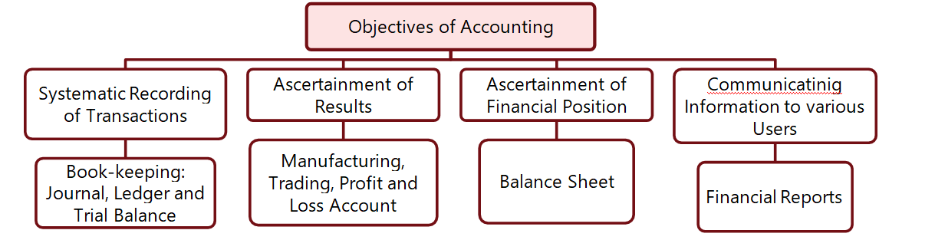

Slide 11
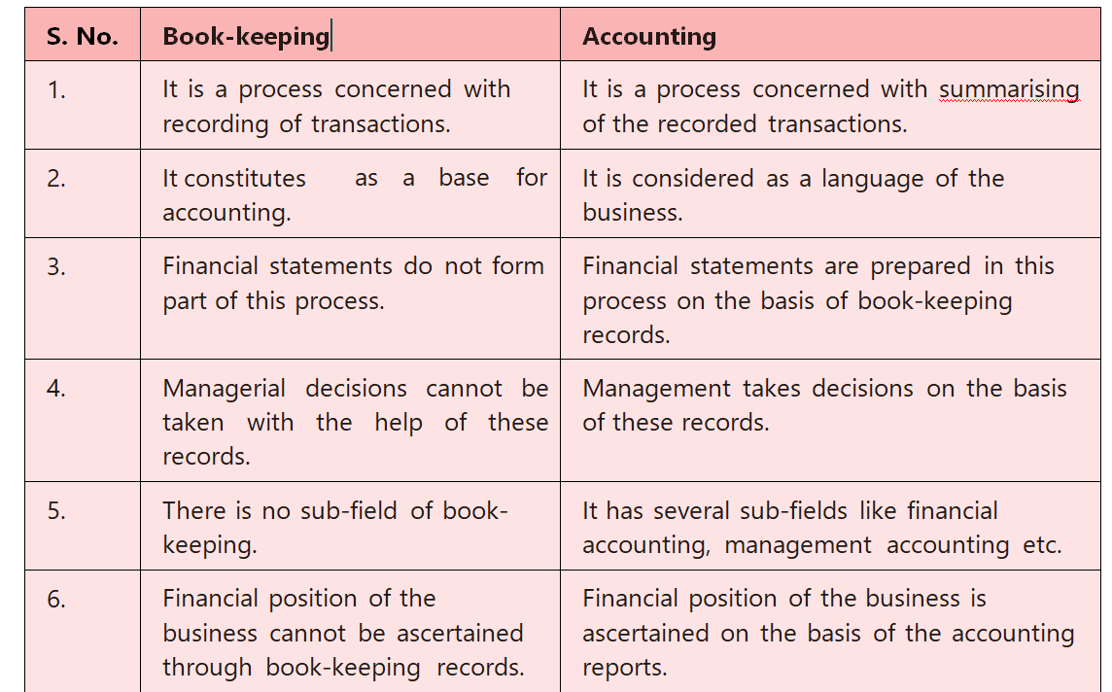
Distinction between Book-keeping and Accounting

Slide 12
SUB-FIELDS OF ACCOUNTING
The various sub-fields of accounting are:
Financial Accounting – It covers the preparation and interpretation of financial statements and communication to the users of accounts. It is historical in nature as it records transactions which had already been occurred. The final step of financial accounting is the preparation of Profit and Loss Account and the Balance Sheet. It primarily helps in determination of the net result for an accounting period and the financial position as on the given date.
Management Accounting – It is concerned with internal reporting to the managers of a business unit. To discharge the functions of stewardship, planning, control and decision- making, the management needs variety of information. The different ways of grouping information and preparing reports as desired by managers for discharging their functions are referred to as management accounting. A very important component of the management accounting is cost accounting which deals with cost ascertainment and cost control. Management Accounting will be dealt with at higher levels of the Chartered Accountancy Course.
Cost Accounting – The terminology of Cost Accounting published by the Institute of Cost and Management Accountants of England defines cost accounting as:
“the process of accounting for cost which begins with the recording of income and expenditure or the bases on which they are calculated and ends with the preparation of periodical statements and reports for ascertaining and controlling costs.”
4. Social Responsibility Accounting – The demand for social responsibility accounting stems from increasing social awareness about the undesirable by-products of economic activities. As already discussed earlier, social responsibility accounting is concerned with accounting for social costs incurred by the enterprise and social benefits created.
5. Human Resource Accounting – Human resource accounting is an attempt to identify, quantify and report investments made in human resources of an organization that are not presently accounted for under conventional accounting practice.

Slide 13
USERS OF ACCOUNTING INFORMATION
Generally users of accounts are classified into two categories,
(a) internal users and
(b) external users.
Management accounting is concerned with identifying information requirements as well as methods of providing such information to management while information requirements of the outside users are generally served by financial statements.

Slide 14
Following are the various users of accounting information:
Investors: They provide risk capital to the business. They need information to assess whether to buy, hold or sell their investment. Also they are interested to know the ability of the business to survive, prosper and to pay dividend. In non-corporate sector, where ownership and management are not essentially separated, the owners still need information about performance of the business and its financial position to decide whether to continue or shut down.
Employees: Growth of the employees is directly related to the growth of the organization and therefore, they are interested to know the stability, continuity and growth of the enterprise and its ability to provide remuneration, retirement and other benefits and to enhance employment opportunities.
Lenders: They are interested to know whether their loan-principal and interest will be paid back when due.
Suppliers and Creditors: They are also interested to know the ability of the enterprise to pay their dues, that helps them to decide the credit policy for the relevant concern, rates to be charged and so on. Sometimes, they also become interested in long-term continuation of the enterprise if their existence becomes dependent on the survival of that business.
Customers: Customers are also concerned with the stability and profitability of the enterprise because their functioning is more or less dependent on the supply of goods, suppose, a company produces some chemicals used by pharmaceutical companies and supplies chemicals on three month’s credit. If all of a sudden it faces some trouble and is unable to supply the chemical, the customers will also be in trouble.

Slide 15
6. Government and their agencies: They regulate the functioning of business enterprises for public good, allocate scarce resources among competing enterprises, control prices, charge excise duties and taxes, and so they have continued interest in the business enterprise.
7. Public: The public at large is interested in the functioning of the enterprise because it may make a substantial contribution to the local economy in many ways including the number of people employed and their patronage to local suppliers.
8. Management: Management as whole is also interested in the accounts for various managerial decisions. On the basis of the accounts, management determines the effects of their various decisions on the functioning of the organisation. This helps them to make further managerial decisions.

Slide 16
RELATIONSHIP OF ACCOUNTING WITH OTHER DISCIPLINES
Accounting is closely related with several other disciplines and thus to acquire a good knowledge in accounting one should be conversant with the relevant portions of such disciplines. In many cases they overlap accounting.
Accounting and Economics:
Economics is viewed as a science of rational decision- making about the use of scarce resources. It is concerned with the analysis of efficient use of scarce resources for satisfying human wants. This may be viewed either from the perspective of a single firm or of the country as a whole.
Accounting is viewed as a system, which provides data to the users to permit informed judgment and decisions. Some non-accounting data are also relevant for decision- making.
Accounting overlaps economics in many respects. It contributed a lot in improving the management decision-making process. But, economic theories influenced the development of the decision-making tools used in accounting.
However, there exists a wide gulf between economists’ and accountants’ concepts of income and capital. Accountants got the ideas of value, income and capital maintenance from economists, but brushed suitably to make them usable in practical circumstances. Accountants developed the valuation, measurement and decision- making techniques which may owe to the economic theorems for origin but these are moulded in the work environment and suitably tempered with reference to relevance, verifiability, freedom from bias, timeliness, comparability, reliability and understandability.
An example may be given to explain the nexus between accounting and economics. Economists think that value of an asset is the present value of all future earnings which can be derived from such assets. Now think about a plant whose working life is more than one hundred years. How can you estimate future stream of earnings? So accountants developed the workable valuation base – the acquisition cost i.e., the price paid to acquire the assets.
At the macro-level, accounting provides the database over which the economic decision models have been developed; micro-level data arranged by the accounting system is summed up to get macro-level database.
Non-overlapping zones of accounting are not negligible. Development of the systems of recording, classifying and summarizing transactions and events, harmonizing the systems by uniform rules and communicating the data is essentially a non-overlapping area of accounting.

Slide 17
Accounting and Statistics: For Example,In accountancy, a number of financial and other ratios are based on statistical methods, which help in averaging them over a period of time. Several accounting and financial calculations are based on statistical formulae.
Accounting and Mathematics: Double Entry book-keeping can be converted in algebraic form; in fact the first known book on this subject was part of a treatise on algebra.
Assets= Liabilities + Equity
Knowledge of arithmetic and algebra is a pre-requisite for accounting computations and measurements. Calculations of interest and annuity are the examples of such fundamental uses. While computing depreciation, finding out installments in hire- purchase and instalments payment transactions, calculating amount to be set aside for repayment of loan and replacement of assets and calculating lease rentals, mathematical techniques are frequently used. Accounting data are also presented in ratio form.

Slide 18
Accounting and Law: An economic entity operates within a legal environment. All transactions with suppliers and customers are governed by the Contract Act, the Sale of Goods Act, the Negotiable Instruments Act, etc. The entity itself is created and controlled by laws. For example, a company is created by the Companies Act and also controlled by Companies Act. Banking, insurance and electric supply undertakings may also have to produce financial statements as prescribed by the respective legislations controlling such entities.
Accounting and Management: Management is a broad occupational field, which comprises many functions and encompasses application of many disciplines including those mentioned above. Accountants are well placed in the management and play a key role in the management team. A large portion of accounting information is prepared for management decision-making.

Slide 19
End of Unit-2

