Slide 1
Normalization:
What is Normalization ?
Normalization is the process of organizing data in a database.
Why Normalization?
To eliminate redundant data and ensure data is stored logically.
Increase Performance.
Easy Updating.
Accuracy.

Slide 2
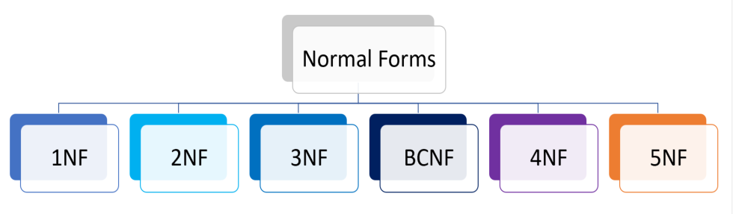

Types of Normalization:

Slide 3
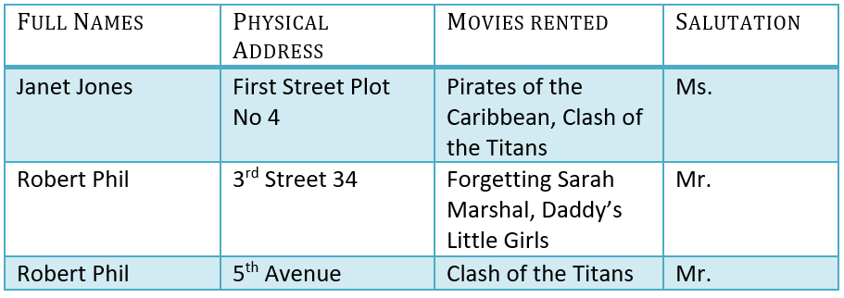
Example :
Assume, a video library maintains a database of movies rented out. Without any normalization in database, all information is stored in one table as shown below.

Slide 4
1NF
Each table cell should contain atomic value.
Each record needs to be unique.

Slide 5
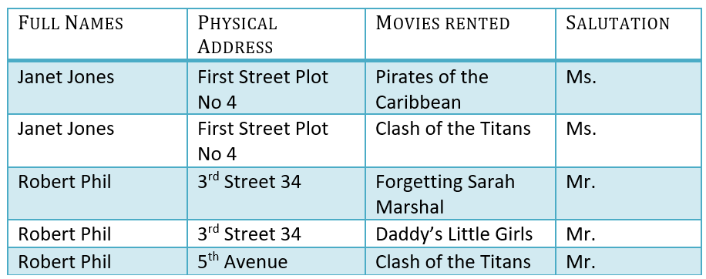

Slide 6
2NF
Be in 1NF
Single Column Primary Key that does not functionally dependent on any subset of candidate key relation

Slide 7
We have introduced a new column called Membership_id which is the primary key for table 1. Records can be uniquely identified in Table 1 using membership id.
In Table 2, Membership_ID is the Foreign Key
Why do you need a foreign key?
You will only be able to insert values into your foreign key that exist in the unique key in the parent table. This helps in referential integrity.

Slide 8

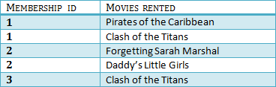
Table 1
Table 2

Slide 9
3NF (Third Normal Form)
Rule 1- Be in 2NF
Rule 2- Has no transitive functional dependencies

Slide 10
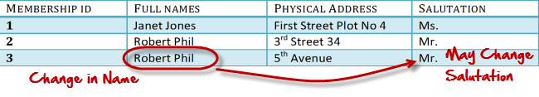
What are transitive functional dependencies?
A transitive functional dependency is when changing a non-key column, might cause any of the other non-key columns to change

Slide 11

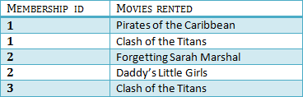

Table 1
Table 2
Table 3

Slide 12
BCNF (Boyce-Codd Normal Form)
A database table is said to be in BCNF if it is in 3NF and contains each and every determinant is a candidate key. The process of converting the table into BCNF is as follows:
Remove the nontrivial functional dependency.
Make a separate table for the determinants.

Slide 13
