Slide 1


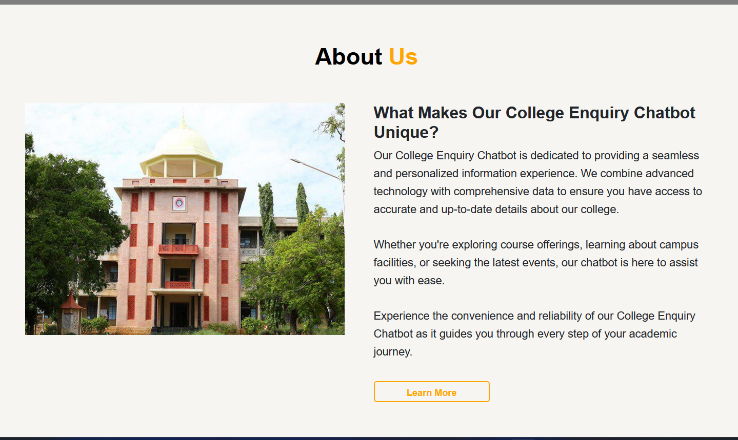
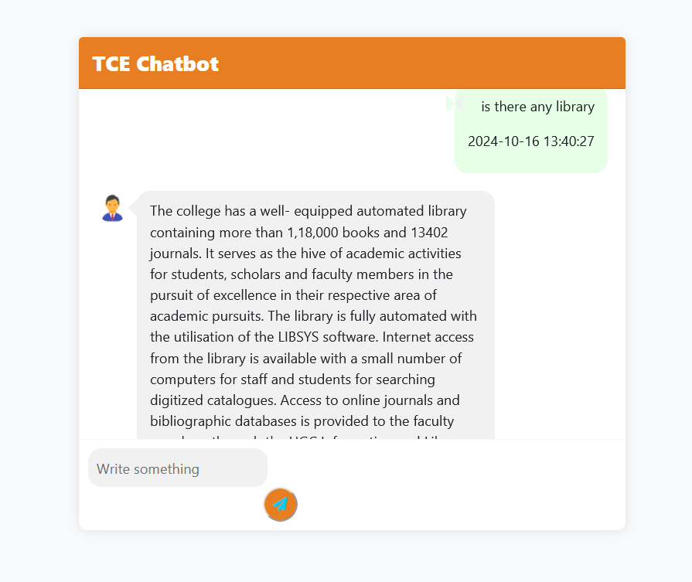
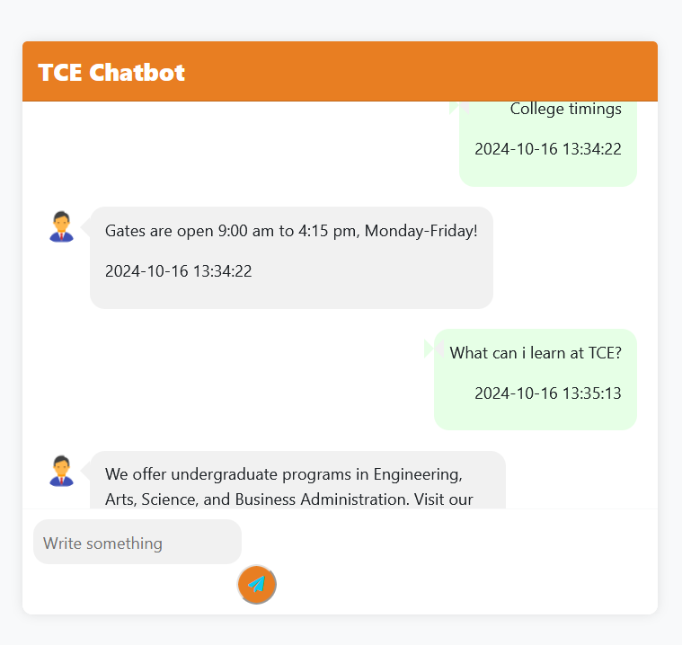
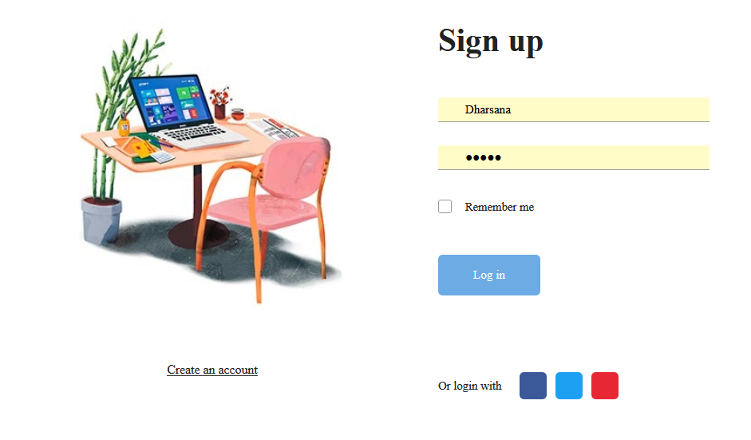
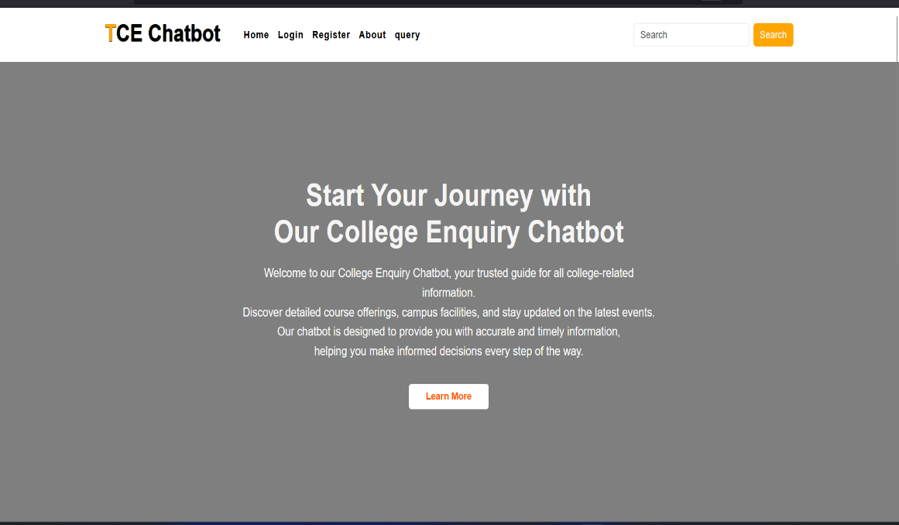
Abstract
Introduction
Methodology
Conclusion
The College Enquiry Chatbot is a user-friendly tool designed to easily access important college information.By using Natural Language Processing (NLP), the chatbot understands user queries and provides accurate responses. Static information is stored in a database, while dynamic updates, like upcoming events, are fetched in real time using web scraping. Additionally, the chatbot integrates Google Maps to assist users with campus navigation. This project aims to improve communication and enhance the overall experience for students at the college.
AI-Driven chatbot for enhanced user experience.
Easy access to important college information.
Detailed insights on courses, faculty, fees, and placements.
Real-time updates on events and scholarships.
Dynamic data integration through web scraping.
Seamless map navigation for campus directions.
Convenient, on-demand assistance tailored to student needs
Query Classification: Categorize queries as static (e.g., fees) or dynamic (e.g., event updates).
System Design: backend-Django Frontend- HTML/CSS/Bootstrap and MySQL
. The College Enquiry Chatbot successfully simplifies how users access important college information. It uses AI and NLP to handle both stored queries and real-time requests, providing fast and accurate responses. Features like live data fetching for events and map navigation make it more dynamic and user-friendly. Overall, this project showcases how AI can improve access to information and enhance the user experience, with room for future updates and added features.
Static Queries-database.
Dynamic Queries-web scraping to retrieve data from external sources.
NLP Integration: Apply NLTK to process and classify user queries.
User Interface: chatbot interface with Bootstrap.
Map Integration-Google Maps for location-based queries.
Deployment: cloud platforms like AWS or docker using Apache.
Results
Team Members
AKSHAYA DK – 22C007
ANITHA P – 22C009
DHARSANA SK – 22C025

