Slide 1

Business Analytics Final Project
professor
SHAHLA ASADI

Slide 2

Goal of the project
The main goal of the project is to develop Regression, Decision tree, and Classification models and implement the model on the test dataset to find its accuracy.

Slide 3
Overview of the Data
There are 3 kinds of variables which are:
Area related – LotArea, GarageArea, and BsmtFinSF1
Date related – YearBuilt, YearRemodAdd, and YrSold
House facility related – FullBath, Half baths, BedroomAbvGr, TotRmsAbvGrd, and Fireplaces.

Slide 4

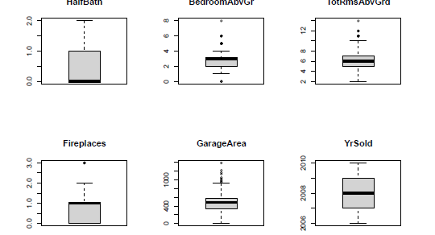
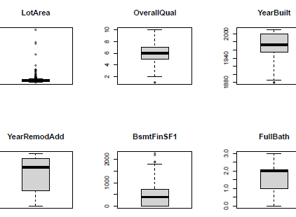
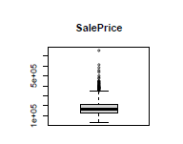
Exploratory Analysis
Illustration of Box Plots of all the variables in the dataset

Slide 5
Modeling Strategy
Predictors used in the models:
GarageArea,
YearBuilt,
FullBath,
OverallQual, LotArea,
BsmtFinSF1,
YearRemodAdd,
Fireplaces

Slide 6
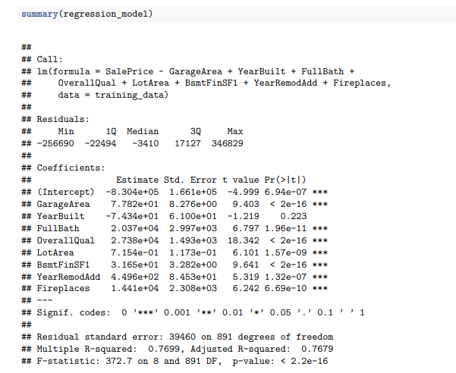
REGRESSION MODEL
R-squared: 0.7699 indicates a strong fit
Adjusted R-squared: 0.7679 slightly lower than R-squared, suggesting the fit is good
F-statistic: 372.7 with p-value < 2.2e-16 indicates the model is statistically significant

Slide 7
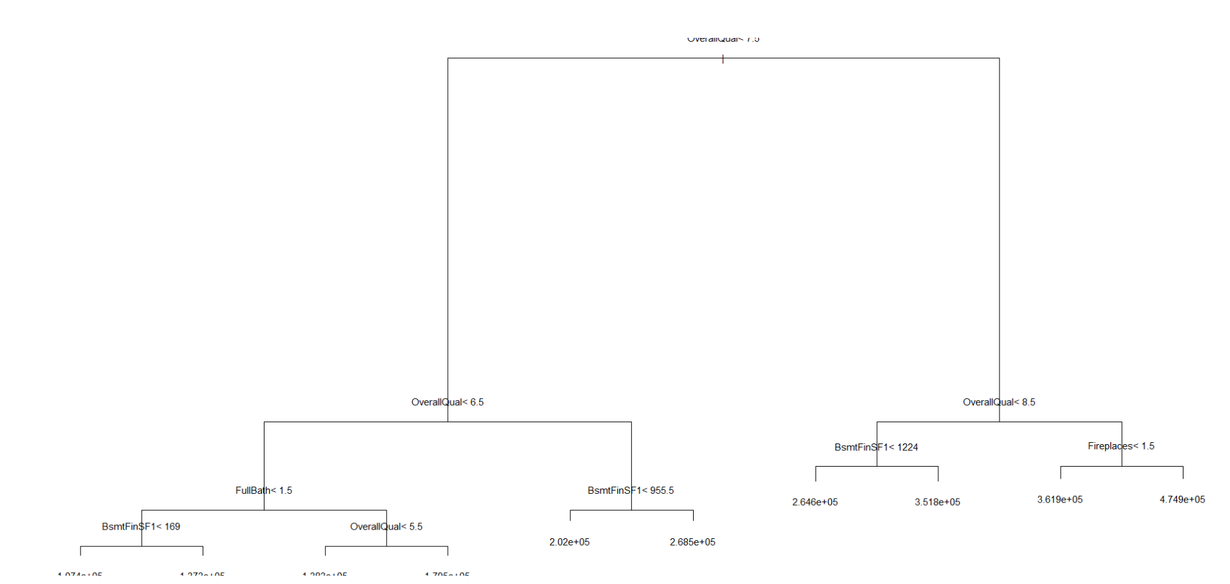
DECISION-TREE MODEL

Slide 8
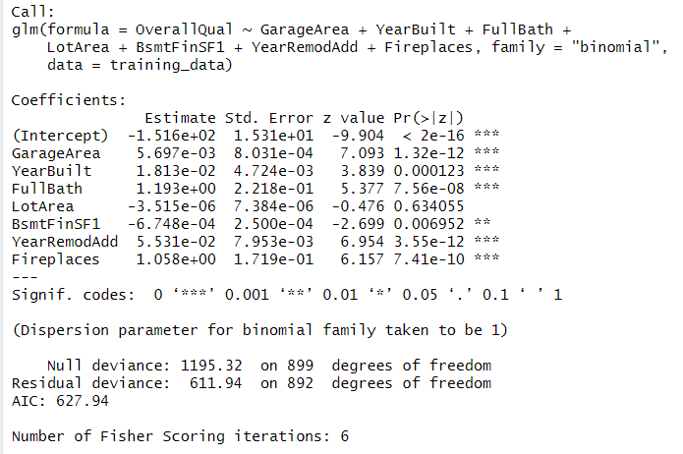
CLASSIFICATION MODEL
The residual deviation is still relatively high, indicating that the model's fit might be improved.
The AIC is reasonable, indicating that the model adequately balances complexity and fit.
Overall, Accuracy of the model is 82%

Slide 9
INSIGHTS AND CONCLUSIONS
The classification model with an overall accuracy of 82.2% has higher accuracy than the remaining models, therefore classification can be concluded as the best model among all.

Slide 10

THANK YOU

