Slide 1
Timely Trends of
Job Postings
Guidance
under
Prof. Dr. Chaojie (Jay) Wang
- Akshaya Narayana
- FX42973

Slide 2
Contents
Introduction
Data Overview
Data Preprocessing
Data Modelling
Results
Streamlit Deployment
References

Slide 3
INTRODUCTION
Job postings serve as a crucial link between job seekers and employers, reflecting the pulse of the job market.
The aim is to analyze job postings data, develop forecasting models, and offer insights into future job opportunities.
By leveraging ARIMA modeling techniques, we seek to predict trends in job openings and provide a framework for predicting future job opportunities.

Slide 4
DATA OVERVIEW
The dataset is sourced from Kaggle, containing extensive information about job postings such as job ID, qualifications, experience requirements, salary range, location, and more.
With a size of 1.74 GB, the dataset comprises 1,615,940 rows and 23 columns.
Job postings are recorded from September 2021 to September 23, providing a comprehensive timeframe for analysis and forecasting.

Slide 5
DATA PREPROCESSING
Initial preprocessing steps include loading the dataset, handling missing values, and removing unwanted columns to streamline the data for analysis.
Converted the 'Job Posting Date' column to datetime format to facilitate time-based analysis.
Calculated role counts for each date to understand the distribution of job postings over time and identify any time patterns.

Slide 6
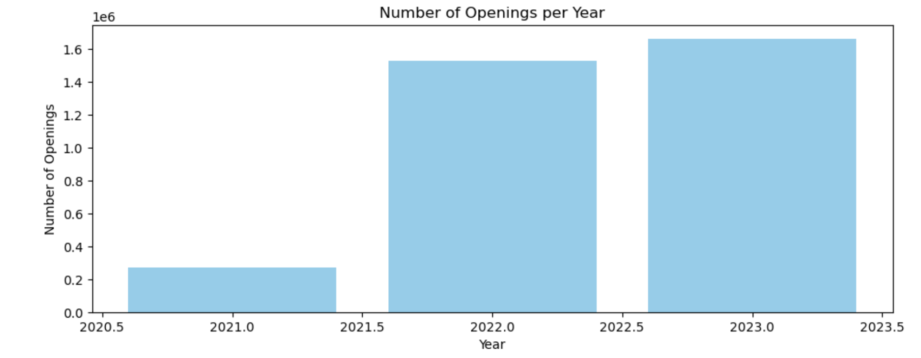

Slide 7
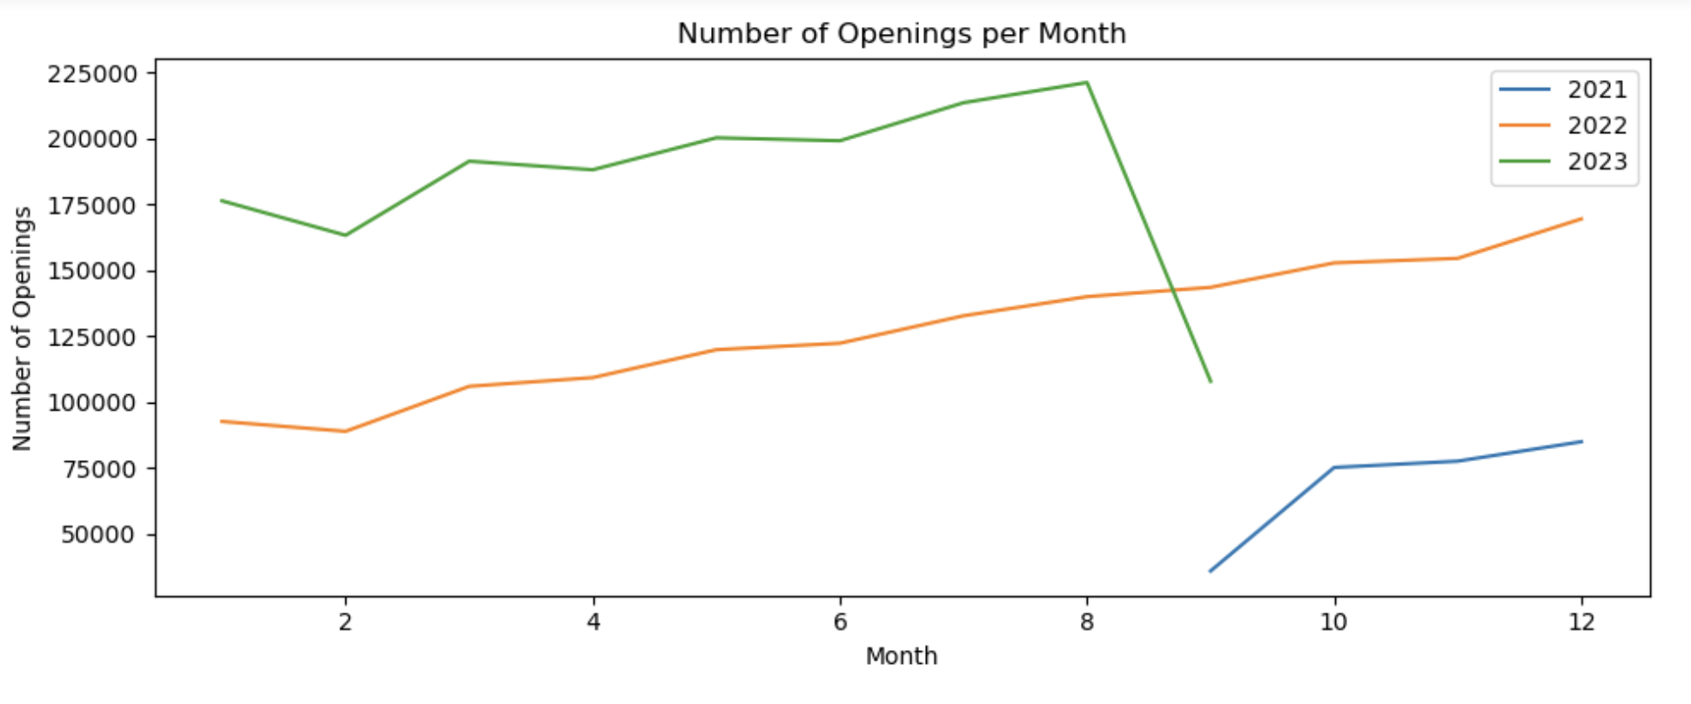

Slide 8
DATA MODELING USING ARIMA
ARIMA is a popular time series forecasting model used to capture time patterns and predict future values based on historical data.
It combines three key components:
AutoRegressive (AR): The model uses past values of the series to predict future values, assuming that the future values are linearly dependent on the past values.
Integrated (I): The integration component involves differencing the series to achieve stationarity, making it suitable for modeling.
Moving Average (MA): The model considers the error terms in predicting future values, incorporating the average of past error terms into the forecasting process.

Slide 9
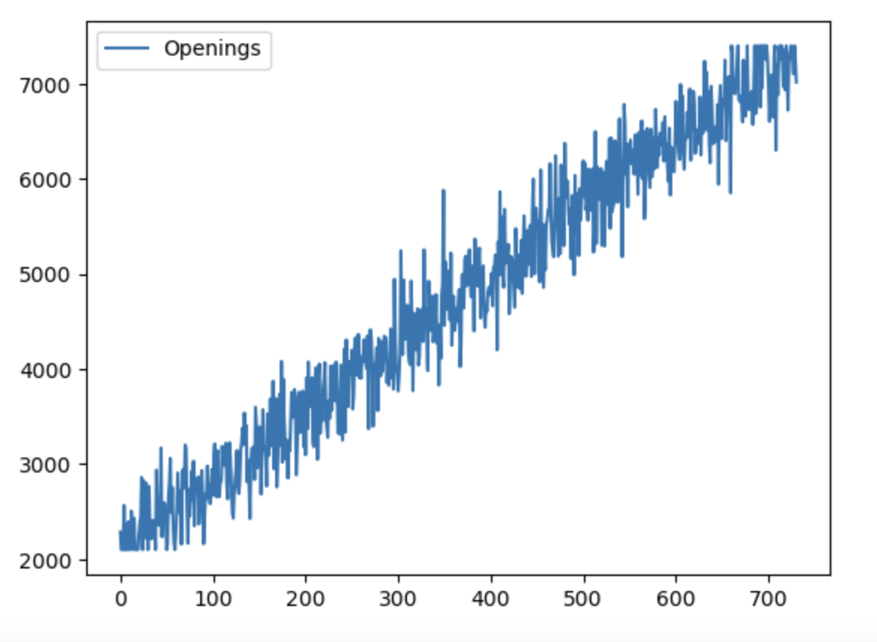
Checking for Stationarity in Time Series
Here is our initial distribution of data, which follows a steady upward trend (Not stationary)
Now, we need to perform 1st differentiation and see if it is stationary.
Stationarity can be found using:
Distribution Curve
ADF test (1.72 e-20)

Slide 10
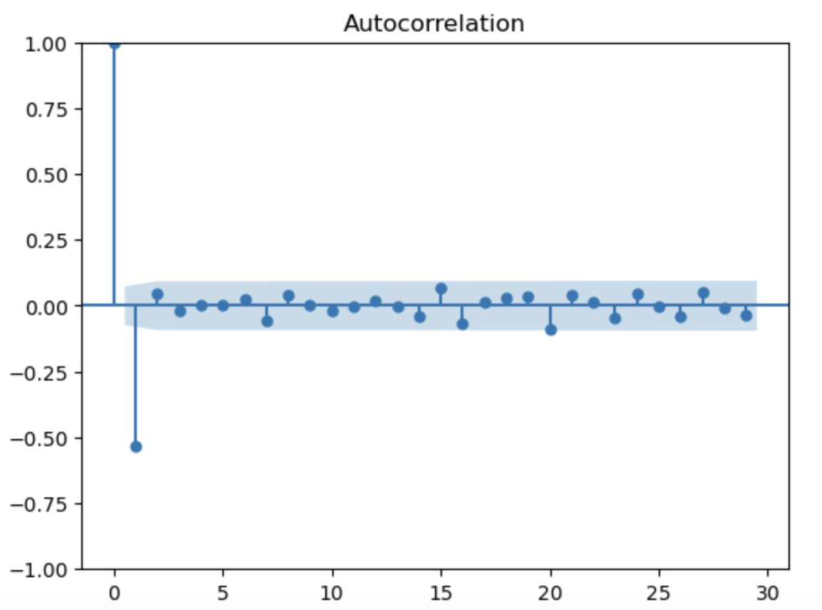
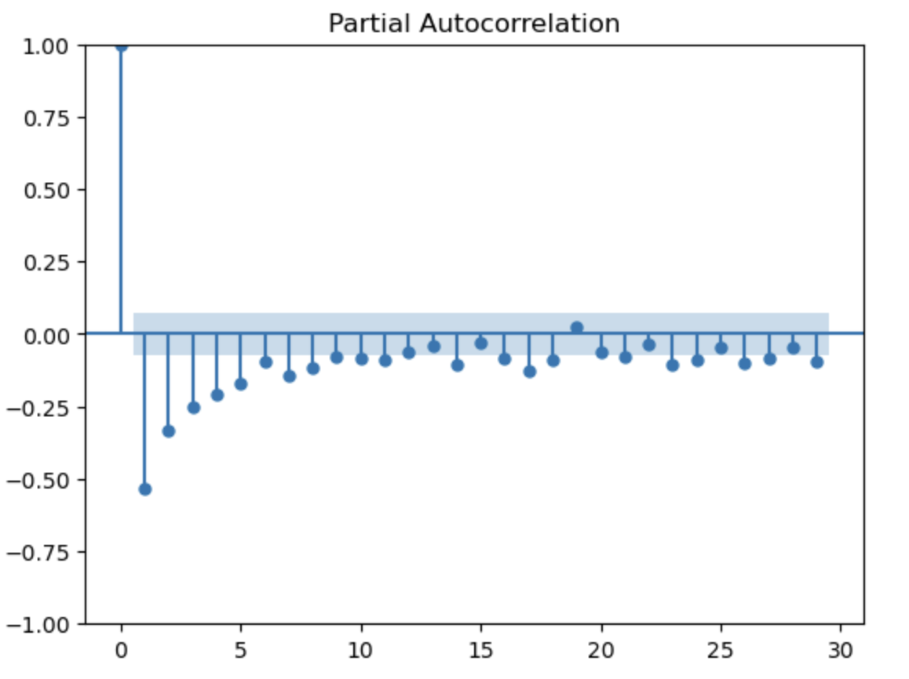
In ARIMA(p,d,q), p d & q can be found using ACF and PACF plots.
d=1(as the plot is stationary after 1st diff)
p=5
q=0

Slide 11
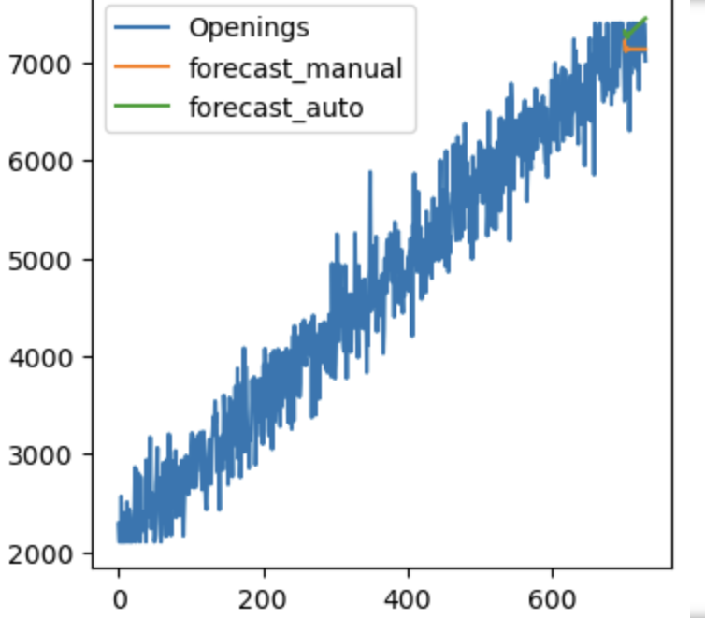
RESULT
Forecasting using ARIMA and Auto ARIMA

Slide 12
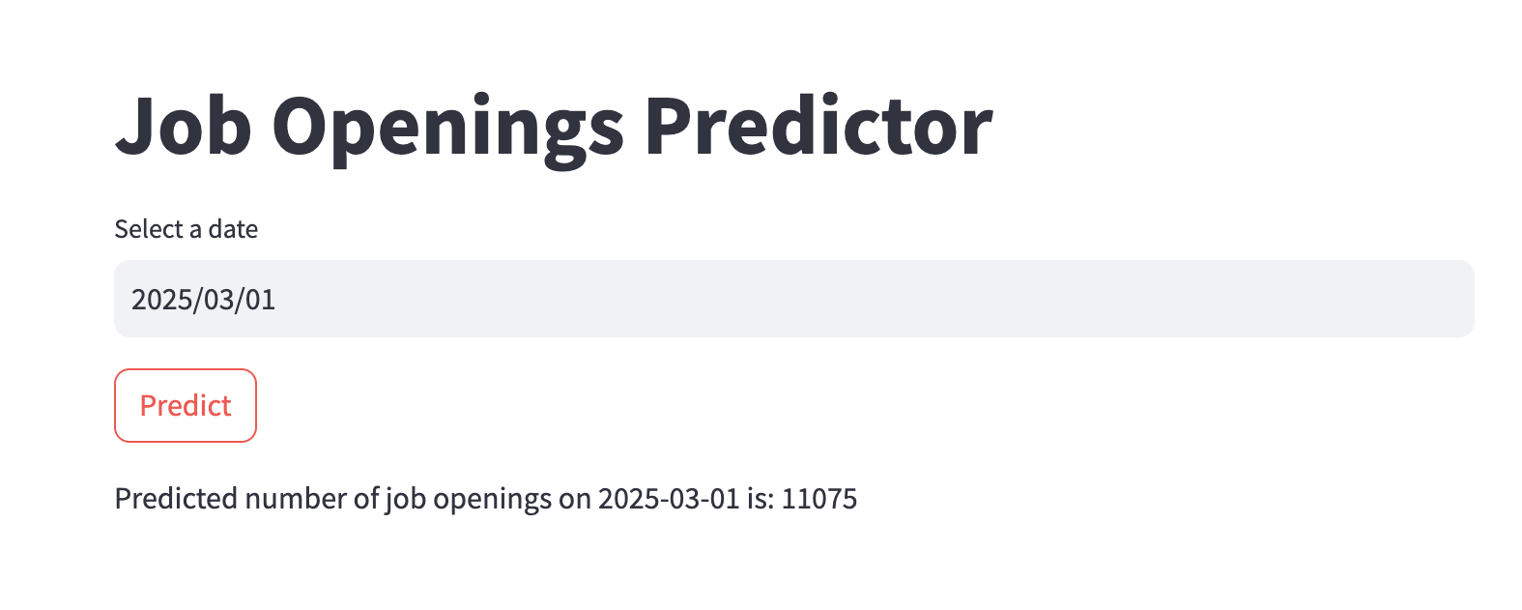
STREAMLIT DEPLOYMENT

Slide 13
REFERENCES
https://www.kaggle.com/datasets/ravindrasinghrana/job-description-dataset/data
https://www.mathworks.com/help/econ/arima.html

