Slide 1
Crime Data Analysis
2014 - 2021
Tamil Nadu

Slide 2
Task Outline
Research crime statistics (from 2014 onwards) in Tamil Nadu
Analyze trends over time.
Classify crimes based on their nature.
Generate innovative statistical charts.
Provide critical insights and control suggestions.
Identify variables that correlate with crime trends.

Slide 3
Executive Summary
Objective: Analyze crime trends in Tamil Nadu (2014–2021) to identify patterns, high-risk categories, and correlations for strategic crime prevention.
Data Source: Tamil Nadu Crime Data from OpenCity.in
Tools Used: Tabula, Excel, Python (pandas), Power BI
Key Deliverables:
  Trend analysis over 8 years
  Classification of crimes by nature
  Statistical visualizations (Key Influencers, Heatmaps, Waterfall)
  Data-driven recommendations for policy and control

Slide 4
Research crime statistics (from 2014 onwards) in Tamil Nadu
Step 1 - For the analysis of crimes in Tamil Nadu, I collected the crime wise data from https://data.opencity.in/dataset/tamil-nadu-crime-data?utm_source=chatgpt.com.
Step 2 - I collected for the years 2014 to 2021.
Step 3 - I downloaded the data as Pdf and then extracted the required tables using tabula and exported into a CSV file.
Step 4 – I cleaned the data using Advanced excel and Python with pandas library and extracted again as a CSV file.
Step 5 – Then Loaded and Transformed the data into the power query for much more cleaning and then finally into Power BI workspace.

Slide 5
Analyze trends over time
Year-on-year trends show a gradual rise in violent crimes, peaking in 2019.
Increasing trend in violent crimes — particularly "Hurt" and "Simple Hurt" between 2016–2020.
Negligence-related crimes have remained consistently high, indicating weak road and public safety enforcement.
Negligence-based crimes (like traffic incidents) have been steadily high after 2017.
Certain crime types appear to follow predictable patterns, useful for forecasting and prevention.
Some crime categories show seasonal or cyclical spikes

Slide 6
Classify crimes based on their nature
Classification:
Violent Crimes – Murder, Attempt to Murder, Culpable Homicide, Grievous Hurt
Negligence-Based Crimes – Causing Death by Negligence, Road/Rail/Medical Negligence
Crimes Against Women - Dowry Deaths, Sexual Harassment, Assault on Women
Self-Inflicted Acts - Attempt to Commit Suicide, Abetment of Suicide
Other IPC Crimes - Wrongful Restraint, Acid Attack, etc.
Basis:
Crimes were classified based on the type of harm caused, such as physical violence, negligence, or self-inflicted acts.
They were also grouped by victim profile and legal context, like crimes against women or IPC-defined offenses.

Slide 7
Innovative statistical charts

Slide 8
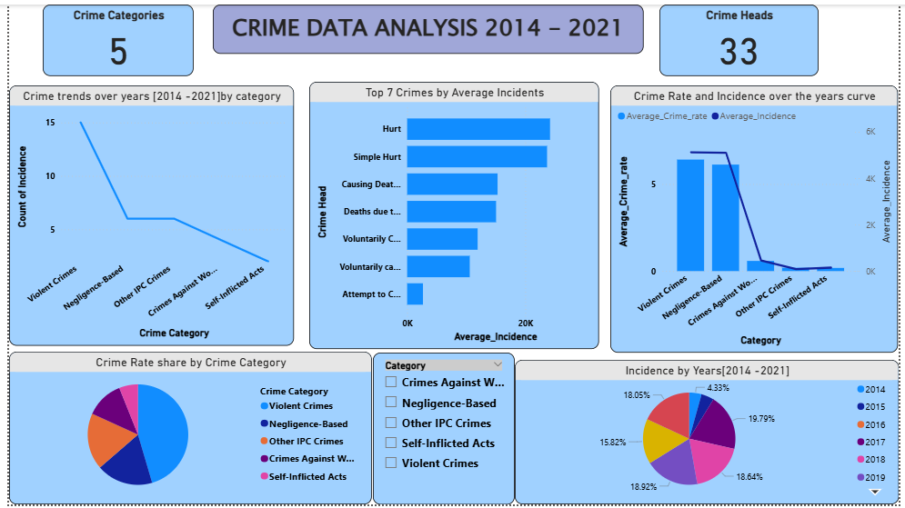
Crime Data Analysis 2014 - 2021

Slide 9
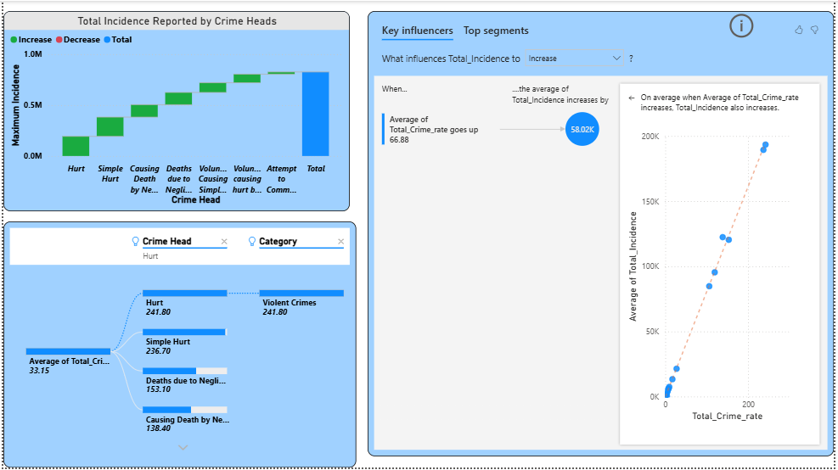
Key Influencer Analysis

Slide 10
Insights and Recommendations

Slide 11
Insight for Violent Crimes
Insight:
Violent crimes have the highest average crime rate and incidence among all crime categories.
Recommendation:
Implementation of community policing programs and increasing patrol frequency in identified hotspots.
Encourage youth engagement programs to divert vulnerable populations from violence.

Slide 12
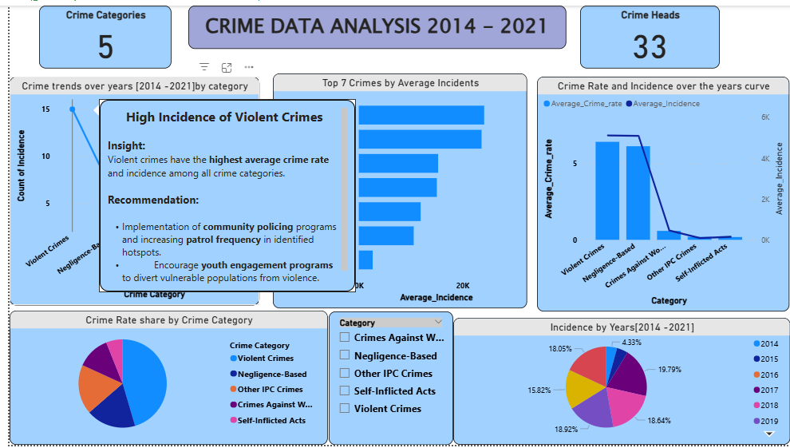
High Incidence of Violent Crimes
Tooltips

Slide 13
Most Common Crime Heads
Insight:
“Hurt” and “Simple Hurt” top the list of average incidents.
Recommendation:
Promote conflict resolution workshops and awareness campaigns on non-violent communication.
Introduce stricter penalties for recurring offenders in these categories.

Slide 14
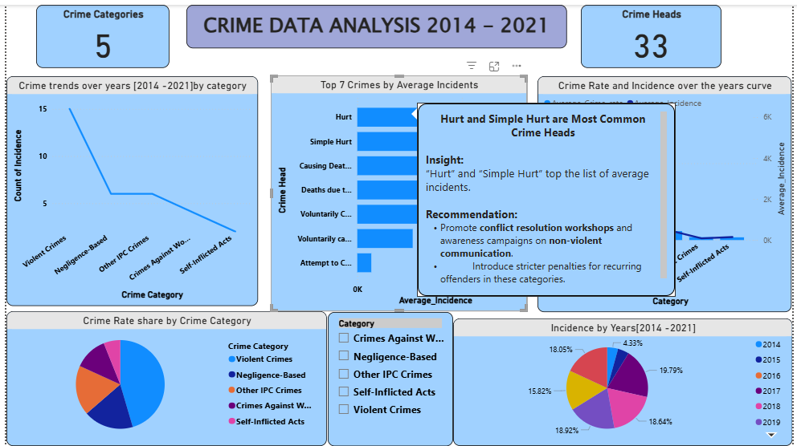
Hurt and Simple Hurt are the most common Crime Heads
Tooltips

Slide 15
High – Negligence Crimes
Insight:
After violent crimes, negligence-based crimes (traffic-related or administrative negligence) rank second.
Recommendation:
Enforce road safety regulations, conduct driver education and awareness drives.
Regularly audit public infrastructure and enforce accountability for lapses.

Slide 16
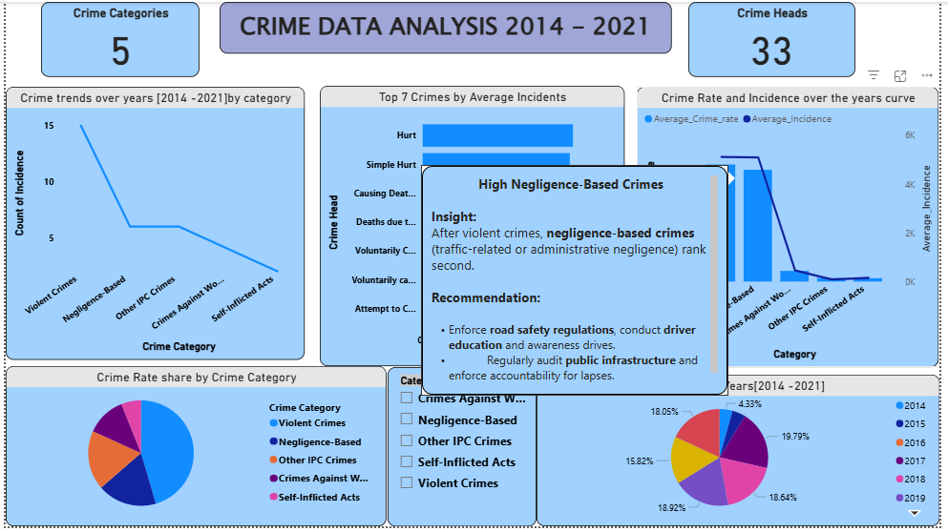
High – Negligence based Crimes
Tooltips

Slide 17
Total Incidence Drive
Insight:
From the Waterfall chart, crimes like Hurt and Simple Hurt contribute the largest increases to total crime incidence across all heads.
Recommendation:
Promote violence de-escalation training and initiate community mediation cells at local levels.
Introduce school and college behavioral education modules to address aggression early.

Slide 18
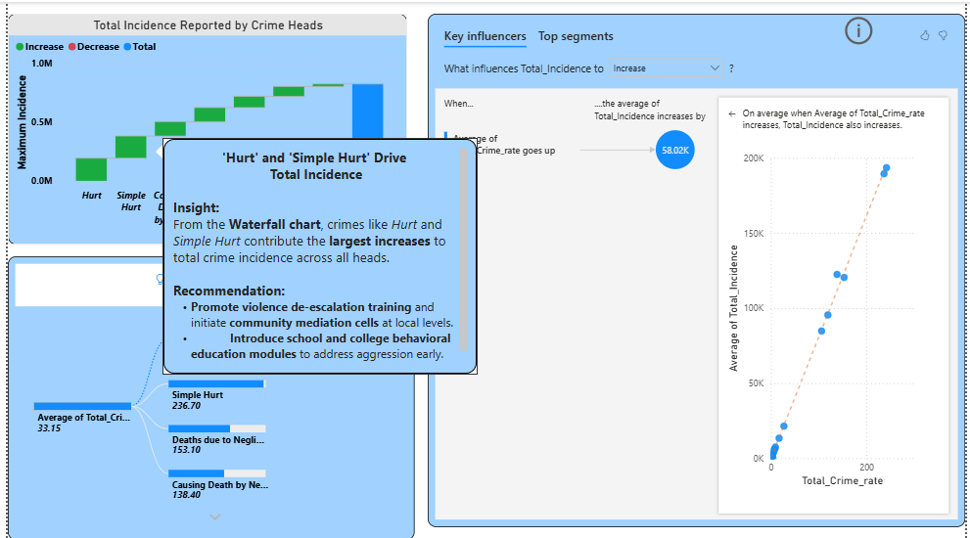
Hurt and Simple Hurt Drive
Total Incidence
Tooltips

Slide 19
Total Crime Rate Strongly Influences Total Incidence
Insight:
The Key Influencers visual shows a strong positive correlation — as the average crime rate increases, total incidence also increases consistently.
Recommendation:
Apply predictive policing models using crime rate data to forecast and prevent spikes in crime incidence.
Focus on early warning systems in high-rate zones using data-driven alerts and targeted interventions.

Slide 20
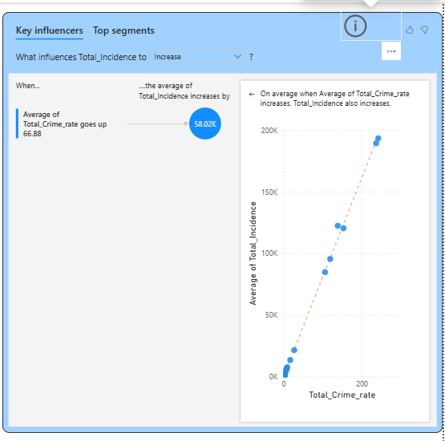
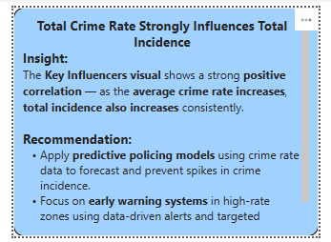
Key Influencers of Crime Incidence and Rates
Buttons

Slide 21
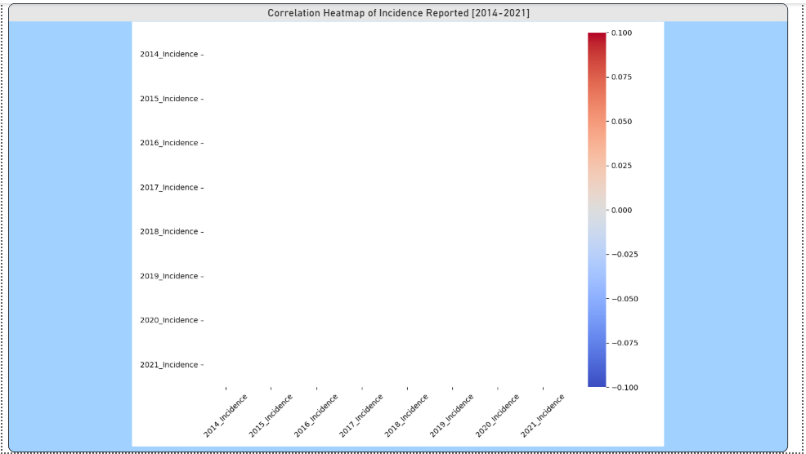
Correlation Heat Map

Slide 22
Thankyou
Regards,
Akshaya S V

