Slide 1
Leave Application Processing System
Team One
Members:
Gao Yumengdie
Kaung Htet Win
Kolanjhikannan Akshayahasinee
Lin Lin Thant
Park Jun Suk
Sharmaine Cheng

Slide 2
To Run Our Codes
Loginname | Password | UserRole
mary1 | password1 | systemadmin
johnny | password1 | manager
peterparker | password1 | Staff
http://localhost:8081/home http://localhost:8081/login

Slide 3
Team Member | Actor | Use Cases | Other Remarks
Kaung Htet Win | Admin | Manage Leave Type Manage Staff Manage Leave Entitlement Manage Approval Hierarchy Public holidays -CRUD Interceptor Login/Logout | Authorization (optional) Reporting (optional) User sessions REST ERD diagram Bootstrap Recording Code Integration
Kolanjhikannan Akshayahasinee | Staff | Manage Leave Application-CRUD Submit Leave Application All leave custom validations along with date helper class | Pagination Email interaction(optional) Initial DB design ERD diagram Code integration Recording
Gao Yumengdie |  | View Personal Leave History | ERD diagram PPT Recording
Lin Lin Thant | Manager | View application for approval View leave application Approve/Reject Leave-CRUD Approve/reject validation | Email Interaction (optional) ERD diagram Recording Code integration
Park Jun Suk |  | View Employee Leave History | ERD diagram PPT Recording
Sharmaine Cheng |  | Claim Compensation (optional) Approve Compensation Claim (optional) | ERD diagram PPT Recording

Slide 4
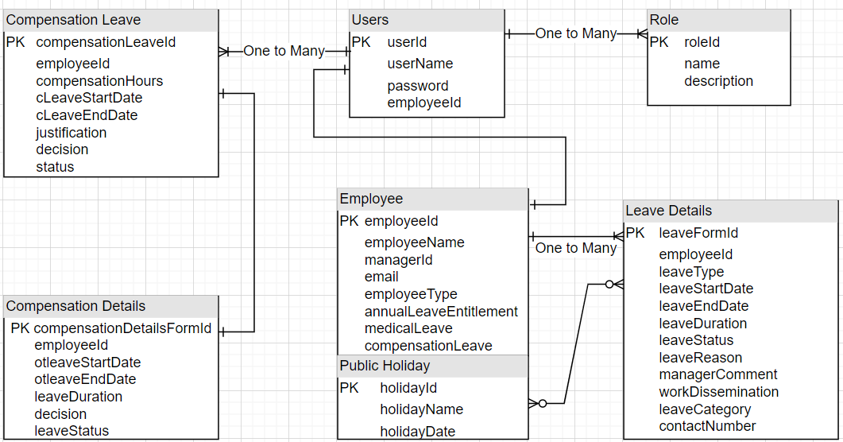
ERD Diagram

Slide 5
Architecture Layer
Repository Class Extending CRUD Services
Dependency
Injection
Client
Controller
Service
Layer
Model
Spring MVC Flow Architecture
HTTPs
request
JPA/Spring Data
Database

Slide 6
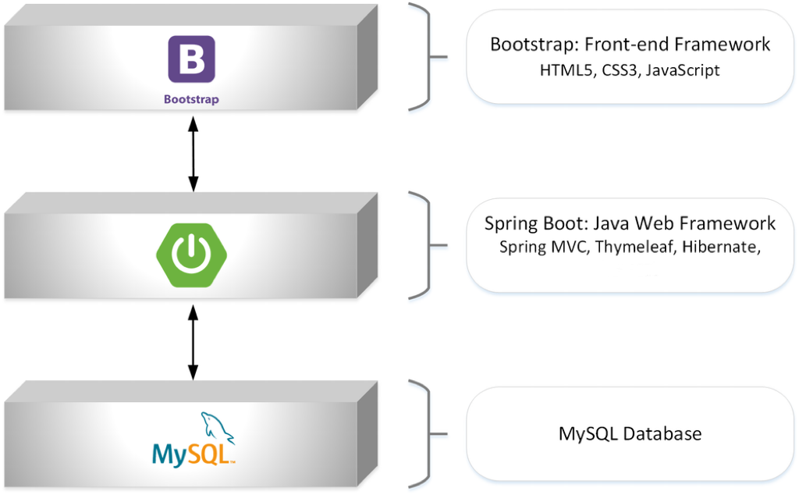

Technologies Used

Slide 7
Lessons Learnt
Technical aspects | For group cooperation
1.CRUD in spring 2. Mapping models 3. Writing custom validations 4. Debugging errors 5.Creating UI using Bootstrap | 1. Clear division of labor 2. Help each other 3. Communicate effectively to complete the task quickly 4.Code merging

