Slide 1
Multiple Disease Prediction System using ML
Diabetes, Heart Disease, and Parkinson's Detection

Slide 2
Introduction
ML-based web application to predict multiple diseases.
Covers Diabetes, Heart Disease, and Parkinson's Disease.
Deployed using Streamlit for easy access and usability.
Promotes early diagnosis and health awareness.

Slide 3
Problem Statement
Chronic diseases are major health challenges.
Early diagnosis is often missed due to lack of access.
Need for an easy-to-use predictive system.

Slide 4
Objectives
Develop a user-friendly ML-based web app.
Enable prediction for Heart Disease, Diabetes, Parkinson’s.
Ensure privacy, accuracy, and accessibility.

Slide 5
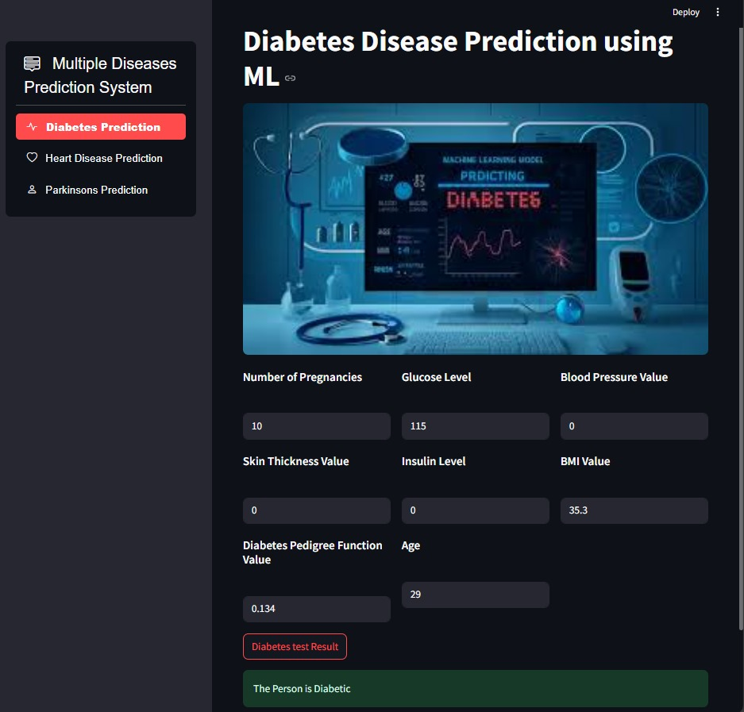
Diabetes Prediction

Slide 6
Diabetes - Key Points
Uses Pima Indians dataset.
Features include glucose level, BMI, age, pregnancies.
Helps in identifying early-stage diabetes.

Slide 7
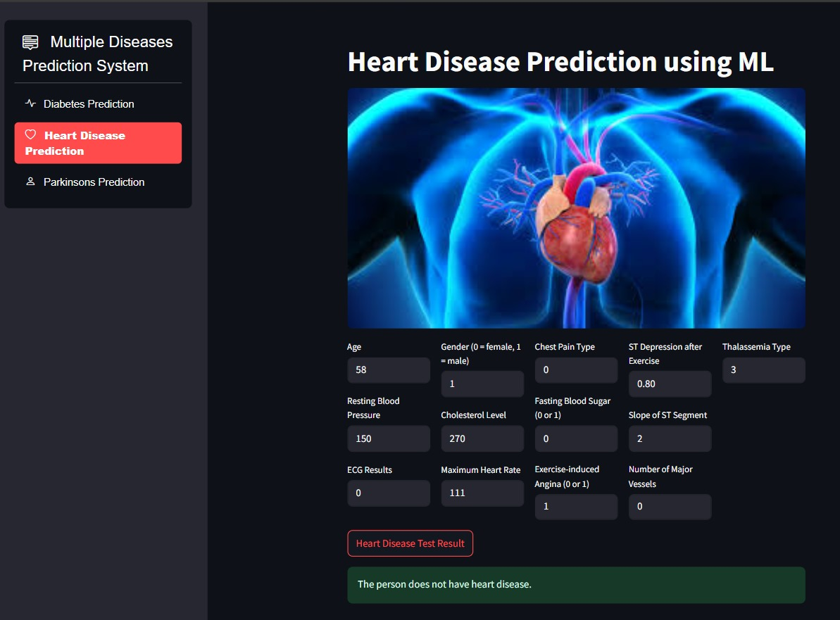
Heart Disease Prediction

Slide 8
Heart Disease - Key Points
Uses UCI/Kaggle dataset.
Inputs like age, cholesterol, ECG, blood pressure.
Predicts the risk of heart-related illness.

Slide 9
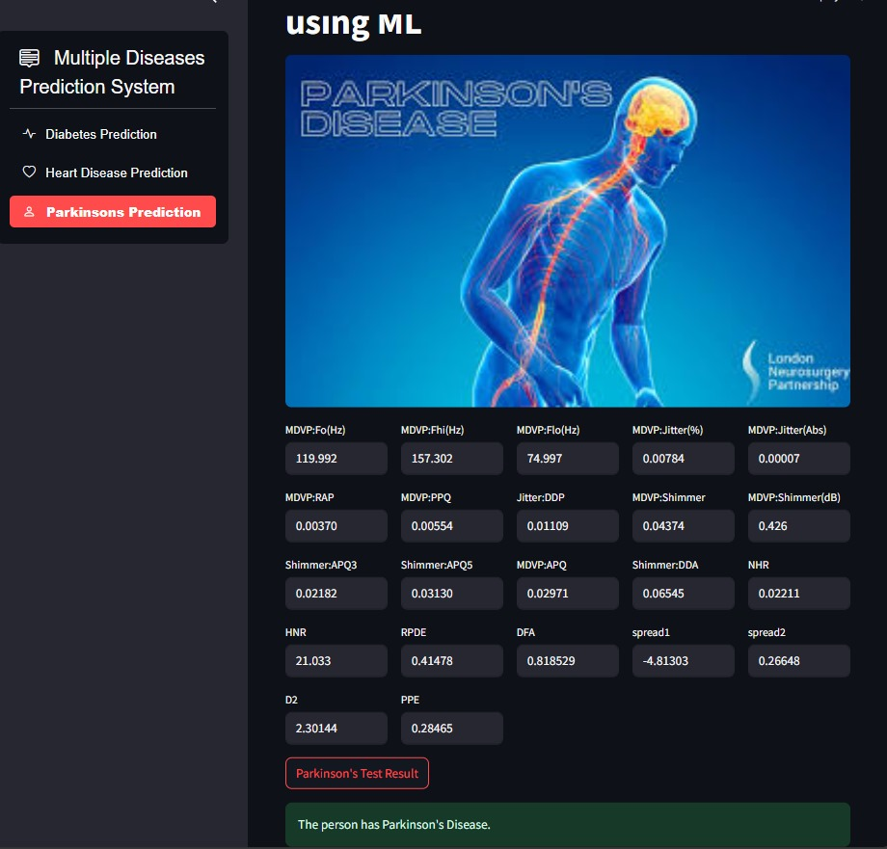
Parkinson's Disease Prediction

Slide 10
Parkinson's - Key Points
Voice-related dataset from UCI.
Analyzes voice frequency, jitter, shimmer etc.
Supports early detection of Parkinson’s symptoms.

Slide 11
Thank You
Presented by: [Your Name/Team]
This project promotes early health intervention.
Powered by Machine Learning & Streamlit.

