Slide 1


HOSPITAL MANAGEMENT SYSTEM
TEAM MARK 1
TEAM MEMBERS:
THOUFIQ
AKSHAY
AKASH
MUKESH

Slide 2
PROJECT DESCRIPTION
OUR PROJECT IS ABOUT HOSPITAL MANAGEMENT SYSTEM.
WHEN A PATIENT WANTS TO CONSULT A DOCTOR HE/SHE HAS TO FILL BASIC DETAILS OF PATIENT .
AFTER FILLING THE PATIENT DETAILS , HE/SHE HAS TO SELECT THE REQUIRED SPECALIST DOCTOR.
THEN , THE CODE EXPLAINS ABOUT : HMS……

Slide 3
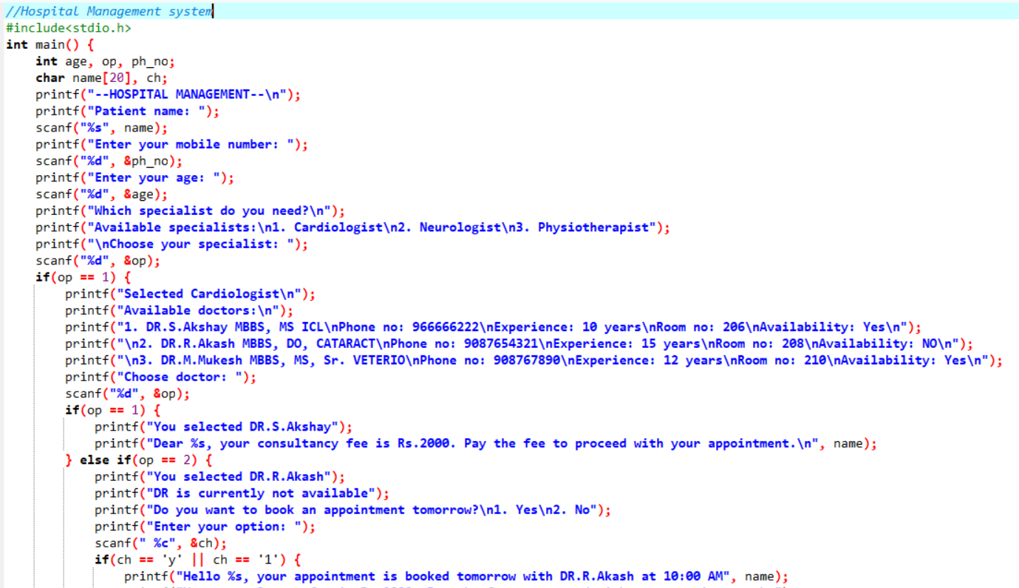
CODE INPUT

Slide 4
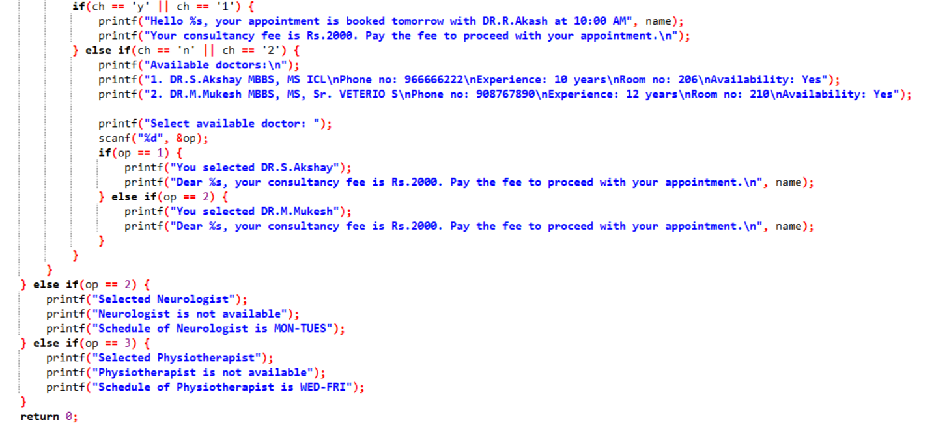

Slide 5
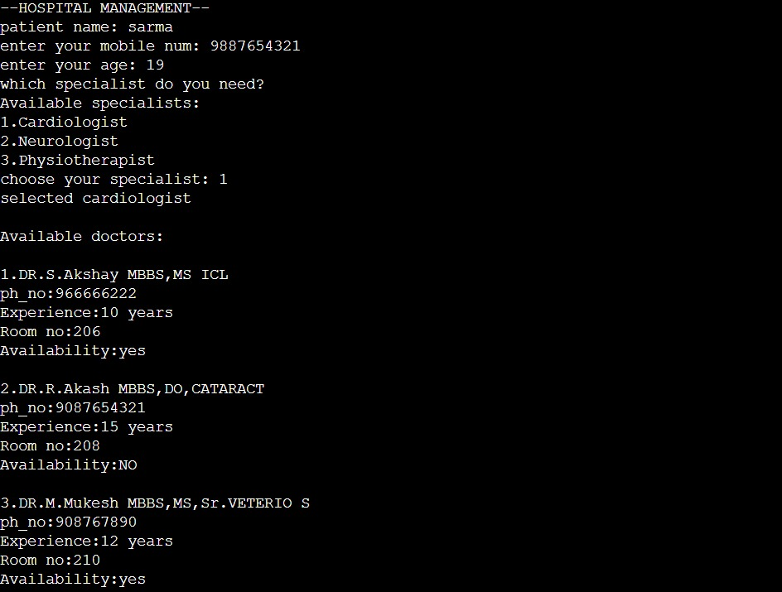
OUT PUT

Slide 6
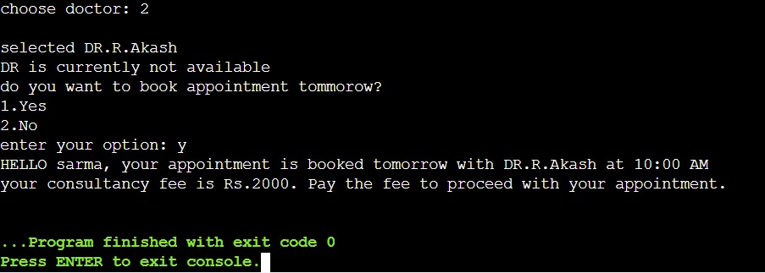

Slide 7


