Slide 1

MALLA REDDY COLLEGE OF ENGINEERING & TECHNOLOGY (Autonomous Institution – UGC, Govt. of India) DEPARTMENT OF INFORMATION TECHNOLOGY
IMPLEMENTATION OF PCA WITH ANN ALGORITHM FOR FACE RECOGNITION
BATCH 03
21N31A1277 –K.AKSHAYA KUMARI
21N31A1268 – K.INDRA KARAN REDDY
21N31A12B3 – MD. MUQSITH
INTERNAL GUIDE:
Dr. K.SURESH

Slide 2
AGENDA
INTRODUTION
LITERATURE
EXISTING AND PROPOSED SYSTEM
SOFTWARE AND HARDWARE REQUIREMENTS
APPLICATION DESCRIPTION
SOFTWARE REQUIREMENT SPECIFICATION
SYSTEM ARCHITECTURE
UML DIAGRAMS
IMPLEMENTATION
CONCLUSION
REFERENCES

Slide 3
INTRODUCTION
A face recognition system is a computer application for automatically identifying or verifying a person from a digital image. One of the ways to do this is by comparing selected facial features from the image and a facial database.
Security and authentication of a person is a crucial part of any industry. There are many techniques used for security and authentication one of them is face recognition.
Facial recognition can be used as a key factor in crime identification and detection, mainly to identify criminals there are several approaches to facial recognition of which Image processing principal component analysis (PCA) and Artificial neural networks (ANN) have been incorporated in our project face recognition as many applicable areas.
The characteristic features called ‘Eigen faces’ are extracted from the storage images using which the system is trained for subsequent recognition of new images.

Slide 4
LITERATURE
Computer vision is a field of ML that tries to teach computers to see and understand images, much like humans do. For instance, a face recognition system works by comparing a captured image of a face to a database of known faces. If it finds a match, it identifies the person; if not, it reports the person as unknown.
The challenge in computer vision lies in converting 3D images (which have depth) into 2D images (which lack depth) while preserving important details. The goal is to create systems that can potentially surpass human vision using advanced computing and mathematical techniques.
To solve problems in computer vision, researchers often use two main approaches:
1.Statistical Models: These models use probability to make educated guesses about what's happening in an image based on known patterns and data.
2.Linear Models: These models use linear algebra and involve taking multiple images from slightly different angles to better understand and interpret the features in an image.

Slide 5
SOFTWARE AND HARDWARE REQUIREMENTS
SOFTWARE REQUIREMENTS
Language: python
Libraries & Framweork:numpy,scipy,seaborn
Operating system: Windows
Development environment :pycharm, Jupyternotebook
HARDWARE REQUIREMENTS
Processor:i5 or i7
RAM: 8GB and above
Storage:256GB and above

Slide 6
EXISTING SYSTEM
EXISTING SYSTEM:
There are several image processing tools, like OpenCV, that include the PCA algorithm and methods for face recognition. However, it can still take a lot of time for developers to add face recognition features to their applications.
Furthermore, selecting appropriate approaches for each step in the process of face recognition is non-trivial, since it directly impacts the final recognition result.
Building a PCA-based face recognition system shouldn’t require much effort for developers, as the technique has been around for years and is well-developed. Developers shouldn’t need to spend time implementing the algorithms and integrating them into their applications.

Slide 7
PROPOSED SYSTEM
This provides a software framework for PCA-based face recognition aiming at assisting software developers to customize their own applications efficiently.
The framework describes the complete process of PCA-based face recognition including image representation, face detection, feature detection, pre-processing, PCA, and verification, and in each step, multiple variations are offered to fit different requirements.

Slide 8
APPLICATION DESCRIPTION:
1. Objective: Create a face recognition system using PCA (Principal Component Analysis) and ANN (Artificial Neural Network) to identify and verify people.
2. Face Detection: Uses PCA to find and isolate faces in images or videos.
3. Feature Extraction: PCA simplifies facial features into a compact form while keeping important details.
4. Training: Trains an ANN with the PCA data to recognize different faces.
5. Recognition: Compares new faces to the trained model to identify them in real-time.
6. Database: Stores face data securely for easy access and management.

Slide 9
SOFTWARE REQUIREMENT SPECIFICATION(SRS)
FUNCTIONAL REQUIREMENTS:
1. Face Detection: The system should detect faces from images using PCA (Principal Component Analysis).
2. Feature Extraction: Use PCA to extract and reduce facial features into principal components.
3. Training the ANN: Train an Artificial Neural Network (ANN) using the principal components as input for pattern recognition.
4. Face Recognition: Once trained, the ANN should identify and classify the faces based on the learned features.
5. Database Storage: The system should maintain a database to store and manage face templates.
6. Accuracy Feedback: Provide feedback on the accuracy of face recognition, displaying whether the face is recognized correctly.

Slide 10
1.Performance: The system should operate efficiently, with quick face detection and recognition under 1 second.
2.Scalability: It should handle an increasing number of face records without performance degradation.
3.Accuracy: Achieve a high recognition accuracy, with minimal false positives and false negatives.
4.Security: Ensure that the facial data stored and processed is secure, protecting user privacy.
5. Usability: The interface should be user-friendly, allowing easy navigation and operation for non-technical users.
.
NON-FUNCTIONAL REQUIREMENTS:

Slide 11
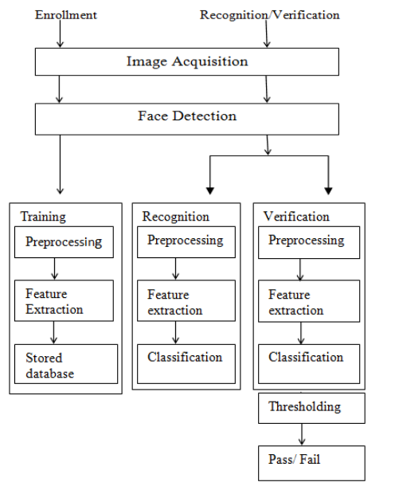
SYSTEM ARCHITECTURE

Slide 12
UML DIAGRAMS
Class Diagram
Use Case Diagram
Sequence Diagram
Activity Diagram

Slide 13
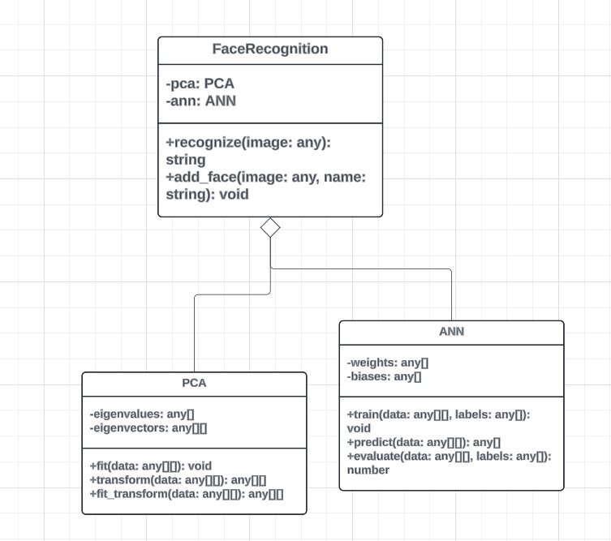
CLASS DIAGRAM

Slide 14
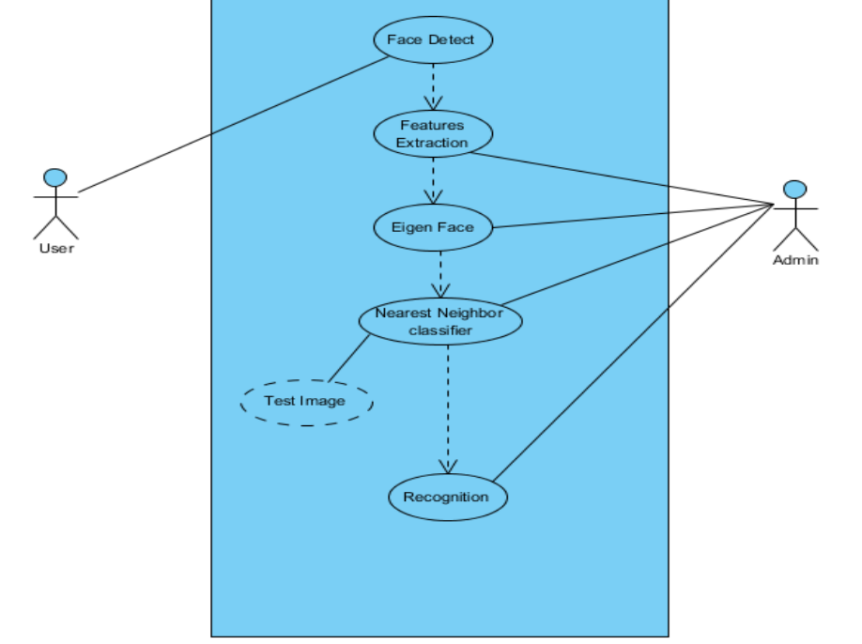
USECASE DIAGRAM

Slide 15
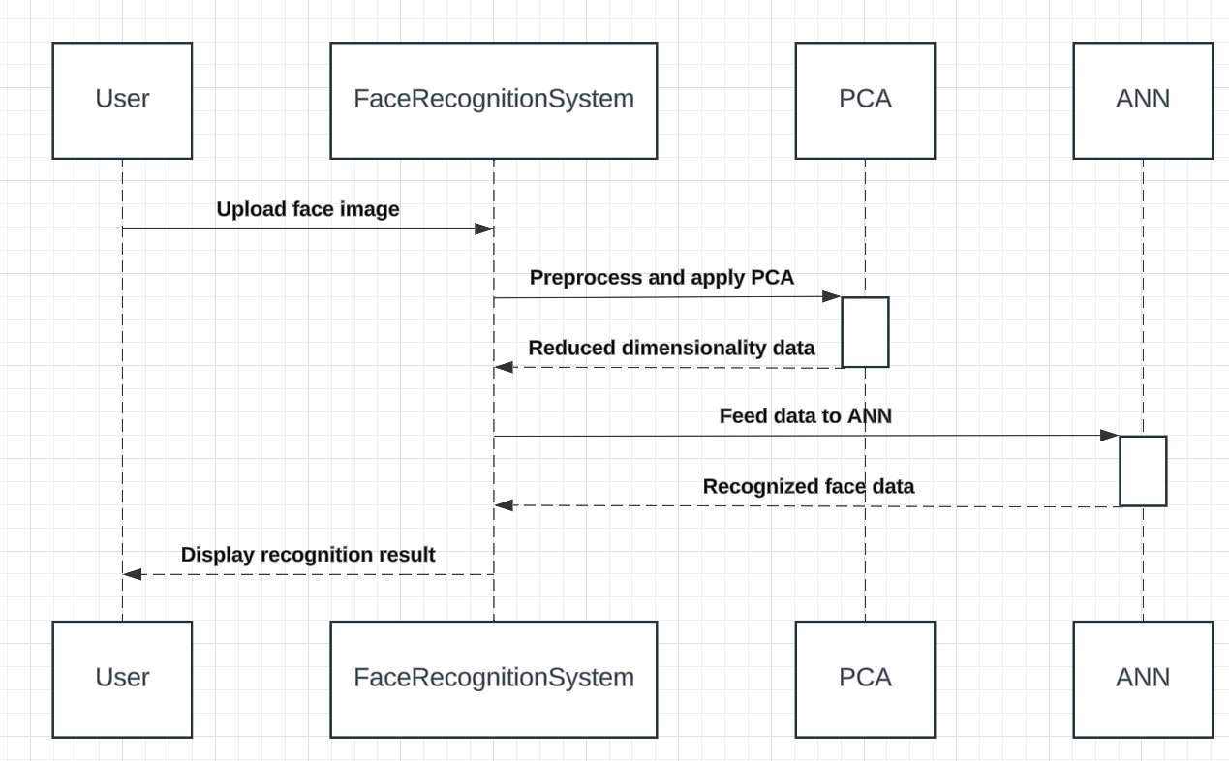
SEQUENCE DIAGRAM

Slide 16
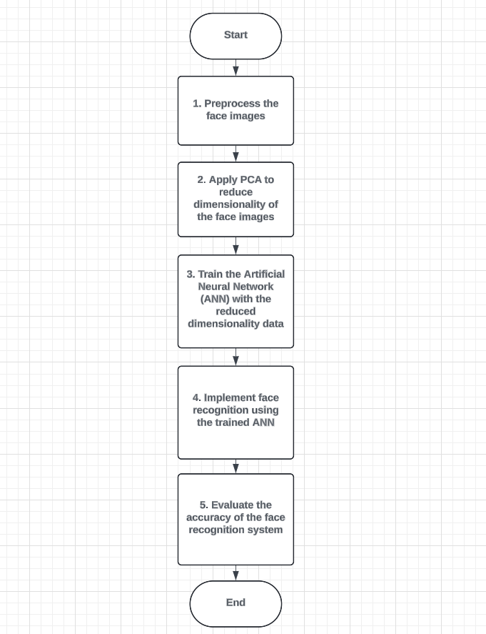
ACTIVITY DIAGRAM

Slide 17
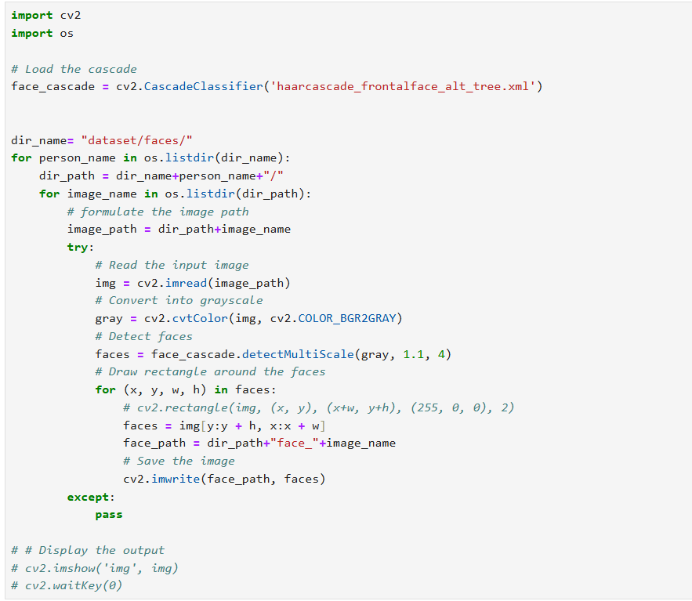
SAMPLE CODE

Slide 19
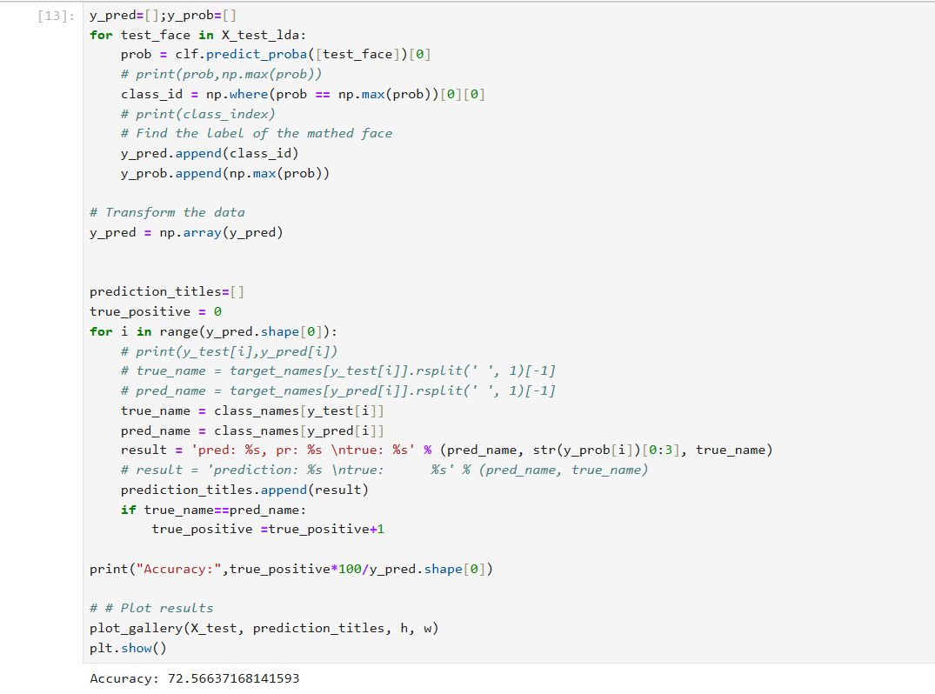

Slide 20
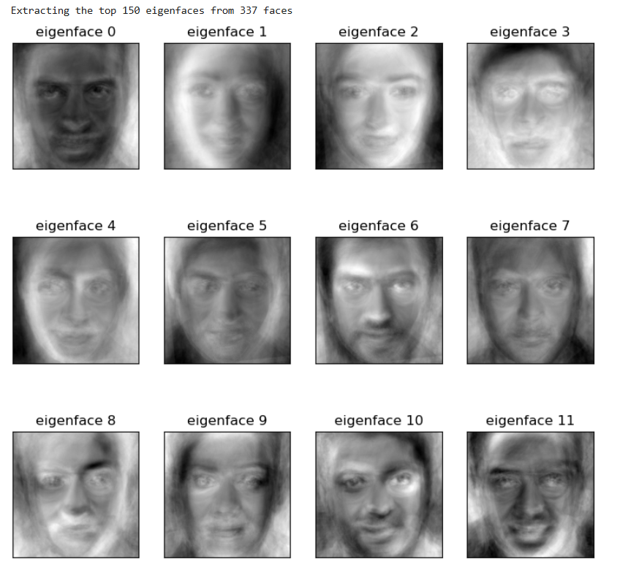
OUTPUT:

Slide 21
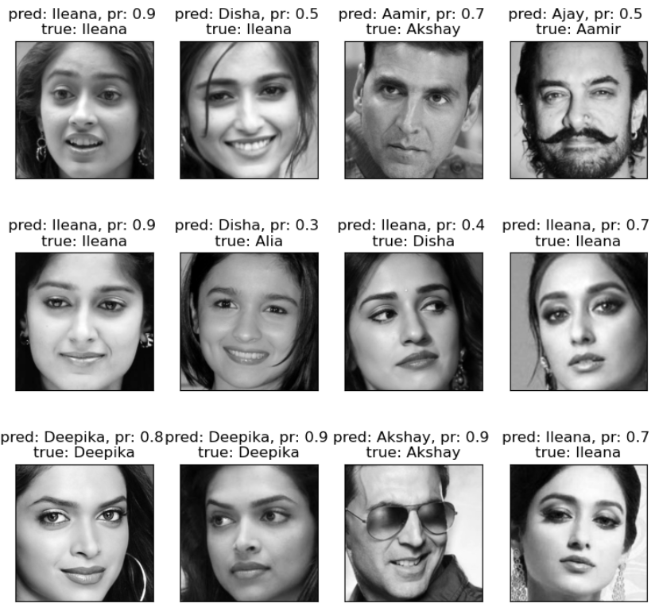

Slide 22
CONCLUSION
This concludes a method of face recognition by merging two techniques PCA, which is used here for feature extraction, and ANN, which is used here for recognition and verification purpose. The principal component analysis method for face recognition is motivated by information theory approach that decomposes face images into a small set of characteristics features images called “eigen faces” which may be thought of as the principal components of the initial training set of face images.

Slide 23
REFERENCES
[1] Sangeeta Kaushik, R. B. Dubey and Abhimanyu Madan. 2014. Study of Face Recognition Techniques. International Journal of Advanced computer Research. 4(1).
[2] Lih-Heng Chan, Sh-Hussain Salleh and Chee-Ming Ting. 2009. PCA, LDA and Neural Network for Face Identification. 4th IEEE Conference of Industrial Electronics and Applications.
[3] G. Ragul, C. Magesh Kumar, R. Thiyagarajan and R. Mohan. 2013. Comparative Study of Statistical Models and Classifiers in Face Recognition. IEEE 2013 International Conference on Information Communication and Embedded Systems (ICICES).
[4] Jageshvar K. Keche Vikas K. Yeotikar Manish T. Wanjari Dr. Mahendra P. DhoreHuman 2015 Face Recognition Based on PCA Method using MATLAB National Conference on “Advanced Technologies in Computing and Networking.
[5] Mayank Agarwal and Himanshu Agrawal. 2010 Face Recognition using Principle Component Analysis, Eigenface and Neural Network.. IEEE International Conference on Signal Acquisition and Processing.

Slide 24
THANK YOU

