Slide 1
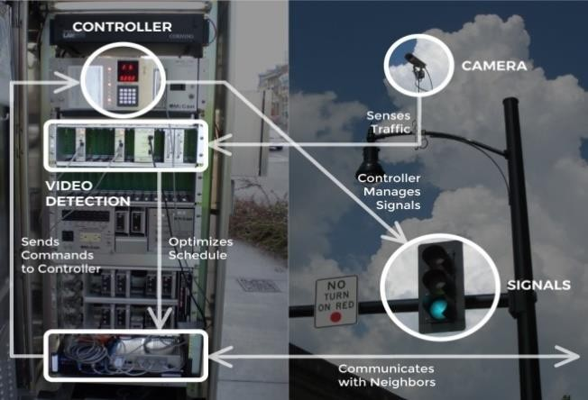
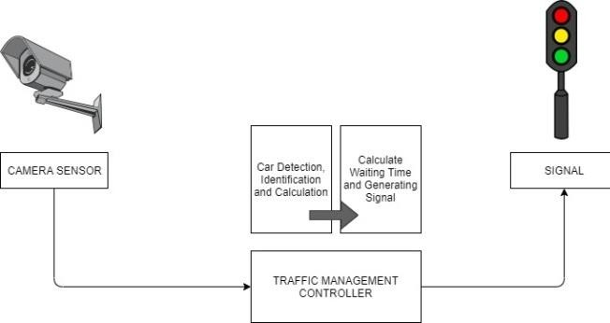
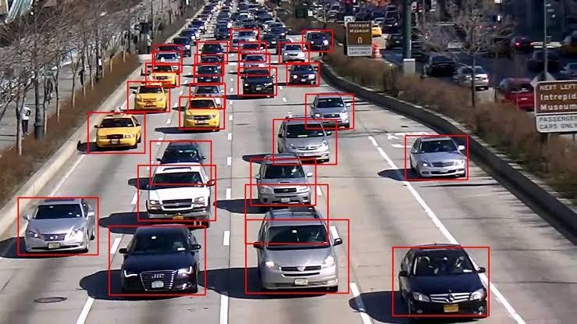
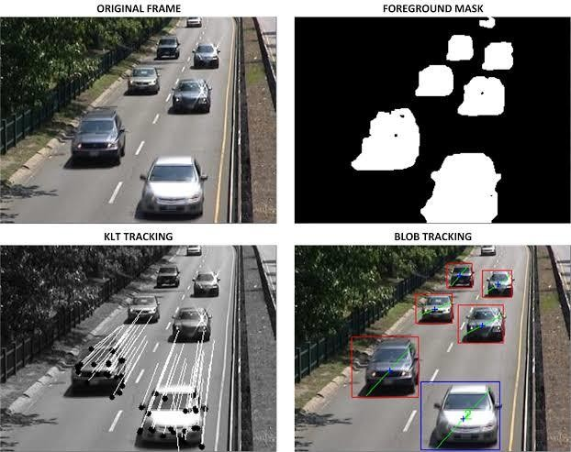
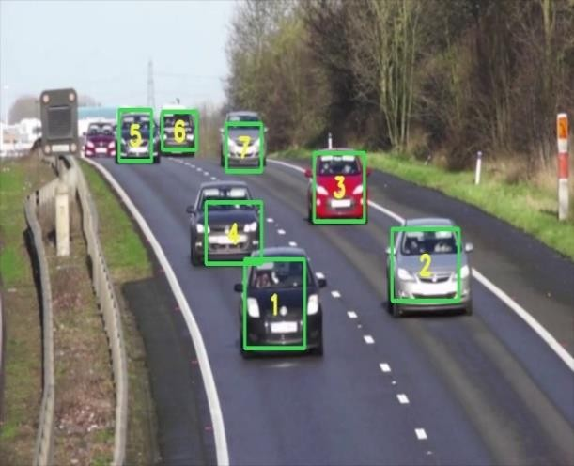
ICAMT-2024, International Conference on Additive Manufacturing Technologies, OCT-2024
Paper ID: ********
IOT Based Dynamic Traffic Management System
P.JAYASUTHA ¹, K AKSHAYA ², M KAVYA ³, A KAVYA ⁴
¹ Assistant Professor, Computer Science and Engineering, Mahendra Institute of Technology (Autonomous), Namakkal District, Tamilnadu-637503, India. jayasuthap96@gmail.com
²⁻⁴ Student, Department of Computer Science and Engineering, Mahendra Institute of Technology (Autonomous), Namakkal District, Tamil Nadu, India – 637503
*Corresponding Author: Assistant Professor, Computer Science and Engineering, Mahendra Institute of Technology, Namakkal District, Tamilnadu-637 503, India. jayasuthap96@gmail.com
Introduction
Calculate Waiting time
After taking the count of vehicles that count is used in calculating the average waiting time for traffic signal and then it sends a signal to controller which allows traffic flow for that direction for calculated time.
Main Algorithm:
When the system initializes first time, it starts with the main algorithm. It then calls Find_MAX_Dir which returns the traffic count for particular direction, it store the count in TRAFFIC_COUNT. Then it check the count value is zero or not, if count is zero it continue with loop otherwise it will call Time calculation algorithm and this algorithm returns calculated the time for the traffic signal
Manipulating signal based on traffic density
Traffic due to automobiles is a major problem in many urban places In India as well as in other countries. Malfunctioning of the traffic lights and Various other dysfunctionalities has led to traffic congestion which hurts the Economy, environment, and overall quality of life. Hence it is very important Tomanage the traffic congestion problem effectively. In this paper, a prototype Is proposed for a traffic management system using IR sensors, Arduino, serial Tothe parallel shift register, and LED displays. The density of the traffic is Measured by placing the IR sensors at the 4lane junction after a certain Distance. The data collected from sensors is used to dynamically change the Sequence of green lights as well as to dynamically change the green light Delays. The proposed road traffic management system is implemented in the Proteus software. For high traffic zone, a higher green light delay is given Whereas for low density zone, the duration of the green light delay is reduced. The system is also designed in such a way as to give preference to the lanes Which have no vehicles/very few vehicles by providing the least green light Delays. Nowadays congestion in traffic is a serious issue. The traffic congestion can also be caused by large Red light delays. The delay of respective light is hard coded in the traffic light and it is not dependent on Traffic. So, a prototype in which delay of signal lights is dependent on traffic is needed. Internet of Things Plays an important role in this aspect. Sensors can be placed to collect traffic data with Arduino as main Microcontroller. There are few systems exist in literature to effectively manage the traffic. Arduino is an open sourcethat has developed microcontroller-based kits for building digital devices and interactive objects That can detect and physical IR system is when a vehicle passes the Road between the IR transmitter and the IR receiver.
Figure 1. Architecture Diagram for Sensor to Signal Processing
Conclusion
Manipulating signal based on traffic density The vehicle count is used to calculate the waiting time for lane and the controller sends appropriate signal to traffic light according to algorithm.This paper presents a system which is based on Internet of Things (IoT) and image processing. This system uses camera sensors as an input system to take real-time data. By analyzing the data system calculates average waiting time for each lane. Proposed system provides feasibility by making it adaptive. The system provides low average waiting time and reliability. Due to low average waiting time the air pollution rate decreases and the use of fuel also decreases. Proposed system decreases traffic congestion. Proposed system provides a more economical and feasible approach towards changing the current traffic management system and making it adaptive and intelligent.
Methodology
Results and Discussions
Working
Adaptive traffic management system that we need to implement is very large. So, we developed a prototype model which works as per the current density of vehicles at the intersection and will vary its time interval with varying traffic condition.In this proposed system, the aim is to achieve low average waiting time or low traffic congestion. The priority will be given depending on the present situation. There are three main parts of the system which are as follows:
Detection of vehicles
Camera sensors are used to take live stream of traffic to measure density of vehicles. The cameras are mounted at four directions that is north, South, East and west. Camera communicated with raspberry pi using USB port. Camera continuously monitors traffic and detect the vehicles. The vehicle detection is done by using image processing. Code for image processing is written in python.
Counting number of vehicles
In this adaptive traffic management system we experimented the idea for four lanes and we have used four camera sensor for four different lanes. These camera sensors were used in the respective four lanes for counting the no of vehicles.
A
B
Acknowledgements
Acknowledgements might go here.
Contact Information
P.JAYASUTHA
Assistant Professor, Computer Science and Engineering, Mahendra Institute of Technology (Autonomous), Namakkal District, Tamilnadu-637503, India. | Tel: +91 9597430916 Email:jayasuthap96@gmail.com
Vehicle Detection
Vehicle Counting

