Slide 1
SALES REPORT OF USA D-Mart Store
Prepared by Akshay kalkar
Date:- 8/4/2025

Slide 2
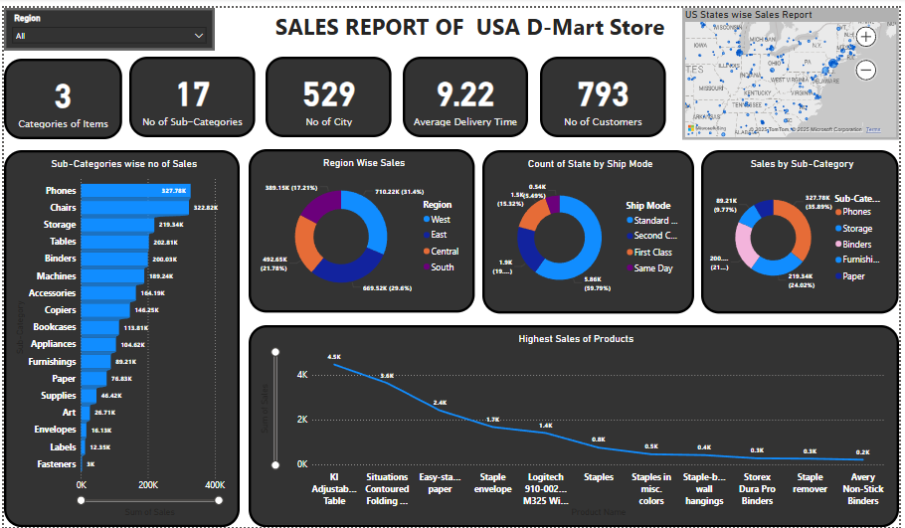
Dashboard Overview

Slide 3
Key Performance Indicators (KPIs)
1. **Categories of Items:** 3
2. **No of Sub-Categories:** 17
3. **Number of Cities:** 529
4. **Average Delivery Time:** 9.22 days
5. **Number of Customers:** 793

Slide 4
Sub-Category Wise Number of Sales
This bar chart highlights the sales volume across various sub-categories.
Phones, Chairs, and Storage are the top-performing segments.
This insight helps identify strong product segments.

Slide 5
Region Wise Sales
Pie chart displaying percentage of total sales per region.
South region leads in sales followed by East and West.
Useful for understanding geographic demand.

Slide 6
State Count by Ship Mode
Shows the count of states served by each shipping mode.
Standard Class and Second Class dominate shipping choices.
Provides insight into preferred delivery options.

Slide 7
Sales by Sub-Category
This pie chart breaks down sales by sub-category.
Phones and Storage contribute the most to sales.
Highlights which sub-categories generate higher revenue.

Slide 8
Top Selling Products
Line chart representing products with the highest individual sales.
The 'KI Adjustable Table' leads the sales chart.
Helps in identifying fast-selling products for inventory focus.

Slide 9
Geographical Sales Distribution (Map)
This interactive map shows sales based on US states.
Clicking a state filters other visuals by region.
Useful for interactive sales exploration.

Slide 10
Region Slicer (Filter)
The slicer allows filtering the dashboard by specific regions.
Updates all visuals according to selected region data.
Supports focused analysis for business strategy.

Slide 11
Summary of Insights
✔ Comprehensive sales performance of D-Mart US stores
✔ Regional and sub-category breakdown of revenue
✔ KPI monitoring for operational and logistics performance
✔ Interactive features enhance data exploration
✔ Ready for decision-making and business planning

