Slide 1

VIGNAN INSTITUTE OF MANAGEMENT AND TECHNOLOGY FOR WOMEN MINI PROJECT PARKING MANAGEMENT SYSTEM
BY
SINDHUJA(22UP1A7206)
AKSHAYA NAIDI(22UP1A7201)
AKSHITHA(22UP1A7212)
CHINMAYEE(22UP1A7263)
ANJALI(22UP1A7207)
GUIDED BY
SANDHYA RANI
(Assistant Professor dept of AI&DS)

Slide 2
ABSTRACT
The Car Parking Management System developed using Python offers a comprehensive solution to address the challenges associated with urban parking management. The key features of the system, including real-time slot availability information and parking status display, aimed at optimizing space utilization and enhancing user experience. The system facilitates efficient parking slot allocation through dynamic management of parking spaces within the parking lot. Using Python programming language, the system maintains a digital representation of the parking lot, dividing it into discrete slots. Through an intuitive command-line interface, users can easily access information regarding available parking slots and current parking status. The system dynamically updates slot availability as vehicles enter and vacate the parking lot, ensuring accurate representation of available parking spaces. Users can query the system to retrieve information on available parking slots, enabling them to make informed decisions when seeking parking. The system provides a comprehensive display of parking status, presenting users with real-time information on slot occupancy. By leveraging Python's capabilities, the system offers a user-friendly interface for viewing the current status of each parking slot, distinguishing between occupied and vacant slots.

Slide 3
INTRODUCTION
A parking management system refers to the innovative technologies providing solutions in the parking industry. The core idea behind any parking management system is self-explanatory.
It’s a system that helps people, companies, and organizations to manage their parking spaces.
Managing car parks isn’t an easy task for companies and organizations because there are lots of moving parts including traffic and the availability of spaces. It is a time-consuming task, requires human labor, and is inefficient. Using a parking management system can help reduce a business’s administrative overhead on parking and reduce the impact of their parking space on their local community.
Parking software is used at educational institutions, municipalities, offices, businesses, and corporate organizations. This article defines parking management systems, discusses their key components, and the different use cases for the systems and software.

Slide 4
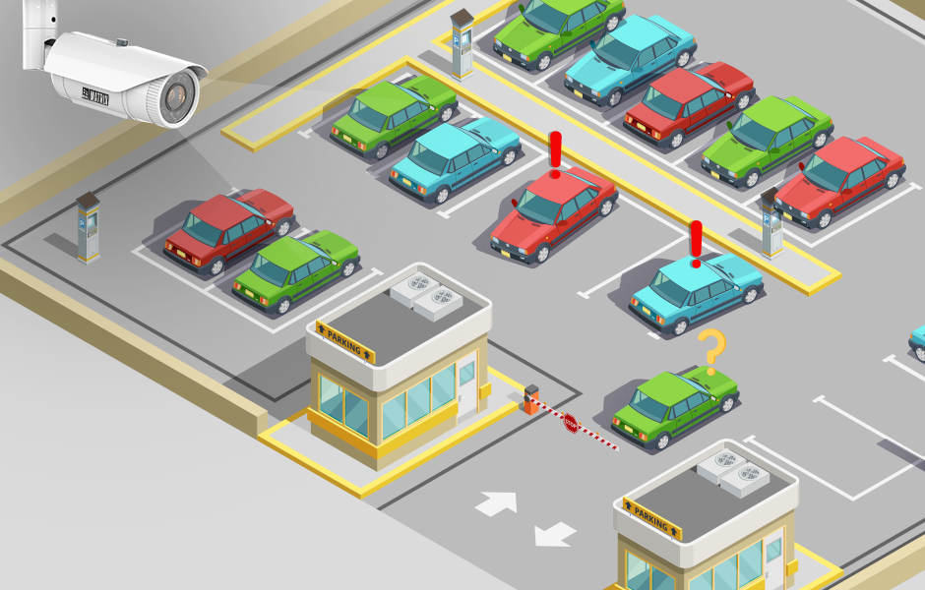
OBJECTIVES
Access control system
Revenue management
Security system
Boom barrier
Statistical information

Slide 5
EXSISTING SYSTEM
Long queues: Traditional parking systems often require customers to take a ticket upon entry and pay for their parking upon exit. This can result in long queues, especially during peak hours or busy periods, which can be frustrating for customers and deter them from parking at your business.
Risk of fraud: Traditional parking systems are susceptible to fraud, as customers can lose their tickets, and it can be challenging to verify the validity of the tickets presented upon exit. This can result in lost revenue for your business.
Inconvenient for customers: Customers need to keep track of their parking tickets, which can be lost, and result in them paying for additional parking time. Additionally, traditional parking systems often require customers to handle cash, which may not be convenient for customers.

Slide 6
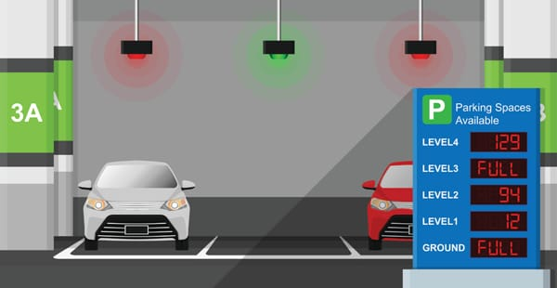
4.Maintenance and management: Traditional parking systems require regular functioning correctly and restocking tickets. This can result in additional costs and management time.
5.Limited parking information: Traditional parking systems do not provide real-time information on parking spaces, which can result in inefficient use of parking spaces and frustrated customers who cannot find a parking spot.

Slide 7
PROPOSED SYSTEM
Convenience: Ticketless parking systems provide a more convenient experience for customers as they do not need to keep track of a ticket or queue to pay for their use of car parks. They can make payments using their mobile phones or contactless payment methods, which saves time and effort.
Improved customer experience: Ticketless parking systems can help businesses improve the customer experience. By eliminating the need for customers to queue to pay for their parking or keep track of a ticket, businesses can reduce wait times and improve overall satisfaction levels.
Increased efficiency: Ticketless parking systems can increase the efficiency of parking operations. They can reduce the time it takes for customers to enter and exit the parking lot, which can help reduce congestion and improve traffic flow.

Slide 8
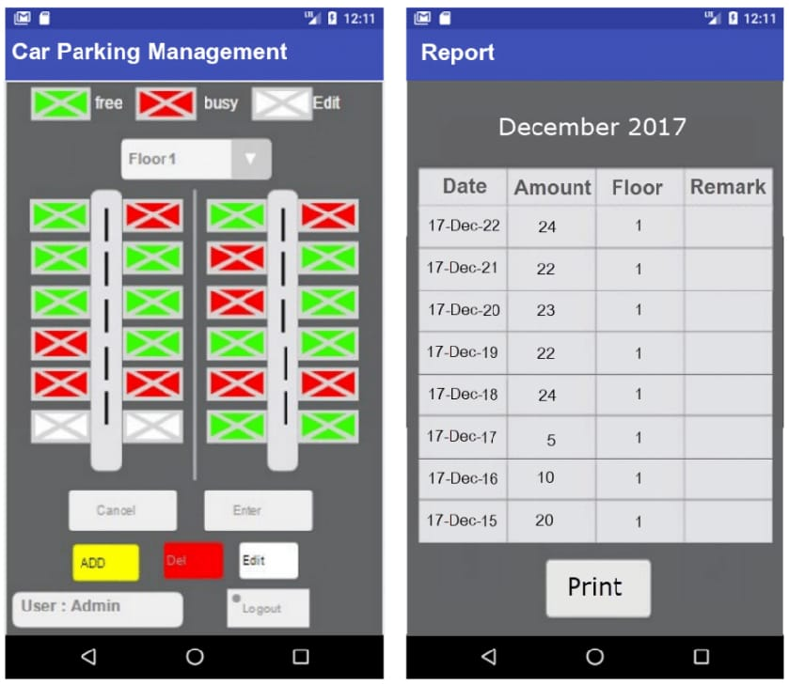
Reduced costs: Ticketless parking systems can be more cost-effective than traditional parking systems. They can eliminate the need for ticket machines and reduce the need for staff to manage the parking lot, which can result in cost savings for the business.
Real-time tracking: Ticketless parking systems can provide businesses with real-time tracking of parking spaces. They can help businesses optimize parking operations by monitoring parking usage and identifying patterns that can inform future decisions.

Slide 9
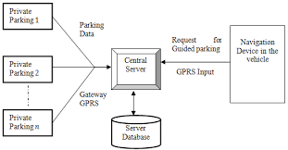
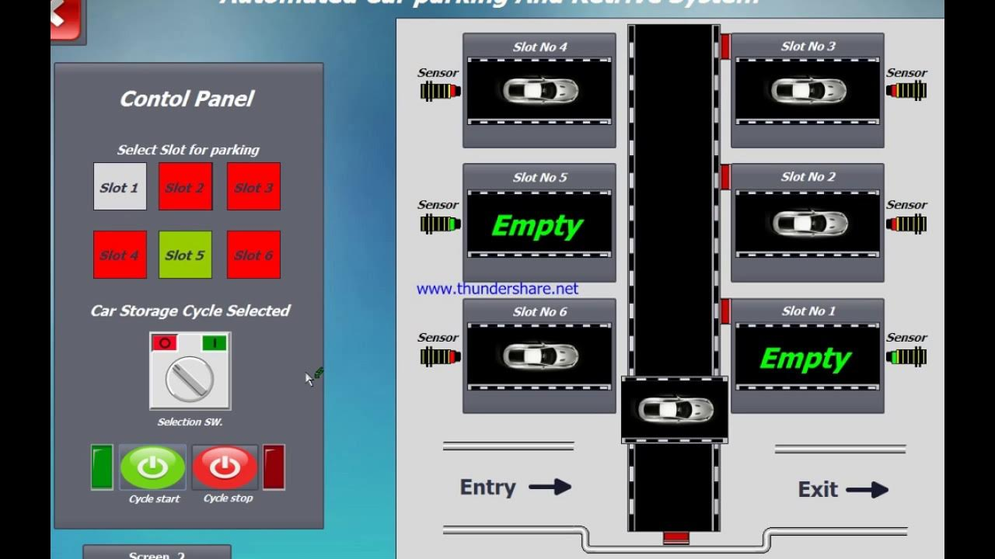
SYSTEM ARCHITECTURE

Slide 10
REQUIREMENTS
HARDWARE DEVICES
Sensors
Cameras and other devices
SOFTWARE REQUIREMENTS
Language of code: Python

Slide 11
“THANK YOU”

