Slide 1
Estimating POS Annotation Consistency of Different Treebanks in a Language
Akshay Aggarwal and Daniel Zeman Univerzita Karlova, Czechia

Slide 2
Motivation and Measure Definition

Slide 3
Motivation
Multiple annotation guidelines for treebanks of same language (Kakkonen, 2006)
Example- POS schemes for treebanks in English language - Penn Treebank (Marcus et al., 1994) and Universal POS tagset (Petrov et al., 2012)
How to check for quality control new/existing treebanks in the language in a given annotation scheme
Train tagger/parser on one treebank and notice drop in parser scores on another
First used for treebanks in Spanish (Martínez Alonso and Zeman, 2016)
Bottlenecks- performance of used model; architecture of trained model
‘Variation nuclei’ method as proposed by Dickinson and Meurers (2003)
Open Problem: determining the degree to which the different treebanks differ from each other
Notes:
Parser evaluation:
also used in case of UDv2.2 ru treebanks by Droganova et al. (2018)
Variation nuclei:
Does not localise, rather states the inconsistencies
Skipping on intro to UD, covered in dataset section
Coming up: KL-divergence

Slide 4
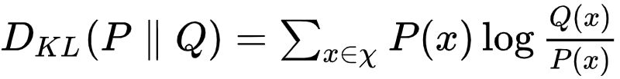
Kullback-Liebler divergence and KLcpos3
Kullback-Liebler divergence is a measure of how one probability distribution is different from a second, reference probability distribution
For discrete distributions P and Q defined on the same probability space 𝜒, divergence from Q to P is defined as
Rosa and Žabokrtský (2015) proposed KLcpos3 measure based on Kullback-Liebler divergence of distribution of coarse POS trigram

Slide 5
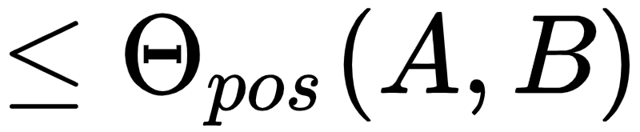
From KLcpos3 to theta_pos (θ_{pos})
Rosa and Žabokrtský (2015) showed KLcpos3 can be effectively used for source selection in a delexicalised cross-language parser transfer scenario
Their Motivation: Treebanks closer in their POS Annotation Distribution should be better fit for source-transfer than those that are further. Our Motivation: Divergence of distribution of POS Annotation in different treebanks can be used to estimate if the treebanks are consistent or inconsistent in their annotation; having accounted for differences in size, and genre distribution of the treebanks.
Symmetric measure theta_pos (θ_{pos}) calculates divergence in distribution of POS trigrams.
The treebanks are consistent in annotation if θ_{pos} is less than or equal to estimated empirical bound for the treebank pair, given by Theta_pos (Θ_{pos})

Slide 6
Dataset

Slide 7
Details of Dataset
Demonstrated utility of the measure on Universal Dependencies version 2.5 (abbreviated as UDv2.5) treebanks (Zeman et al., 2019)
UDv2.5 contains 157 treebanks in 90 languages with some languages containing upto 5 treebanks
UD is perfect playground for the proposed measure
multiple treebanks (re-)annotated as per same annotation guidelines
multiple languages so that the measure is not language-centric
UD provides internal ranking of individual treebanks
Assessment of the treebank’s compliance with the guideline
Treebank that adheres better to the guidelines contains fewer inconsistencies
We work with high quality treebanks, rated as 3.5 stars or more out of 5 stars.
Assumptions while working with data:
A given treebank is internally consistent in its annotation - reinforced through selection of high quality treebank(s)
In case the above requirement is too restrictive, data from individual genres in a treebank is internally consistent in annotation
Notes:
Features used:
Size of treebank
Number of genres
Output from official UD validator for syntax and other errors
Known error types in UDAPI

Slide 8
Dataset Size and θ_{pos}

Slide 9
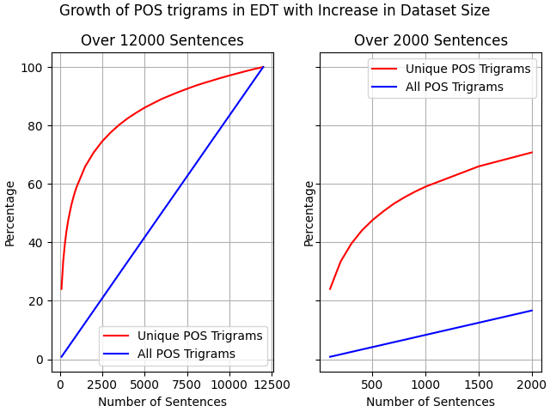
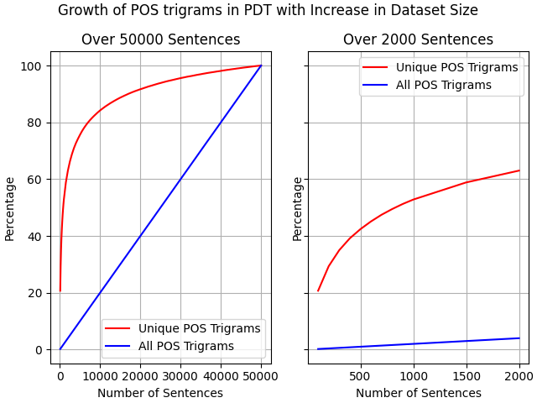

Caveats Related to Data Size
POS trigrams in small part of dataset cannot be considered representative of those present in entire dataset
Difference in Average Sentence Length of the two treebanks
Total number of syntactic words
Number of POS trigrams
Notes:
Figures show variability in
No of distinct POS trigrams
Total no of POS trigrams
More no of unique POS trigrams needed for the treebanks to be comparative

Slide 10
Caveats Related to Data Size (Heuristic Constraints)
Datasets A, B can be compared if
Individual dataset has at least 400 sentences, size(A) ≥ 400 & size(B) ≥ 400; and
Dataset with smaller average sentence length has at least as many as syntactic words as 400 sentences in the other dataset

Slide 11
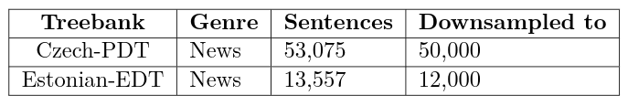
Experimental Setup
Treebank Requirements:
Large number of sentences in a single-genre (news)
High Star Rating
Different language families
Treebanks Used:
Czech-PDT (Indo-European, rated 4.5 stars)
Estonian-EDT (Uralic, rated 4 stars)
Experimental Process:
Downsample the data from either treebank
Run k-fold cross validation on the downsampled data
Report the average score of the cross-validation run
For treebanks A, B containing data from same genre, but differing only with respect to the size of data

Slide 12
Genre Distribution and θ_{pos}

Slide 13
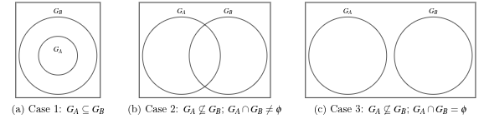
Caveats Related to Genre Distribution in Data
Genre definition is not explicit
chemistry and physics can be separated, or clubbed under science
Multi-genre classification of data also possible
Dataset X can be split into constituent genres such that G_{X} = {A₁, A₂, A₃, …, A_{i}}
Different genres in dataset X might not adhere to the constraints specified before
Set of such genres indicated by G_{adulterant} (G_{adulterant} ⊆ G_{X})
Might not always be possible to split the dataset into constituent genres
Notes:
Definition of genre depends on Topic vs source
Physics forum - physics and blog
Figures: |G_A| <= |G_B|

Slide 14
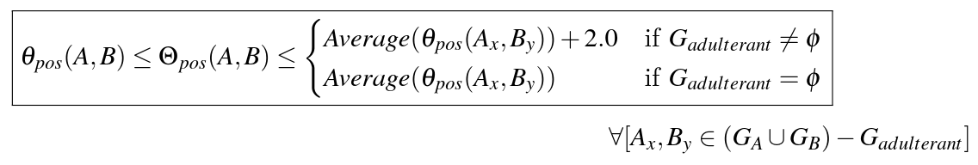
Experimental Setup
Treebank Requirements:
Large number of sentences in multiple genres
High Star Rating
Different language families
Treebanks Used:
Polish-LFG (Indo-European, rated 4 stars)
Finnish-TDT (Uralic, rated 3.5 stars)
Experimental Process:
Downsample the data from considered genres in a given treebank
Study interaction of genres starting from 1 : n, leading to m : n
Report the θ_{pos} score on each interaction
X_{y} denotes genre y present in dataset X
where
Notes:
First equation is for the combination of genres, while the second equation is how the genres interact with each other

Slide 15
Combining It All

Slide 16
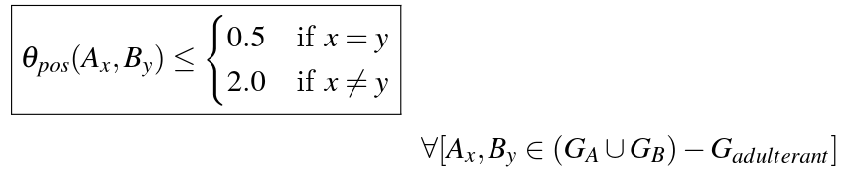
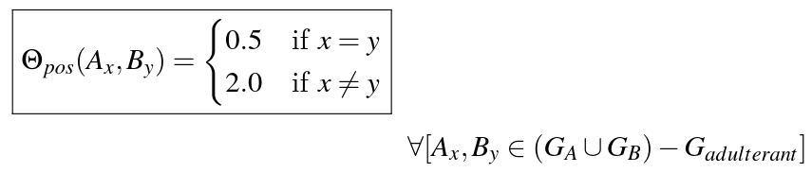
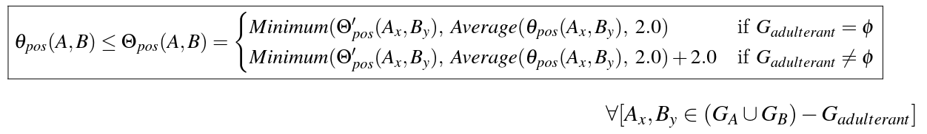
Multiple Genres in Both Treebanks
So far
Simply averaging the calculated θ_{pos} scores for each non-adulterant genre is not enough
Case in point:
θ_{pos}(A_{x},B_{x}) = 2 // exceeds limit of 0.5
θ_{pos}(A_{y},B_{x}) = 2.2 // exceeds limit of 2.0
θ_{pos}(A,B) = 2.5
Average θ_{pos} = 2.1 ≤ 2.5
The treebanks would be marked as consistent, even though inconsistent in all genre-wise annotations
Θ_{pos} for each genre, Θ’_{pos}
where
Overall Θ_{pos}
Notes:
Upper limit is at 4.0
Case example: 0.8, 1.2 -> still be pronounced as consistent

Slide 17
Marking Treebanks in UDv2.5 for (In)Consistency

Slide 18
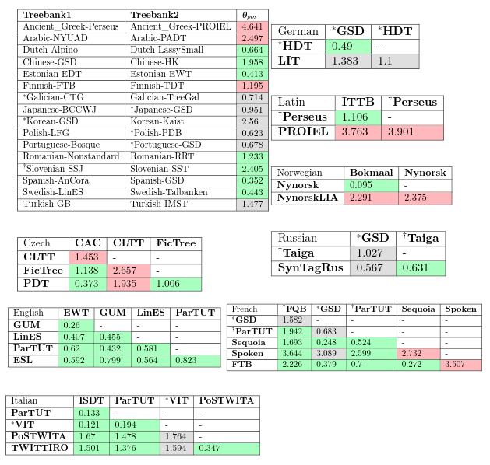
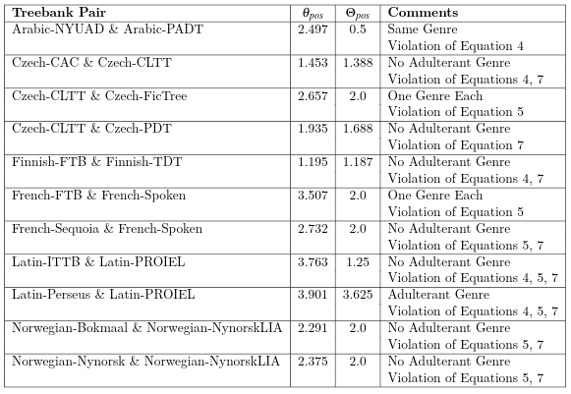
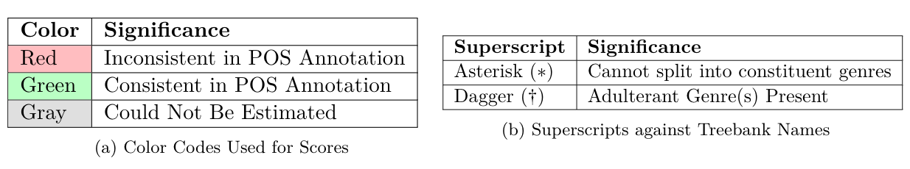
Consistent/Inconsistent Treebank Pairs In UDv2.5
Θ_{pos} Scores of Treebank Pairs Marked as Inconsistent
Legend:
Notes:
Small Treebanks with where the total number of sentences is 1k or less are not included - eliminates PUD

Slide 19


Working Example (Latin Treebanks)
Statistics of constituent genres in Latin-ITTB and Latin-PROIEL treebanks.
Calculated θ_{pos} scores:
Notice θ_{pos}(Latin-ITTB_{nonfiction}, Latin-PROIEL_{nonfiction}) > 0.5 Similarly, θ_{pos}(Latin-ITTB_{nonfiction}, Latin-PROIEL_{bible}) > 2.0
For calculating Θ_{pos}, we need to calculate
Average θ_{pos} = Average(3.702, 3.558) = 3.63
Θ’_{pos} = Average(0.5, 2.0) = 1.25
Since, there are no adulterant genres, the Θ_{pos} is given by:
Θ_{pos} = Minimum( Average θ_{pos}, Θ’_{pos}, 2.0) = Minimum( 3.63, 1.25, 2.0) = 1.25
This is less than the calculated score of the complete treebank. The pair of treebanks is inconsistent in their POS Annotation
Notes:
In second table, the given values show the scores that were received from calculations and not estimations

Slide 20
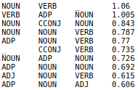
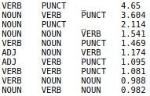
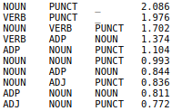
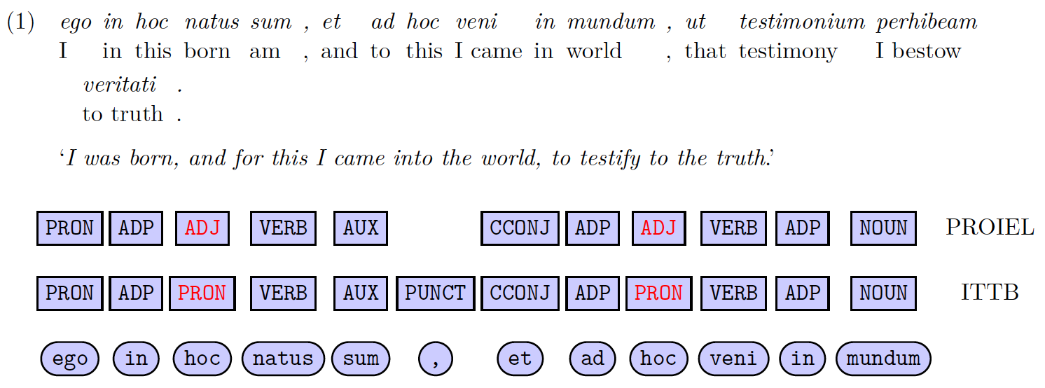
Top 10 Trigrams (Latin Treebanks) and Their % Composition
Latin-PROIEL
Latin-Perseus
Latin-ITTB

Slide 21
Conclusion
Proposed measure to judge POS annotation consistency between different treebanks
Belonging to same language
Annotated under same guideline
The measure is
Extensible to any given guideline
Independent of tagger performance
Not affected by the language’s typology or its family
Can be used to localise points of inconsistency
Often, in conjunction with techniques as proposed by Dickinson and Meurers (2003)
Localisation is possible both inter- and intra-treebanks
Demonstrated utility of measure in UDv2.5 treebanks

Slide 22
Selected References
Marie-Catherine de Marneffe, Miriam Connor, Natalia Silveira, Samuel R. Bowman, Timothy Dozat, and Christopher D. Manning. 2013. More Constructions, More Genres: Extending Stanford Dependencies. In Proceedings of the Second International Conference on Dependency Linguistics (DepLing 2013), pages 187–196, Prague, Czech Republic, August. Charles University in Prague, Matfyzpress, Prague, Czech Republic.
Markus Dickinson and W. Detmar Meurers. 2003. Detecting Errors in Part-of-speech Annotation. In Proceedings of the Tenth Conference on European Chapter of the Association for Computational Linguistics - Volume 1, EACL ’03, pages 107–114, Stroudsburg, PA, USA. Association for Computational Linguistics.
Tuomo Kakkonen. 2006. Dependency treebanks: methods, annotation schemes and tools. In Proceedings of the 15th Nordic Conference of Computational Linguistics (NODALIDA 2005), pages 94–104, Joensuu, Finland, May. University of Joensuu, Finland.
Mitchell Marcus, Grace Kim, Mary Ann Marcinkiewicz, Robert MacIntyre, Ann Bies, Mark Ferguson, Karen Katz, and Britta Schasberger. 1994. The Penn Treebank: Annotating Predicate Argument Structure. In Proceedings of the Workshop on Human Language Technology, HLT ’94, page 114–119, USA. Association for Computational Linguistics.
Héctor Martínez Alonso and Daniel Zeman. 2016. Universal Dependencies for the AnCora treebanks. Procesamiento del Lenguaje Natural, (57):91–98.
Rudolf Rosa and Zdeněk Žabokrtský. 2015. KLcpos3 - a Language Similarity Measure for Delexicalized Parser Transfer. In Proceedings of the 53rd Annual Meeting of the Association for Computational Linguistics and the 7th International Joint Conference on Natural Language Processing (Volume 2:Short Papers), pages 243–249, Beijing, China, July. Association for Computational Linguistics.
Zeman, Daniel; Nivre, Joakim; Abrams, Mitchell; et al., 2019, Universal Dependencies 2.5, LINDAT/CLARIAH-CZ digital library at the Institute of Formal and Applied Linguistics (ÚFAL), Faculty of Mathematics and Physics, Charles University, http://hdl.handle.net/11234/1-3105.

Slide 23

“That’s all Folks!”

