Slide 1

VAAGDEVI COLLEGE OF ENGINEERING
(Affiliated to JNTUH & Accredited by NBA, New Delhi)
Bollikunta, Warangal Urban.
Department of Electrical and Electronics Engineering
PREDICTIVE DUTY CYCLE CONTROL OF THREE PHASE ACTIVE FRONT END RECTIFIER
By
B.Ramya(18646D4305)
(PE)
Mini project guide
Mrs..T.Nirmala nidhi.

Slide 2
ABSTRACT
Model predictive control is one of the modern control technique used for power converter and electric drive application.This paper proposed an online optimizing duty cycle control approach for three phase active front end rectifier,aiming to obtain optimal control action under different operating conditions.
Finite control set model predictive control uses the inherent discrete nature of the power converter for the selection suitable switching state for each sampling period.
A cost function is formulated based on the control variables and corresponding reference values.
FCS MPC technique is applied for current control of active front end rectifier.
In this MPC,outer control loop is used to which is pI controller is used to maintain dc link voltage and inner current loop which is FCS MPC is used for current control.
On the other hand, dutycycle signals are optimized instead of possible switching states.
The performance of active front end rectifier is evaluated in

Slide 3
INTRODUCTION
years, many changes have occurred in the electricity sector to improve the energy efﬁciency and environmental sustainability of generation, transport and ﬁnal use segments, involving the need to update and improve the electric grids .
In traditional power systems, the reliability impact could be signiﬁcant when a large amount of variable DG is integrated on it.
Another important change regards the spread of the so-said dispersed or distributed generation (DG), including renewable sources generation plants (such as PV or wind micro-turbine) and high efﬁciency production systems (such as gas micro-turbine) .

Slide 4
OBJECTIVES
Improving microgrid efficiency
Improving environmental sustainability of generation, transport.
Network management.

Slide 5
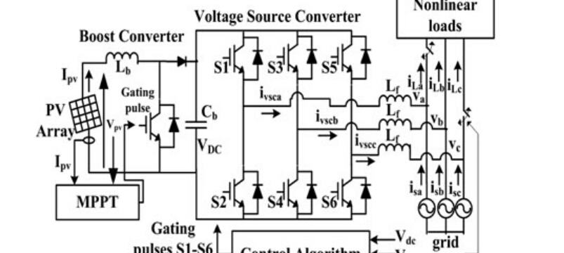
General scheme of proposed system:

Slide 6


