Slide 1

VAAGDEVI COLLEGE OF ENGINEERING
(Affiliated to JNTUH & Accredited by NBA, New Delhi)
Bollikunta, Warangal Urban.
Department of Electrical and Electronics Engineering
Impact of Unified Power-Quality Conditioner Allocation on Line Loading, Losses, and Voltage Stability of Radial Distribution Systems
By
G.Arjun (18641D4316)
(PE)
Major project guide
Dr. A.Sateesh kumar

Slide 2
Abstract
This project presents an investigative study on the analysis of unified power-quality conditioner (UPQC) allocation on radial distribution systems. A design approach for UPQC, called sag-based design for phase-angle control for UPQC (UPQC-SPAC) is proposed. The phase-angle shifting of the load voltage required to mitigate a given value of voltage sag is determined and the same is used during a healthy operating condition in order to provide the reactive power compensation of a distribution network. To study the impact of the UPQC-SPAC allocation on distribution systems, it is placed at each node, except the substation node, one at a time. The load-flow algorithm for radial distribution systemsis suitably modified to incorporate the UPQC-SPAC model.

Slide 3
Introduction
In today’s world there is great importance of electrical energy as it is the most famous from of energy and all are massively relying on it. Without supply of electricity life cannot be imagined.
At the same time the quality and continuousness of the electric power supplied is also very important for the efficient functioning of the end user equipment.
Many of the commercial and industrial loads require high quality undisturbed and constant power.
Thus maintaining the qualitative power is topmost important in today's world.
Electric power quality (PQ) has become the concern of utilities, end users, manufacturers, and all other customers.
Power quality is the set of parameters defining the properties of power supply delivered to the users in normal operating conditions in terms of continuity of supply and characteristics of voltage (magnitude, frequency, symmetry, waveform etc.).

Slide 4
Modern electronic equipment's and devices, such as microprocessors, microcontrollers, telecommunications equipment and sensitive computerized equipment's etc. are susceptible to PQ problems.
Poor PQ has become a more important concern of both power suppliers and customers.
The global bill for poor power quality is more than 500 billion Euros per year which is 50% of the turnover of the global electricity sector.
For many business uses, the cost of poor PQ is higher than the electricity bill and the cost is rising.
Due to power electronics devices there is serious effect on quality and continuousness of electric supply.
Because of power electronics devices there is uninterrupted power supply, flicker, harmonics, voltage fluctuations etc.
There is also PQ problems such as voltage rise/dip due to network faults, lightning, switching of capacitor banks. With the excessive uses of non-linear load (computer, lasers, printers, rectifiers) there is reactive power disturbances and harmonics in power distribution system

Slide 5
Literature review
[1] Y.-J. Shin ; E.J. Powers ; M. Grady ; A. Arapostathis, “Power quality
indices for transient disturbances”, IEEE Transactions on Power
Delivery, Vol. 21 , no. 1, pp. 253 – 261, 2006.
For reasonable power quality assessment of transient disturbances in electric power systems, new transient power quality indices are developed based on a signal processing technique, time-frequency analysis. Based on the time-frequency distribution of a transient disturbance, a set of time-frequency based power quality indices are developed. In this paper, the instantaneous disturbance energy ratio,
IEEE Trans. Ind. Application, vol. 32, no. 6, pp. 1312-1322, 1996.
Attention has been paid to active filters for power conditioning which provide the following multifunctions: reactive power compensation; harmonic compensation; flicker/imbalance compensation; and voltage regulation. Active filters in a range of 50 kVA-60 MVA have been practically installed in Japan. In the near future, the term "active filters" will have a much wider meaning than it did in the 1970s.
[

Slide 6
3] L.G Gyugyi, “Power electronics in electric utilities, static VAR compensators”, Proc. IEEE, 876(4), pp. 483-494, 1988
The author deals with dynamic VAR compensation of electric power systems, applying power electronics for reactive power generation and control. After an overview of the emergence and status of modern, solid-state VAR compensators in utility and industrial applications, it is shown how dynamic VAR compensation increased transmittable power by providing voltage support, transient stability improvement, and power oscillation damping in electric power transmission systems. Methods of reactive power generation and control using thyristor-controlled reactors, with fixed and thyristor-switched capacitors or modern gate-turn-off (GTO) power converters that can function without AC capacitors or reactors, are described. A summary is included of the control structure and operation to provide the desired characteristics and performance in power systems applications

Slide 7
Exsisting system
Major power quality problems
Voltage sag
Voltage swell
Voltage dip
Voltage flickering
High harmonics

Slide 8
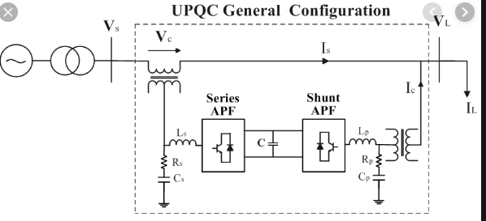
Basic circuit of Upqc
Upqc
UPQC is a multifunction power conditioner that can be used to compensate various voltage disturbances of the power supply, to correct voltage fluctuation, and to prevent the harmonic load current from entering the power system.

Slide 9
Purpose of upqc
The quality of the Electrical power is effected by many factors like harmonic contamination , due to non-linear loads, voltage and current flickering due to arc in arc furnaces, sag and swell due to the switching of the loads etc.
One of the many solutions is the use of a combined system of shunt and active series filters like unified power quality conditioner (UPQC)

Slide 10
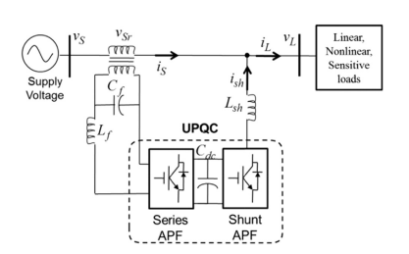
Proposed circuit diagram

Slide 11
Description of upqc
UPQC is the integration of series and shunt active power filters ,connected back-to back on the dc side, sharing a common DC capacitor The series component of the UPQC is responsible for mitigation of the supply side disturbances
The shunt component is responsible for mitigating the current quality problems caused by the consumer

Slide 12
Advantages
UPQC can compensate both voltage related problems such as voltage
harmonics, voltage sags/swells, voltage flicker as well as current
related problems like reactive power compensation, power factor
correction, current harmonics and load unbalance compensation.

