Slide 1

InsurAI Corporate Policy Automation and Intelligence System
Akshaya T

Slide 2
Table of contents
01
02
03
04
05
06
Objectives
Resources
Budget
Solutions
Communication plan
Conclusion

Slide 3
Employee Dashboard
Modules:
My Policies: View policies assigned by admin.
Claims:
Submit claim: description, amount, select policy, multiple files
View submitted claims: claim number, description, amount, policy, date/time, assigned agent
Progress Notes: Tracks claim from submission → agent assignment → updates by agent
Book Appointment:
View agent free slots
Book preferred slot
Email notification sent to agent
Agent updates appointment status within 15 mins → else marked “Missed” and emailed

Slide 4
Admin Dashboard
Modules:
Policy Management:
Create/view policies with name, code, type, premium, coverage, dates, risk, renewal options, notes
Claims Management:
View all claims
Assign agent to each claim
Approve/Reject claim
Agents Management:
View all agents and their details

Slide 5
Agent Dashboard
Modules:
Assigned Claims:
View claims assigned by admin
Access uploaded documents
Add progress notes & process the claim
Appointments:
View appointments booked by employees
Receive email notifications for new bookings
Update status within 15 mins after completing a appointment (Missed if not updated)
Free Time Schedule:
Set weekly availability (On/Off toggle for leave)
Edit/Delete slots
Only active slots visible to employees

Slide 6
Project Overview
InsurAI is an AI-powered insurance management system.
Role-based system for Employee, Agent, Admin.
Automates policies, claims, and appointments.
Reduces manual work and improves efficiency.

Slide 7
Objectives
Our aim
The goal
An aim in a corporate context is a goal or desired result that the organization seeks to achieve. The aim should be clear and achievable, and often serves as the basis for further planning actions inside the organization
Goals inside a company are usually specific and measurable, with clearly defined deadlines and outcomes. The company’s goals help focus the actions of the organization and ensure resources are used effectively

Slide 8
Resources
Human
resources
Financial resources
Physical resources
The project team is responsible for the successful execution of the project. Our team is composed of experienced professionals with the necessary skills and expertise to complete the project on time and within budget
Our project budget is $100,000. This budget includes all expenses associated with the project, including salaries and equipment. We have allocated these resources to ensure that we are able to complete the project within budget
Our project requires a number of specialized pieces of equipment. We will be using [insert equipment and their functions]. All equipment is in good working condition and has been tested and calibrated prior to use

Slide 9
Budget
Sources of funding
Personnel costs
Funding for a company can come from personal savings or investments, bank loans and other loan options, venture capital and angel investors, grants, competitions or programs, crowdfunding…
Personnel costs refer to the expenses incurred in hiring, training and retaining staff for a company. This can include salaries, bonuses, benefits and other payroll-related costs
Equipment and materials
Travel and miscellaneous
Equipment and materials costs refer to all the expenses related to the purchasing, maintenance and upkeep of any physical items used in production or other business processes inside the company
Travel and miscellaneous costs refer to expenses related to any travel-related activities, such as conferences, trainings or business trips. It may also include office supplies, communications services, licenses and other miscellaneous expenses

Slide 10
Technology Stack
Frontend
Database
Backend
HTML, CSS, JavaScript
MySQL
Java Spring Boot
Chatbo
Notifications
Security
Gemini API
Email service for appointment updates
JWT Authentication

Slide 11
$500,000
200 units
25%
Net profit of the project
Break-even point
Market share in the industry

Slide 12
Chatbot Feature
AI chatbot integrated with InsurAI system
Can answer queries related only to InsurAI database
Examples:
“What is the status of my claim?”
“List my assigned policies”
Improves accessibility and reduces manual query handling

Slide 13
Email Notification System
AI chatbot integrated with InsurAI system
Can answer queries related only to InsurAI database
Examples:
“What is the status of my claim?”
“List my assigned policies”
Improves accessibility and reduces manual query handling

Slide 14

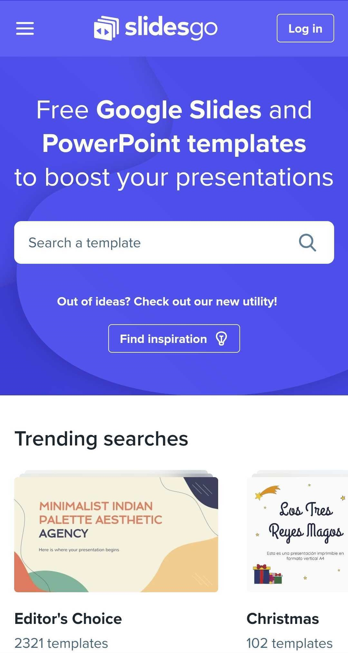
Key Features
Role-based dashboards: Employee / Agent / Admin
Policy management and claim submission
Appointment booking & scheduling
Progress tracking for claims
Email notifications for booking & missed appointments
Chatbot for InsurAI queries
Secure login with JWT authentication
File upload & document management

Slide 15
Benefits
Future Enhancements
Reduces manual workload in insurance management
Efficient claim tracking & policy assignment
Improves communication between employees & agents
Real-time updates & accountability with email notifications
Chatbot provides instant query handling
Secure, role-based, and structured system
Fully AI-powered chatbot with natural language queries
Analytics dashboard for claims, policies, and appointments
Mobile app for employees and agents
SMS notifications for appointments
Machine Learning for claim risk assessment and fraud detection

Slide 16
Conclusion
InsurAI: Complete AI-assisted insurance management system
Automates policies, claims, and appointments
Role-based dashboards enhance efficiency and transparency
Integrated chatbot and email notifications improve user experience
Scalable and secure system for modern insurance workflows

