Slide 2
Support Vector Machine
Support Vector Machine (SVM) is a powerful machine learning algorithm used for linear or nonlinear classification, regression, and even outlier detection tasks.
SVMs can be used for a variety of tasks, such as text classification, image classification, spam detection, handwriting identification, face detection, and anomaly detection.
SVMs are adaptable and efficient in a variety of applications because they can manage high-dimensional data and nonlinear relationships.

Slide 3
Linear SVM
A Linear Support Vector Machine (SVM) is a classification algorithm that finds the best straight line (or hyperplane) to separate data points of different classes when the data is linearly separable.
Non-Linear SVM
A Non-Linear Support Vector Machine (SVM) is a classification algorithm that uses kernel functions to transform the data into a higher-dimensional space, allowing it to find a non-linear decision boundary to separate data points when the data is not linearly separable.

Slide 4
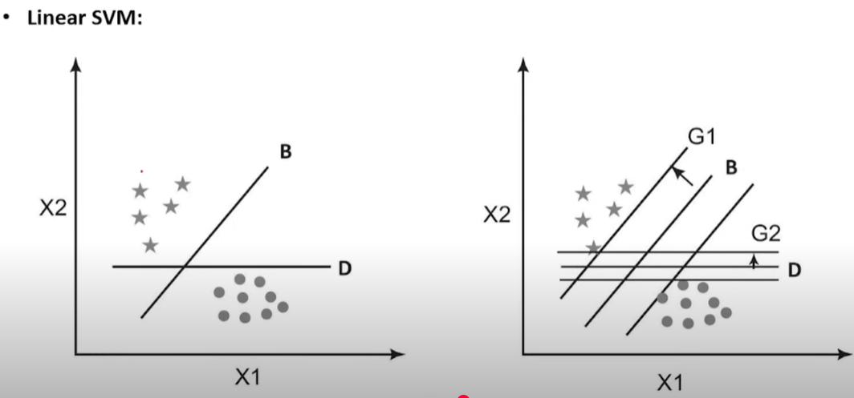

Slide 5
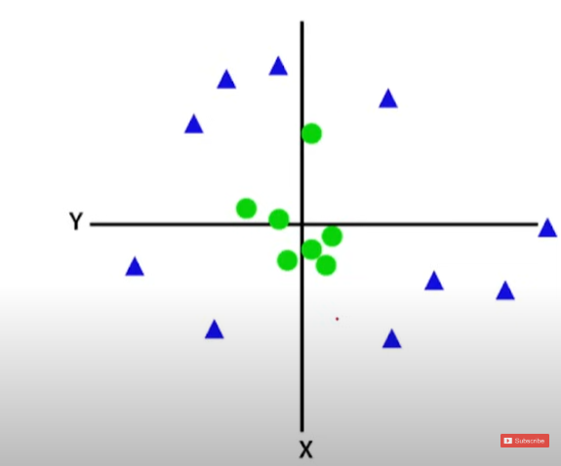
Non Linear

Slide 6
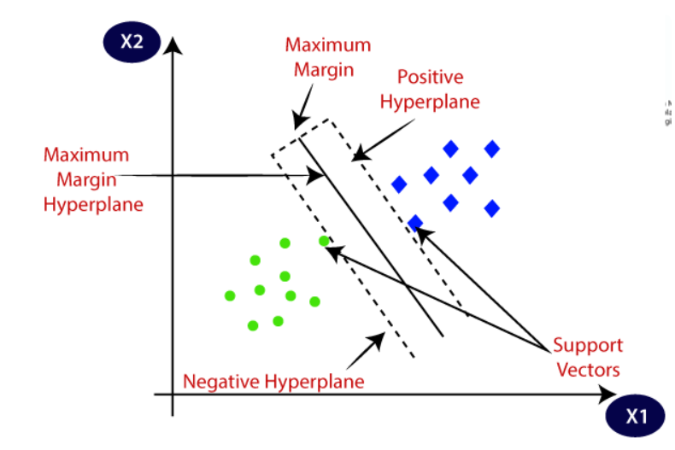
SVM

Slide 7
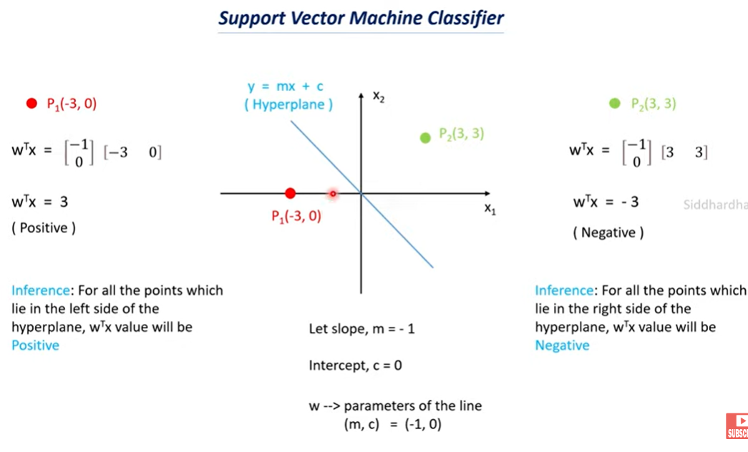

Slide 8
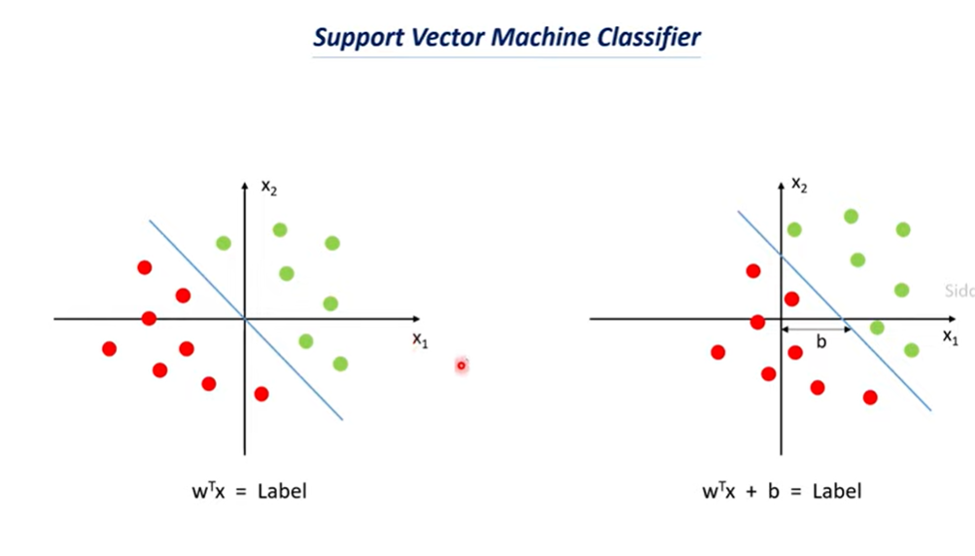

Slide 9
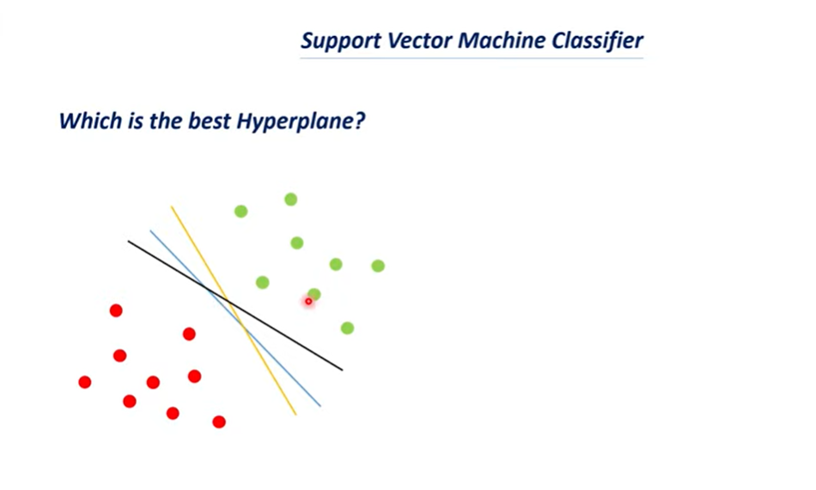

Slide 10
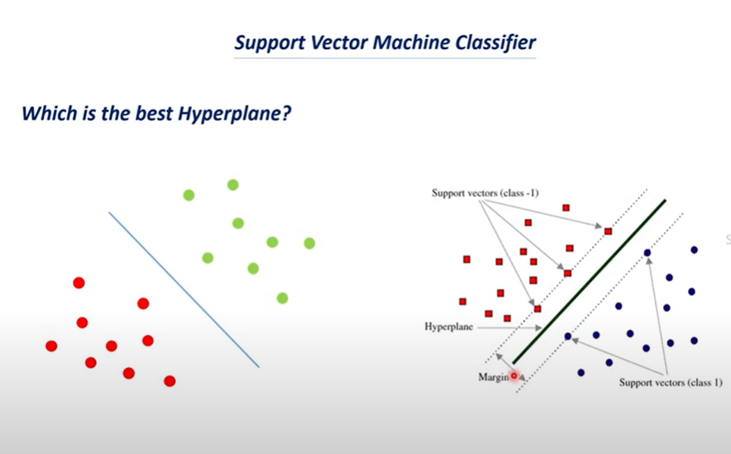

Slide 11
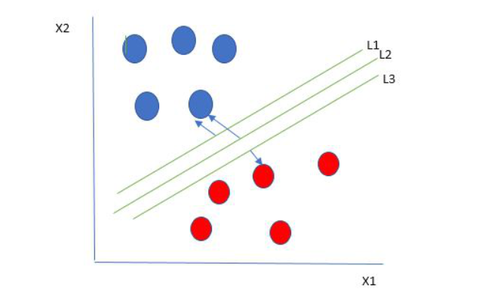
One reasonable choice as the best hyperplane is the one that represents the largest separation or margin between the two classes.
So we choose the hyperplane whose distance from it to the nearest data point on each side is maximized. If such a hyperplane exists it is known as the maximum-margin hyperplane/hard margin. So from the above figure, we choose L2.

Slide 12
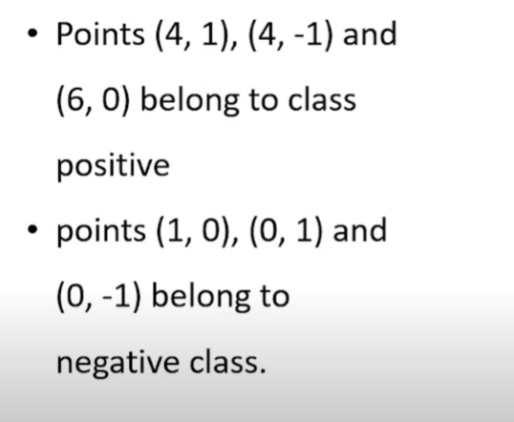
SVM -Example
Here,

Slide 13
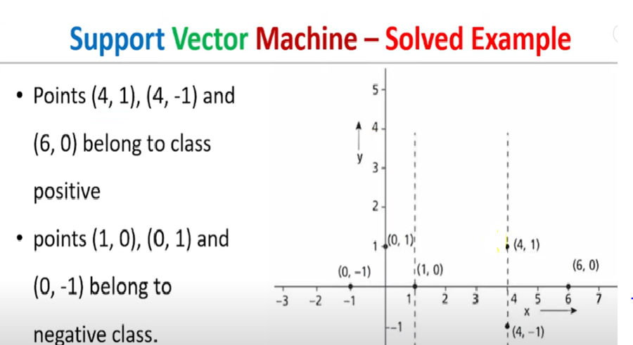

Slide 14
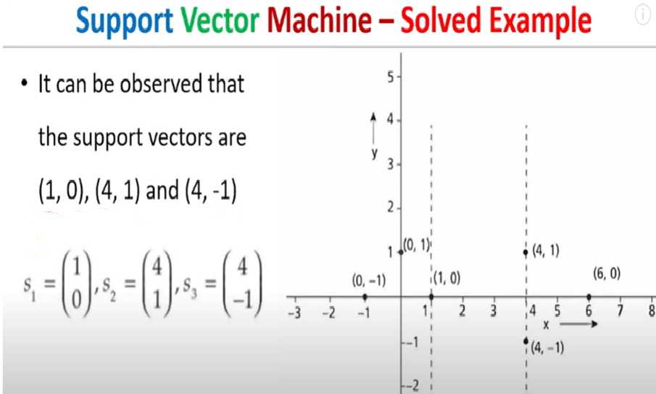

Slide 15
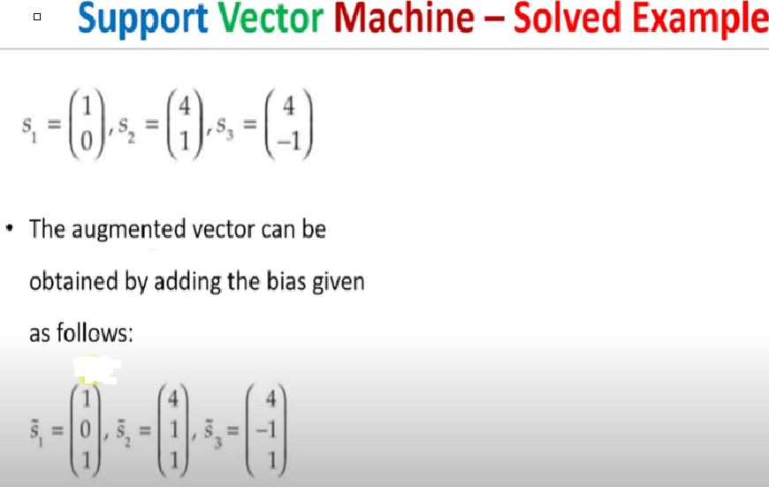

Slide 16
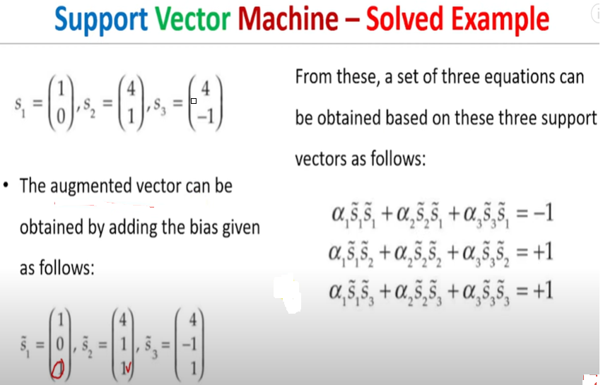

Slide 17
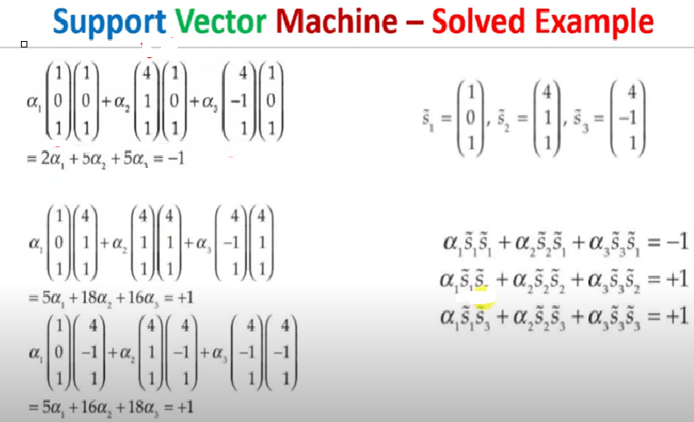

Slide 18
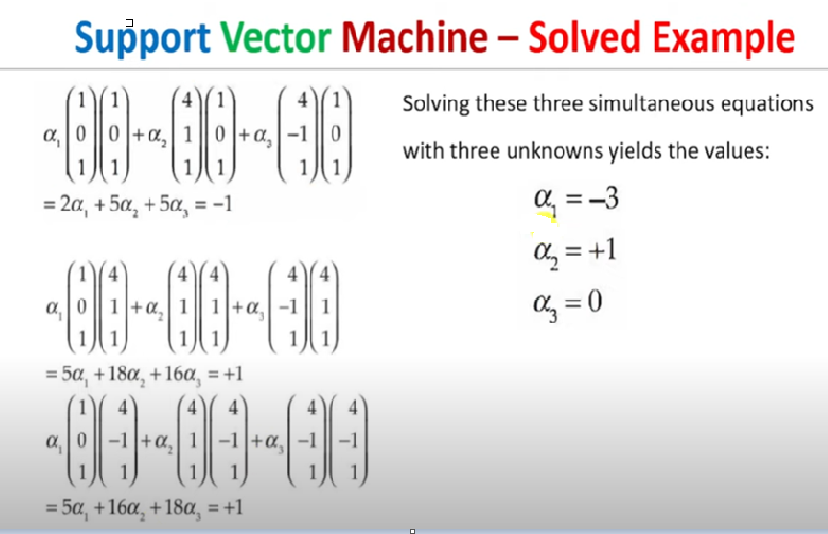

Slide 19
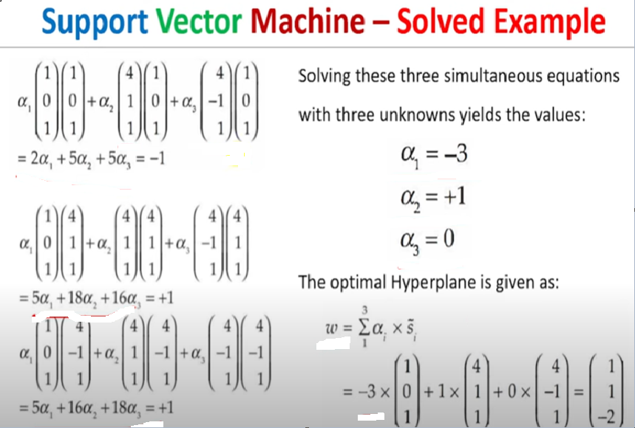

Slide 20
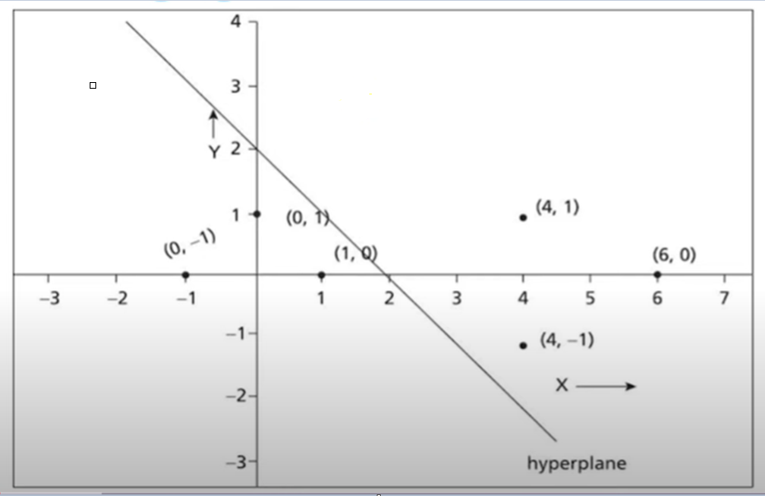
SVM -Example

