Slide 1

InsurAI Corporate Policy Automation and Intelligence System
Akshaya T

Slide 2
Table of contents
01
02
03
04
05
06
Project Overview
Technology Stack
Modules
Features & Development phases
Workflow, Benefits
Enhancements, Conclusion

Slide 3
Project Overview
InsurAI is an AI-powered insurance management system.
Role-based system for Employee, Agent, Admin.
Automates policies, claims, and appointments.
Reduces manual work and improves efficiency.

Slide 4
Technology Stack
Frontend
Database
Backend
HTML, CSS, JavaScript
MySQL
Java Spring Boot
Chatbot
Notifications
Security
Gemini API
Email services for
appointment updates
JWT Authentication

Slide 5
Employee Dashboard
Modules:
My Policies: View policies assigned by admin.
Claims:
Submit claim: description, amount, select policy, multiple files
View submitted claims: claim number, description, amount, policy, date/time, assigned agent
Progress Notes: Tracks claim from submission → agent assignment → updates by agent
Book Appointment:
View agent free slots
Book preferred slot
Email notification sent to agent
Agent updates appointment status within 15 mins → else marked “Missed” and emailed

Slide 6
Admin Dashboard
Modules:
Policy Management:
Create/view policies with name, code, type, premium, coverage, dates, risk, renewal options, notes
Claims Management:
View all claims
Assign agent to each claim
Approve/Reject claim
Agents Management:
View all agents and their details

Slide 7
Agent Dashboard
Modules:
Assigned Claims:
View claims assigned by admin
Access uploaded documents
Add progress notes & process the claim
Appointments:
View appointments booked by employees
Receive email notifications for new bookings
Update status within 15 mins after completing a appointment (Missed if not updated)
Free Time Schedule:
Set weekly availability (On/Off toggle for leave)
Edit/Delete slots
Only active slots visible to employees

Slide 8
Chatbot Feature
AI chatbot integrated with InsurAI system
Can answer queries related only to InsurAI database
Examples:
~What is the status of my claim?
~List my assigned policies”
Improves accessibility and reduces manual query handling

Slide 9
Email Notification System
Appointment Booking:
Employee books → agent receives email with details
Missed Appointment: Agent fails to update status within 15 mins after completing the appointment → email alert for missed schedule
Enhances accountability and workflow transparency.

Slide 10
Key Features
Role-based dashboards: Employee / Agent / Admin
Policy management and claim submission
Appointment booking & scheduling
Progress tracking for claims
Email notifications for booking & missed appointments
Chatbot for InsurAI queries
Secure login with JWT authentication
File upload & document management

Slide 11
Development Phases
M1 – Backend Setup: Spring Boot, Database, JWT, Entities (User, Policy, Claim, Appointment), APIs
M2 – Employee Module: Dashboard, My Policies, Submit/View Claims, Progress Notes, Book Appointment
M3 – Admin Module: Dashboard, Policy Management, Claims Management, Agents Management
M4 – Agent Module & Integration: Assigned Claims, Appointments, Free Time Schedule, Email Notifications, Frontend-Backend Integration, Chatbot assistance

Slide 12
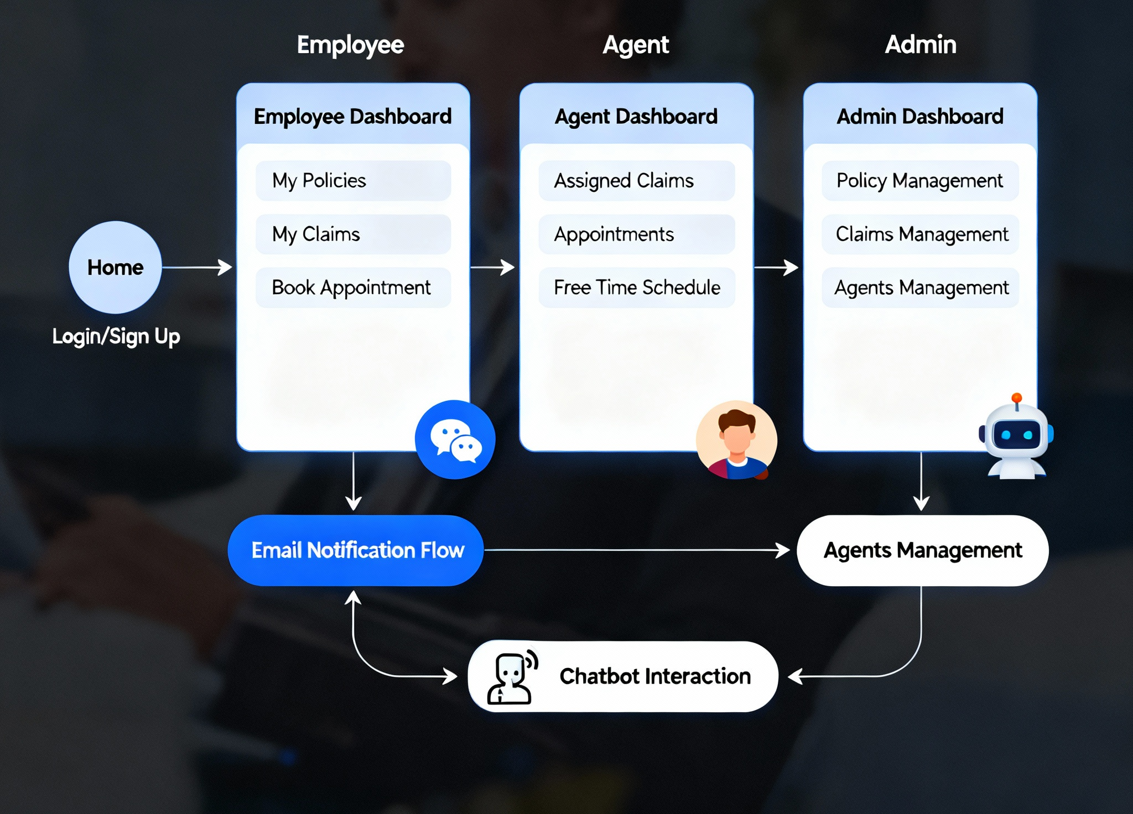
Workflow Diagram

Slide 13
Benefits
Future Enhancements
Reduces manual workload in insurance management
Efficient claim tracking & policy assignment
Improves communication between employees & agents
Real-time updates & accountability with email notifications
Chatbot provides instant query handling
Secure, role-based, and structured system
Fully AI-powered chatbot with natural language queries
Analytics dashboard for claims, policies, and appointments
Mobile app for employees and agents
SMS notifications for appointments
Machine Learning for claim risk assessment and fraud detection

Slide 14
Conclusion
InsurAI: Complete AI-assisted insurance management system
Automates policies, claims, and appointments
Role-based dashboards enhance efficiency and transparency
Integrated chatbot and email notifications improve user experience
Scalable and secure system for modern insurance workflows

Slide 15
Thank You!
Any Queries? mail at: akshayathangaraj02@gmail.com

