Slide 1
Introduction
The U.S. healthcare insurance market is complex, offering a wide range of plans with different costs and benefits. Plans are categorized into metal levels—Bronze, Silver, Gold, and Platinum—each with varying cost-sharing options. Additionally, plans are classified by type, such as HMOs (Health Maintenance Organizations) and PPOs (Preferred Provider Organizations), adding more choices for consumers.
Despite this variety, many people struggle to pick the right plan for their needs. Factors like state and county significantly influence the availability and affordability of plans, creating disparities across regions. These variations make it harder for consumers to find affordable coverage and pose challenges for policymakers and insurers aiming to provide fair access to healthcare.
This project explores how healthcare premiums and benefits vary based on plan type, metal tier, and location. By identifying trends and inequities, we aim to help consumers make informed decisions, guide insurers in improving their offerings, and alert regulators to areas needing attention.
Research Questions:
1. How do premiums vary by metal levels and plan types (PPO, HMO)?
2. Are there regional differences in plan affordability?
3. Can premiums be predicted using benefits and regional factors?

Slide 2
Literature Review
Researches by Dafny et al. (2012) and Ericson & Starc (2012), Studies by Kaushik et al. (2022) and Bhatia & Gill (2022), Sha Chen and Zhiye Lin (2022) helped us in preparing data for analysis.
Key Insights and Theories:
Non-Linear Relationships in Premiums
Research showed that premiums don’t follow a simple pattern, so advanced models like Random Forest and XGBoost were chosen.
These models are excellent for understanding complex interactions between factors like plan type, metal level, and location.
The Role of Geography
Studies highlighted that premium costs vary greatly by state due to factors like healthcare costs and competition.
This reinforced the importance of using statistical tools like ANOVA to analyze regional differences.
Better Data Preprocessing
Past studies showed that cleaning data with methods like median imputation and removing extreme values improves analysis.
These steps were used to ensure accurate and meaningful results in this project.

Slide 3
Methodology
Research Design
Aim: Analyze healthcare premium variations and predict premiums using machine learning.
Key Objectives:
Investigate premium variations by metal levels and plan types.
Examine regional disparities in plan affordability.
Predict premiums using plan and regional attributes.
Methodology: Combined EDA, statistical tests, and predictive modeling for comprehensive insights.
Data Collection
Source: Health Insurance Plans dataset (data.healthcare.gov).
Variables:
Dependent: Healthcare plan premiums.
Independent: Metal levels, plan types (HMO, PPO),
state, county, deductibles, out-of-pocket
maximums, co-payments, co-insurance.
Data Preprocessing
Median Imputation: Handled missing values for stability.
Outlier Removal: IQR method reduced distortions.
Log Transformation: Normalized premium data.
Data Analysis
Exploratory Data Analysis (EDA):
Visualized trends across plan types and metal levels using box and scatter plots.
Statistical Testing:
ANOVA: Confirmed state-level differences in premiums.
Predictive Modeling:
Random Forest: Best performance (R² = 0.899).
XGBoost: Robust (R² = 0.7602).
KNN: Secondary model, lower accuracy.

Slide 4

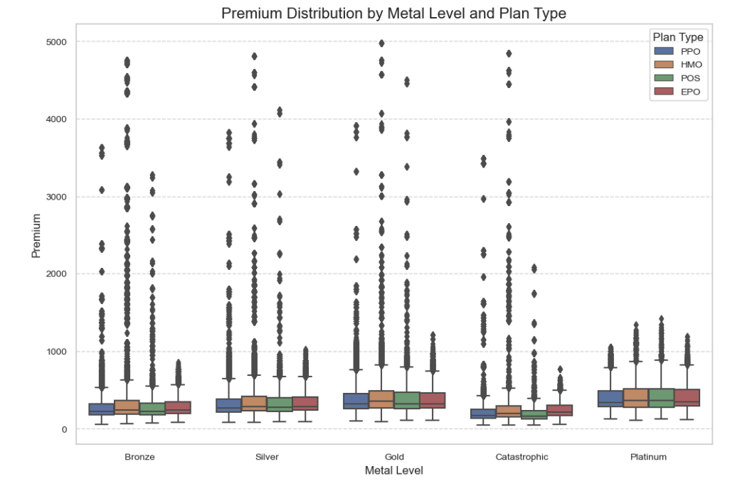
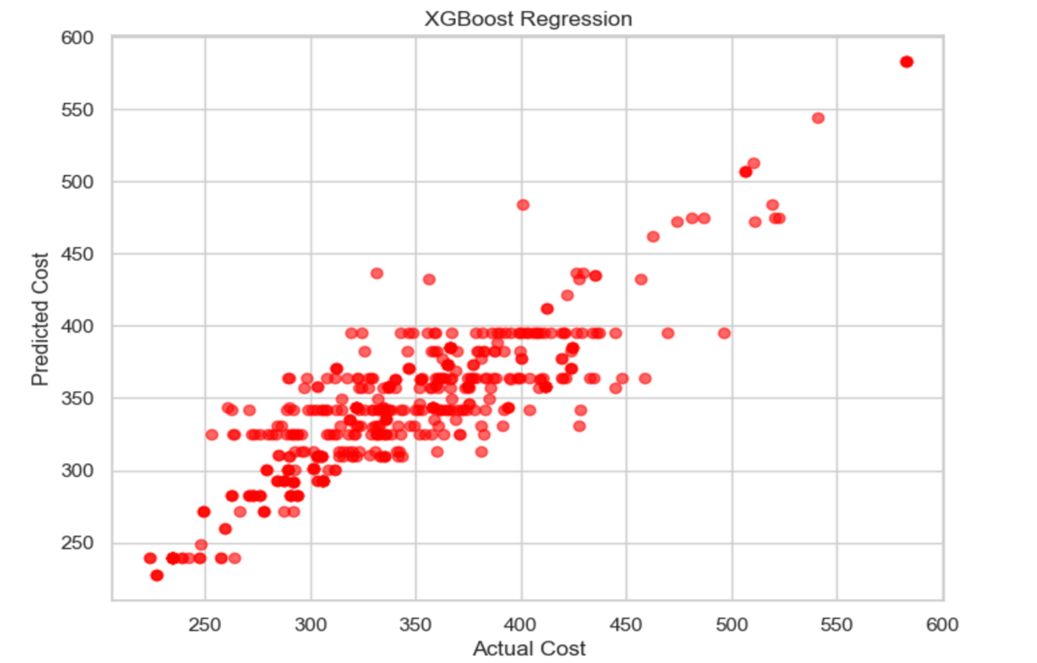
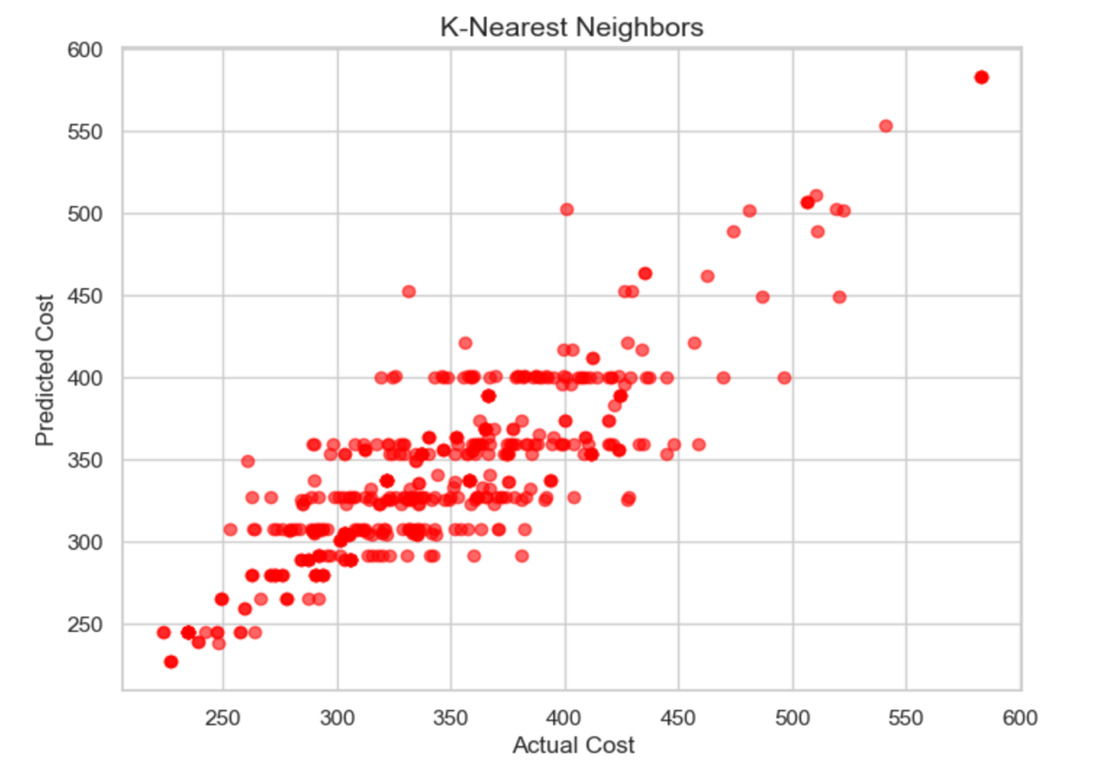
Key Findings
Premium Variations by Metal Levels and Plan Types
Metal Levels:
Premiums rise with comprehensiveness: Platinum > Gold > Silver > Bronze (most affordable).
Plan Types:
PPO plans generally have higher premiums than HMO plans across all metal levels.
Regional Disparities in Premiums
Significant differences in premiums across states:
Higher Premiums: Virginia.
Lower Premiums: Wyoming, Alaska.
ANOVA Results:
F-value: 698.35, p < 0.05 → Statistically significant regional differences.
Predictive Model Performance
Random Forest:
R²: 0.899 (90% variability explained).
Error Metrics: MAE: 0.192, RMSE: 0.511 → Highest accuracy.
XGBoost:
R²: 0.7602 (76% variability explained).
Error Metrics: MAE: 22.02, RMSE: 30.05 → Good performance.
KNN:
R²: 0.7299 (73% variability explained).
Higher MAE and RMSE → Less effective for this analysis.

Slide 5
Discussion & Conclusion
Relation to Literature
Market competition impacts premiums (Dafny et al., 2012).
Demographics and state policies explain geographic variations (Frakt, 2019).
Random Forest and XGBoost validated as effective models (Lundberg et al., 2018).
Limitations
Public dataset inaccuracies; imputation may underrepresent extremes.
State-level focus excludes county-specific nuances.
Results specific to U.S. healthcare system; not globally applicable.
This concise structure ensures a clear and impactful single slide. Let me know if further edits are needed!
Premium Variations:
Higher premiums for comprehensive plans: Platinum > Bronze.
PPO plans are costlier than HMO due to flexibility.
Regional Disparities:
Premiums vary by state: Higher in Virginia, lower in Wyoming/Alaska.
Driven by competition, healthcare costs, and state regulations.
Predictive Models:
Random Forest: Best performer, explains 90% of premium variability.
XGBoost: Strong, but slightly less accurate.
Significance of Research
For Consumers: The findings help individuals make informed decisions when selecting healthcare plans by understanding cost variations across types, levels, and regions.
For Insurers: Insights into premium drivers can guide insurers in tailoring their plans to meet market demands while remaining competitive.
For Policymakers: Identifying regional disparities highlights areas where intervention may be needed to ensure equitable access to affordable healthcare.
This research provides a data-driven framework to understand and address key issues in the U.S. healthcare insurance market, benefiting all stakeholders involved.

