Slide 1
Patients Condition Classification Using Drug Reviews
P-194 GROUP-7

Slide 2
Team members:
Mr. Chaman Kumar pandey
Mr. Akshay Keshav Balte
Mr. Aaditya Sharma

Slide 3
Business Objective:
The aim of project is to examine how patients are feeling using the drugs their positive and negative experiences so that we can recommend him a suitable drug . By analyzing the reviews, we can understand the drug effectiveness and its side effects .

Slide 4
Project Architecture / Project Flow
Data Preparation
Data Cleaning
EDA
Model Building
Model Deployment
Dataset

Slide 5
EXPLORATORY DATA ANALYSIS AND VISUALIZATION

Slide 6
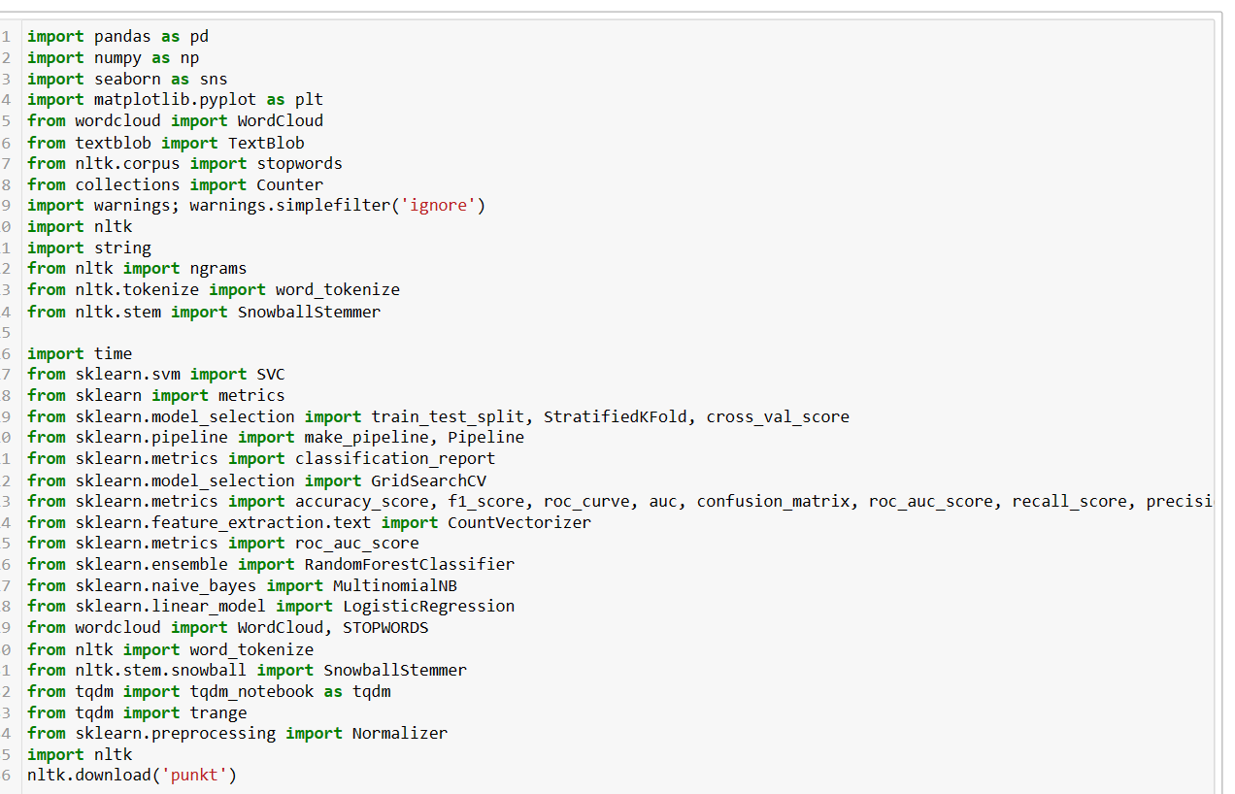
IMPORTING LIBRARIES

Slide 7
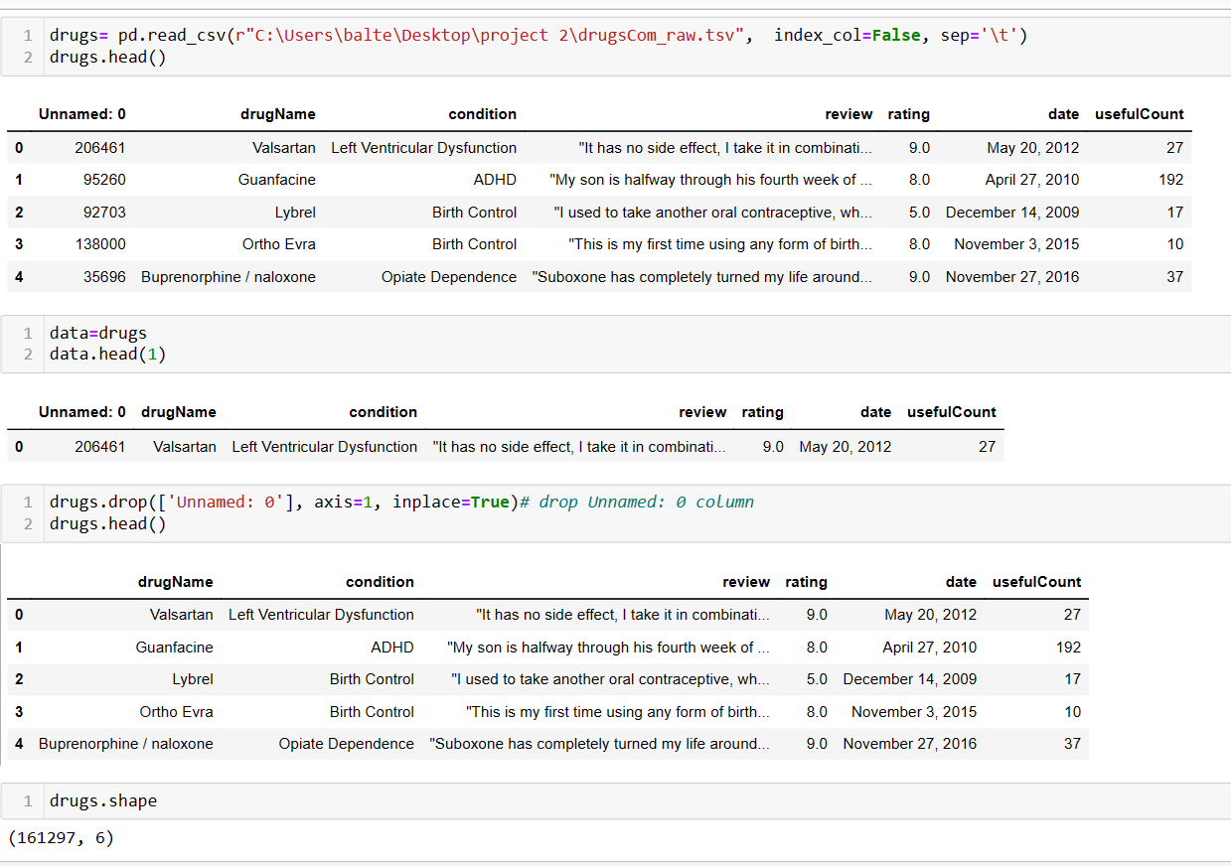
IMPORTING DATASET

Slide 8
DATASET DETAILS:
Dataset contains 161297 Entries and 6 Features.
Drug review dataset has some missing or null values and no duplicates values .
Drug review dataset contains 899 null rows at the beginning which is removed in subsequent EDA process.

Slide 9
Column Information:
DrugName (categorical): Name of drug.
Conditioin(categorical): Name of condition.
Review(text): Patient review.
Rating(numerical): 10 star patients rating.
Date(date): Date of review entry.
UsefulCount(numerical): Number of user who found review useful

Slide 10
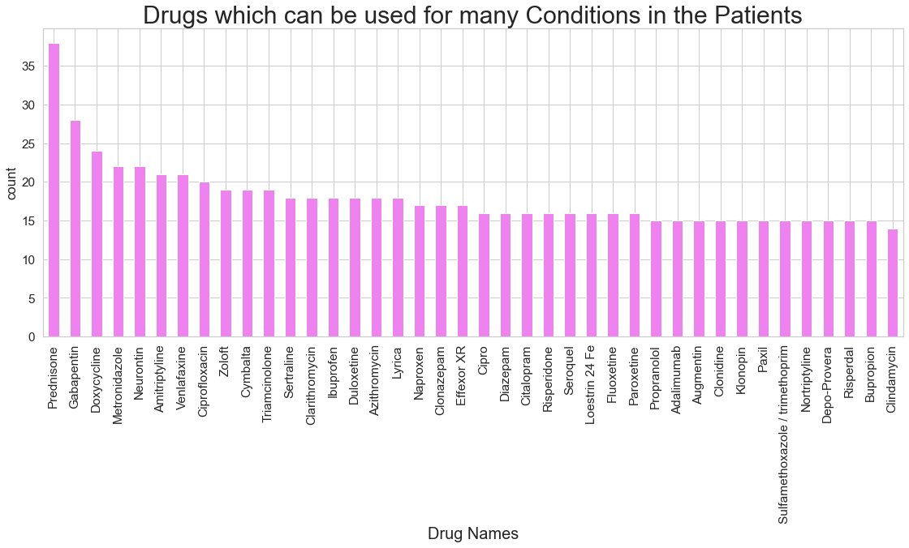
Plot for top Drug which used in many condition.

Slide 11
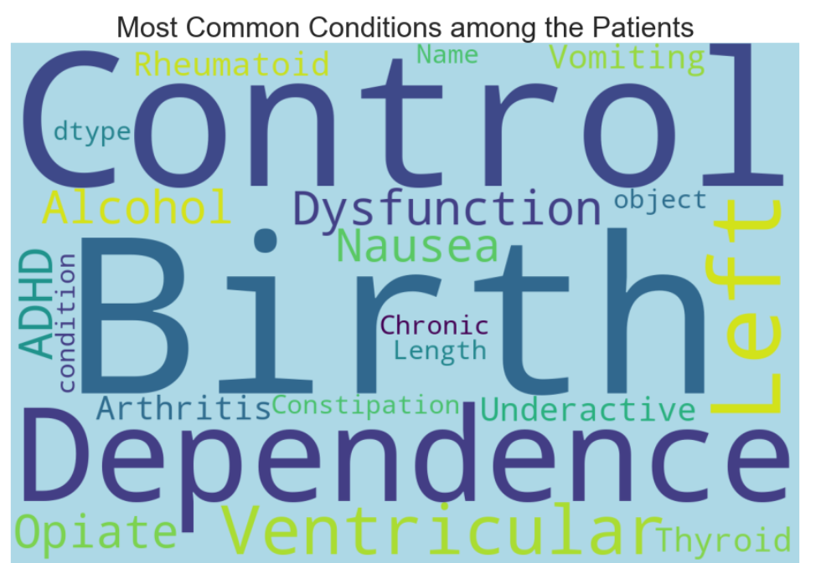
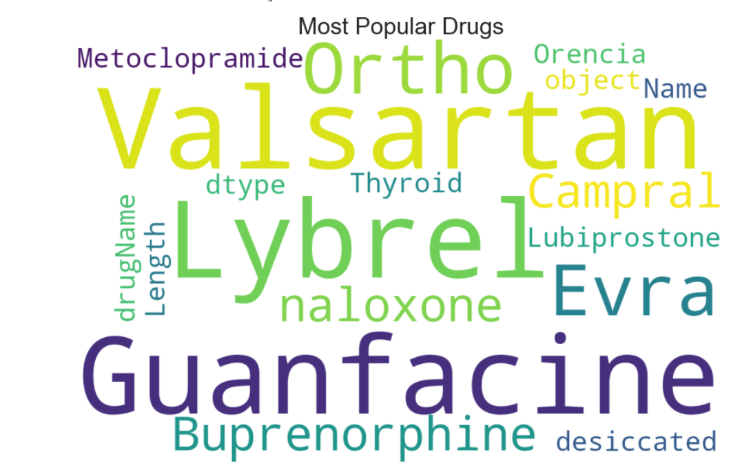
Most common condition and popular drug:

Slide 12
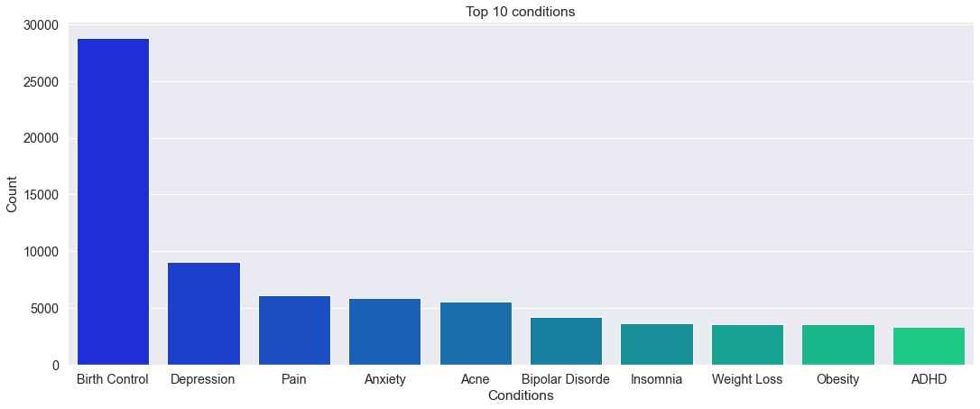
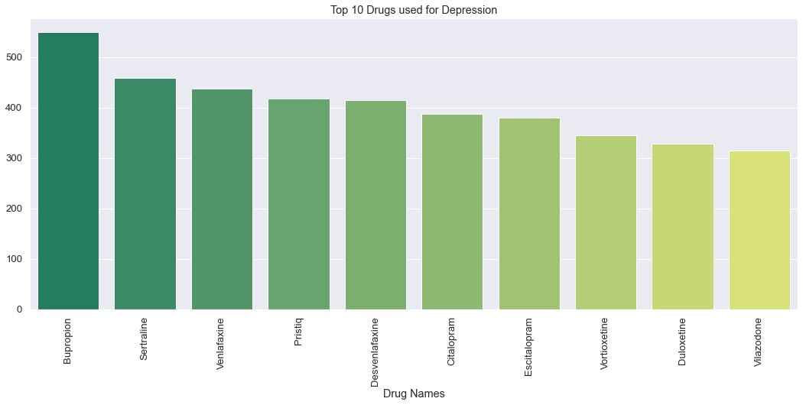
Top 10 condition and top 10 drug used in depression:

Slide 13
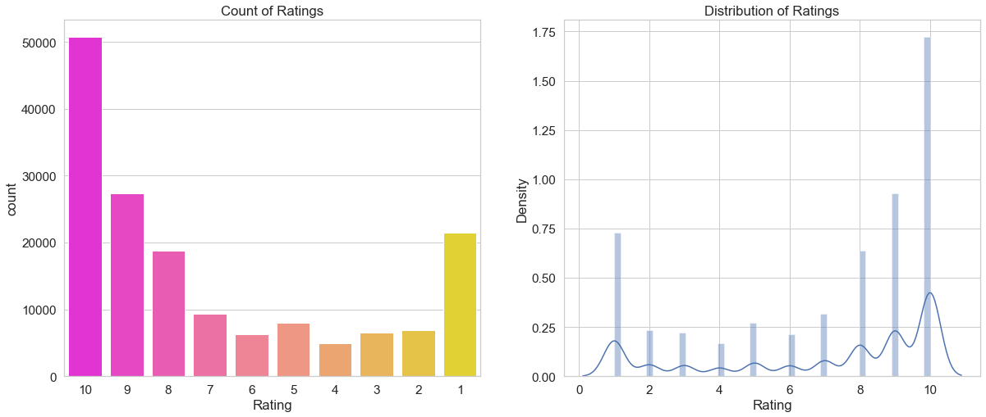
Rating:

Slide 14
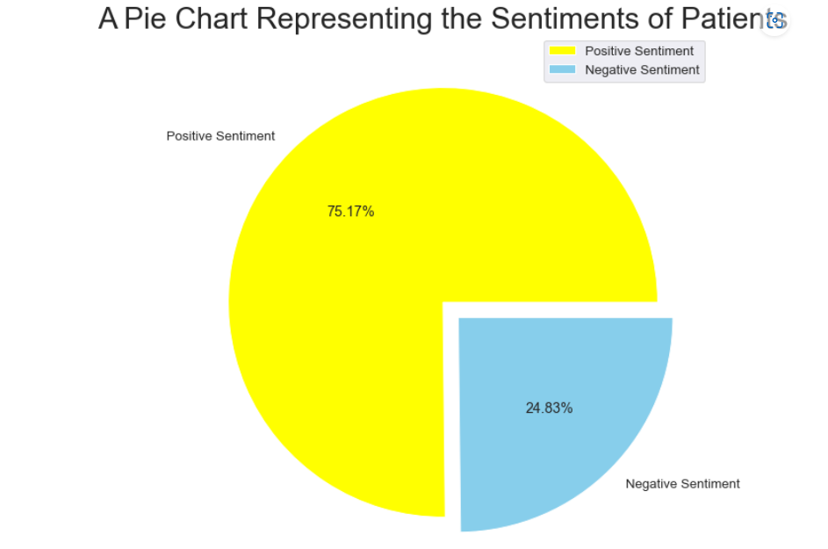
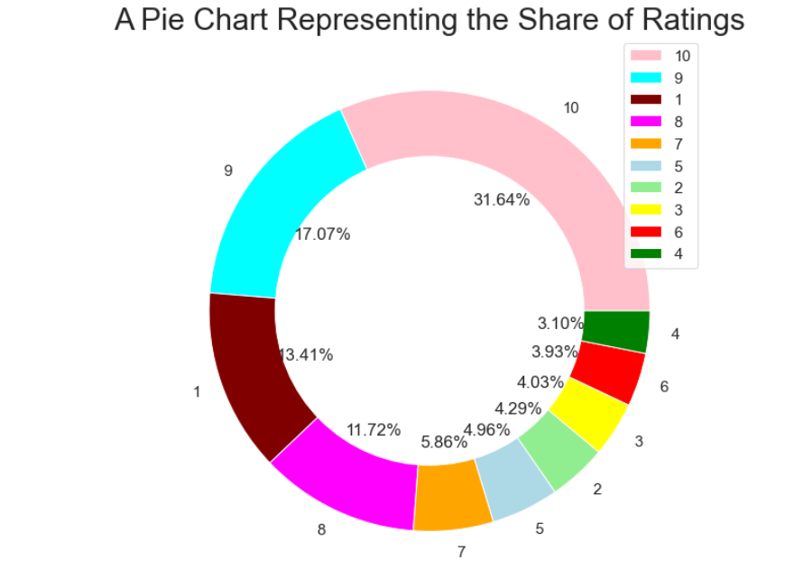
Positive and negative sentiments and rating chart:

Slide 15
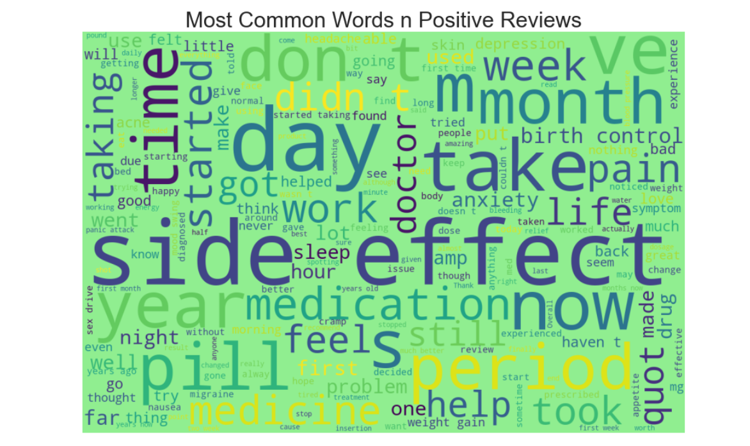
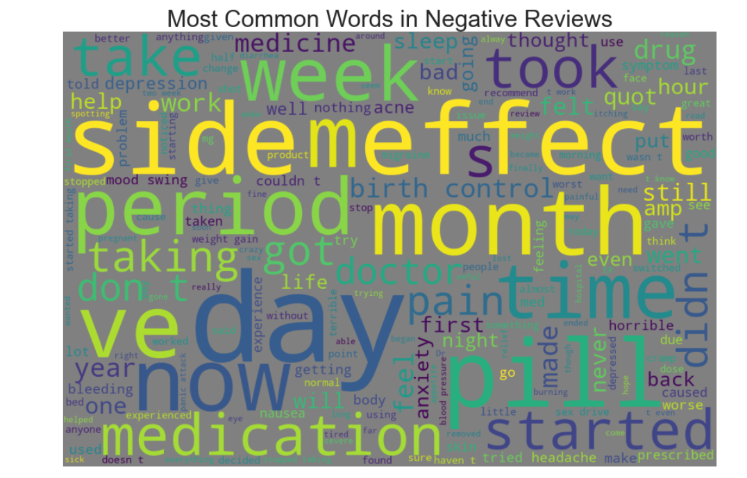
Most common words in positive and negative review :

Slide 16
MODEL BUILDING:

Slide 17
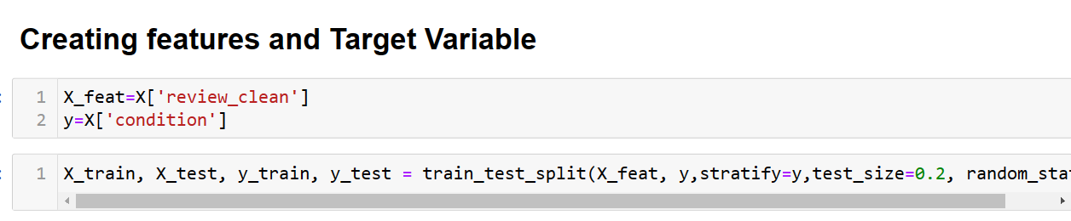
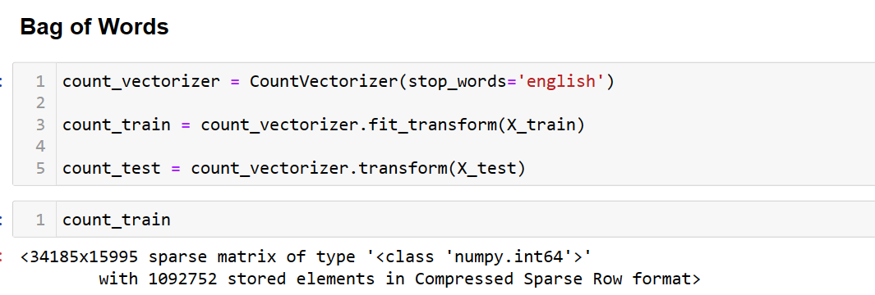
Data scaling:
We have split our data in the train and test dataset and to fine accuracy of our model :

Slide 18
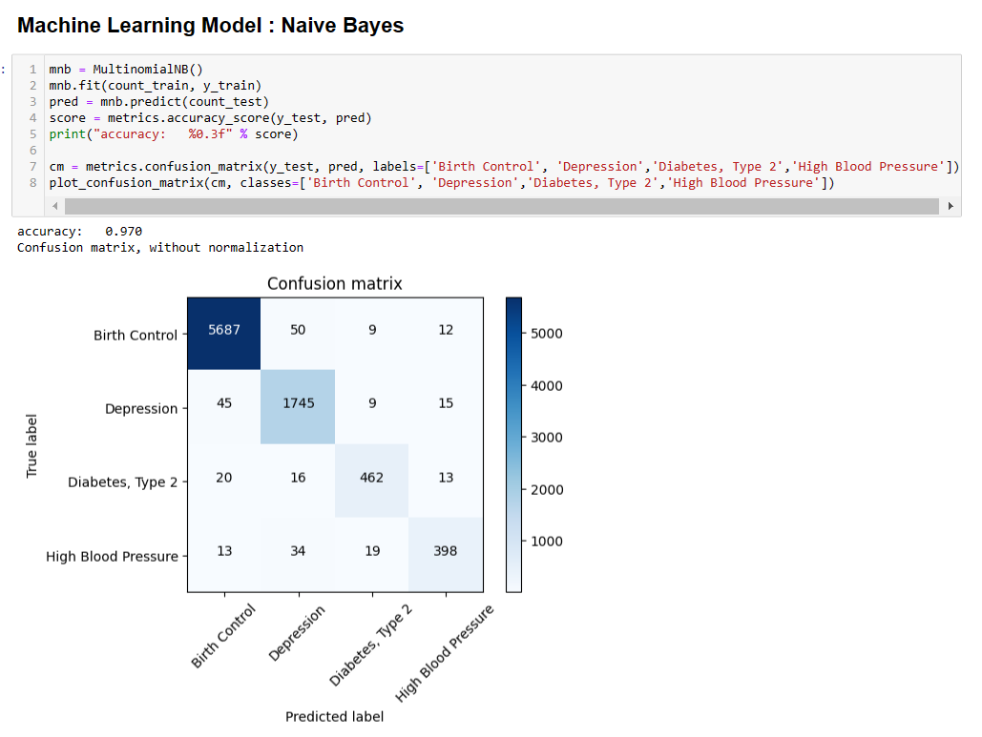
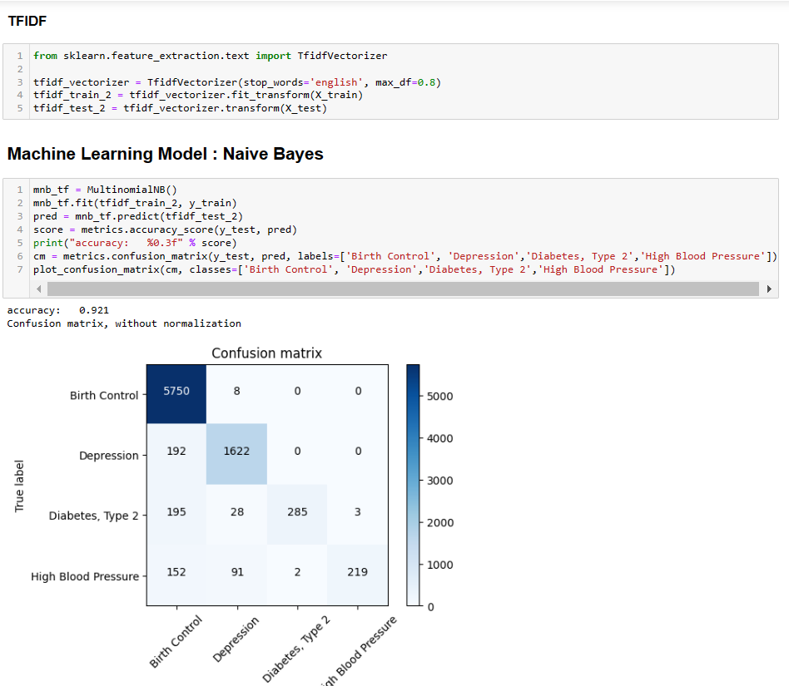
NAÏVE BAYES

Slide 19
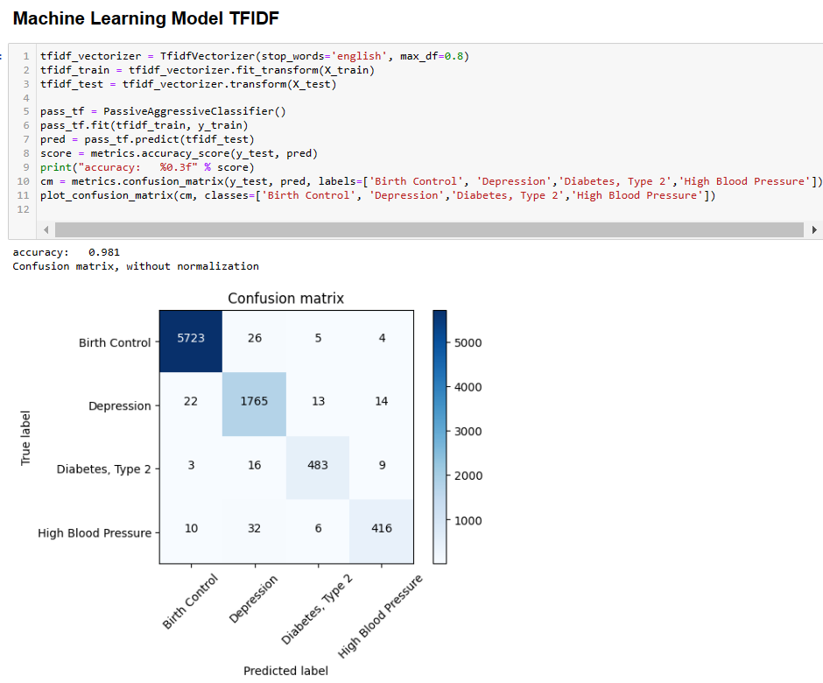

ML MODEL FOR TFIDF

Slide 20
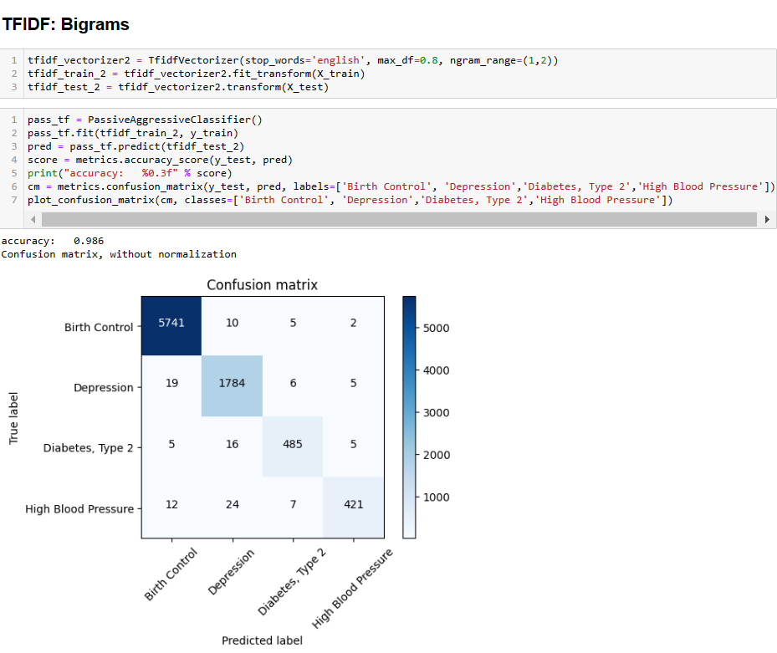
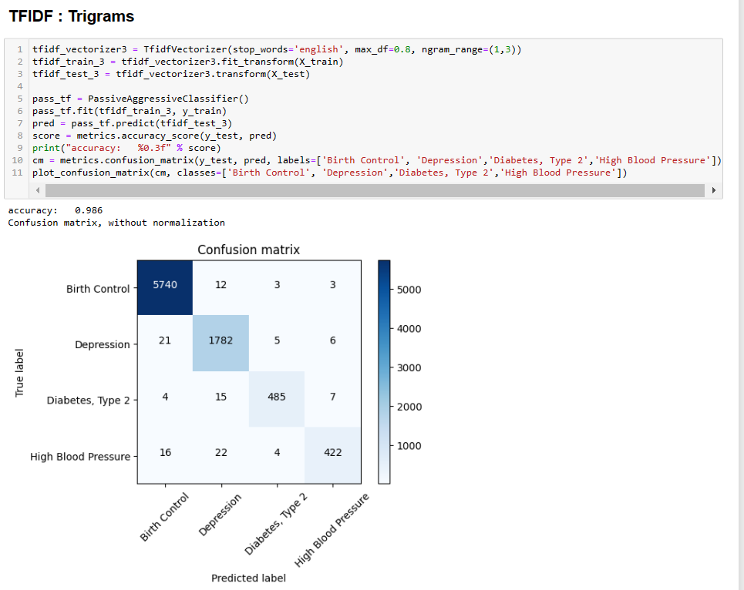
TFIDF FOR BIGRAMS AND TRIGREMS

Slide 21
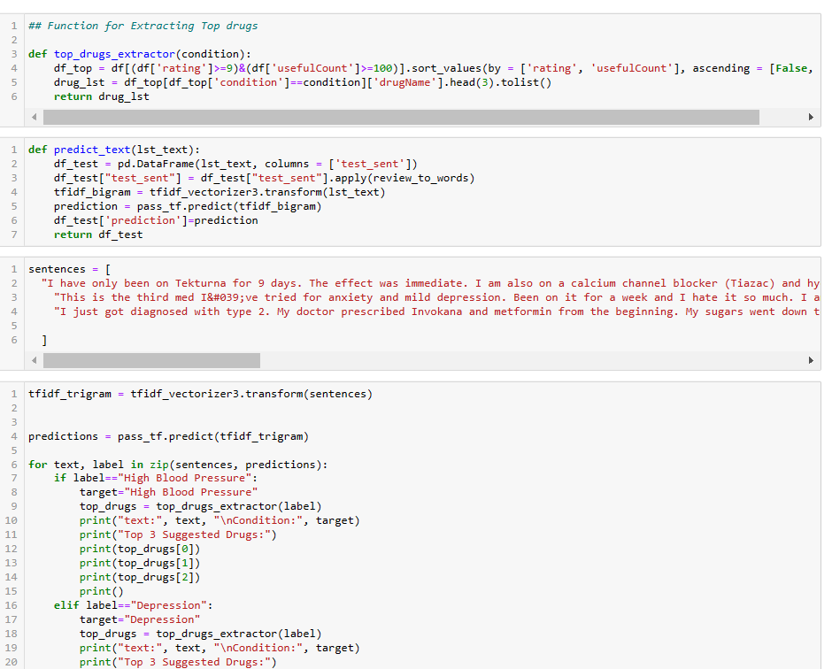
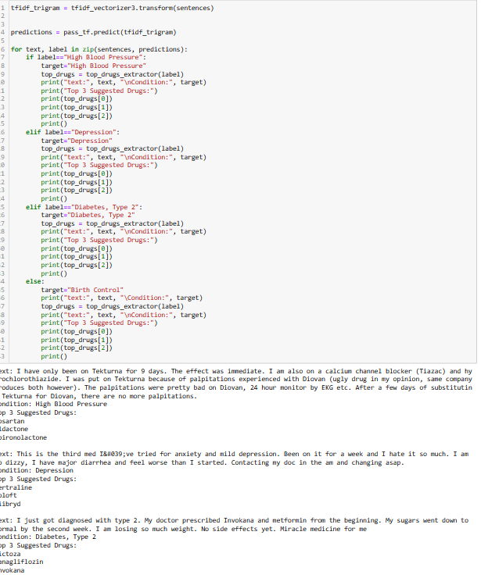
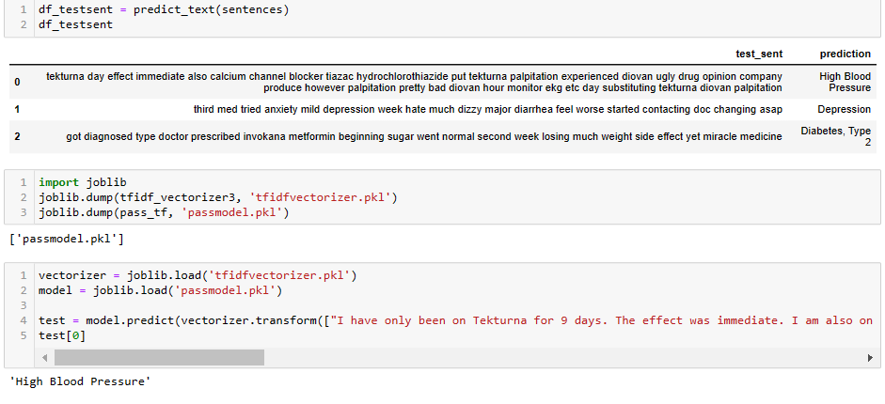
FOR DEPLOYNMENT

Slide 22
MODEL DEPLOYMENT

Slide 23
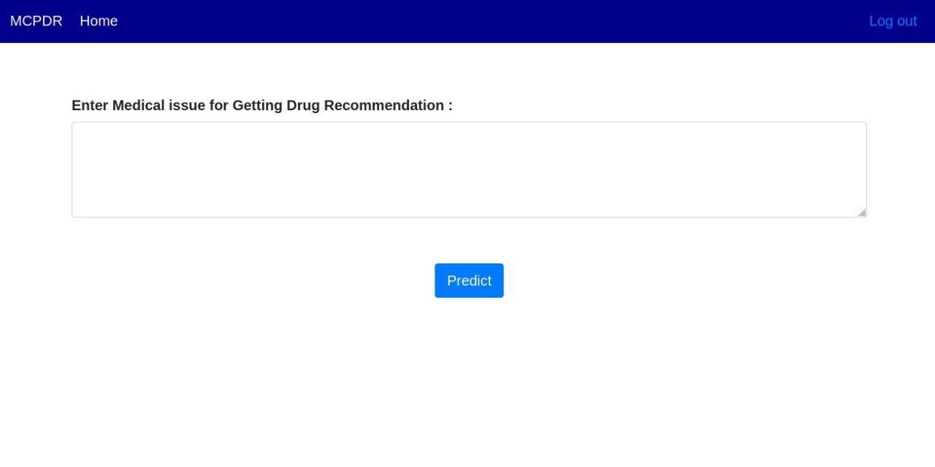
ENTER REVIEW

Slide 24
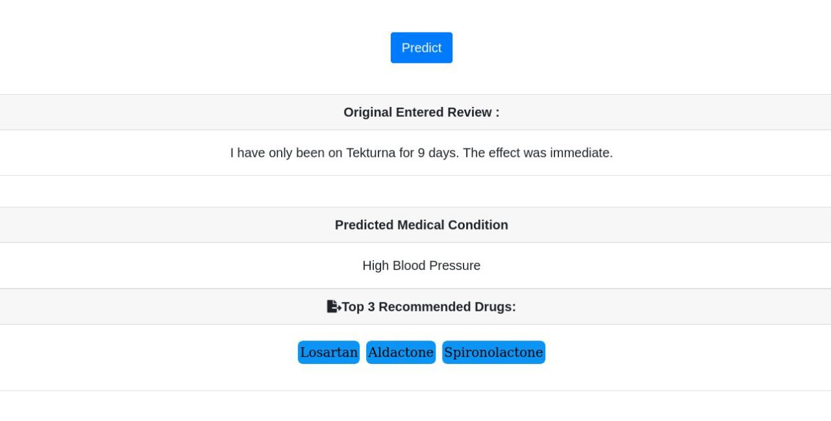
When you enter review it predicted medical condtion and also recommend top dugs

Slide 25
THANK YOU

