Slide 1
LARGE-SCALE POWER PLANT-WIDE PROCESSES WITH BIG DATA
BY-
Ashwat Sai
Jahid Azad

Slide 2
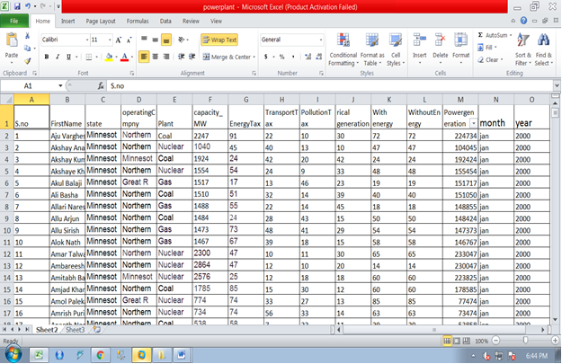
Dataset Of Power plant

Slide 3
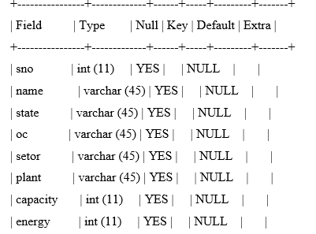
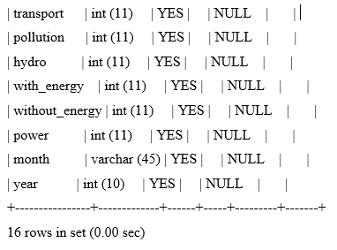
Description of power plant Query: mysql> desc plant;

Slide 4
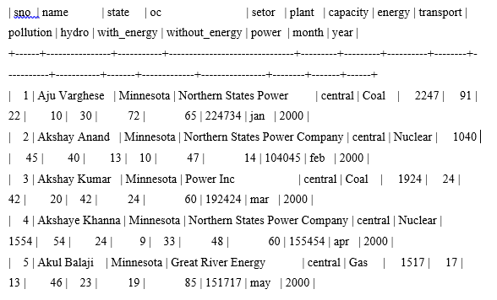
Example Query
Query:
mysql> select * from plant limit 3;

Slide 5
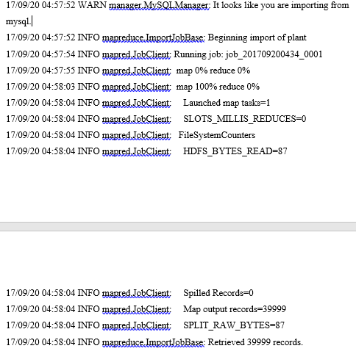
Mysql Database To Hadoop[HDFS]:Using Sqoop Tool
Query:
sqoop import --connect jdbc:mysql://localhost/movielens --username training --password training --table plant --m 1 --target-dir power

Slide 6
Output
1,Aju Varghese , Minnesota,Northern States Power,central,Coal,2247,91,22,10,30,72,65,224734,jan,2000
2,Akshay Anand , Minnesota,Northern States Power Company,central,Nuclear,1040,45,40,13,10,47,14,104045,feb,2000

Slide 7
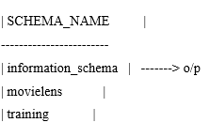
Working With Eval and Query[show dtabases]
Query: “show databases”

Slide 8
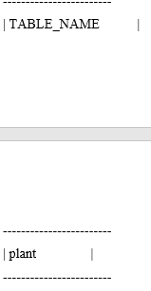
Working With Eval and Query[show tables]
Query: “show tables”

Slide 9
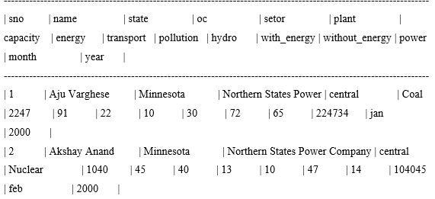
Working With Eval and Query[see the table(plant)]
Output
Query:
"select * from plant limit 2“

Slide 10
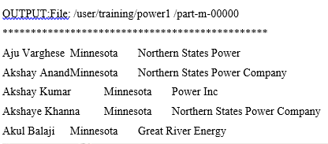
To Retrieve the Particular columns with conditions apply
Query:
columns "name,state,oc“

Slide 11
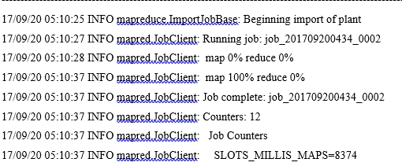
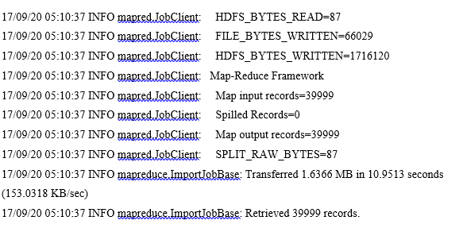
Logs:

Slide 12
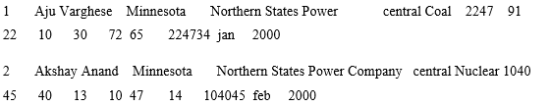
HOW TO ANALIZE DATA THROUGH HIVE QUERIES
1)How to see the total data?
Query:
hive> select * from power limit 2;
Output:

Slide 13
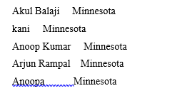
2)How to see particular columns in power table?
Query:
hive>select name , state from power where oc='Great River Energy' ;
Output:

Slide 14
3)To see columns names by using this configuration
Query: hive> set hive.cli.print.header=true;
4)How to apply conditions and see the result?
Query: hive> select * from power where sector='central' limit 5 ;

Slide 15
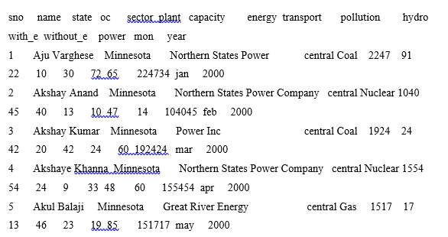
Output:

Slide 16
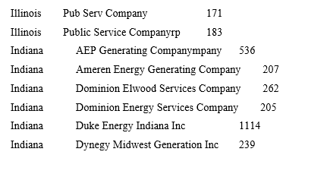
5) How to apply conditions on the power data?
Query: hive> select state,oc,count(*) from power group by state,oc;
Output:

Slide 17
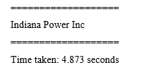
6) How to find max capacity powerplant from the particular state ?
Query: hive> insert overwrite table pow1 select state,oc,sum(capacity) from power where state='Indiana' group by state,oc;
Output:

Slide 18
PARTITIONS IN HIVE
1) Adding xml configurations for partitions table
Query:
hive> set hive.exec.dynamic.partition.mode=nonstrict;
hive> set hive.exec.dynamic.partition=true;
2) loading the data from original table(power) to new table(power part)
hive> insert overwrite table power_part
partition (pow ='Minnesota')
select * from power where state='Minnesota';

Slide 19
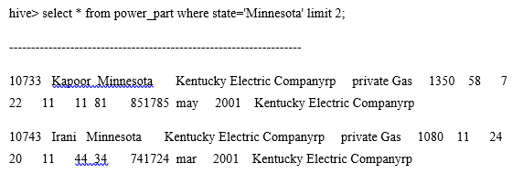
Output:

Slide 20
BUCKETING IN HIVE
loading the data from original table(power) to new table(tran_buk)
Query:
hive> insert overwrite table tran_buk select * from power;

Slide 21
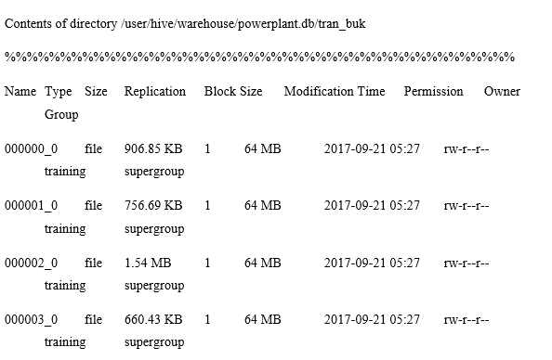
Output:

Slide 22
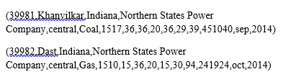
LOAD DATASET FROM HDFS INTO THE PIG
DATA SET PUT INTO HDFS
Query: grunt> p1 = LOAD
VERIFY THE DATA LOADED OR NOT
Query: grunt> DUMP p1;
Output:

Slide 23
HOW TO ANALIZE THROUGH JAVACODE[MAPREDUCE JOBS]
How To Run Java Program Through Terminal
Query: hadoop jar plant.jar Pow_Dri poooo1 mro1

Slide 24
GROUP BY [power]
Query:
grunt> group_p1 = GROUP p1 by oc;
grunt> describe group_p1;
FILTER BY[power]
Query:
grunt> filter_p1= FILTER p1 BY state == 'Minnesota';
grunt> describe filter_p1;

Slide 25
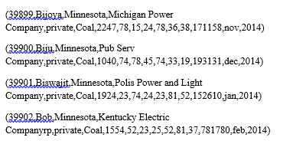
Output

Slide 26
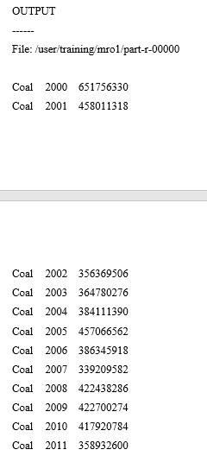
Output:

Slide 27
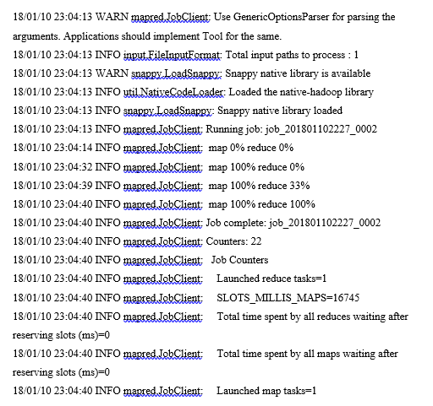
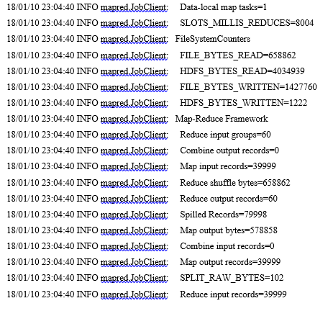
Logs:

