Slide 1
Rout Map Of Chd
By:
Ravinder Singh

Slide 2
. INTRODUCTION TO ASSIGNED PROJECT
1.1 Route Mapping
Route Mapping is a project based on JAVA technology. As the name says the project is to map the route
or path. For the illustration we took the Chandigarh city.A whole map for the city is drawn including all
the sectors along with individual blocks in the sectors. The database used for storing all the paths is MS
Access. There are two forms used, one is login form and another one is jmap form. Login form is a user
Authentication form which is used to check the unauthorized use of the system. The another form is jmap
form which includes the whole city map. All the sectors are there with their respective blocks and paths
which connect them to each other. This form provides a graphical interface to the user to select the sector
for which the path is required. User just has to click the sector on the screen and the required path will be
highlighted. No other information is needed. The calculated path got stored in the database.

Slide 3
The other
techniques used are Swing JDBC, Event Handling, JAVA applets and AWT etc. This software reduces the
using MS Access.
user overheads to a great extent and provides a very interactive interface. There are different modules used
such as to draw the sectors, to draw the image, calculate the path and then store the path in the database.
These modules help to provide user with the whole city map in a graphical manner from which user can
select the required sectors for which the path has to be find. Then the software provides the user with the
required path by highlighting the specific area in the city map. All the paths are stored in the database

Slide 4
WHY JAVA PROGRAMMING LANGUAGE?
The Java programming language is a high-level language that can be characterized by all of the following buzzwords:
Simple
Object oriented
Robust
Secure
Architecture neutral
Portable
High performance
Multithreaded
Dynamic
With most programming languages, you either compile or interpret a program so that you can run it on your computer. The Java programming language is unusual in that a program is both compiled and interpreted. With the compiler, first you translate a program into an intermediate language called Java bytecodes —the platform-independent codes interpreted by the interpreter on the Java platform. The interpreter parses and runs each Java bytecode instruction on the computer. Compilation happens just once; interpretation occurs each time the program is executed. The following figure illustrates how this works.
You can think of Java bytecodes as the machine code instructions for the Java Virtual Machine (Java VM). Every Java interpreter, whether it's a development tool or a Web browser that can run applets, is an implementation of the Java VM.
Java bytecodes help make "write once, run anywhere" possible. You can compile your program into bytecodes on any platform that has a Java compiler. The bytecodes can then be run on any implementation of the Java VM. That means that as long as a computer has a Java VM, the same program written in the Java programming language can run on Windows 2000, a Solaris workstation, or on an iMac.

Slide 5
HARDWARE REQUIREMENTS
Pentium 4
256 MB RAM
Minimum of 8 MB memory

Slide 6
SOFTWARE REQUIREMENTS
Windows XP –SP2
JDK-1.5
Microsoft Access

Slide 7
Data Flow Diagram

Slide 8
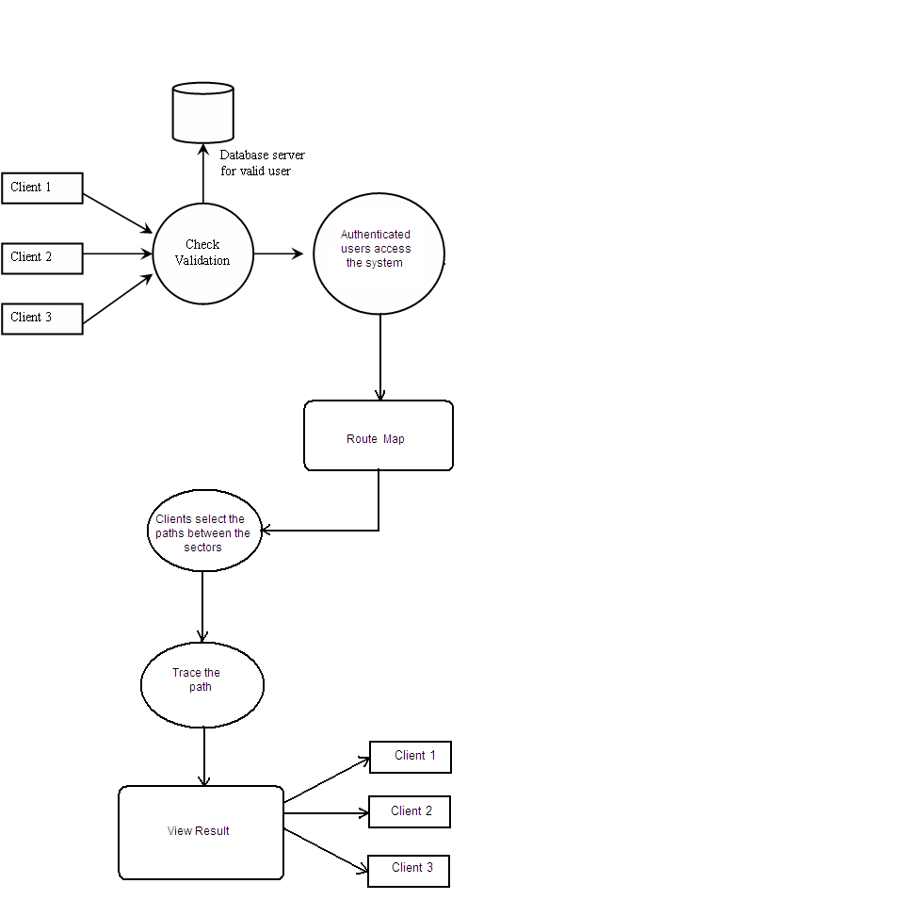

Slide 9
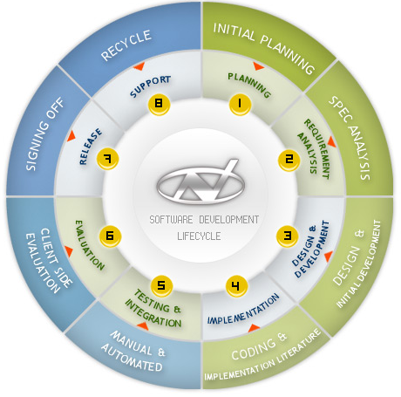
S D L C

Slide 10
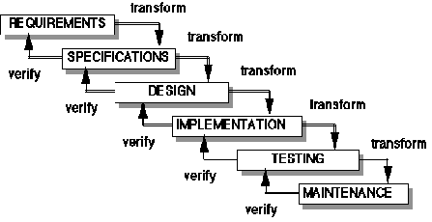
WATERFALL MODEL

Slide 11
SNAPSHOTS

Slide 12
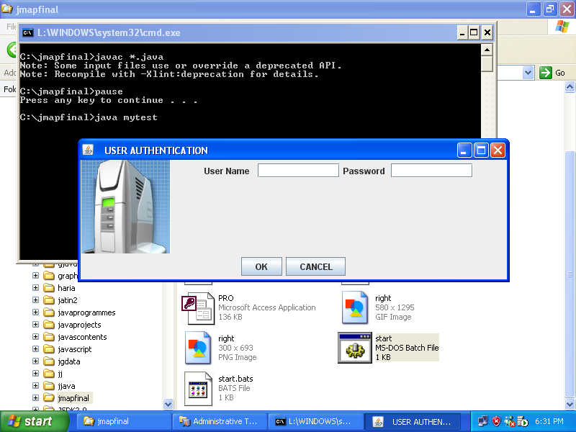

Slide 13
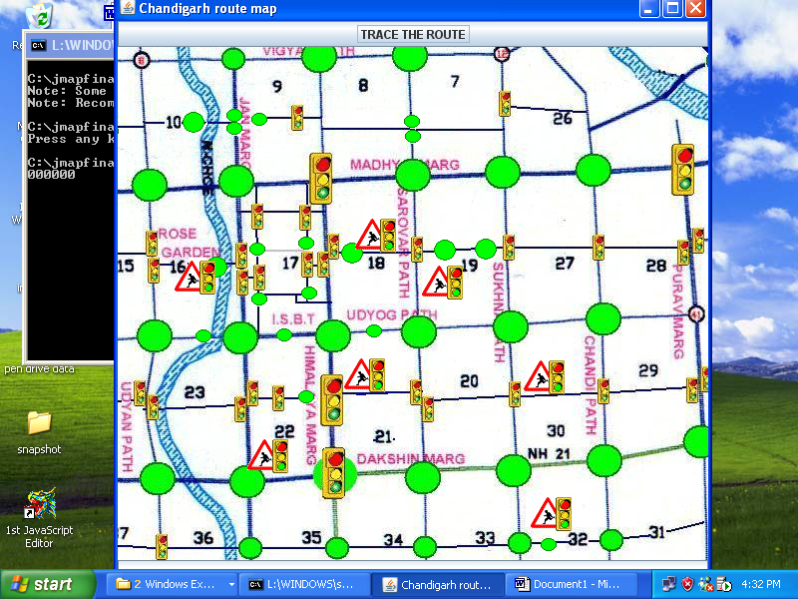

Slide 14
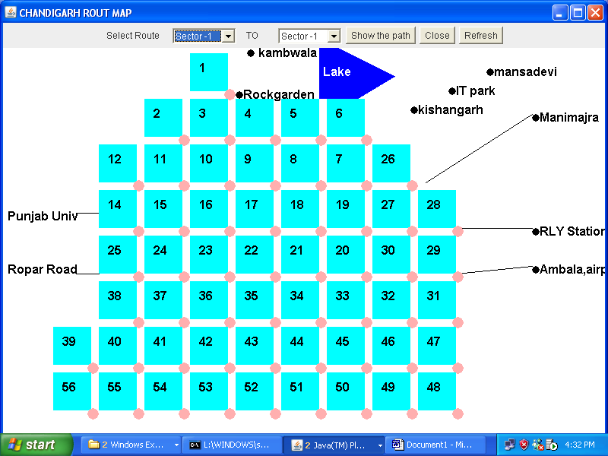

Slide 15
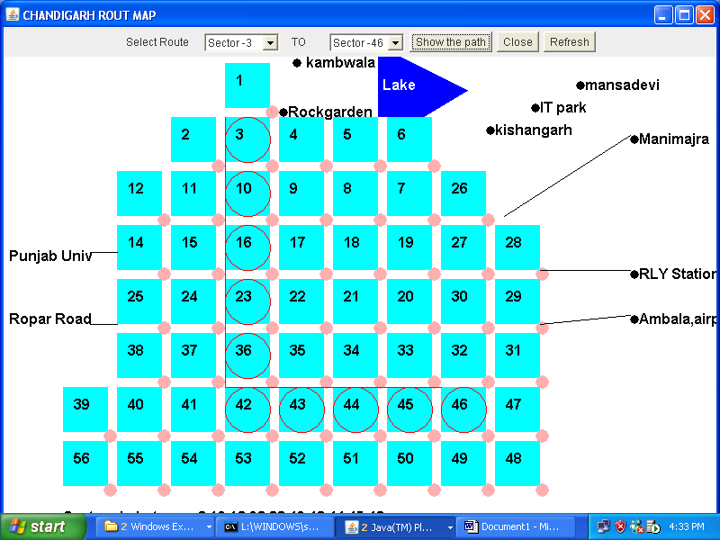

Slide 16


