Slide 1
wordle
Mini-Project on:
Department of Information Science and Engineering
Subject : Python Programming
(18ISE451)
Group : 11
Submitted to
Dr. Mohan S.G
Professor, HOD
Dept of ISE
NMIT
Presented by:
Akshay Prashant Hegde(1NT20IS015)
Byalalli Jagadish(1NT20IS037)
Smriti Suresh (1NT20IS164)
Vilok Bhat(1NT20IS187)

Slide 2
Table of Content
Introduction
Objective
Problem Statement
Flowchart
Algorithm
Method of Working
Code snippets
Results and snapshots
Conclusion

Slide 3
Introduction:
The wordle is a web-based word game created and developed by Welsh engineer Josh Wardle. Wardle making it public in October 2021. The game gained large popularity in December 2021. This was later owned and published by The New York Times Company since February 2022, and later the game was created in various languages other than English.
A player has six attempts to guess a five-letter word, with feedback given for each guess in the form of colored tiles indicating when the letters match or occupy the correct position.
A green tile means you have predicted the correct placement of the word.
A yellow tile means the letter is present in the word, but your prediction had the wrong position.
And lastly a white tile means the letter is not present in the word.
Everyday the game has a single daily solution, with all players attempting to guess the same word, and the player can play the game only once in a day. But in our game player can play the game number of times without limit.

Slide 4
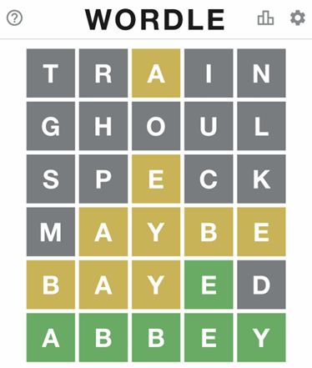
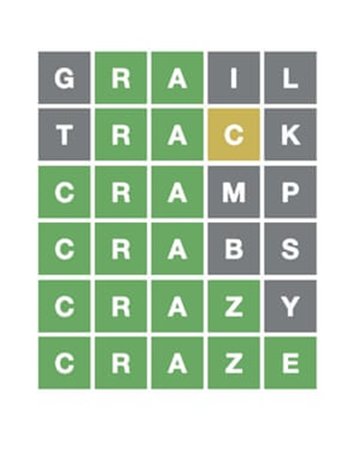
This is the quick view of the wordle game:
Fig 1
Fig 2

Slide 5
Objective
Build a Python program that plays Wordle. It should make guesses of 5 letter word and try and figure out the ultimate answer word in 6 guess as possible.
There will be 6 tries to guess the word correctly.
If the guess word at the exact position of a letter in the word, it will turn GREEN.
If the guess word’s letter that exists, but it is in the wrong position it turns YELLOW
If the letter does not exist, it will stay WHITE only or that letter does not change to any other color.
If the word is guessed within the 6 attempt, player won the game else it will display the correct word at the end.

Slide 6
PROBLEM STATEMENT
The game requires a list of words out of which the interpreter should choose a word at random. The user first must input their first guess. If the random word contains that guessed letters in the correct position it will be shown in green color as the output.
The user will be given a total of 6 tries to try and guess the random 5 letter word within the given set of tries

Slide 7
Flowchart:
start
Come up with new secretword
Ask player to guess
Letter in word
Letter not in word
if guessed word is correct
Player guessed & won
Player ran out of attempt and lose
Ask player to play again
end

Slide 8
Algorithm
STEP 1: Start
STEP 2: Come up with the new secret word
STEP 3: Ask the player to guess the word
STEP 4: If player guesses the word go to step 9
STEP 5: If the word is not correct
STEP 6: He gets another chance
STEP 7: If the player does not guess the word in 6 chances
STEP 8: he loses and go to step 10
STEP 9: player wins and go to step 11
STEP 10: ask the player to play again
STEP 11: If player wants to play again go to step 2
STEP 12: End

Slide 9
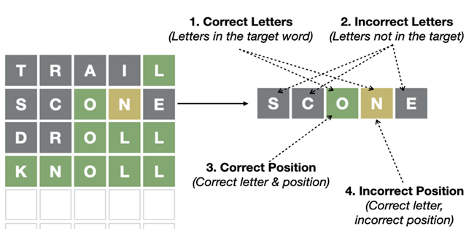
METHOD OF WORKING:
In this example the word player guessed which are at correct position are showing in Green color.
And letters which are there in original word but not in exact position are showing in Yellow color. Other incorrect letters are showing in grey color.
In our game also we implemented in such away that, the player have to guess the random word in 6 attempts. If players fails guess the word in 6 attempt, he lost the game, and that random word will be displayed.
If the guess word at the exact position of a letter in the word, it will turn GREEN.
If the guess word’s letter that exists, but it is in the wrong position it turns YELLOW
If the letter does not exist, it will stay WHITE only
If players wants to play again, he/she can play it.

Slide 10
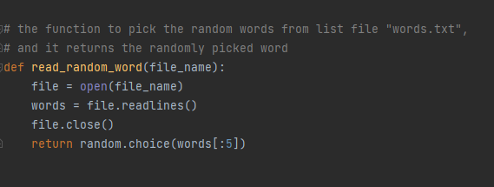
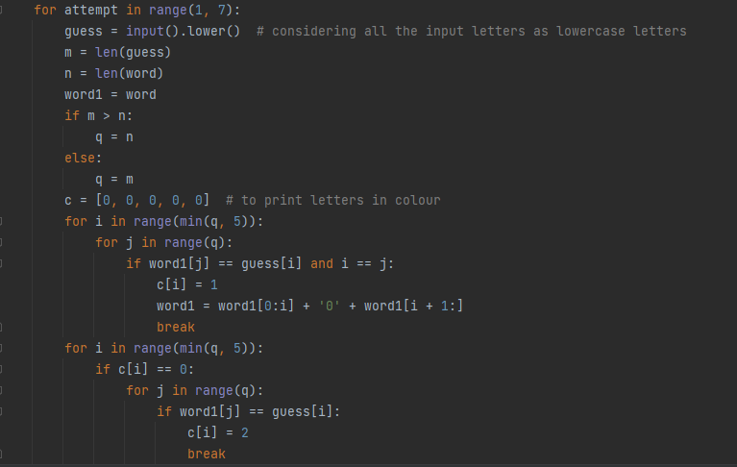
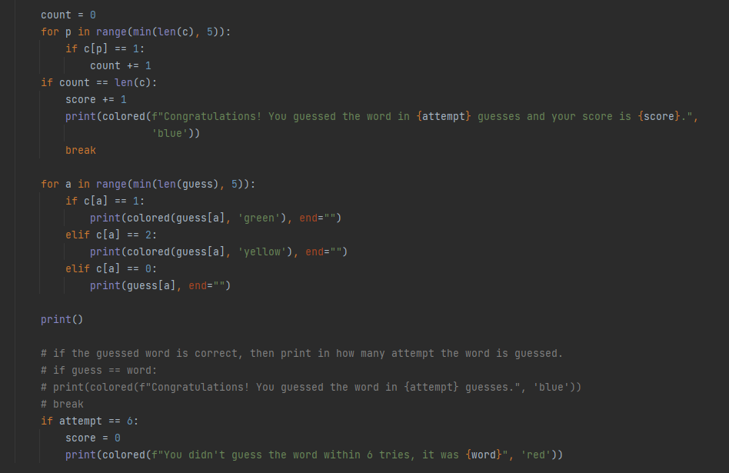
Code snippets
In this Project we are using read_random_word function to return the random word from the text file “word.text” which consist of list of five letter words.
Function for pick the random word for text file
In this program we are using termcolor package for coloring the letters in word.
If the letter is in correct position as the original word, that letter in word which the player guessed is shown in green color. If the letter exists but not in correct position, then it is shown in yellow color. Otherwise, it will be shown in white color.
Main logic of the program and for coloring

Slide 11
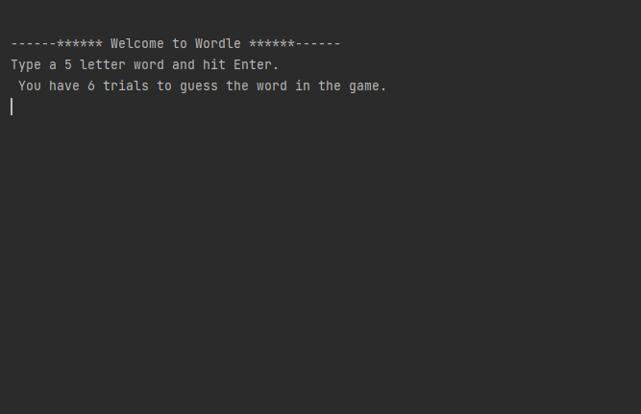
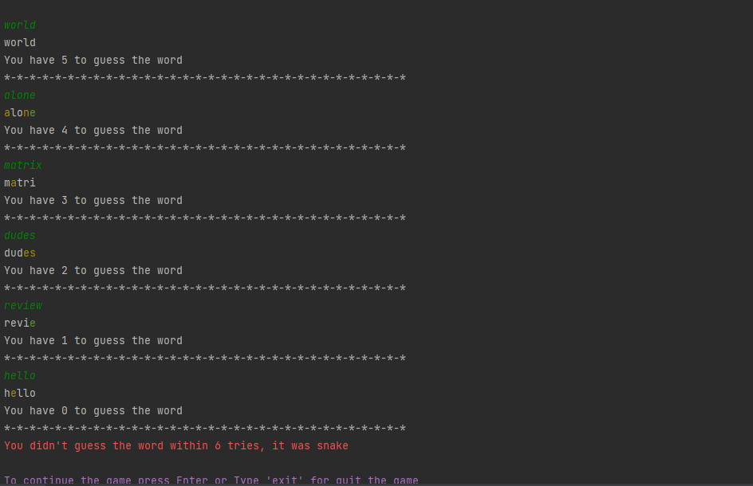
RESULTS AND SNAPSHOTS:
This is the interface of the game
When the 6 attempts exceeds , it will display ‘you lose the game’ and display the original 5 letter word and score will be initialized to zero.
Continued.,

Slide 12
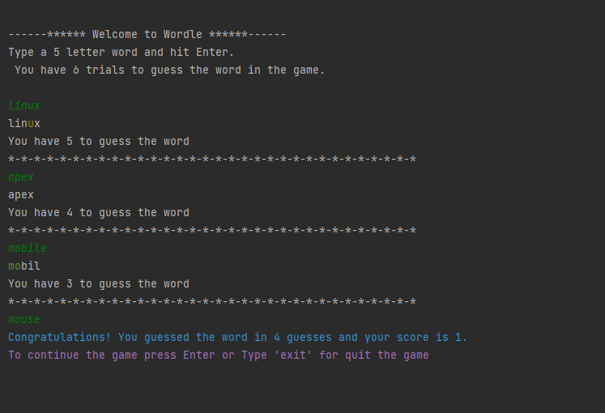
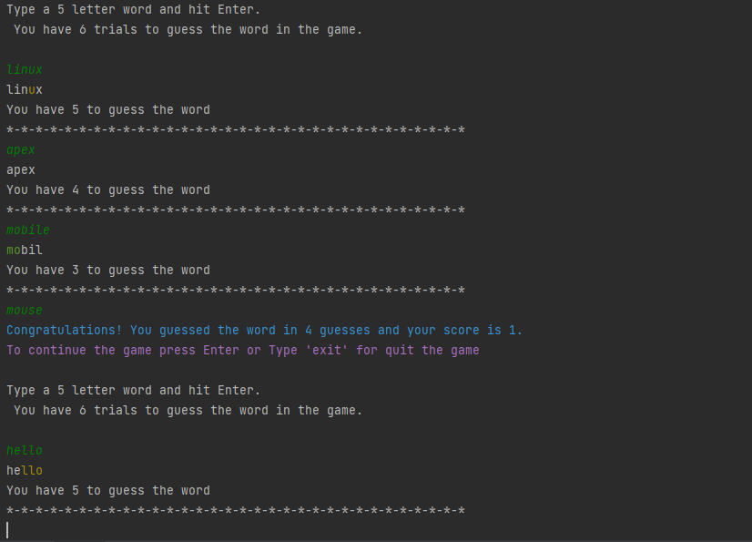
When player guess the word within the 6 attempts, and it display ‘you guessed the word’ and score will be incremented by one and display the score.
After 6 attempt or won the game, If player wants to play again or quit the game, it will ask player to hit to continue else type “exit” to quit.

Slide 13
Conclusion
In the conclusion of this Wordle game project, Wordle is the most popular word guessing game on the internet nowadays. In this game player may guess words like cities, known character, famous words etc., From this we can explore and learn more about the Python programming and its applications. Some of the concepts we can learn from this project are importing modules/packages, lists, fstrings, comparison of words, case conditions(like if else, elif etc.,), loops(like for loop, while loop) etc., This game is simple to code and easy to understand.
We have met up with the objectives of this project. From this game, player would be able to enjoy it.

Slide 14
Source and Reference
Think-Python
-By Allen Downey
(for string, loops, conditions)
Stackoverflow (for termcolor package )
w3schools (for random module and built-in function)
Our project GitHub link:
https://github.com/VilokBhat/Wordle.git

