Slide 1
Nim Game using Python (Mini-Max Algorithm)
Akshay Khanna.J
Register No: 2117240030005
CSE (AIML)-A
Faculty In-Charge: Mrs. M. Divya

Slide 2
Problem Statement
• To design a Python-based Nim Game that uses the Mini-Max algorithm for optimal decision-making.
• The AI player should predict the best move and ensure victory by applying game theory logic.

Slide 3
Theoretical Background
• The Mini-Max algorithm is used in decision-making and game theory.
• It explores all possible game states recursively to choose the optimal move.
• In the Nim Game, it uses XOR (Nim-sum) to determine winning and losing positions.

Slide 4
Algorithm Explanation
1. Represent piles of objects as game states.
2. On each turn, remove one or more objects from a pile.
3. The player forced to take the last object loses.
4. The Mini-Max algorithm evaluates all possible outcomes recursively.
5. The AI selects the move that maximizes its chance to win.

Slide 5
Implementation and Code
def display_rules():
print("\n===== NIM GAME RULES =====")
print("1. There are multiple piles of stones.")
print("2. Each player can choose any one pile in their turn.")
print("3. From that pile, they can remove one or more stones.")
print("4. The player forced to take the last stone loses the game.\n") print("===========================\n")
def display_piles(piles):
print("Current piles status:")
for i, pile in enumerate(piles, 1):
print(f"Pile {i}: {'●' * pile} ({pile} stones)")
print()def nim_game():
print("Welcome to the Nim Game!")
display_rules()
piles = [3, 4, 5]
player = 1
while any(piles):
display_piles(piles)
print(f"--> Player {player}'s turn <--")
try:
pile = int(input("Choose a pile number (1-3): ")) – 1
remove = int(input("Enter how many stones to remove: "))
except ValueError:
print("⚠ Invalid input! Please enter numbers only.\n")
continue if pile < 0 or pile >= len(piles):
print("⚠ Invalid pile number! Choose again.\n")
continue
if remove <= 0 or remove > piles[pile]:
print("⚠ Invalid number of stones to remove! Try again.\n")
continue
piles[pile] -= remove
print(f"Player {player} removed {remove} stone(s) from Pile {pile + 1}.\n" )
if not any(piles):
print(f"🎉 Player {player} wins the game! 🎉")
break
player = 2 if player == 1 else 1 # switch turns
print("\nGame Over. Thanks for playing!")# Run the game
nim_game()

Slide 6
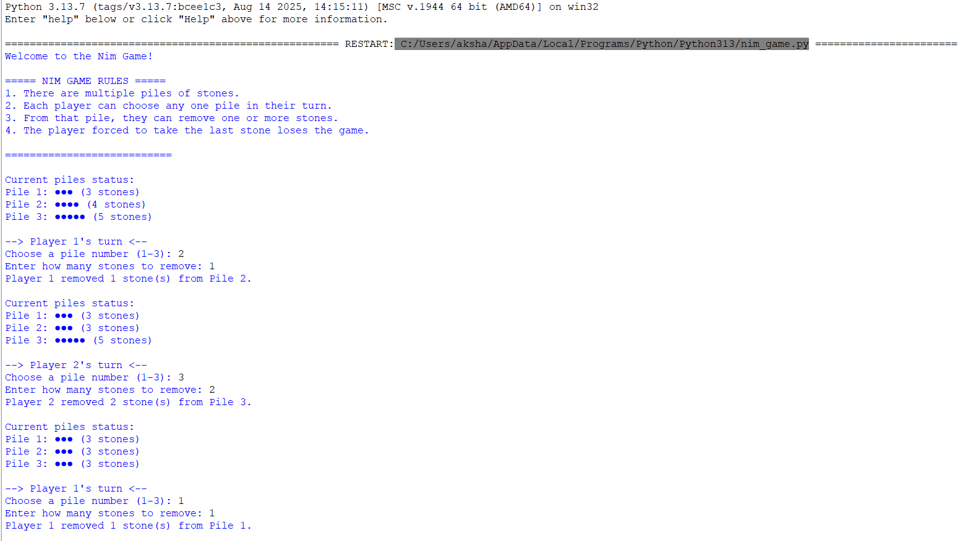
Output and Results
Sample Output:

Slide 7
Future Enhancement
• Implement a graphical user interface (GUI) for better interaction.
• Extend the game to multiplayer mode.
• Apply alpha-beta pruning for faster decision-making.
• Integrate online gameplay using sockets.

Slide 8
References
1. Stuart Russell & Peter Norvig, Artificial Intelligence: A Modern Approach
2. John von Neumann & Oskar Morgenstern, Game Theory
3. Python Documentation – https://docs.python.org
4. GeeksforGeeks – Minimax Algorithm
5. Medium Blog – Understanding Nim Game and XOR logic

