Slide 1

Basic Details of the Team and Problem Statement
Ministry : Ministry Of Education
PS Code: SIH1434
Problem Statement Title : Making career choices and AI based counselling accessible to every child at secondary level along with aptitude tests and detailed career paths.
Team Name: Innovates
Team Leader Name: Mohit Khandelwal
Institute Code : C-42227
Institute Name: Dr. D Y Patil Institute Of Technology -Pimpri.
Theme Name: Smart Education

Slide 2
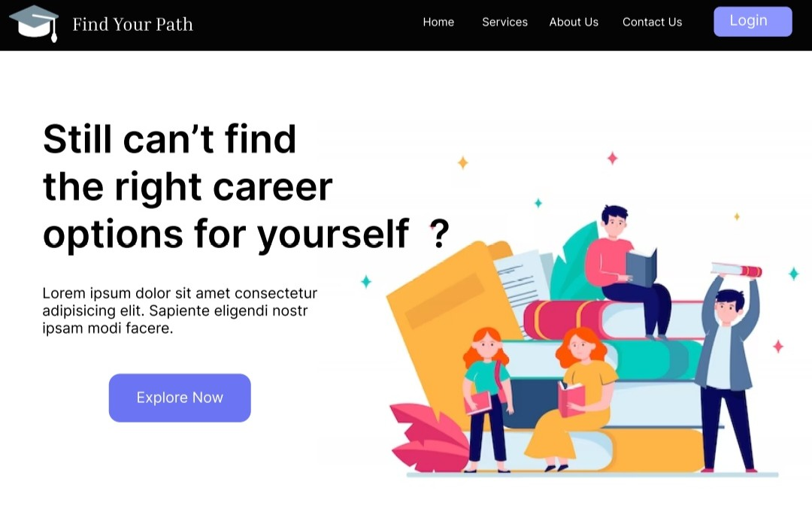
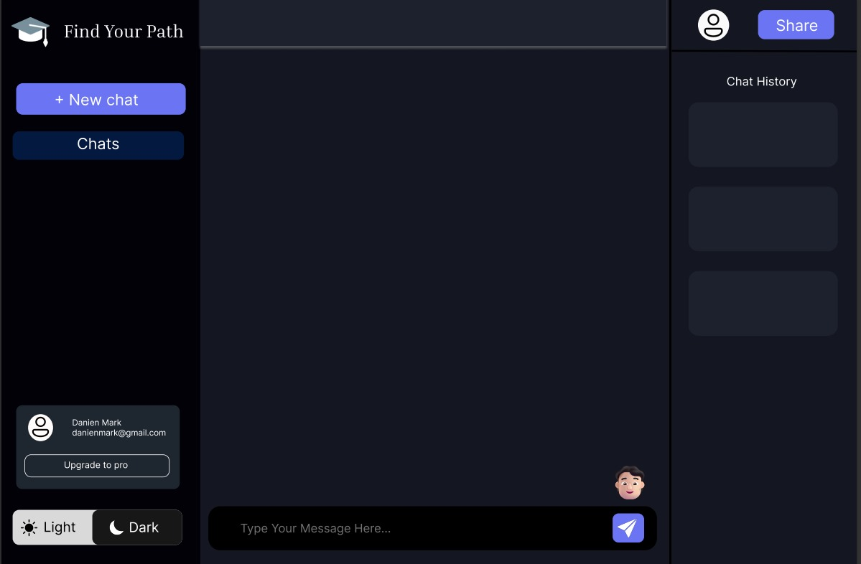
Idea/Approach Details
idea/Solution/Prototype :
Our main idea is to provide users with a comprehensive and personalized career guidance experience.•
Emotion Detection : It helps us understand the user's emotional state, which impacts their decision-making process•
The Chatbot : The chatbot assesses the user's sentiments during the conversation.• Sentiment Analysis - Sentiment analysis helps us to responses the user's needs effectively.•
Personalized Recommendations : The outcome is a personalized recommendation based on emotional state, sentiments, and interests.- Users can choose their preferred format for receiving recommendations•
Aptitude Session and Feedback : The aptitude session refines our understanding of the user's skills and interests.- A feedback form allows users to provide input on their satisfaction with our services.
Technologies Used :
Front-end ( HTML,CSS, JS )
Back-end Development (PHP, MySQL, Python)
AI & NLP
Database Management
Server Deployment
Real-time Communication

Slide 3
Idea/Approach Details
Dependencies :
Use Cases :
Data Availability and Quality: Ensuring data accessibility and reliability is crucial for informed decision-making and analysis.
Emotion Detection Algorithms: Algorithms designed to identify and analyze human emotions, often used in applications like customer feedback analysis.
Sentiment Analysis Tools: Software tools that assess public sentiment towards products, services, or topics by analyzing text data.
User Engagement: Measuring and enhancing user interaction and involvement with a product or service to improve customer satisfaction and loyalty.
Integration of Aptitude Assessment: Combining aptitude tests into hiring or educational processes to evaluate individuals' skills and capabilities effectively.
Student Career Planning : Personalized guidance for students based on emotions, interests, and aptitudes.
Professional Career Transitions : Assessing readiness for career switches and receiving feedback.
Mental Health and Career Alignment : Reducing stress by aligning careers with well-being.
HR Support and Recruitment : Assessing candidate emotional readiness for roles.

Slide 4
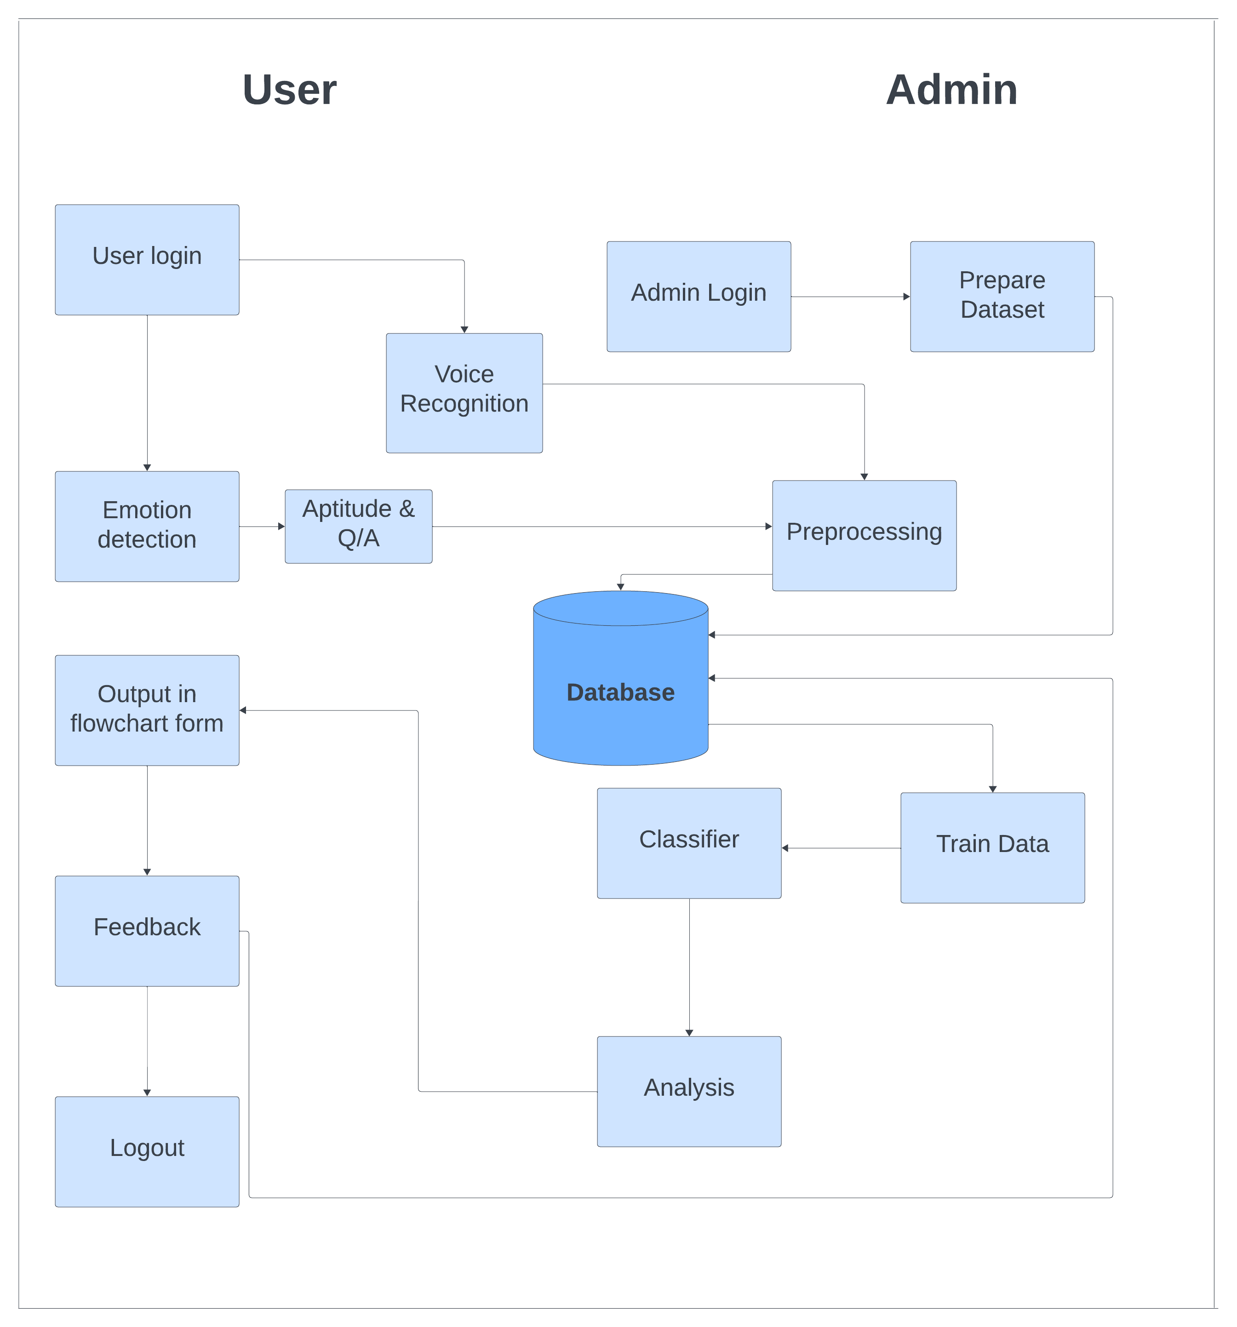
Architecture Diagram

Slide 5
Team Member Details
Team Leader Name: Mohit Khandelwal
Branch (Bachelor Of Engineering): Stream (AI&DS): Year ( III ):
Team Member 1 Name: Priyanka Gaikwad
Branch (Bachelor Of Engineering): Stream (AI&DS): Year ( III ):
Team Member 2 Name: Meet Agarwal
Branch (Bachelor Of Engineering): Stream (CS): Year ( III ):
Team Member 3 Name: Ayush Jain
Branch (Bachelor Of Engineering): Stream (AI&DS): Year ( III ):
Team Member 4 Name: Rushank Ambekar
Branch (Bachelor Of Engineering): Stream (AI&DS): Year ( III ):
Team Member 5 Name: Pruthvesh Baitule
Branch (Bachelor Of Engineering): Stream (AI&DS): Year ( III ):
Team Mentor 1 Name: Mrs. Shubhangi Suryawanshi
Category : Academic Expertise : ML, Deep Learning , Data Science Domain Experience : 15 Years
Team Mentor 1 Name: Mrs. Apurva Kandelkar
Category : Academic Expertise : Machine Learning Domain Experience : 12 Years

