Slide 1
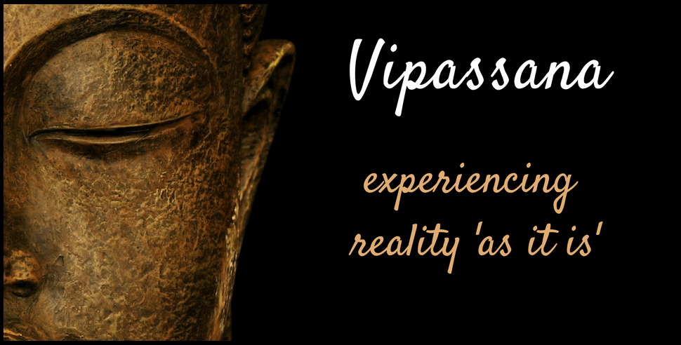

Slide 2
Table of Content
What is Vipassana?
Brief History.
About the Course.
Potential Benefits.
How it can be beneficial for us.
My Takeaways.
Conclusion.
References.

Slide 3
What is Vipassana
To see things as they really are.
A way of self transformation through self-observation.
It involves observing your thoughts and emotions as they are, without judging them.
It focuses on the deep interconnection between mind and body.

Slide 4
Brief History
Ancient mindfulness meditation technique.
It was rediscovered by Gautam Buddha 2500 years ago and was taught by him as a universal remedy for all ills.
In India, It was started by S.N. Goenka 1969.

Slide 5
About the Course
10 days residential course.
Code of Discipline: To abstain from killing, stealing, sexual activity, telling lie and intoxicants.
Noble silence
First 3 days for breathing exercise.
Then: Observing sensation throughout the body, understand their nature, developing calmness by learning not to react them.
Last Day: meditation of kindness.
Free of cost.

Slide 6
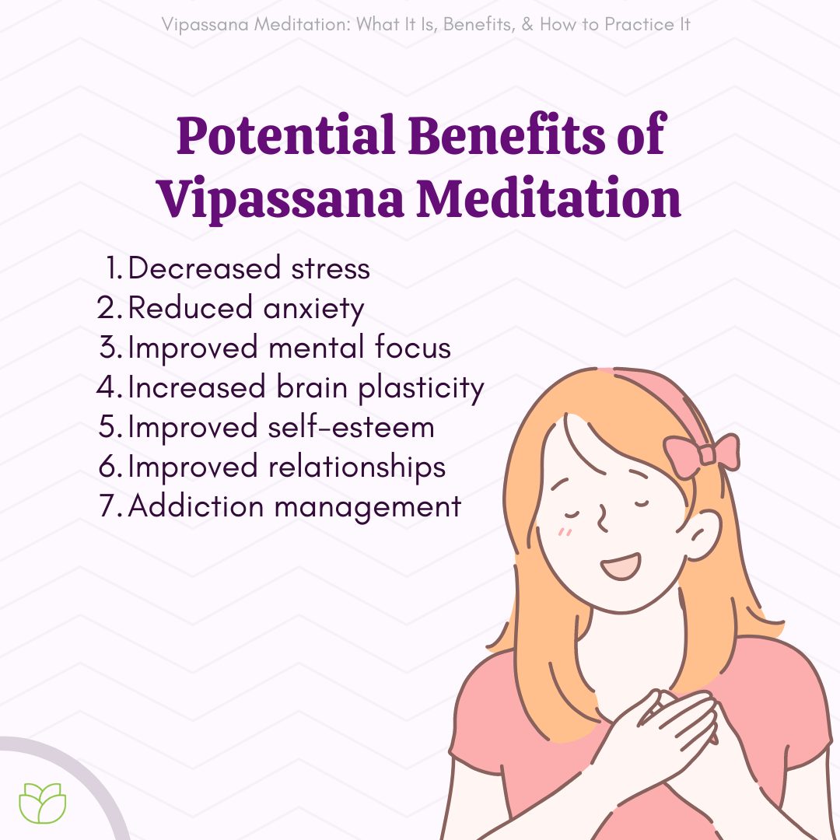

Slide 7
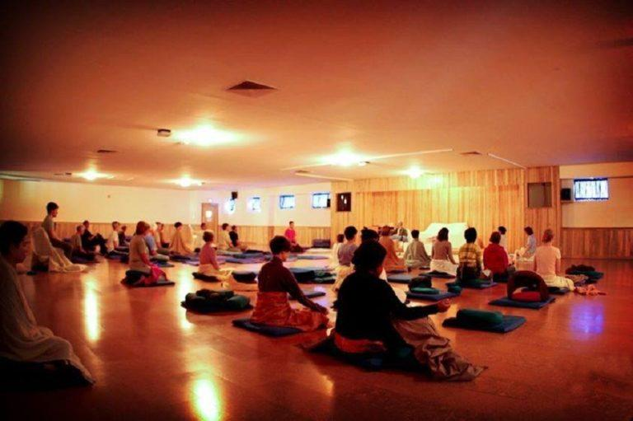
Let’s do some practice

Slide 8
How it can be beneficial for us:
Helps in reducing stress and frustration, while also boost focus and compassion.
Balance our emotions.
Helps in deal with people.
Relationship.
Increase overall productivity.

Slide 9
My Takeaways:
To do your work with minimal disturbing others.
Be in present and keep a balance in thinking about past/future.
Respect others and their opinion.
Do Regular meditation.

Slide 10
Conclusion
The more this technique is practiced, the greater the freedom from miseries and closure the approach to the ultimate goal of full liberation.
10 days are not enough but can provide the results which are vivid and obviously beneficial in everyday life.
References:
Book - Pravachan Saransh
Website - https://www.dhamma.org/en/index

Slide 11
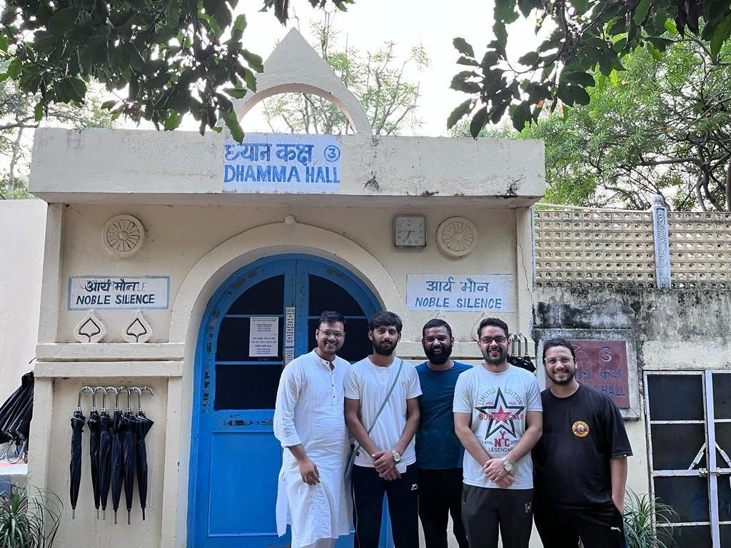
Thank-you

