Slide 1
Machine Learning
Project
Topic: Diabetes.
Done By :Akshay kumar B P
Submitted To : CVSN REDDY

Slide 2

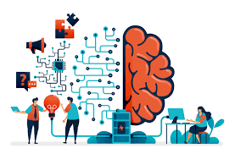
Artificial Intelligence
AI is intelligence demonstrated by the machine,where the human intelligence is put into the machine.
.
.
In computer science, the field of artificial intelligence as such was launched in 1950 by Alan Turing.

Slide 3
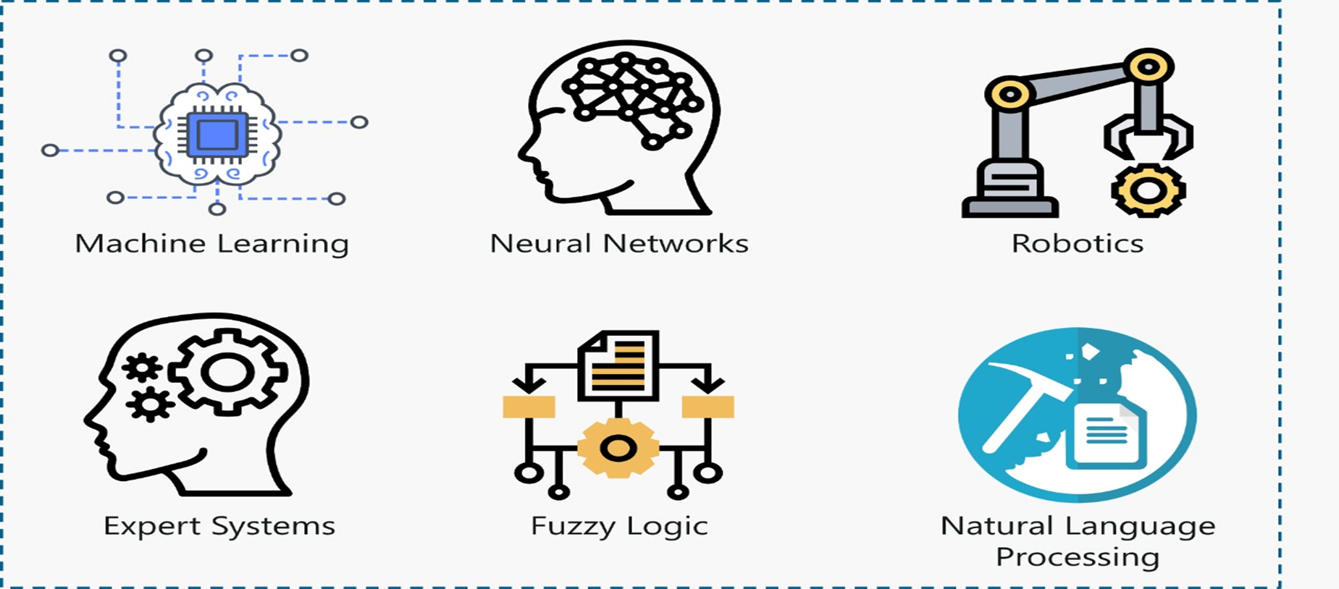
Branches of AI

Slide 4
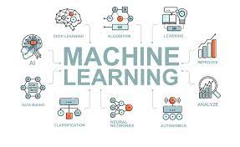
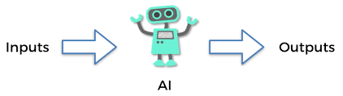
Machine learning
Machine learning means making the computers to learn like human beings.
We give input and output to the machine leaning algorithm and it builds a model. It predicts the future

Slide 5
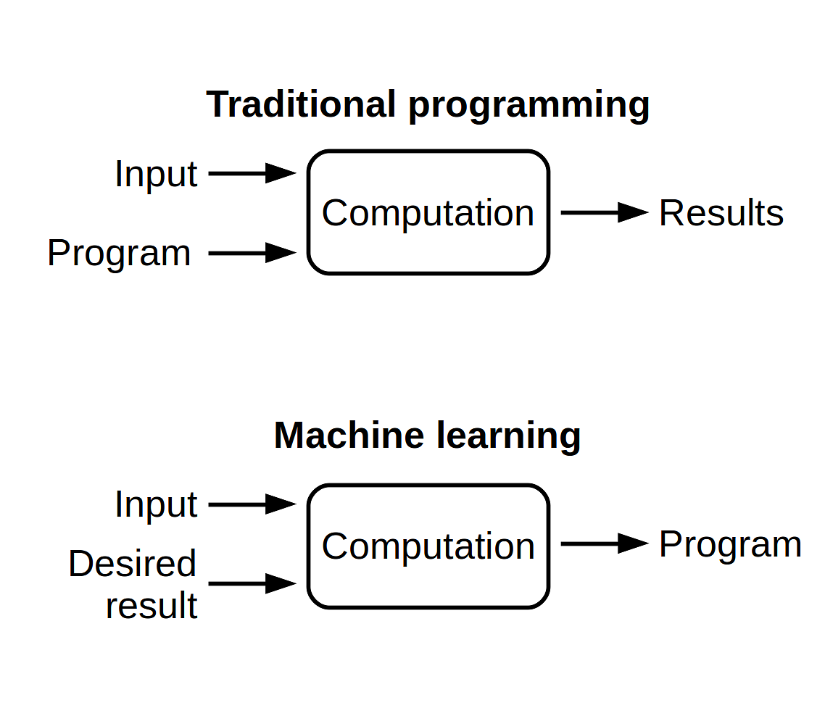
Machine Learning

Slide 6
Features ,Labels & Model
X=3 F(x)=9..Input and Output
X=4 F(x)=12
X=5 F(x)=15
X=6 F(x)=18
F(x)=3x..Model
What is X=10 ?
Ans:30
Inputs are called Features.
Output are called Labels.
Function is called Model

Slide 7
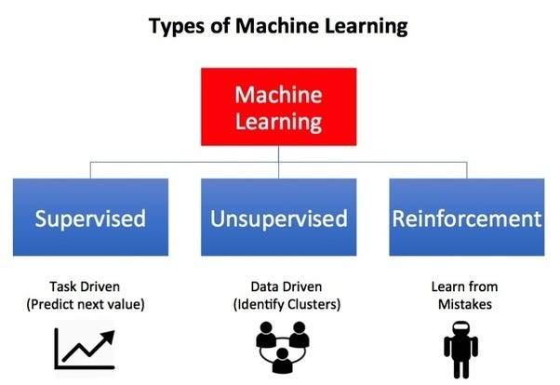
Types of machine learning:-

Slide 8

Supervised Learning
Learning from others is called Supervised Learning.
Supervised learning will have features and labels.
There are two algorithms:-
1.Regression
2.Classification

Slide 9


Unsupervised learning
Learning on our own is called UNSUPERVISED LEARNING.

Slide 10
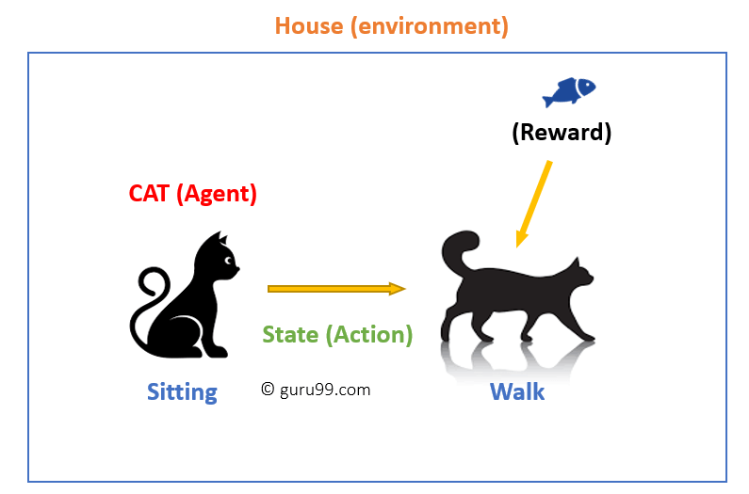
Reinforcement Learning
Machine Learning method in which the user is rewarded for the desired behaviour or punished for the undesired behaviour.

Slide 11
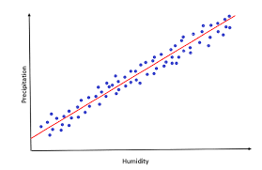
Explain Different Machine learning algorithms with example
Regression Algorithm
Regression Algorithm means which have a continuous data.
In regression we use only:
Linear regression
Non-Linear regression

Slide 12
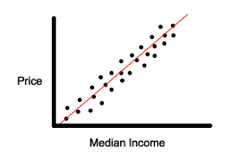
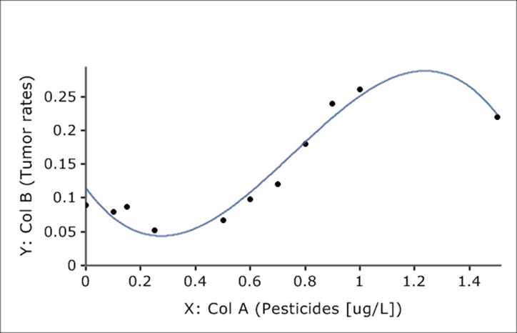
Regression Algorithm
Linear Regression
Non-linear Regression

Slide 13
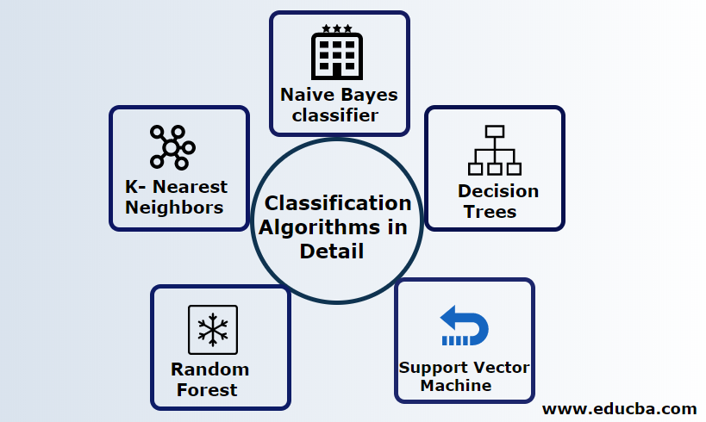
Classification Algorithm
Classifying the data either one like Yes Or No, Ture Or False etc.
In classifying we use:
Logical Regression.
Decision Tree.[DT]
Random Forest.[RF]
K Nearest Neighbour[KNN]
Support Vector Machine[SVM]
Naïve Bayes

Slide 14
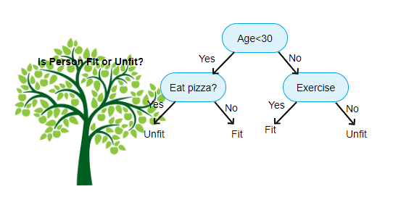
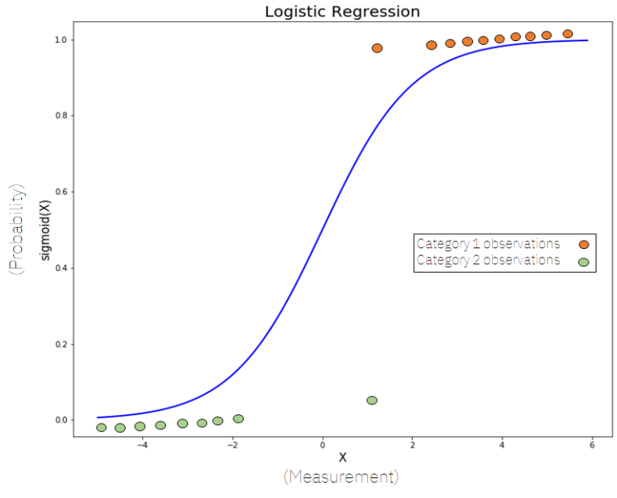
Logistic Regression
Decision Tree

Slide 15
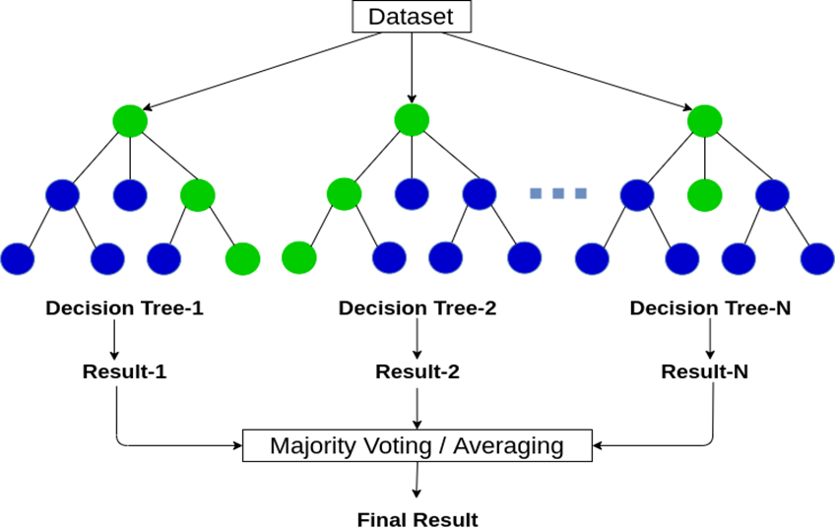
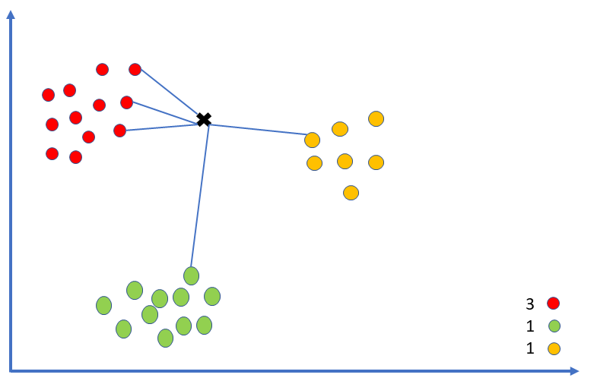
Random Algorithm
K Nearest Neighbour

Slide 16
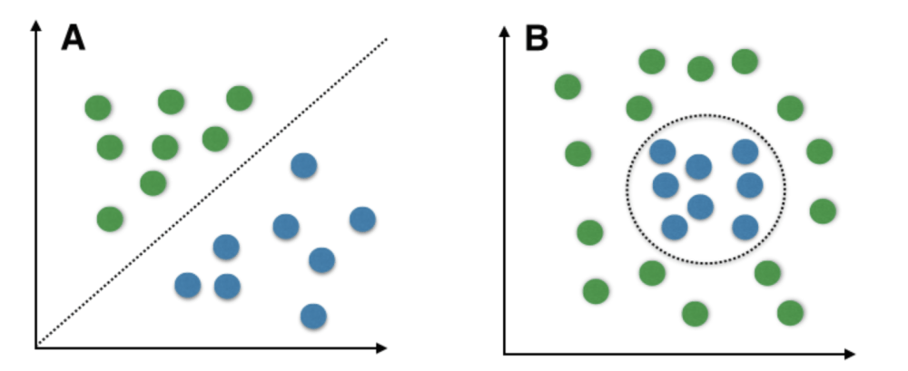
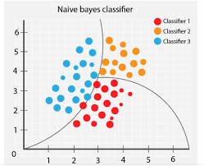
Support Vector Machine(SVM)
Naïve Bayes

Slide 17
THANK YOU

