Slide 1
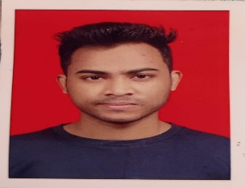

AKSHAYKUMAR BAWANE
WMS CONSULTANT
Background
Significant experience and focus on Application maintenance and support in Retail domain. Trained for WMS application. I have a good understanding of WMS Modules such as Inbound, outbound and Inventory management.
Experience
Having a good understanding on Manhattan Warehouse management System
Experienced in GK POS SYSTEM by Loreal .
Experienced in incident management and problem management resolution.
Experienced in writing efficient SQL Queries.
Creating and sharing accurate Daily, weekly and monthly reports in a timely manner.
Proficient knowledge on the process flow, order flow, sourcing and scheduling rules, inventory synchronization, 3rd party systems etc.
Resolve the tickets/incidents raised on portal as per the priority and given time.
Having a good understanding on UNIX SYSTEM.
Education
Bachelor of Technology in Computer Engineering from Government College of Engineering, Jalgaon.
Education
Manhattan Warehouse management System
Point of sale (POS)
SQL
PL SQL
Agile Software Development
IoT Workshop
Technical Skills
Certifications
The information contained in this document is proprietary. Copyright © 2021 Capgemini. All rights reserved.

