Slide 1

EXPLORATORY DATA ANALYSIS
EMPLOYEE ATTRITION RATE
BY
Akshaykumar

Slide 2
INTRODUCTION
Attrition is the departure of employees from the organization for any reason.
Attrition of employees can not be avoided. Measuring attrition can uncover many answers related to the functioning within the organization. Higher attrition rates signal a need for further investigation.
In this project we try to analyze what features are affecting the attrition. We have conducted Univariate, Bivariate and Trivariate analysis for our features.
There are 1470 observations in the dataset.
Each row represents an employee.
There are 20 features describing different characteristics of an employee in the company.

Slide 3
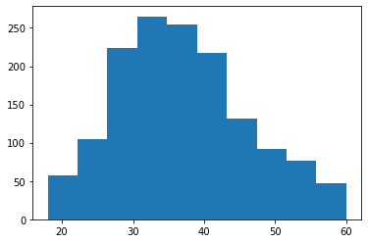
Univariate Analysis
Age
Type: Continuous
Observations:
In the company, we notice that the mean age of employees is almost same as the median age. Hence, we came to the conclusion that age is normally distributed with average age of 37 years.
Under our analysis, in the company almost 68% of the employees lie in the age bracket of 27- 46.
In the company we observe that the range of age of employees is from 18-60.
Environment Satisfaction
Type: Categorical
Observations:
As per our analysis, 61.15% of employees have high environmental satisfaction, and 20% of employees have low environment satisfaction.
Are these 20% of employees have more chance of leaving the company?

Slide 4
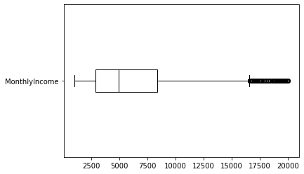
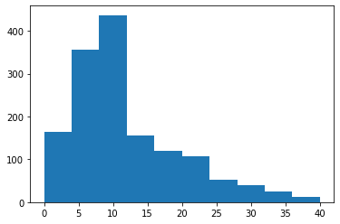
Monthly Income
Type: Continuous
Observations:
As mean is shifting towards the right of the median, the distribution is rightly skewed.
25% of employees have monthly income more than 8379 and
around 25% of employees have monthly income less than 2911.
We can see that the monthly income in the fourth quarter is widely spread.
Is monthly income and age of employee effecting attrition rate?
Total Working Years
Type: Continuous
Observations:
25% employees have work experience greater than 15 years.
Half of the employees have less than 10 years of working experience.
Distance From Home
Type: Continuous
Observations:
Half of the employees are staying nearby the company and 25% employees stay far (> 14 km) from the company.
Are these employees have more chances of leaving the company?

Slide 5
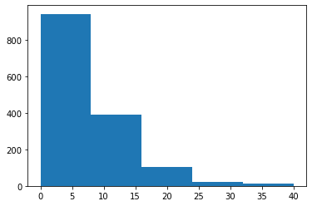
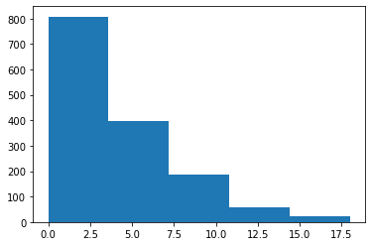
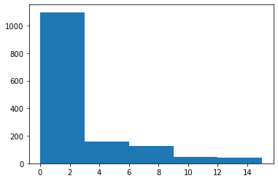
Years At The Company
Years In Current Role
Years Since Last Promotion
Years With Current Manager
Years At The Company
Years In Current Role
Type: Continuous
Observations:
There are more employees who have worked for few years in the company.
25% employees are working for more than 9 years.
Half of the employees are changing the role within 3 years.
Half of the employees are promoted within a year
There are 25% employees who are getting late promotion. Are these employees
getting good salary and have good job satisfaction?
Out of all the employees 50% are getting new manager within 3 years.
Years Since Last Promotion

Slide 6
Gender
Education Field
Marital Status
Over Time
Type: Categorical
Observations:
We can observe that there is no gender bias in the company. (Male 60%)
More employees are from the Life Science and Medical background (~73%).
In the company almost half (45.78%) of the employees are married.
28.3% employees are working over time. Are these employees have high attrition rate?
Work Life Balance
Type: Categorical
Observations:
Around 71% employees have better work life balance.
The remaining 29% are not able to balance their work.
Is work life balance, distance from home are affecting the attrition rate?

Slide 7
Job Involvement
Type: Categorical
Observations:
In the company, 5.64% of employees are least involved in their respective job. (Are these employees leaving the company?)
68.83% of the employees in the company are actively involved in their job.
Job Level
Type: Categorical
Observations:
Under our analysis, more than 36.94% of the employees are at level 1.
Are these employees have more chance of leaving the company?
How job level and department together affecting the attrition rate?
Job Satisfaction
Type: Categorical
Observations:
Around 61.28% of the employees in the company have higher job satisfaction.
Is this affecting the attrition rate?

Slide 8
Department
Type: Categorical
Observations:
65.37% employees are working in the R&D department.
HR has the least number of employees(4.28%).
Attrition (Target Variable)
Type: Categorical
Observations:
Under our analysis, the attrition rate is 16.12%.
Business Travel
Type: Categorical
Observations:
We observe that the employees who travel rarely are about 70.95% and travel frequently is 18.84%.
The remaining 10.2% employees in the company do not travel.

Slide 9
Bivariate Analysis with Attrition
Business Travel
Out of all the employees who travel frequently, 24.91% have churned the company and this percentage is comparatively more than the employees who never travel or travel rarely.
We also observe that the employees who never travel have least attrition rate.
Gender
Gender | Female | Male
Attrition
0 | 85.2 | 82.99
1 | 14.8 | 17.01
There doesn't seem to be much difference in attrition rates between males and females.
So gender might not affect the attrition rate much.
Marital Status
Out of all the employees who are single, 25.53% have left the company.
These people mostly belong to the mid-age group, so they might be switching companies to obtain career growth and higher salaries.
Over Time
Taking into account the overtime workers in the company, 30.53% churn the company.
Among the marital status, which group is doing more overtime?

Slide 10
Job Level
In the company out of the employees who have job level 1, 26.34% have left the company.
What about the education background of these employees?
Whether job level and department are related?
Most of these employees might be single, or they might work at the same level for a long time.
We have also observed that 14.68 % employees with job level 3 have left the company.
Environment Satisfaction
Environment Satisfaction | 1 | 2 | 3 | 4
Attrition
0 | 74.65 | 85.02 | 86.31 | 86.55
1 | 25.35 | 14.98 | 13.69 | 13.45
In our analysis, Environment Satisfaction has little effect on the attrition rate,
mainly because employees who have higher environmental satisfaction have
a lot of attrition as well.
Job Involvement
Under our analysis we found that out of all the employees who are less involved in the job, 33.73% have left the company.
It might be that they are unhappy with their current job and are looking for a new one.
Education Field
Even though there are more employees from medical and life science backgrounds, the attrition rate of employees with HR, Marketing, and Technical Degrees is more.

Slide 11
Department
The attrition rate of the employees across all the three departments are almost the same.
Is Department affecting the attrition rate?
Job Satisfaction
We have observed that employees having good job satisfaction as well as employees with low job satisfaction have more or less the same attrition rate.
So this might not affect the attrition rate.
Work Life Balance
In the company, we observe that the employees with low work life balance have higher chances of leaving the company.
We also observe that there are very few employees with work life balance rating 1.
This might not affect the attrition rate much.
Distance From Home
In the company, 50% of the employees who churned are traveling for more than 10 km.
So employee staying far away from the company have more chance of attrition rate.

Slide 12
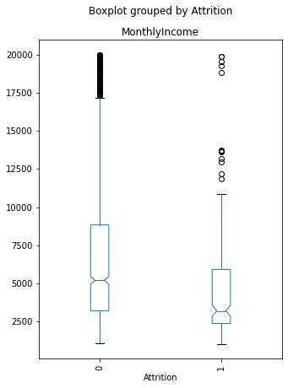
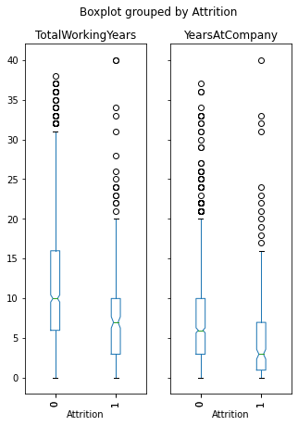
Monthly Income
From the box plot we see that 75% of the employees who are leaving the company have low monthly income . So we can infer that low monthly income affects attrition.
Monthly Income
Total Working Years
Years At Company
In the company employees who have total working experience less than 10 years have more chances of attrition.
Employees with less working years at the company have more chance of leaving the company.
Are these two features related?

Slide 13
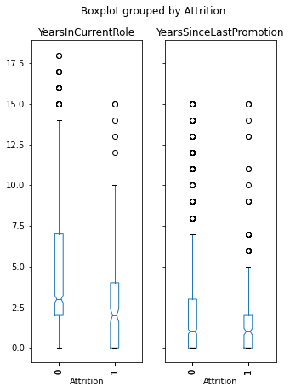
Years in Current Role and Years Since Promotion
In the company employees who have experience less than 3 years in current role have more chances of leaving the company.
In the company there employees who are not promoted for many years, but still working in the company.
These employees might be getting good salary.
75 % of the employees leaving the company haven't been promoted in the past two years.

Slide 14
Trivariate Analysis with Attrition
Marital Status and Over Time
Under our analysis, out of all the employees who are single, and doing over time, half of the employees are leaving the company.
So we infer that marital status and overtime both affecting the attrition.
Job Level and Department
We observe that the employees with low job level have churned more.
This pattern is observed across all the three departments.
So we infer that Department may not affect much to the attrition, however job level affects the attrition.
Job Level and Education Field
Under our analysis, employees from medical and life science background with higher job level have least attrition.
We also observe that the employees with HR, technical degrees, and marketing having low job levels are having high attrition rates.
Out of all the employees with a technical degree having high job level, 33% are leaving the company.

Slide 15
CONCLUSION
Variables causing the attrition
Overtime: employees who are doing overtime may have more work pressure.
Monthly Income: employees leaving the company have low income compared to the employees staying back in the company.
Marital Status: employees who are single have less responsibilities compared to others
Job level: employees with low job level are paid less compared to others.
Total working years: as experience is low for the young generation, they get low income which is causing churning.
Age: young age employees leave the company due to low income and better opportunity outside.
Years In Current Role: employees who have been working for less than 3 years in the same role are leaving the company. Employees who have worked many years in the company with the same role are satisfied with their role and obtain better salary.

Slide 16


