Slide 1
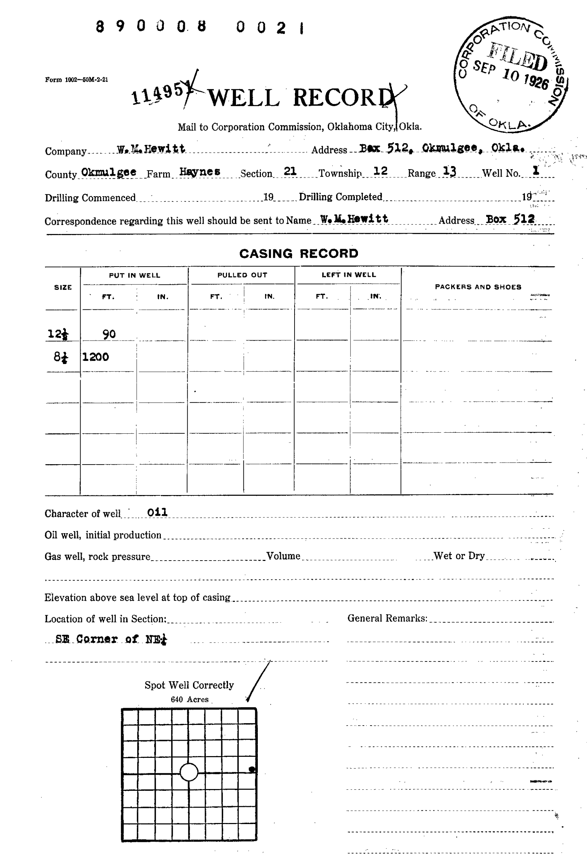
PDF to Structured Well Location Data
End-to-End Pipeline: Data Flow • Transformations • ML Improvements
Akshay Kumar Mundrathi
Feb 10, 2026
Raw document of well record in pdf format.
Converted it into pixels.
Extracted necessary information by various techniques.
Segregated information such as Section, Township, Range, precise dot location (U-Net model) with respect to the grid corners into excel sheets.
Transformed into query loads.
Performed SQL queries on AWS RDS to get latitude and longitude from Section, Township, Range, precise dot location with respect to the grid corners.
Populate map with the well locations.
Notes:
Welcome to the technical walkthrough of our PDF-to-structured-data pipeline. This end-to-end workflow transforms scanned well records into machine-readable CSV formats ready for GIS and analytics.

Slide 2

What We Will Cover
Inputs and targets: Defining extraction goals
PDF rendering: High-res CV image generation
Grid Extraction: Multi-method region cropping
Location crop: STR bounding box grouping
OCR/LLM extraction: Transforming pixels to text
Normalization: Grid click to NW mapping
Data Merging: Joining extraction branches
Final Dataset: CSV schema and status fields
QA Strategy: Confidence and failure signals
Future Roadmap: U-Net segmentation plan
Notes:
Today we will walk through the ten stages of our pipeline, from raw input handling to the final QA and our upcoming move toward deep learning-based segmentation.

Slide 3
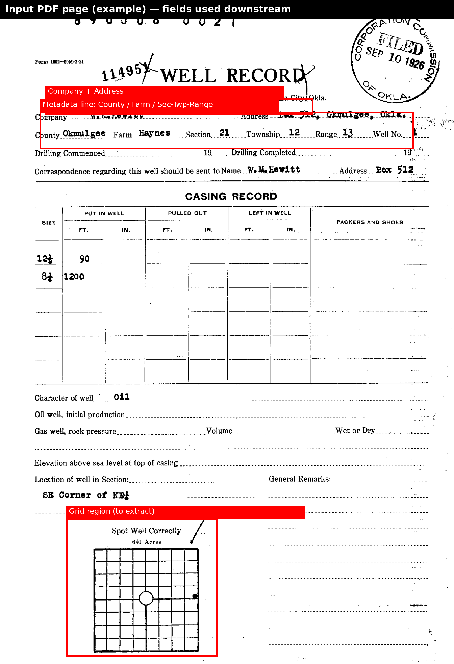
Input PDF and Target Fields
Core Extraction Targets:
County: Identifies the regional administrative area.
STR (S-T-R): Section, Township, and Range identifiers.
Well Grid: The "Spot well correctly" coordinate grid.
The pipeline transforms unstructured scans into machine-readable fields for GIS ingestion.
Notes:
This annotated view shows the critical regions we target: the header for county and location text, and the central grid for spatial coordinates. Our goal is to convert these visual markers into validated database entries.

Slide 4
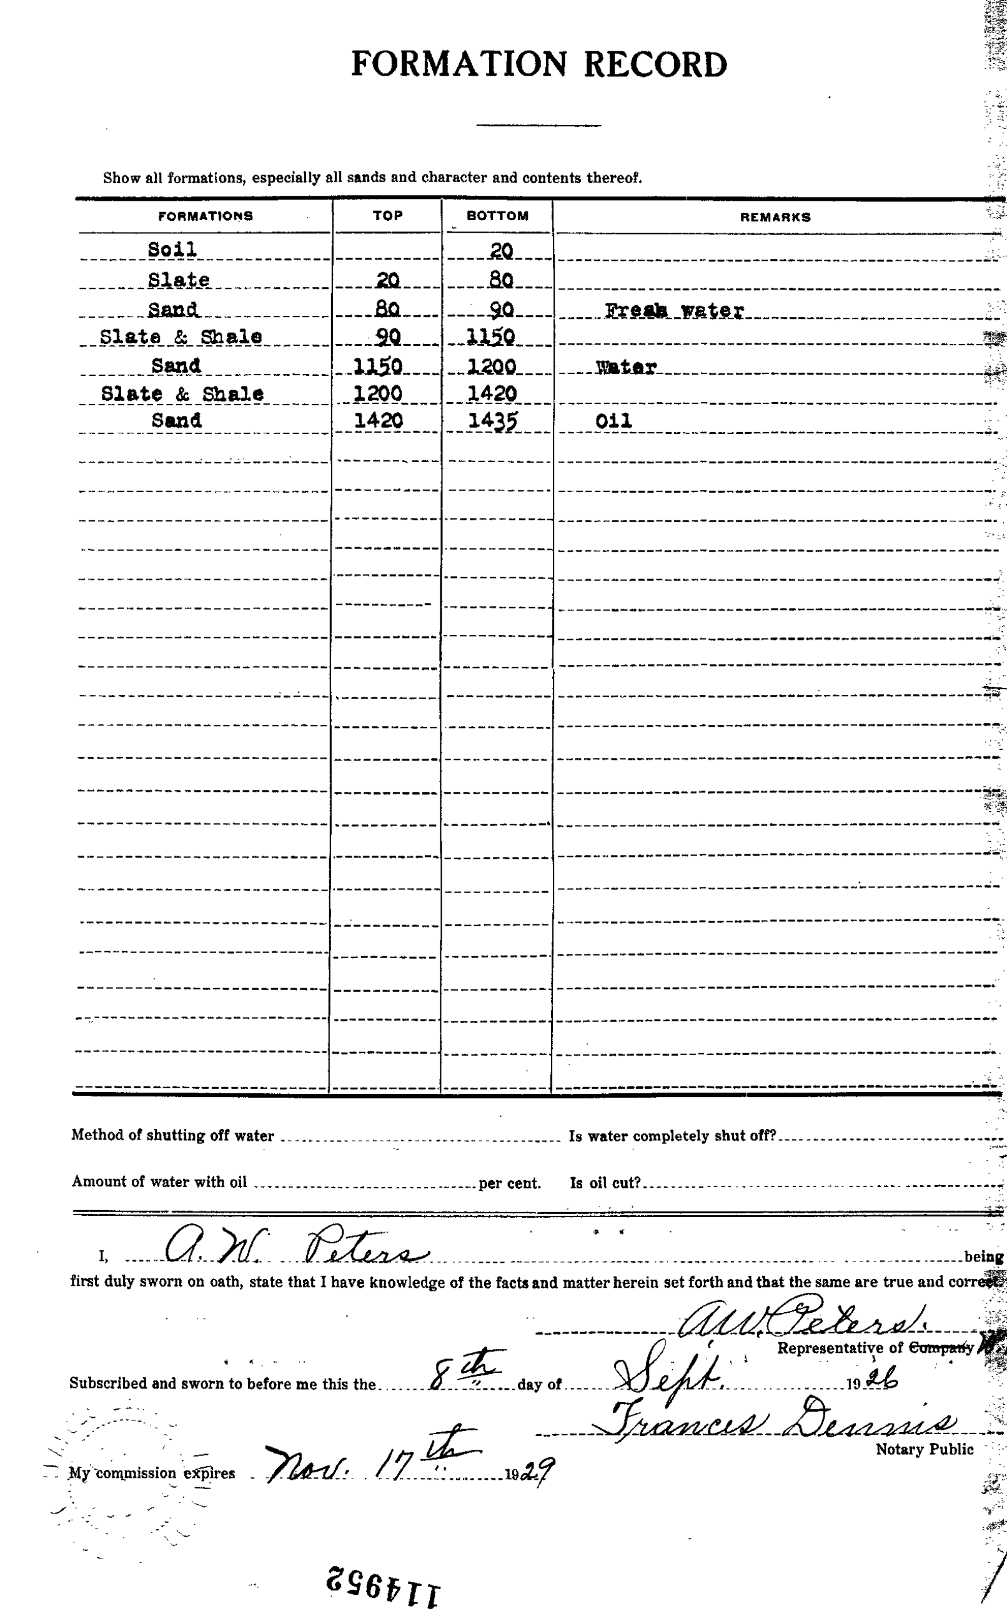
Stage A — PDF Rendering to Images
Rendering Strategy
Multiplier: 2x resolution boost for clarity.
Output: Per-page OpenCV BGR images.
Logic: Sequential processing of multipage files.
Note: Pipeline identifies relevant pages automatically; non-grid pages are filtered later.
Page 1: Usually contains grid
Page 2: Supporting info only
Notes:
Before analysis, we convert PDFs to high-resolution OpenCV images. We use a 2x resolution multiplier to ensure that small text and thin grid lines are detectable by our downstream OCR and computer vision algorithms.

Slide 5
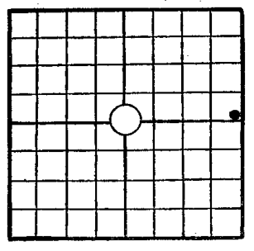

Stage B — Grid Extraction & Logging
Process Objective
Locate and isolate the square grid region from the full page.
Handle variability in scan quality using a multi-method approach.
Output: Individual PNG crops for localized dot detection.
[LOG EXCERPT]
--- Page 1 ---
✅ Grid extracted and saved: ..._page_1_grid.png
--- Page 2 ---
⚠️ No grid detected on this page.
Notes:
Stage B focuses on isolating the grid. Every page is logged: a successful extraction is marked with a green check, while pages lacking a grid are flagged. This logging is crucial for auditing the pipeline's coverage.

Slide 6

How Grid Detection Chooses the Best Crop
The extract_grid_region_combined Algorithm:
Parallel Candidate Detection: Run Adaptive Threshold, Otsu, Canny, Hough, Rotated, and
Corners methods simultaneously.
Geometric Filtering: Validate each candidate against strict bounds: • Aspect Ratio: 0.85 – 1.15 (Targeting square grids)
• Dimensions: 280px to 850px width/height • Minimum Area: 78,400 pixels
Selection: Rank all valid candidates and choose the one with the maximum area.
Fail-Safe: If no candidates pass filters, return "No grid detected".
Notes:
Our combined detection algorithm uses a 'best of many' strategy. By running multiple computer vision methods and filtering for expected geometric properties, we ensure high reliability across varied scan conditions.

Slide 7
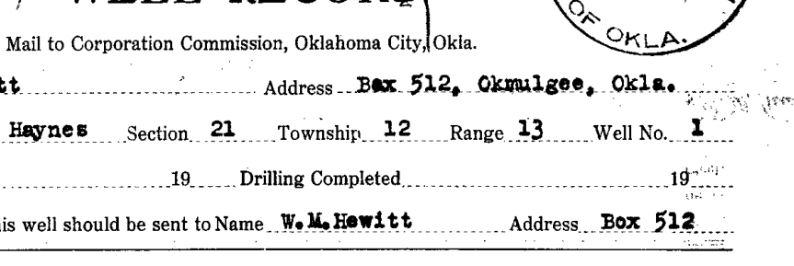
Stage C — Unified Bounding Box Crop for STR
Unified Location Crop Logic
Keyword Detection: Scan page for "Section", "Township", and "Range".
Box Grouping: Identify the bounding boxes for detected keywords and their adjacent value fields.
Union Operation: Compute a single Unified Bounding Box that encapsulates the entire STR block.
Persistent Output: Save the region as a "unified_value" image for OCR processing.
Implementation Details: Uses get_unified_bounding_box to find the smallest rectangle containing all relevant keywords and values on the page.
Notes:
Stage C introduces the 'Unified Bounding Box'. Instead of individual crops, we group all Section, Township, and Range fields into one image. This preserves the visual context, which is essential for accurate multi-field extraction.

Slide 8

Stage D — OCR the Cropped STR Region
Pixels to Data: Google Vision OCR
Source: Cropped PNG of the STR region.
Process: PNG → Byte Stream → Google Vision Cloud Vision API.
Result: Raw JSON text detection blocks.
The Challenge of Noise: Scanned documents often yield "noisy" raw text (e.g., "Sec: 19 | T: 2ON | R: 14"). Later LLM parsing is required to normalize these values.
Example Raw OCR Response:
"Section 21 Township 12 Range 13 Spotted Correct: YES"
Note: OCR provides the raw text; structure is added in Stage E.
Notes:
In Stage D, we send the unified STR crop to Google Vision. While the OCR is highly accurate, it still picks up artifacts from the scan, which is why we rely on LLMs in the next step to clean and structure the data.

Slide 9

Stage E — STR Extraction Using LLM Vision
Intelligent Normalization with Gemini:
Iterative Processing: run_str_csv_extraction iterates through all cropped unified images.
Extraction Logic: extract_str_from_image calls Gemini to identify discrete Section, Township, and Range fields.
Handling Formats: Normalizes complex formats like 17N / 12E or 27-N into standardized numeric/text fields.
Intermediate Storage: Outputs are saved to a preliminary STR CSV for the final merge stage.
This stage bridges the gap between raw OCR noise and high-quality structured database fields.
Notes:
Stage E uses Gemini to parse the images and OCR results. Its primary value is normalization—taking various handwriting or typing styles for Section, Township, and Range and turning them into a consistent format.

Slide 10

Stage F — County Detection & Confidence
County Extraction Pipeline:
LLM Pass 1: Gemini detects the county name from the localized header crop.
Fuzzy Matching: Raw response is compared against a canonical list of known counties.
Confidence Scoring: Based on match quality and LLM certainty.
Fallback Strategy: The Pass2_Used flag tracks if a secondary analysis was required.
Data Field Management:
• Detected County: Standardized name.
• Confidence: 0-100 score.
• Pass2_Used: Boolean flag.
• Raw Response: Traceability for audits.
Matches are validated via parse_county_base_name_response to prevent hallucination.
Notes:
County detection includes a robust validation layer. We don't just take the LLM's word for it; we fuzzy-match the output against a master list and assign a confidence score to highlight records that might need manual review.

Slide 11

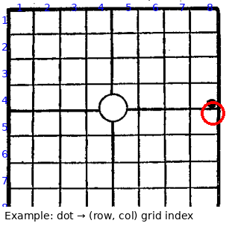
Stage G — Dot to Grid Coordinates
Coordinate Mapping Process:
Step 1: Identify dot centroid within the isolated grid crop.
Step 2: Map pixel coordinates to a 8x8 matrix (row, col).
Step 3: Convert discrete (row, col) to a PLSS quarter-quarter label.
Example Mapping:
A dot at Row 4, Col 8 translates to the directional code NE-SE-SE.
Function get_nw_coordinates handles the multi-level quadrant logic.
Notes:
Stage G converts the visual dot into spatial coordinates. We map the dot to an 8x8 grid and then translate those indices into standard PLSS quarter-quarter labels like 'NE-SE-SE', making the data GIS-ready.

Slide 12

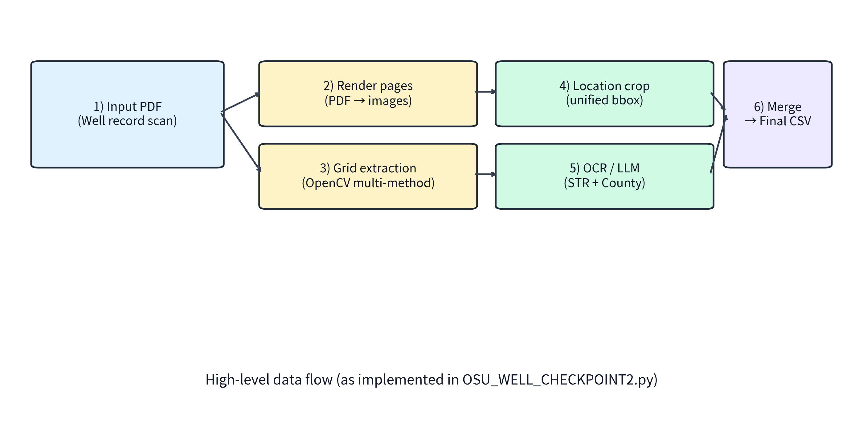
End-to-End Flow and Merge Points
Dual-Branch Parallel Processing:
Branch A: Text Extraction (County + STR) via Google Vision & Gemini LLM.
Branch B: Grid Extraction & Dot Detection via Computer Vision (CV2).
The Merge: Both branches join using the image_id (base filename) to create the combined final CSV.
Notes:
Our pipeline operates in two parallel branches: one for text and one for visual grid analysis. By processing these separately and merging them via a unique image ID, we maintain modularity and high processing speed.

Slide 13
Final Output Dataset (CSV) — Column Meanings
The final_combined_output.csv delivers structured spatial data:
image_id: The unique identifier linked to the source file.
Section/Township/Range: Standardized location identifiers.
Detected County & Confidence: The identified county and its match score.
Pass2_Used: Indicates if fallback logic was triggered.
row/col: 1-based indices for the 8x8 well grid.
nw: The hierarchical PLSS directional label (e.g., SE-NW-SW).
Status: Current processing state (e.g., "Cropped").
Notes:
The final CSV is our primary deliverable. It provides a clean, schema-consistent dataset that combines administrative text data with precise spatial grid coordinates for every processed well record.

Slide 14
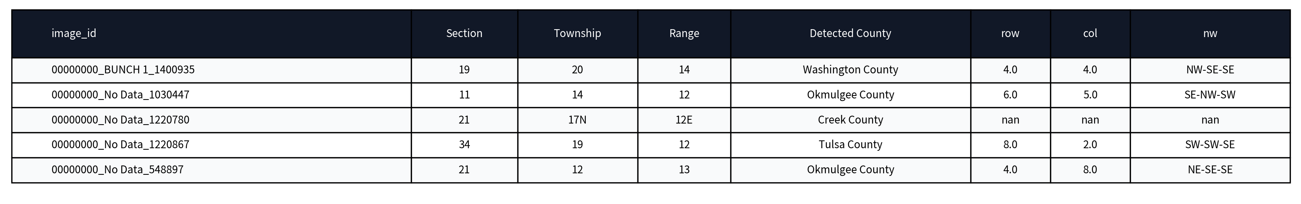
Final CSV Example Rows
Practical Insights:
Handling Missing Data: Fields marked 'nan' indicate no detection was possible for that specific image.
Data Complementarity: The row/col and nw fields provide a precise spatial overlay to the STR text data.
Validation: Notice high confidence (100) for standard county matches.
Notes:
Here's a snapshot of the actual output. You can see how the pipeline handles varied inputs—standardizing Section/Township/Range text while simultaneously providing the NW directional codes from the grid analysis.

Slide 15

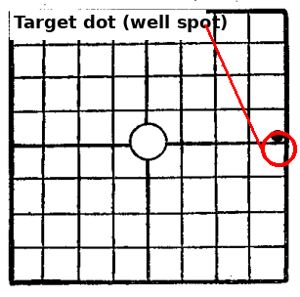
Why Dot Detection Is Hard on Scanned Grids
The Limitations of Classic CV:
Noise & Speckles: Dust and artifacts mimic dots.
Contrast Issues: Faded ink vs. thick grid lines.
Geometric Distortions: Scan skew and rotation affect alignment.
Occlusions: Stamps or handwriting crossing into the grid.
The Solution: Deep learning segmentation provides a robust alternative to pixel-level thresholding, learning to distinguish the true dot from surrounding noise.
Notes:
Traditional CV methods struggle with the 'real world' noise of historical scans. Things like paper speckles or overlapping stamps can easily confuse simple edge detection, which is why we are moving toward a more robust segmentation model.

Slide 16
QA Signals and Common Failure Modes
Failure Mode | Target Signal | Impact
Missing Grid | Logs: "No grid detected" | Missing row/col & nw fields
County Misread | Confidence Score < 90 | Possible Pass2_Used fallback
Dot Ambiguity | Status != "Cropped" | Coordinate mismatch in GIS
Actionable QA Ideas:
Thresholding: Auto-flag any Confidence score below 85 for human review.
Review Queue: Route "No grid" or "Pass2_Used=True" cases to a manual QA dashboard.
Sampling: Periodically sample 5% of "Cropped" records to verify dot placement.
Notes:
Our QA strategy relies on built-in signals. By monitoring confidence scores and logging flags like 'No grid detected', we can efficiently isolate failures and route them to a manual review queue, ensuring the final dataset remains high-quality.

Slide 17
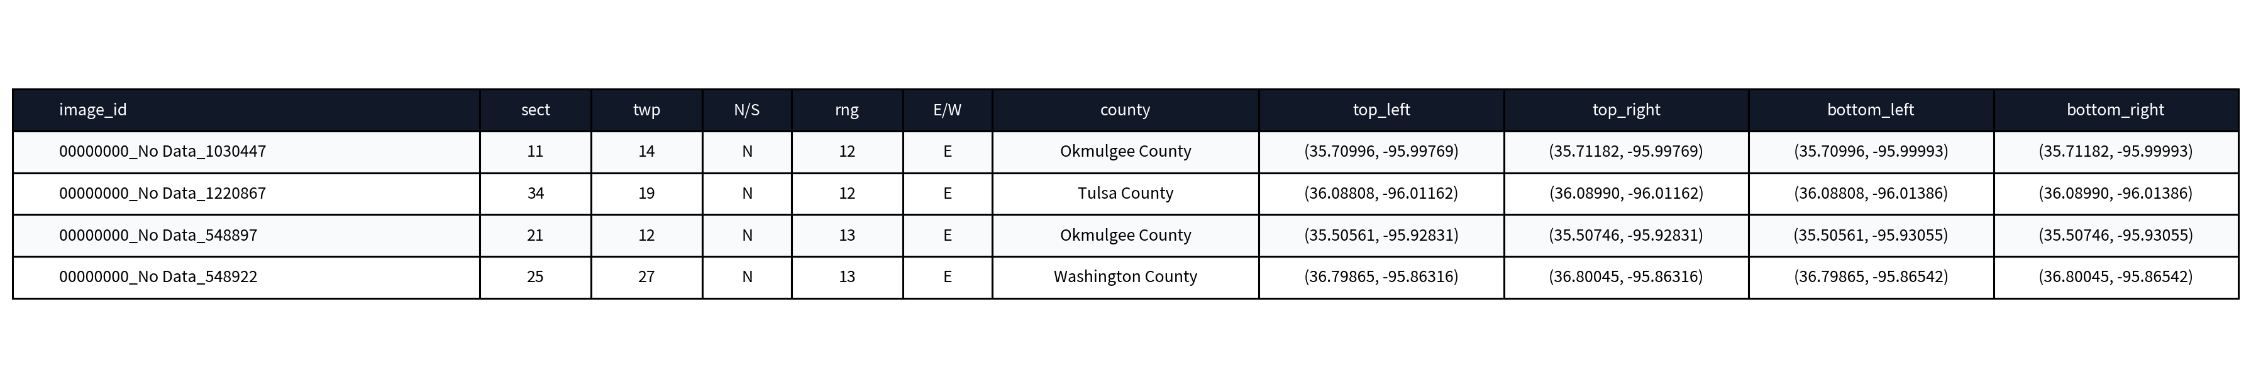
How Latitude and Longitude Are Computed from PLSS + Grid Data
Problem Statement:
Lat/lon are NOT directly stored in the source data.
Computed from PLSS metadata + human-selected grid.
Township/Range/Section/County → SQL lookup in PLSS table/view → section corner coordinates (4 corners).
How the Location Is Calculated:
Township/Range info → PLSS database lookup.
PLSS lookup → section boundary corner coordinates.
Grid row/col → relative position (x,y) on 0-1 scale.
Relative position + corners → bilinear interpolation.
Interpolate lat vertically then horizontally; lon horizontally then vertically.
Inputs Used:
Section number, Township (N/S), Range (E/W)
County name
Grid position: row (1-8), col (1-8)
Section corners: top_left, top_right, bottom_left, bottom_right (lat, lon)
(row, col) → (x, y)
(x, y) + corners → (lat, lon)
Example corner coordinates (from SQL match)
Notes:
This slide explains the geometric transformation from grid indices to geographical coordinates. By using bilinear interpolation within the PLSS section boundaries (retrieved via SQL), we achieve high-precision spatial mapping for every well.

Slide 18
Post-Processing: SQL Query and Lat/Lon Calculation
Start: final_combined_output.csv
(Section, Township, Range, County, row, col, image_id)
SQL Query Step: plss_query_matches.csv
Output of SQL query / PLSS match
Read 4 corners
Compute relative (x,y)
Bilinear interpolation
Write Back: final_combined_output_with_latlon.csv
(Adds latitude, longitude columns)
# Compute lat/lon
corners = plss_db.lookup(county, township, range, section)
lat, lon = interpolate(row, col, corners)
Notes:
This overview shows how the post-processing stage consumes the initial extraction results. By joining with the PLSS database via SQL, we obtain the necessary section corners to interpolate precise latitude and longitude coordinates.

Slide 19
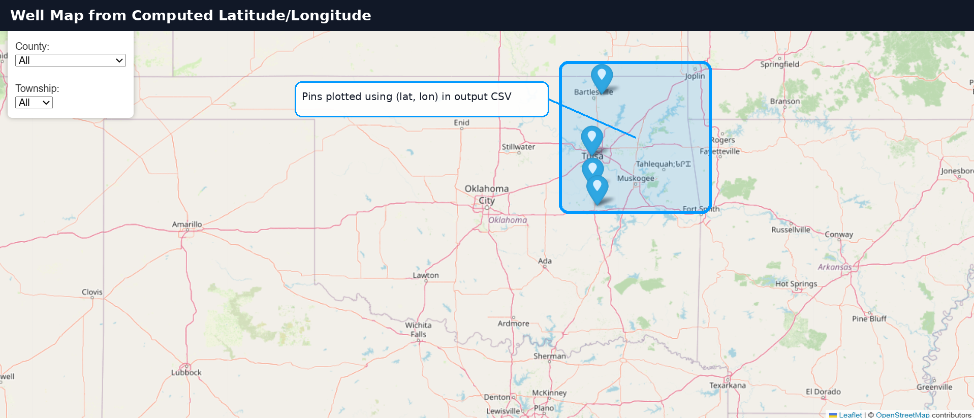
Well Map from Computed Latitude Longitude
Input: Output CSV with latitude, longitude
Plot: One marker per well (filter by County/Township)
Outcome: Spatial QA + quick discovery of outliers
Notes:
This slide showcases the final deliverable: a visual map of the processed well locations. Mapping the computed coordinates allows for spatial validation and immediate identification of any records that may fall outside expected geographic bounds.

Slide 20

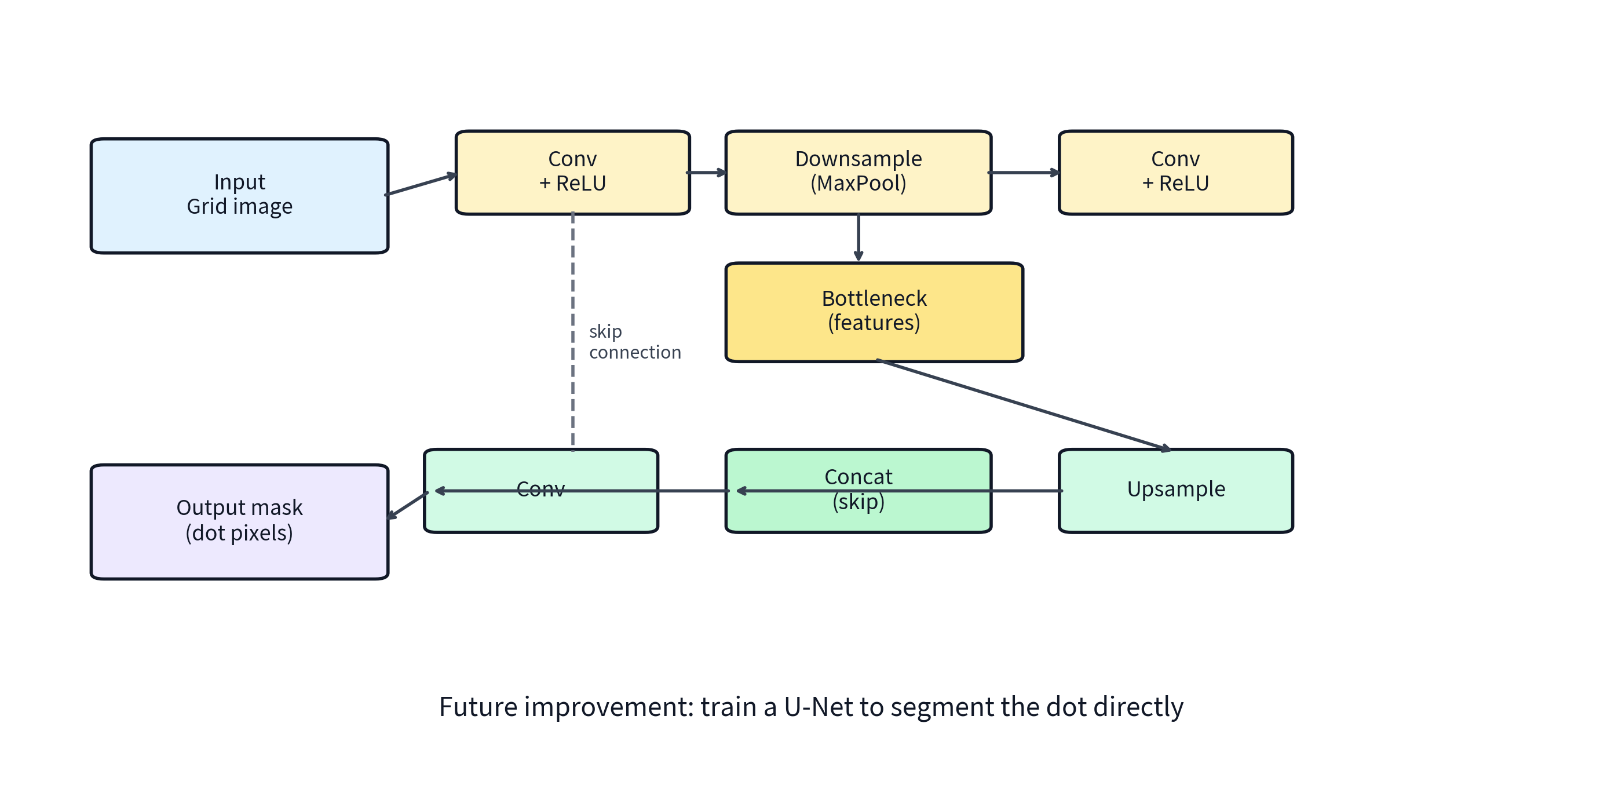
Future — U-Net Dot Segmentation
Note: After we can compute lat/lon reliably, the main remaining bottleneck is robust dot detection.
Developing a Robust Model:
Labeling: Generate binary masks for dot centroids.
Augmentation: Inject noise, blur, and rotation to train for low-quality scans.
Loss Function: Combined Dice + BCE for precise boundary segmentation.
Post-Processing: Centroid extraction → 8x8 Row/Col mapping.
Integration: Use the U-Net as a high-confidence assist or replacement for the current CV2 stage.
Notes:
Our future roadmap includes building a U-Net specifically for dot segmentation. By training on augmented data that mimics real-world scan noise, we can achieve far more reliable coordinate extraction than current methods.

Slide 21

Next Steps and Q&A
Pipeline Summary:
Inputs: Scanned multipage PDFs.
Transforms: Parallel CV + LLM processing.
Lat/Lon: Computed via SQL PLSS corners + bilinear interpolation → map visualization.
Outputs: Validated, GIS-ready CSV data.
Immediate Roadmap:
Stabilize classic CV dot detection.
Automate ground-truth labeling.
Train & Deploy U-Net Segmentation.
Map the latitude and longitude locations of well
Q&A
Notes:
In conclusion, our pipeline successfully automates the extraction of well data, with a clear roadmap toward even higher reliability via deep learning. We're now open for any questions.

