Slide 1
WELCOME
Literature Survey
Abstract
Objectives
Title
Thank You
Introduction
Reference
Problem Statement
Problem Definition
System Architecture
Use Case Diagram
DFD
Rutuja Prabhudesai 16UIT11044XX
Shivani Patil 16UIT11041XX
Vinay Sakhare 16UIT12046XX
Kanishk Shedsale 16UIT12049XX
Akshaykumar Patil 16UIT12037XX

Slide 2
Literature Survey
Smart Security System
Objectives
Abstract
Thank You
Introduction
Reference
Problem Statement
Title
Problem Definition
System Architecture
Use Case Diagram
DFD
USING IOT AND AI

Slide 3
Abstract
This project gives an outline for an automatic system to control and secure specific area, based on digital image processing with the help of Internet of Things and AI.
The system consists of a sensor, digital camera, database and the smart phone.
Sensors are placed in the specific area which alerts camera to start recording the activity in that area.
Then video is than divided into frames.
Image analysis is performed to detect and recognize and match the image with the stored dataset of the authenticated people.
If the image captured does not match with the dataset then an alert message is send to the owner of that area.
about
Literature Survey
about
about
Objectives
Introduction
Title
about
Thank You
about
Reference
References
Problem Statement
Abstract
Problem Definition
System Architecture
Use Case Diagram
DFD

Slide 4
Introduction
Motion Sensors
Camera
Video Segmentation
Image Analysis
Image Recognition
Generating alert message and alarm
about
Literature Survey
about
about
Objectives
Title
about
Thank You
about
Reference
References
Problem Statement
Abstract
Problem Definition
Introduction
System Architecture
Use Case Diagram
DFD

Slide 5
Literature Survey
IoT based Home Security through Digital Image Processing Algorithms (2017)
Detection of human-being and non-human object from image and video sequences (2017)
Deep Neural Network for Human Face Recognition (January 2018)
Face Recognition and IoT Based Smart Lock Access System (2018)
A Smart Security System with Recognition (December 2018)
Smart Home Management System Based on Face Recognition Index in Real-time (2019)
about
Literature Survey
about
about
Objectives
Title
about
Thank You
about
Reference
References
Introduction
Problem Statement
Abstract
Problem Definition
System Architecture
Use Case Diagram
DFD

Slide 6
Problem Statement
To provide smart security system to the specific area using IOT (sensors) and AI (face detection).
about
about
about
Objectives
Title
about
Thnak You
about
Reference
References
Problem Definition
Abstract
Literature Survey
System Architecture
Introduction
Use Case Diagram
DFD
Problem Statement

Slide 7
Problem Definition
The sensors will sense the motion in the specified area and activate the cameras. This cameras will record the activity and send it for further image analysis. If the human detected from that image does not match with the authenticated people then it generates an alert message as well as alert alarm.
about
about
about
Objectives
Title
about
Thank You
about
Reference
References
Abstract
Literature Survey
System Architecture
Introduction
Use Case Diagram
Problem Statement
DFD
Problem Definition

Slide 8
Objectives
The main objective is to implement the system that provides advance security to prevent undesirable events.
about
about
about
Objectives
Title
about
Thank You
Use Case Diagram
about
Reference
References
Abstract
Problem Definition
Literature Survey
System Architecture
Introduction
DFD
Problem Statement

Slide 9
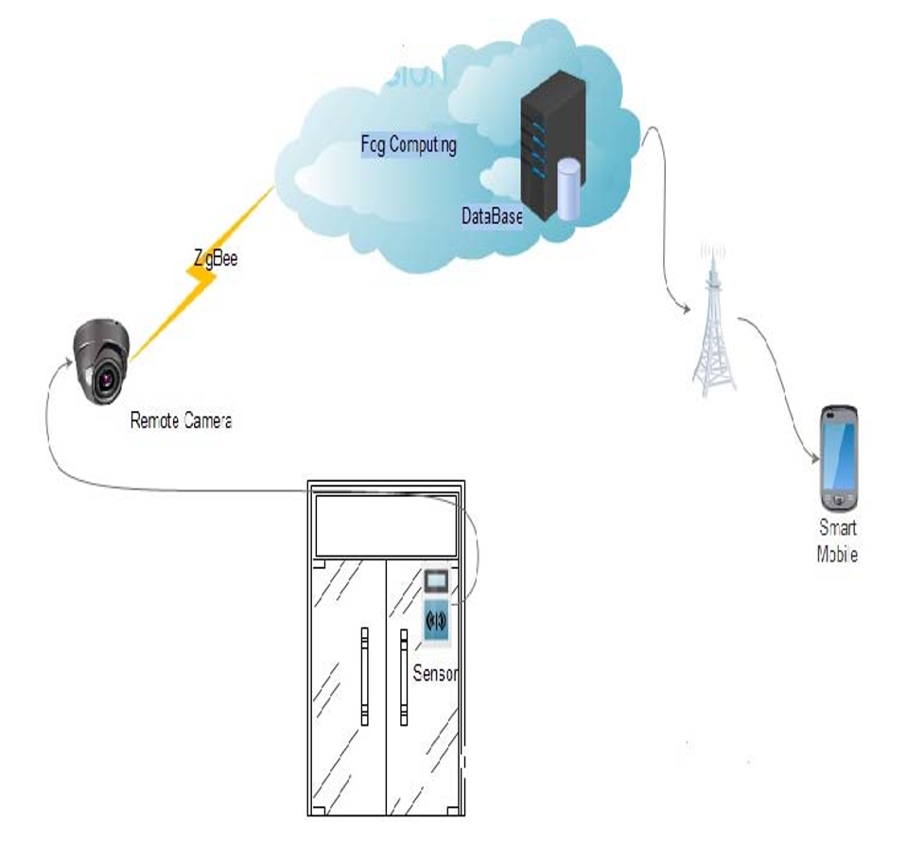
System Architecture
about
about
about
Objectives
Title
about
Thank You
about
Reference
References
Abstract
Problem Definition
Literature Survey
Introduction
Use Case Diagram
System Architecture
DFD
Problem Statement

Slide 10
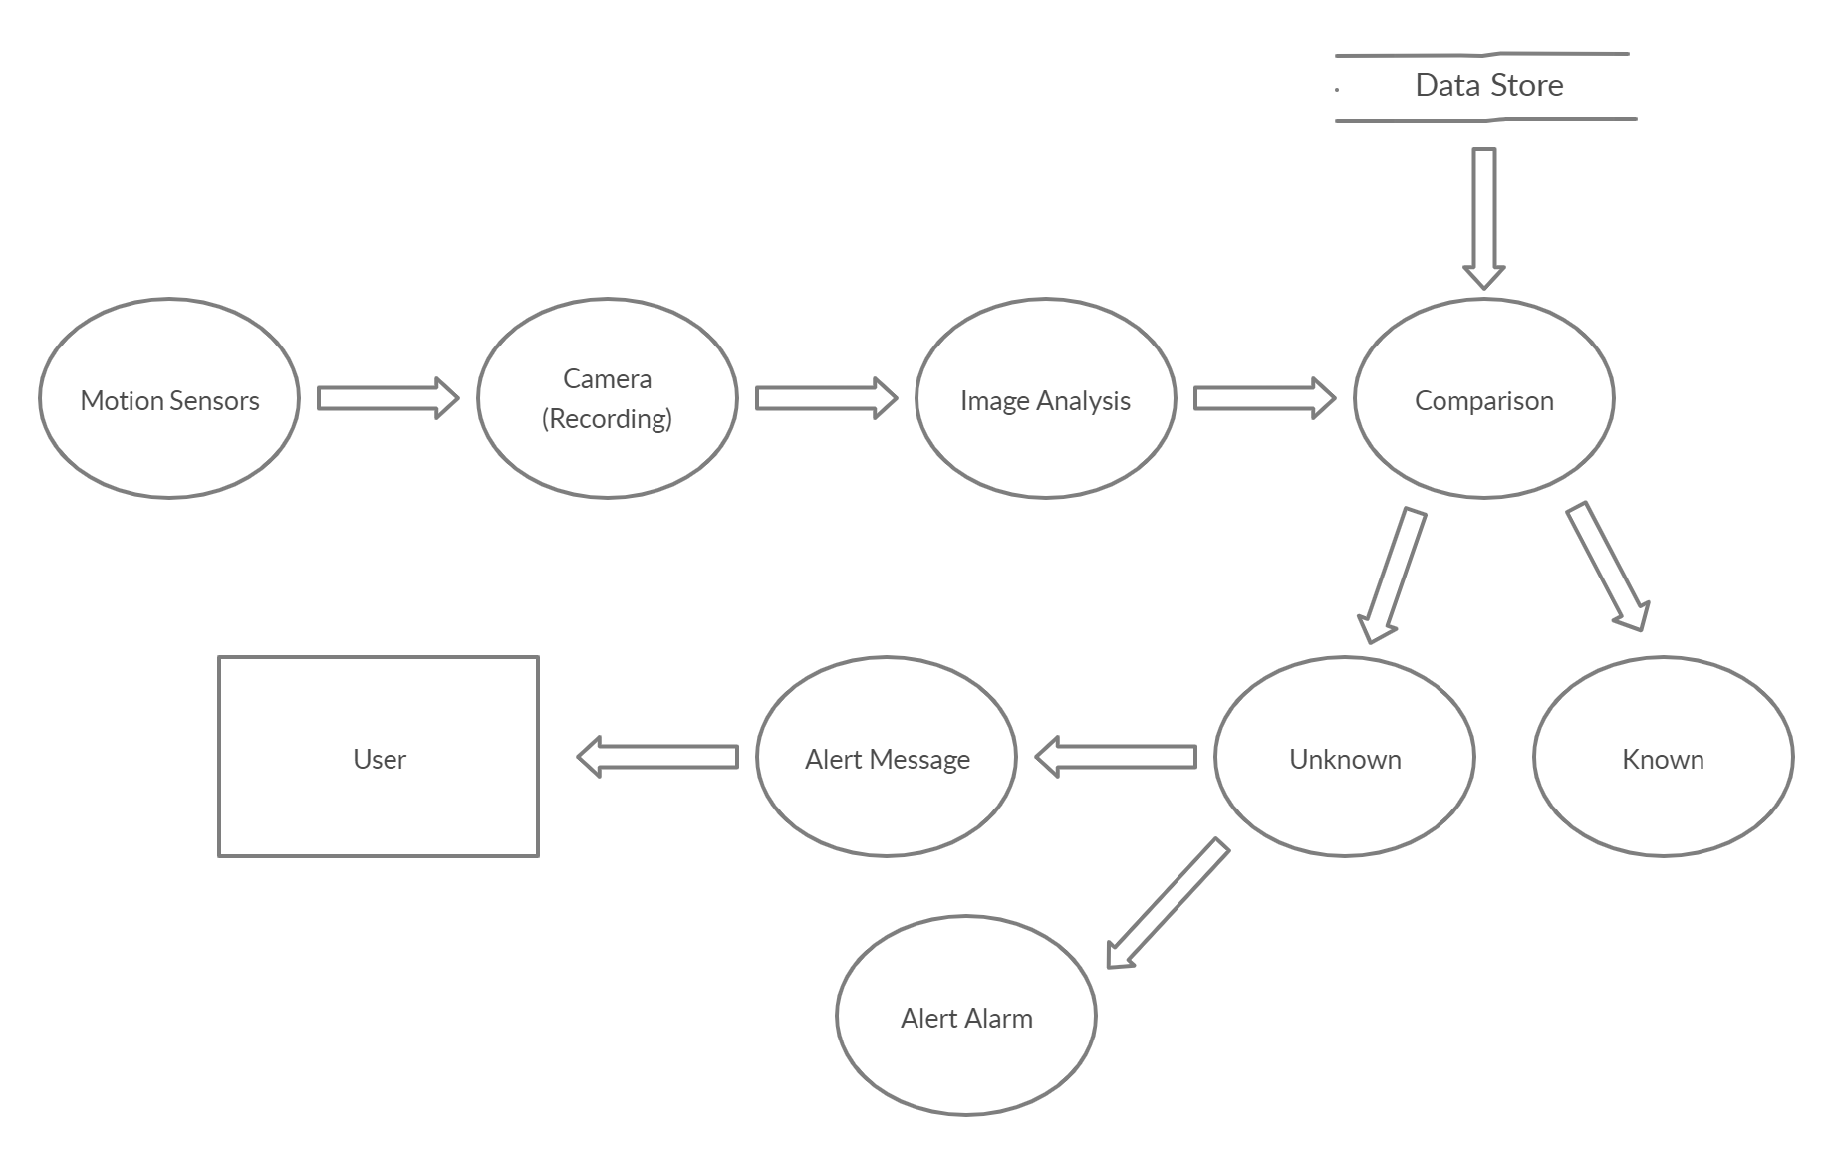
Data Flow Diagram
about
about
about
Objectives
Title
about
about
Reference
References
Abstract
Thank You
Problem Definition
Literature Survey
Introduction
System Architecture
Use Case Diagram
Problem Statement
DFD

Slide 11
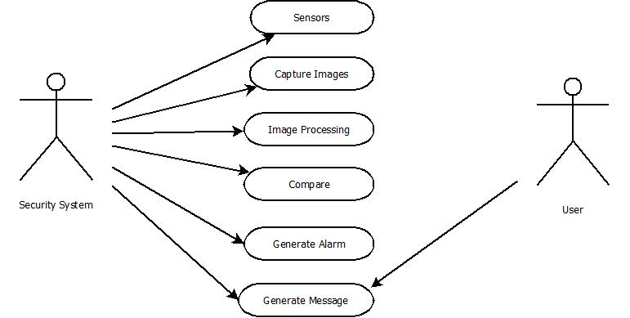
Use Case Diagram
about
about
about
Objectives
Title
about
Thank You
about
Reference
References
Abstract
Problem Definition
Literature Survey
Introduction
System Architecture
Use Case Diagram
DFD
Problem Statement

Slide 12
REFERENCES
Design and Implementation of Home Automation System Using Facial Expressions
P.C. Soumya Computer Science and Engineering, Amrita Vishwa Vidyapeetham, Coimbatore.
Face Recognition Using SVM Combined with CNN for Face Detection
Masakazu Matsugu, Katsuhiko Mori, and Takashi Suzuki , Canon Inc., Intelligent I/F Project., 5-1, Morinosato-Wakamiya, Atsugi.
The Research Based on Face Detection and Location System
Dong Yinghong, Wang Lele, and Bian Jing
College of Computer Science and Technology, Changchun University Changchun, Jilin Province, China
about
about
about
Objectives
Title
about
Thank You
about
References
References
Abstract
Problem Definition
Literature Survey
Introduction
System Architecture
Use Case Diagram
DFD
Problem Statement

Slide 13
Thank You
about
about
about
Reference
Title
about
about
References
Objectives
Abstract
Thank-You
Literature Survey
Introduction
Problem Definition
Use Case Diagram
System Architecture
DFD
Problem Statement

