Slide 1
MACHINE LEARNING PROJECT
Project 16:
RL-based Learning-Rate Scheduler
Done by
B Abhinav
Ch Charunya
N Akshay
100523733007
100523733011
100523733073

Slide 2



Motivation: Beyond Static Learning-Rate Schedules
Sensitive Hyperparameter
Fixed Heuristics Fall Short
The RL Paradigm
The learning rate (η) is the most sensitive hyperparameter in deep learning. A poor step size causes divergence or slow plateauing.
StepLR, Cosine and Exponential schedules are rigid and open-loop. They cannot react to noisy gradients, plateaus or saddle points.
Framed as a Markov Decision Process, an RL agent monitors loss velocity and adaptively steers the step size.

Slide 3




Methodology: Deep Q-Network (DQN) Controller
Closed-Loop MDP Setup
6D State Representation
Child model: 3-layer CNN on CIFAR-10. Each environment step is one full training epoch.
[TrainLoss, DeltaLoss, ValAcc, DeltaValAcc, ProgressRatio, log10(LR)] — a snapshot of the convergence trajectory.
Action Space & Bounds
DQN Learning Mechanics
5 multipliers {×0.5, ×0.8, ×1.0, ×1.25, ×2.0}, with LR clipped to [10⁻⁵, 0.20] for numerical safety.
Experience replay buffer (2,000 transitions), ε-greedy exploration and target-network synchronization.

Slide 4
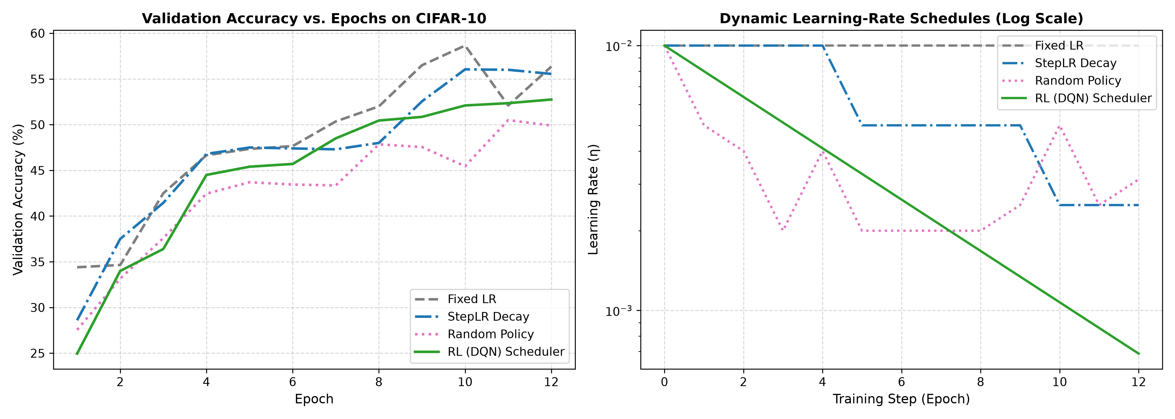
Empirical Results: CIFAR-10 Benchmark Comparison
52.75%
55.55%
RL (DQN)
StepLR Decay
56.35%
49.90%
Fixed LR (0.01)
Random Policy
Validation accuracy after 12 epochs
Performance Benchmark
Learned Policy Dynamics
The RL (DQN) scheduler reached 52.75% validation accuracy (reward 42.70), beating the random baseline (49.90%, reward 39.90).
It discovers a two-phase schedule: high LR during early feature learning, then gradual adaptive decay once validation accuracy stagnates.

Slide 5



Limitations & Practical Challenges
Computational Overhead
Collecting rollouts means training the child model for full epochs, which is very expensive for billion-parameter models.
Meta-Overfitting & Transferability
Policies trained on compact CNNs do not transfer zero-shot to other architectures (e.g., Vision Transformers) or datasets without fine-tuning.
Temporal Credit Assignment
A learning-rate change can take several epochs to show its effect, which adds credit-assignment noise.

Slide 6



Societal Impact, Green AI & Ethics
Environmental Impact & Green AI
Democratization of ML
Safety Guardrails
Brute-force grid search has a large carbon footprint. Controllers that converge in fewer epochs cut datacenter power use.
Removes manual tuning friction so non-specialists and low-compute academic labs can train models efficiently.
Hard-coded LR clipping prevents catastrophic divergence, keeping automated production pipelines stable.

