Slide 1
Automated code generation on Triage wikis
oneDoc
Irfan
Akshay Shetty
Sucheta

Slide 2
Problem Statement
Today we have multiple documents to study a feature. Example : Cisco wiki, twiki ,techzone , ddts , TAC articles , email conversations.
To fully understand and properly debug any problem, we need to search multiple documents related to the same feature.
Often the information is scattered through multiple documents . A feature may have good description in SFS , configurations might be put up in a techzone article , tweaks and debuggability features might be in a ddts or email conversations .
Sometimes the same information is available in multiple documents , confusing the developer or user which one to refer to .

Slide 3
Various formats
Multiple docs
Difficult to use
Scattered information
Maintenance nightmare
Information Duplication

Slide 4
Solution
Define one standard format for all features , components and platforms.
Model generated through UI using model template and user input
Developers and testers can continuously update the models . The quantity and quality of the models improve with time and effort leading to better information searching and debuggability .
Traverse through the decision tree to pinpoint any issues or get complete feature information including dependencies and subsystems.

Slide 5
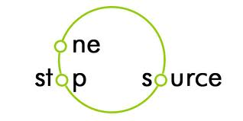
What exists
Information is scattered in
Wiki
SFS
TAC TOI
Deepdive
Test plans, C bugs, cs-emails
Single standard template
Not dependent on component, platform, OS
One stop information model
UI to generate the model with data from user- User need not learn a new format to write the data.
Modularity enables us to store the data in any format, json, xml or anything else.
Format can be changed at any point without affecting any of the users.
How we troubleshoot today:
Need subject matter expert
Traverse through all docs
Collect information
Need different subject matter expert if not our component
oneDoc
Transforms to an all new model

Slide 6
The two aspects of the solution
Model generation based on a UI
Application that would take the model as input , build a decision tree and traverse the decision tree and solve/pinpoint the problem.

Slide 7
UI to generate models
FEATURE DESCRIPTION
feature qnode {
requires {
state {
description “Find the number of qnodes used" ;
cli "nile debug qnodes 0 0 4096";
verify {
no-of-schedulers < 40000;
blame efp-qos-egress;
}
}
}
}
Enter feature name
smand
Enter the show command
nile debug qnodes 0 0 4096
Enter the cli description
Find the number of qnodes used
Enter the cli condition
no of schedulars > 40000 , blame efp-qos-egress
SUBMIT

Slide 8
Application
Check hardware , software , license
Error
Check configs
Error
Blame missing configuration
Feature model
Check show commands
Error
Blame the corresponding
Model based on verification
Check logs
Error
Blame the culprit model
Check subsystem model

Slide 9
Apps on the top
User Configuration guide, tac toi, troubleshooting guide generator
Collect all performance and scale numbers
Subsystem too complex to model? Rethink design? Break it down?
auto-sync on doc change. Users rate models. Poor models are improved
Collect all performance and scale numbers
Walk-through generation to explain how the entire device is working?
Bug closed, behavior changed, cs-email query? Auto-update request sent to Engineer
Machine learning on big data?
Model pipelines of how packet flows through system?
Troubleshooter that understands the full system behavior and its components can be built
Subsystem too complex to model? Rethink design? Break it down?
Anything you want!

Slide 10
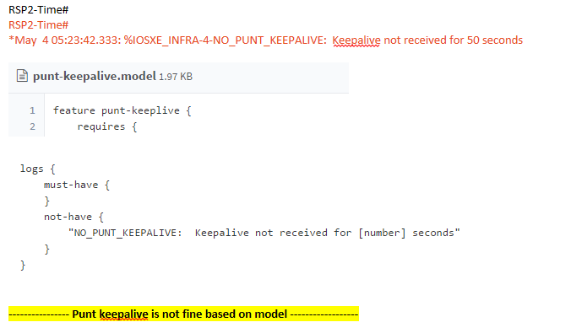
Demo

Slide 11
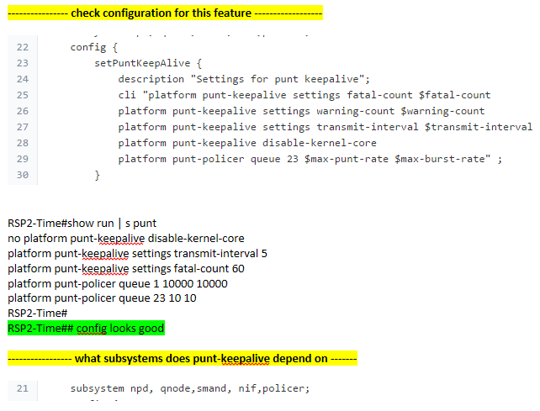

Slide 12
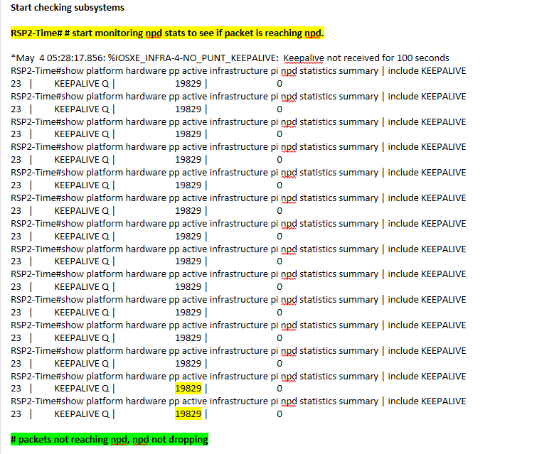

Slide 13
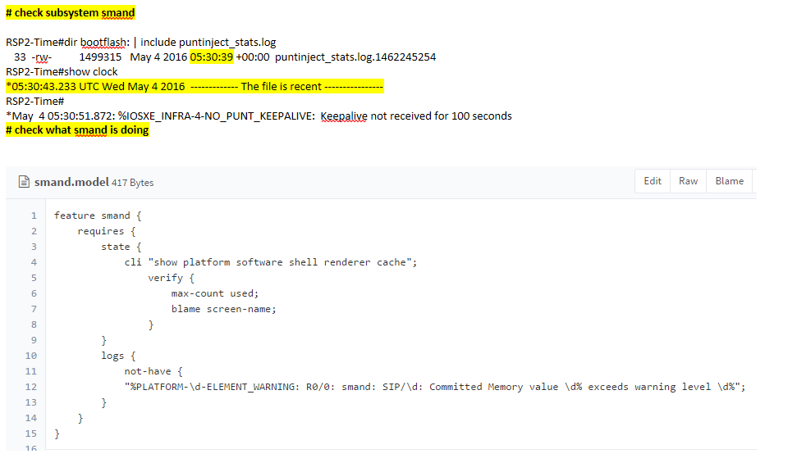

Slide 14
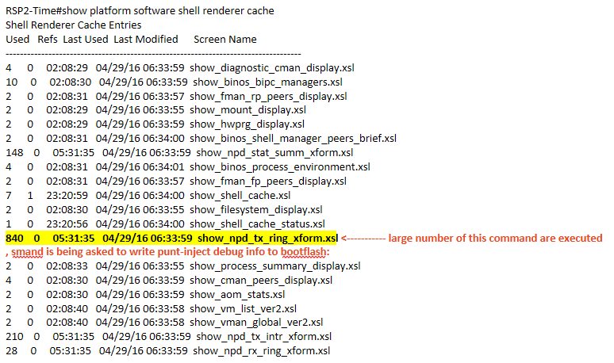

Slide 15
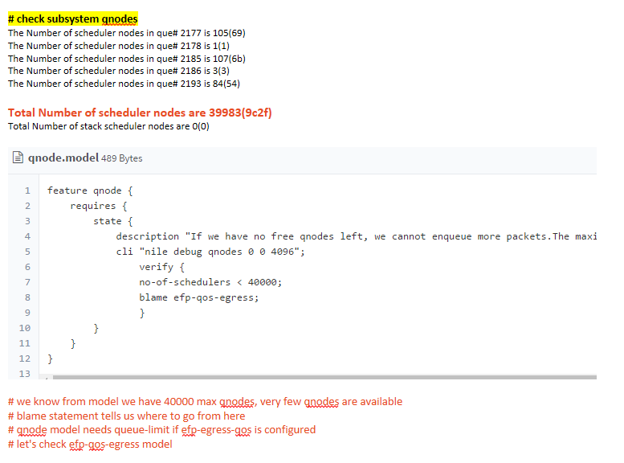

Slide 16
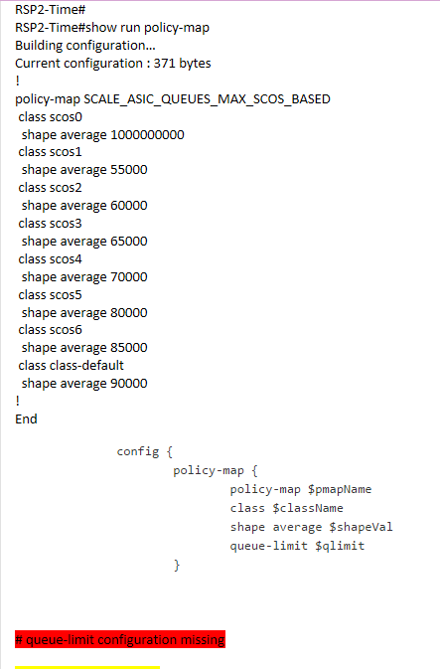

Slide 17
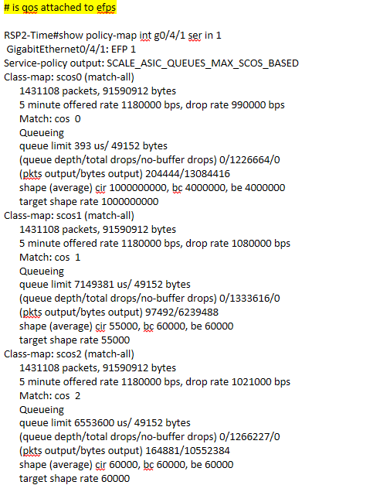

Slide 18


Slide 19
Why adopt oneDoc ?
One extensible and readable template
Model develops with iterations starting from developer to test to tac and cycle thereafter.
With change in design/implementation/ bug fix, only one doc needs to be updated
One extensible and readable template
Reduced time $$$$
Engineers can build on the same doc as new info comes
User need not worry about format
Debugging gets easy $$$$
Verification and maintenance is simplified $$$$
Template will guide user to generate the model
Clean, gives confidence to customers
Allows for tools to be built on top of standard
More Innovation!!

Slide 20
Challenges and future
We have created the oneDoc app to create models based on inputs from the user
Few models have been developed. The increase in quality and quantity of models will gradually happen when adaptation increases.
The debugger application is currently ongoing .

Slide 21
Contact
Irfan , SPAG ( mohirfan@cisco.com)
Sucheta , SPAG ( suchecha@cisco.com)
Akshay , SPAG ( akshashe@cisco.com )

