Slide 1
ONLINE TICKET BOOKING
Project By :
1140 – Akshay Patil
1037 – Chanchal Narkhede
Guided By :
Mr.Kashinath Patil

Slide 2
Introduction
Our project basically manages the ticket booking process of a multiplex, providing an interface to the user to book movie tickets in a more easy way.
At the front end we have used Jsp ,bootstrap ,css and in the back end Spring Boot, Hibernate and My SQL database.
The project proceeds through a sequence of well-designed forms provided with validations to ensure consistency, reliability and most importantly correctness of information feed into the database.

Slide 3
Platform
“Online Ticket Booking” software is designed and developed on Open Platform i.e. J2EE and Spring boot Framework.
My SQL Server is used to maintain the database.

Slide 4
Modules
Login Module
Sign Up Module
Payment Gateway Module
Admin Module
User Module

Slide 5
User Types
1. Admin:
Admin can add, delete, update the Theaters and Movies.
Admin can view the Theater List, Movie list.
2. User:
User can see the Theater List, Movie list, price of the ticket, show timings.
User can book the movie ticket.

Slide 6
Features
Booking management via Smartphone and Laptop/Desktop.
Online Payment Gateway.
Highly Responsive user interface.
Easy to use and user friendly.

Slide 7
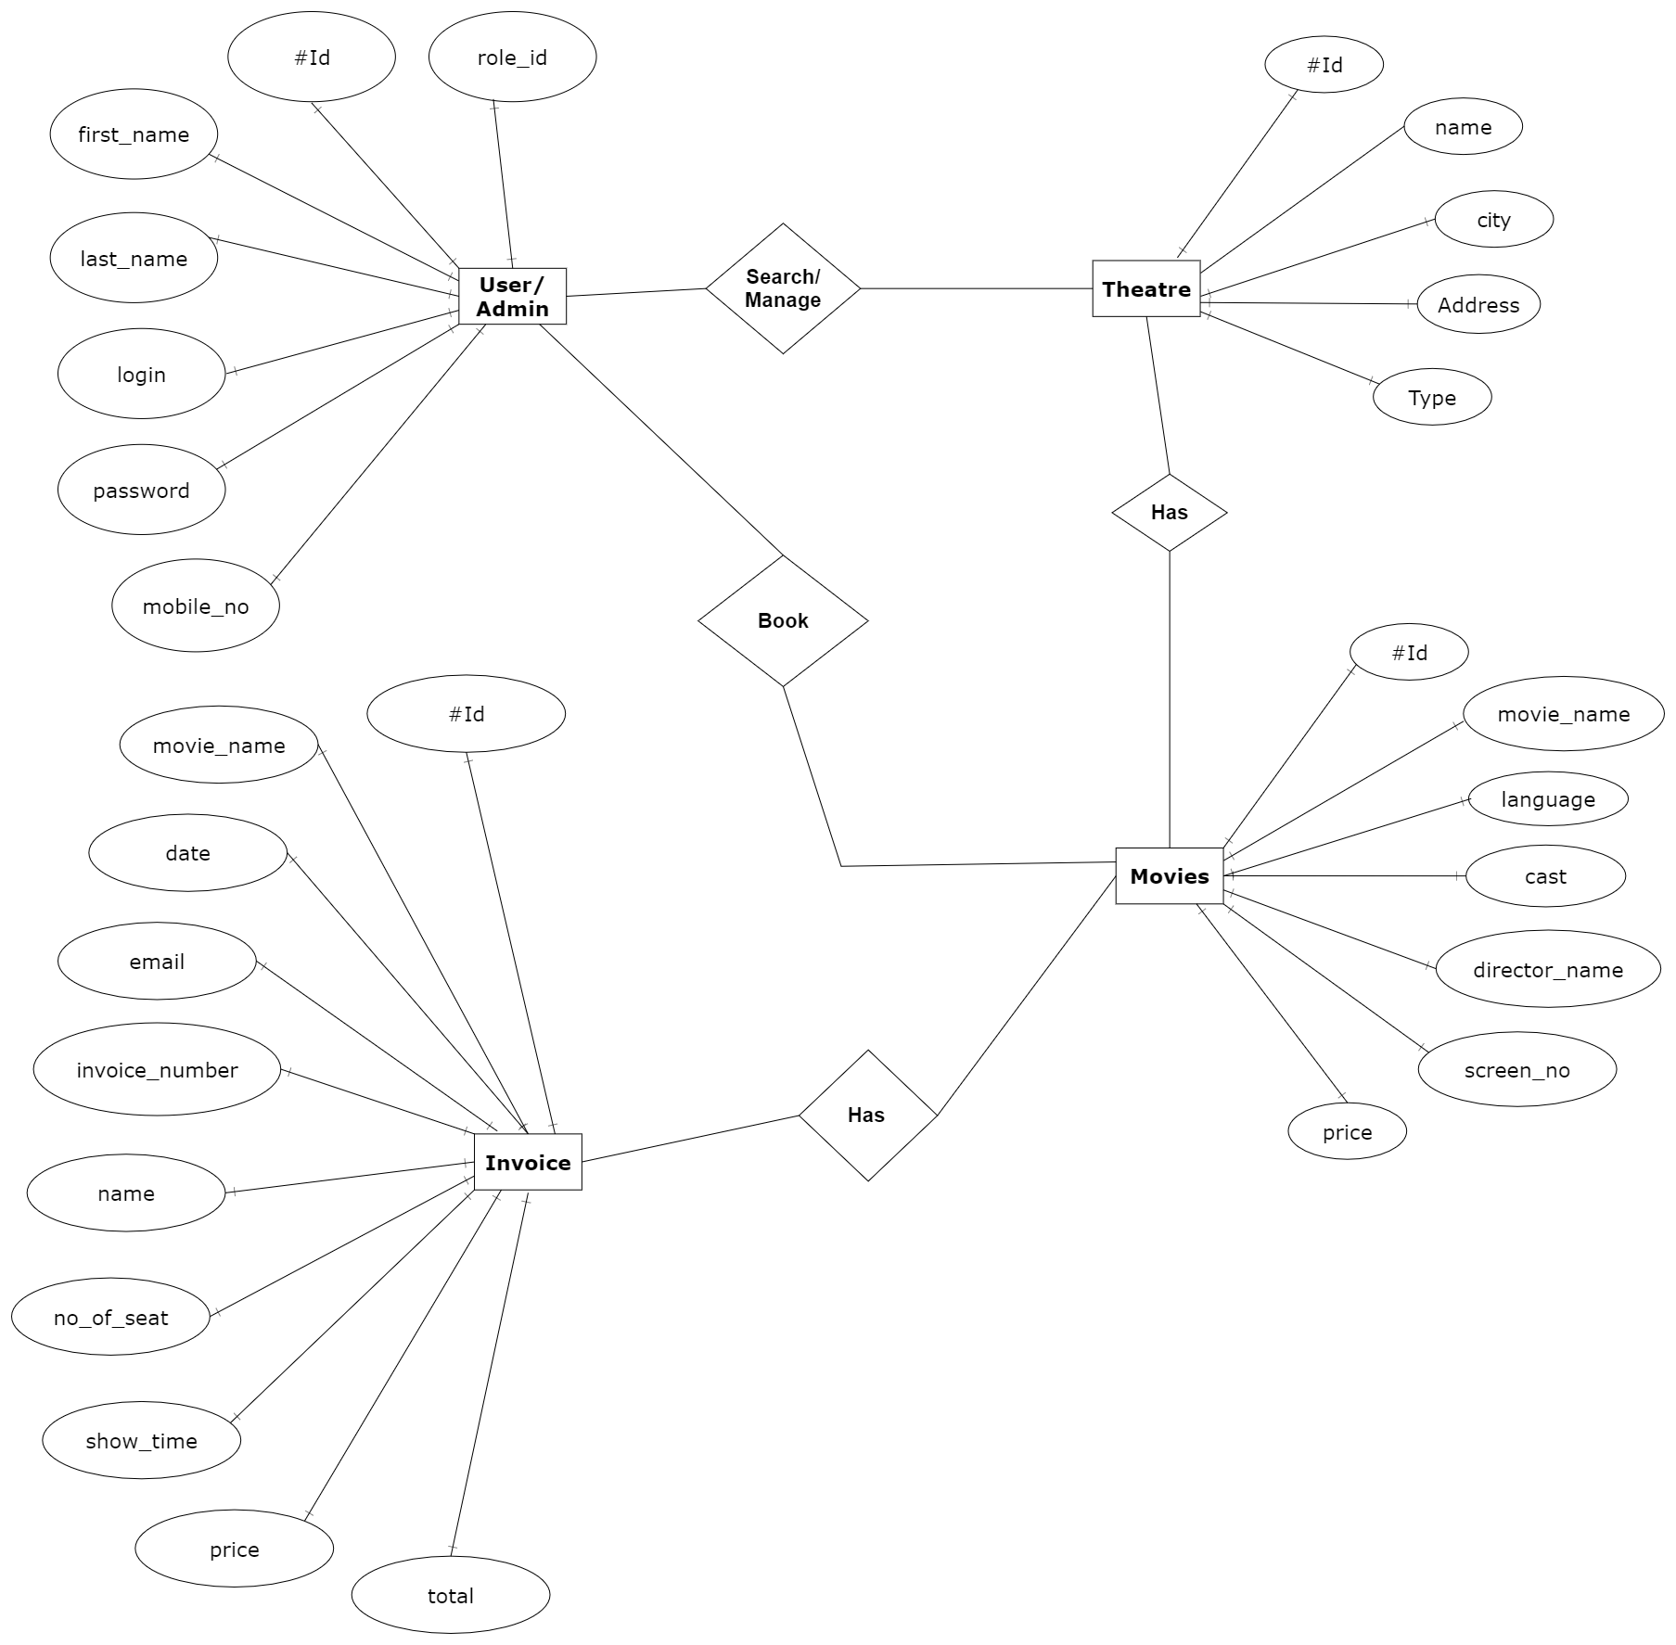
ER- Diagram

Slide 8
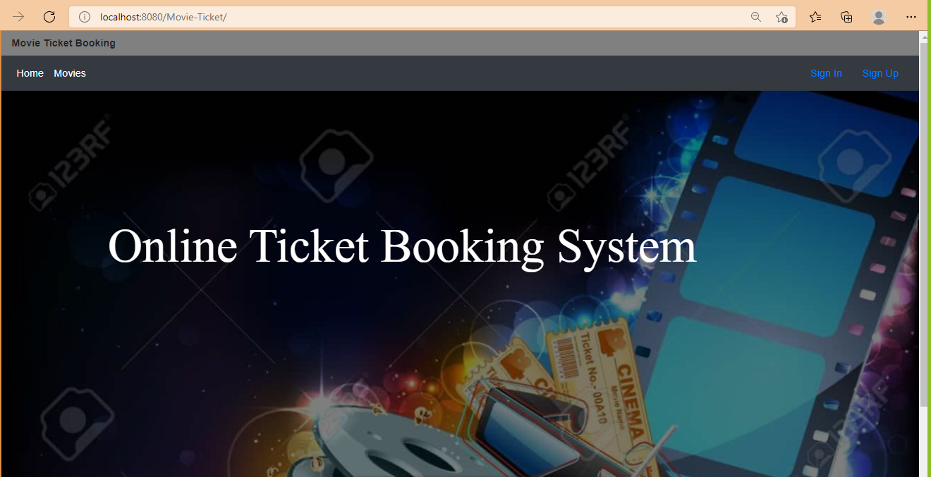
Home Page

Slide 9
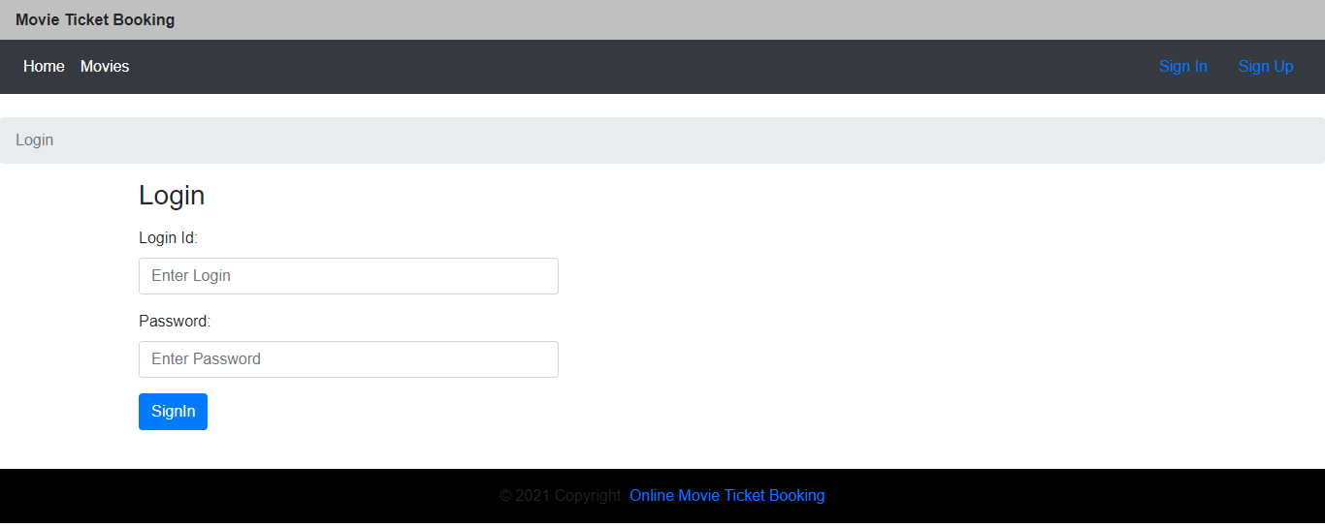
Login Page This is the first page for signing in. The Admin and User can sign up or log in from this console.

Slide 10
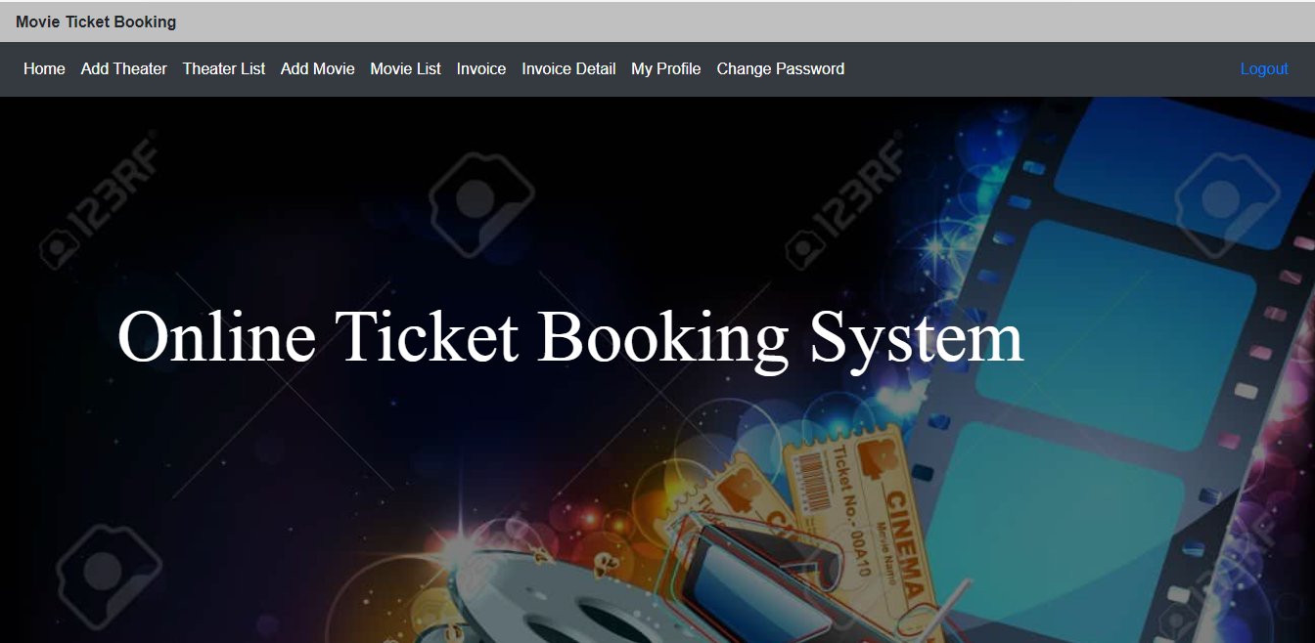
Admin Page This page displays the functionalities available to the admin.

Slide 11
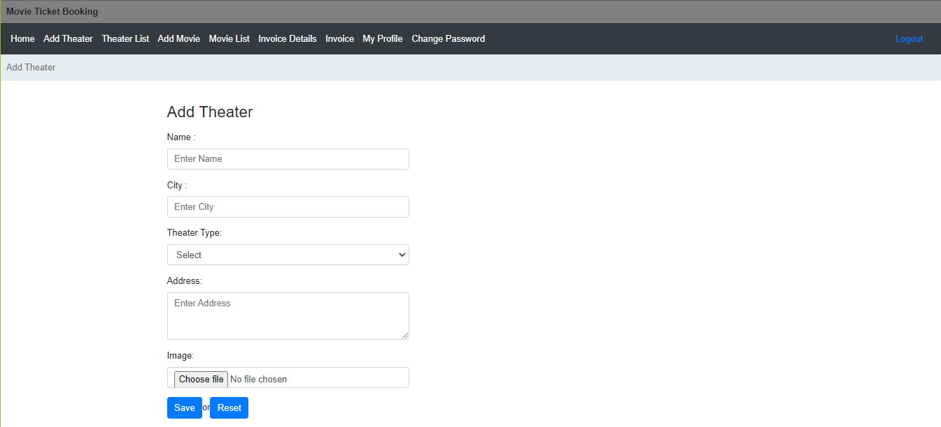
Admin add theater Page

Slide 12
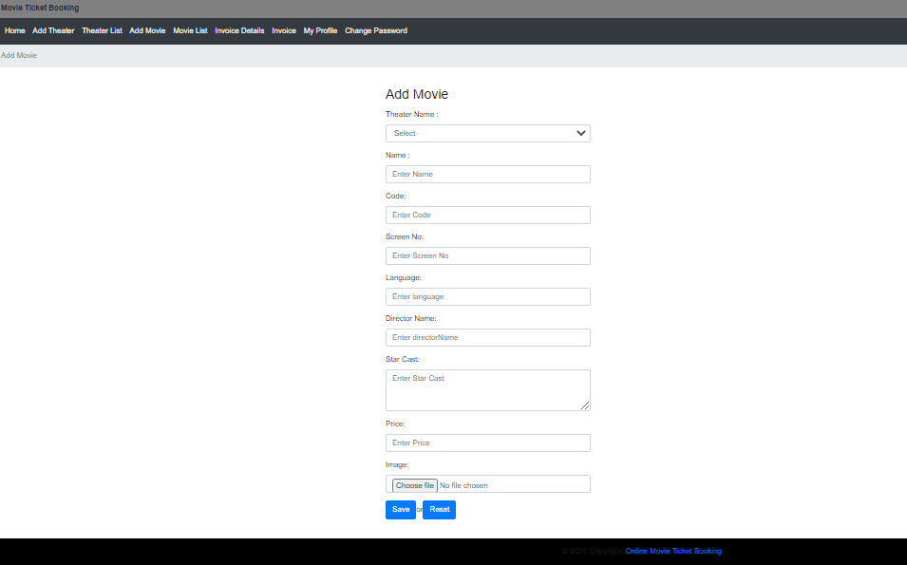
Admin add movie Page

Slide 13
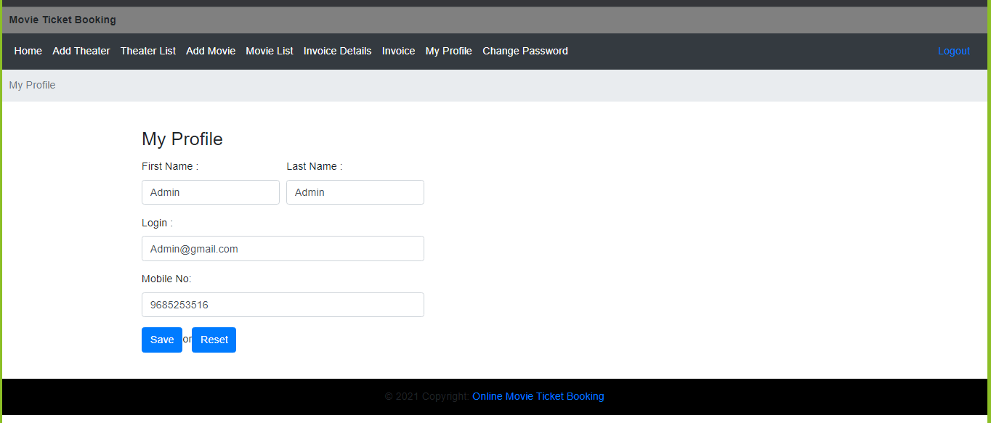
Admin change profile Page

Slide 14
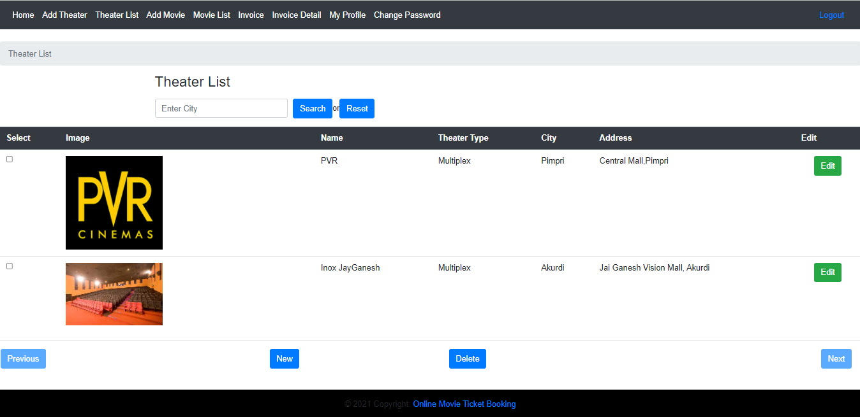
Admin theater list Page

Slide 15
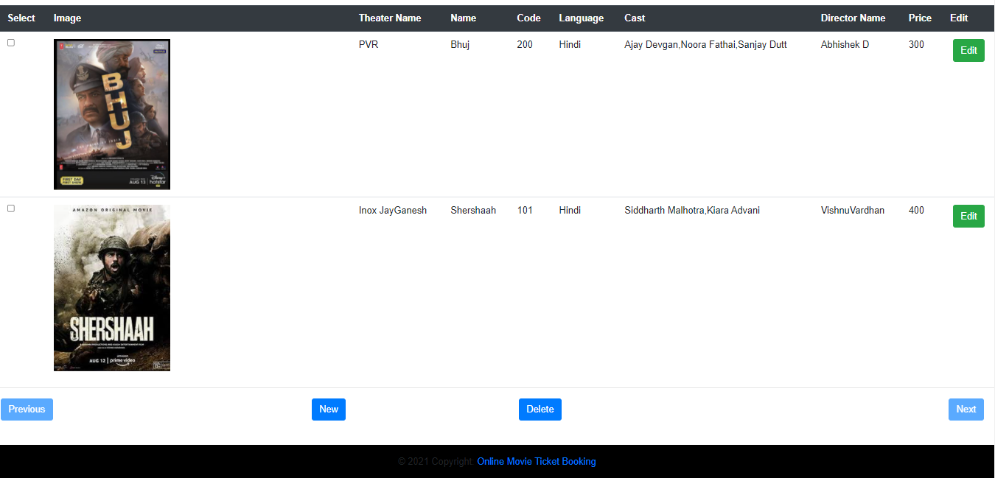
Admin movie list Page

Slide 16
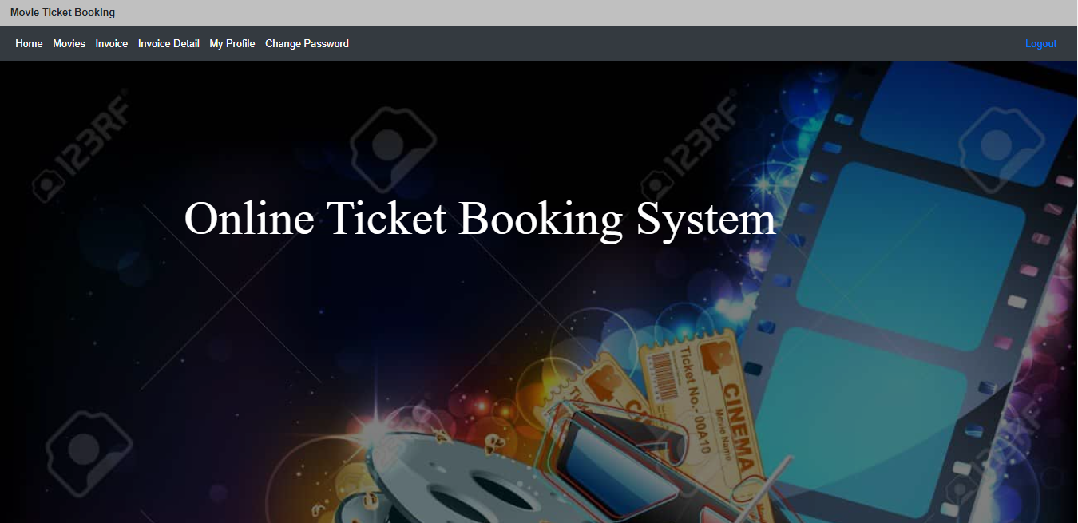
User Page This page displays the functionalities available to the User.

Slide 17
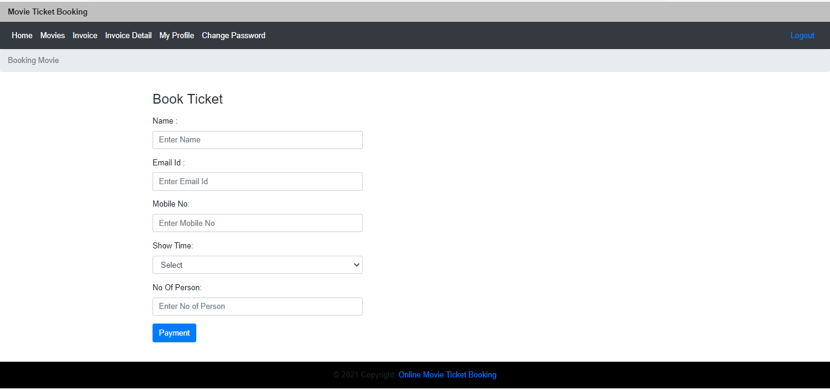
User Booking Page

Slide 18
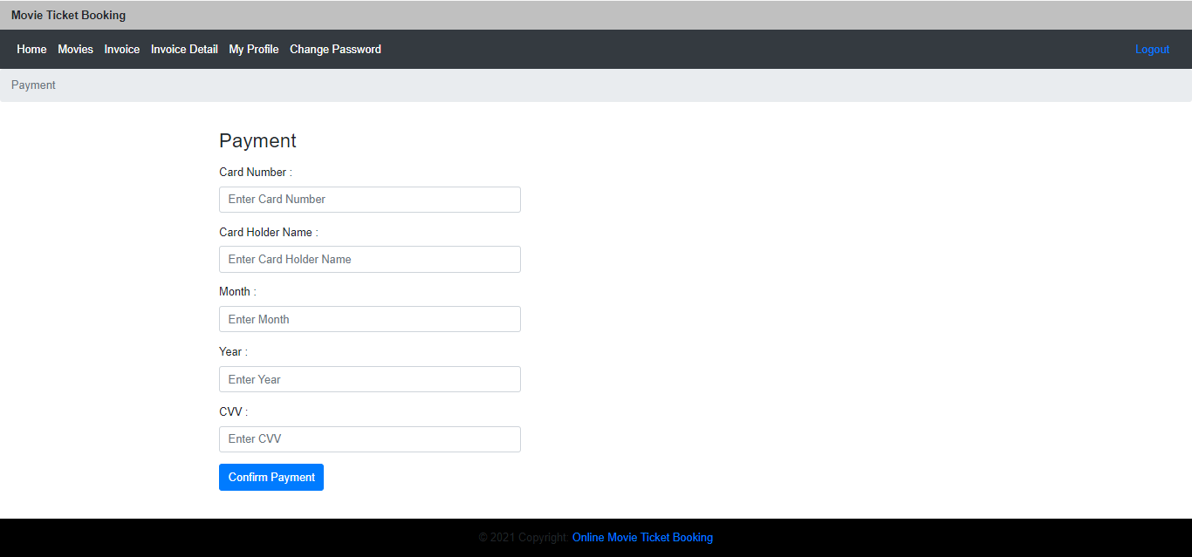
Process Completion

Slide 19
Future Scope
User can book ticket with multiple payment options.
User can see No of seats available and can book ticket with seat number.
Invoice will be mailed to Users registered Email Id.
It will grant more easy access.

Slide 20
Conclusions
The project has been developed successfully and the performance of the system has been found satisfactory.
The security has been incorporated by any placement firm.
User friendly menu driven interface has been provided to the user to interact with the system.
The system provides an integrated environment for the customers to watch the movies.

Slide 21
THANK YOU ☺

