Slide 1

Project-1 Web-series data analysis using HDFS and Hive
Under guidance of: Developed by:
Alwyn Micaiah Akshay Paurush singh
(Trainer) Bhadauria

Slide 2
Title
Introduction
i) Aim
ii) Description
iii) Objectives
Applications used
Output Screenshots
Hive query result into a File
Partition in Hive

Slide 3
1-Introduction
AIM: The goal of the project is to analysis the web-series dataset using HDFS and Hive.
Description: For this Big-data project, I took the web-series data from Kaggle website, and converted that data into CSV file. The dataset contains 9 columns and 12500 rows approximately. Then using Ambari I imported the CSV file data into HDFS. After that I created one database and table inside that database using Hive. Then I loaded the web-series data into the Hive table and finally did some analysis on that dataset with the help of Hive queries. And also stored the output of Hive queries back into HDFS.

Slide 4
Objective: The objective is to analysis the web-series data and also used that dataset to answer the following questions:
Which streaming platform(s) can I find this web series on?
Average IMDb rating and other ratings
What is the genre of the title?
What is the synopsis?
How many seasons are there right now?
Which year this was produced?
For which age group this web-series is appropriate.

Slide 5
2-Applications used
HDFS: for storing large web-series dataset and provides easier access to hive tables.
Hive: Hive is used to facilitates easy data summarization, ad-hoc queries, and the analysis of web-seires datasets stored in Hadoop compatible file systems.

Slide 6
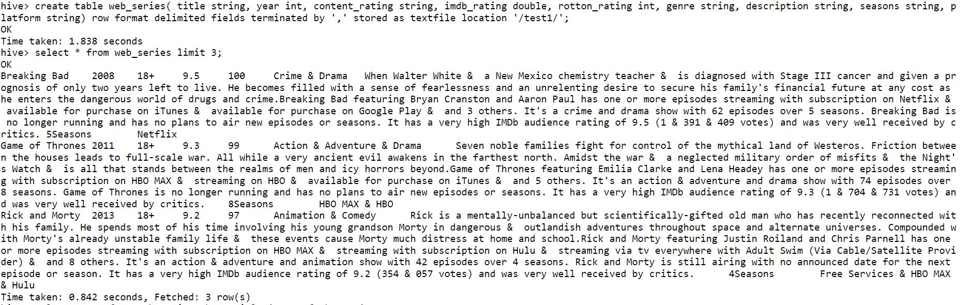
3-Output Screenshots
Create database akshaydb;
Use akshaydb;
Create table

Slide 7
Select * from web_series;

Slide 8

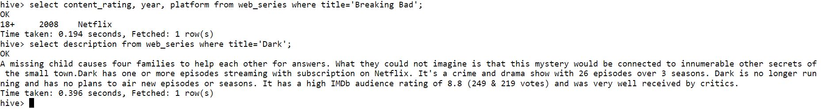
Select genre from web_series where title=‘Game of Thrones’;
Select content_rating, year, platform from web_series where title=‘Breaking Bad’;
Select description from web_series where title=‘Dark’;

Slide 9
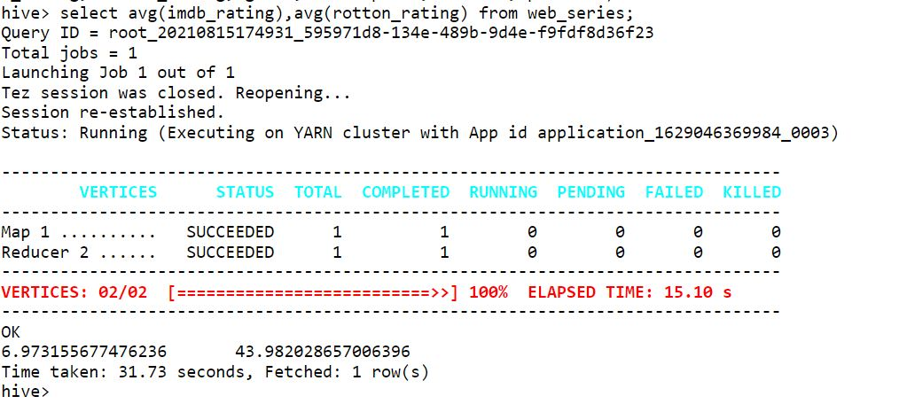
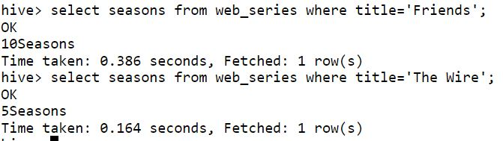
Select avg(imdb_rating), avg(rotton_rating) from web_series;
Select seasons from web_series where title=‘Friends’;

Slide 10
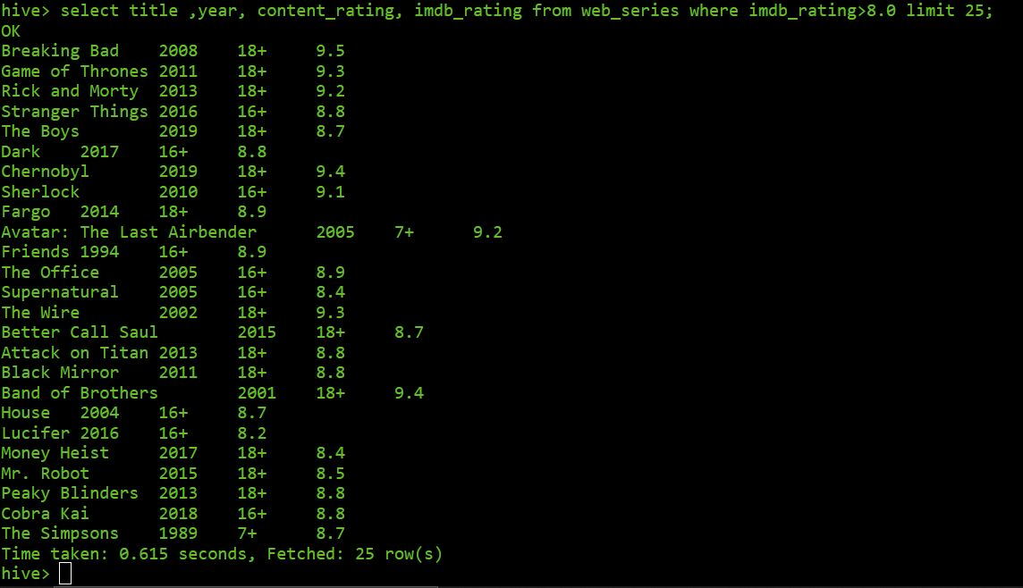
Select title, year, content_rating, imdb_rating from web_series where imdb_rating > 8.0 limit 25;

Slide 11
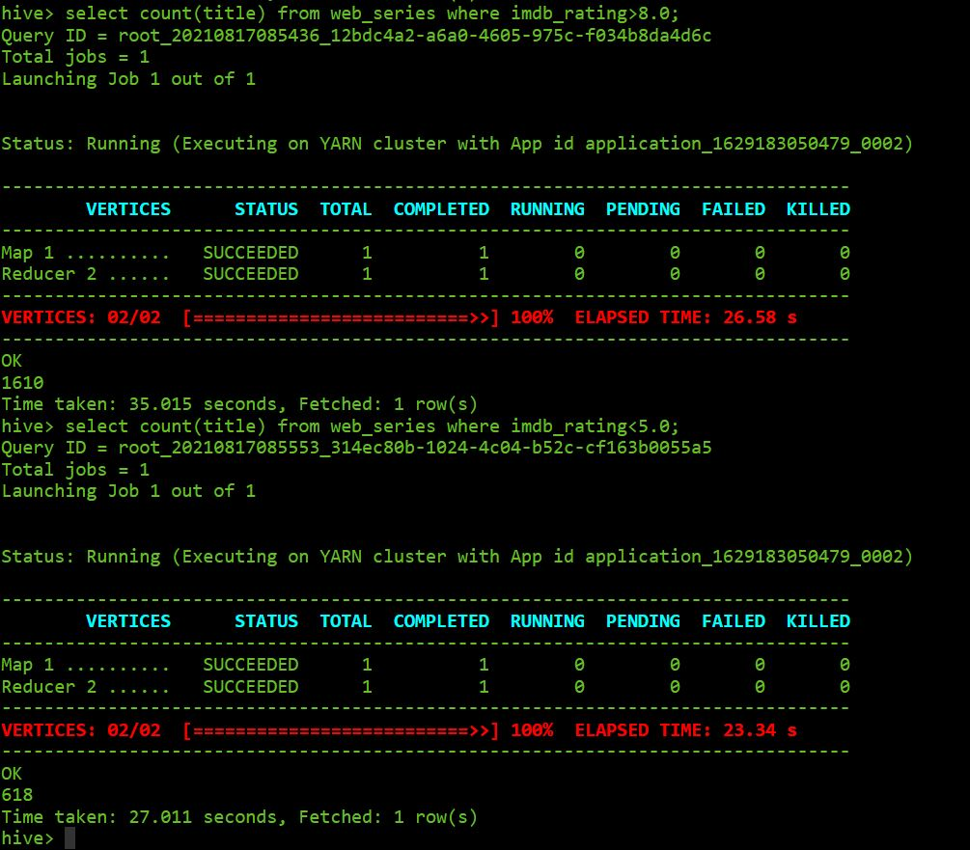
Select count(title) from web_series where imdb_rating > 8.0;

Slide 12
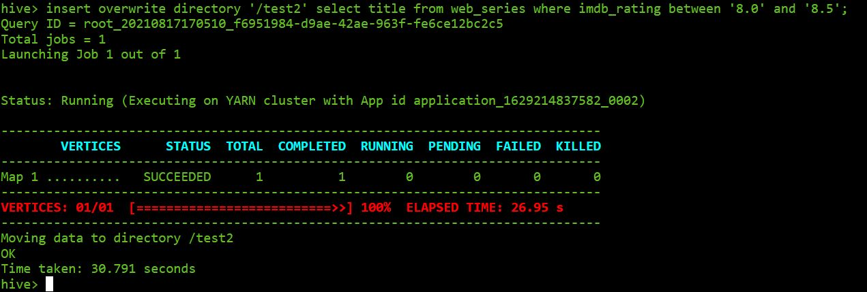
4-Hive query result into a File
Insert overwrite directory ‘/test2’ select title from web_series where imdb_rating between ‘8.0’ and ‘8.5’;

Slide 13
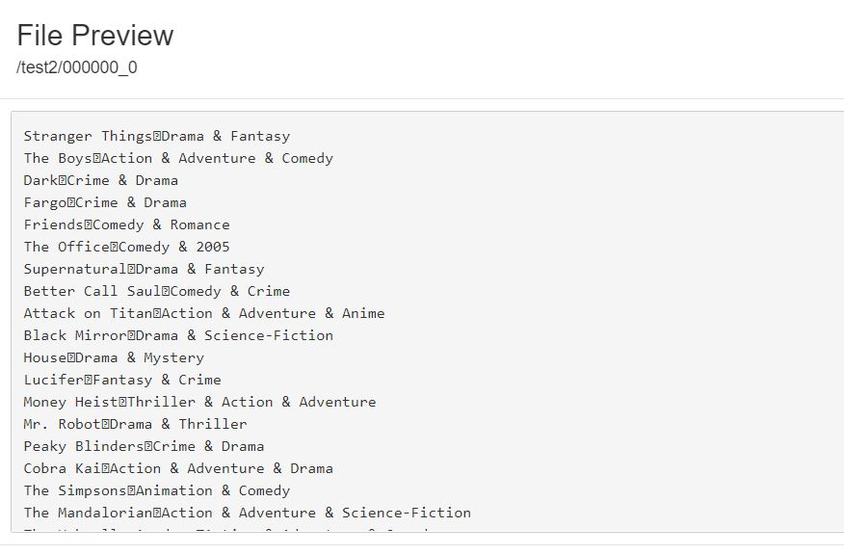
Hive query output imported in hdfs directory.

Slide 14
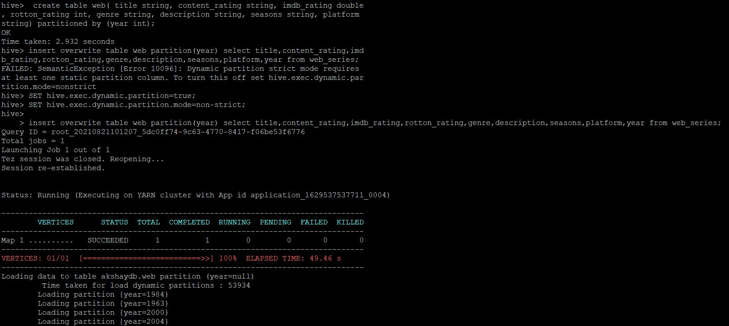
5-Partition in Hive
Create table web(title string, content_rating string, imdb_rating double, rotton_rating int, genre string, description string, seasons string, platform string) partitioned by (year int);

Slide 15
Insert overwrite table web partition(year) select title, content_rating,imdb_rating, rotton_rating, genre, description, seasons, platform, year from web_series;

Slide 16
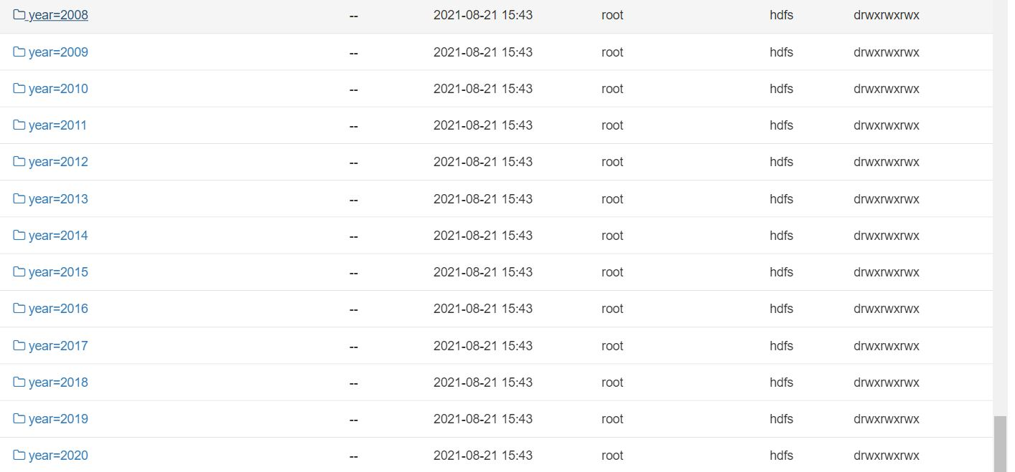
partition file based on year created in hive/warehouse directory.

Slide 17
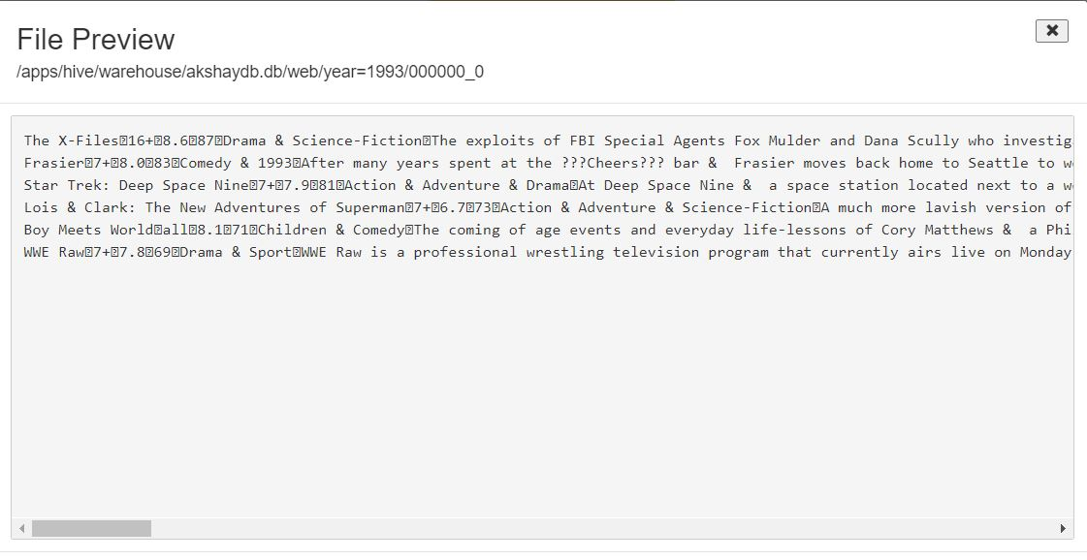
Content of one of the years in partition file in HDFS.

Slide 18
Thank you!!

