Slide 1
Lab Assignment on Unit I: (Mandatory Assignment)
Part A: Setup a wired LAN using Layer 2 Switch and then IP switch of minimum four computers. It includes preparation of cable, testing of cable using line tester, configuration machine using IP addresses, testing using PING utility and demonstrate the PING packets captured traces using Wireshark Packet Analyzer Tool.
Part B: Extend the same Assignment for Wireless using Access Point
Motivation: Learn to setup wired and Wi-Fi office/organization network
Outcome: Students will able to setup wired and Wi-Fi network
Image Sources: iplocation.net, mongosukulu.com

Slide 2
Equipments Required
Cat 3, Cat 5, Cat 5e Cat 6a Cables and RJ45 Connectors
Crimping Tool
Line Tester
One server Node with Open Source and Internet Support
HTTP Server (Apache) with Website pages of your Institute
Four Client Nodes with Wi-Fi Support
Wireshark Protocol Analyzer on all nodes
Layer-II Switch
Layer-III IP Switch
Wi-Fi Access Point 2.4 GHz
High Gain Wireless USB Adapter (Repeater)
IP Address Configuration Chart

Slide 3
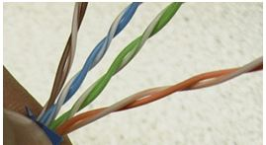
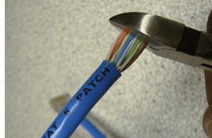
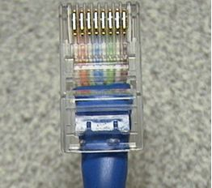

Cable Preparation
Orange – 1 & 2 Green – 3 & 6 Blue- 4 & 5 Brown- 7 & 8

Slide 4
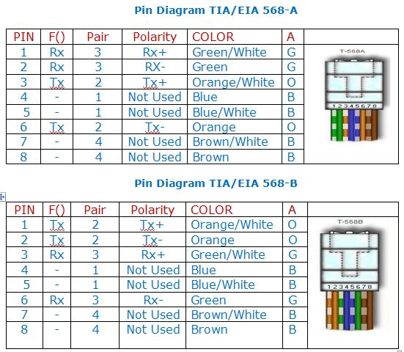
TIA/EIA 568A and 568B Wiring Standards

Slide 5
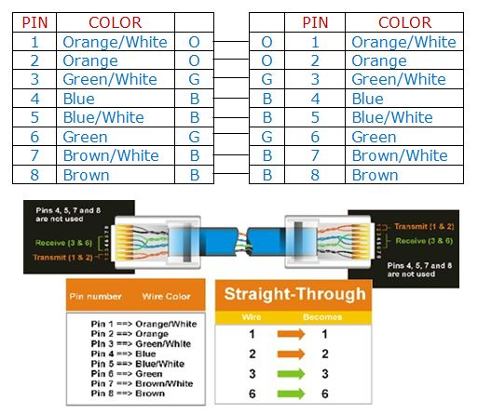
Pin Diagram TIA/EIA 568-B for Straight-Through Cabling
Either 568A or 568B on both end
Uses only Orange and Green Pairs
FOR DTE-DCE ( Computer/Router To Modem/Hub/Switch)

Slide 6
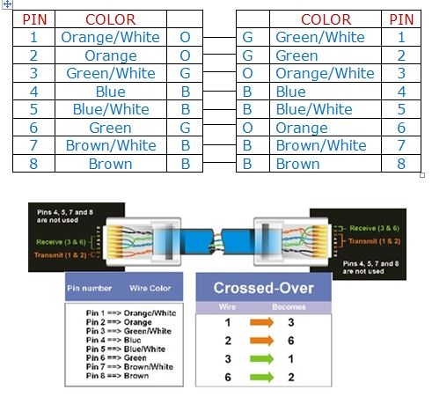
Pin Diagram EIA/TIA 568B for Cross-Over Cabling
568A on one end and 568B on the other end or Vice Versa
Uses only Orange and Green Pairs
For DTE-DTE and DCE-DCE(Computer To Computer, Router To Router, Modem To Modem)
The wires to swap are One and three, Two and six

Slide 7

Demo I : Crossover Cable
IP Address: 192.168.1.2
Subnet Mask: 255.255.255.0
Gateway: 192.168.1.1
IP Address: 192.168.1.3
Subnet Mask: 255.255.255.0
Gateway: 192.168.1.1
ping 192.168.1.3
ping 192.168.1.2
Capture the traces of ping using Wireshark Protocol Analyzer

Slide 8
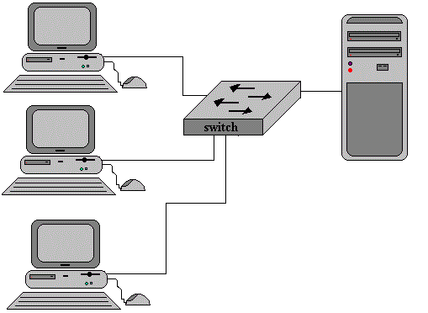
Demo II : Setting Up LAN using Straight-Through Cable
IP Address: 192.168.1.2
Subnet Mask: 255.255.255.0
Gateway: 192.168.1.1
IP Address: 192.168.1.3
Subnet Mask: 255.255.255.0
Gateway: 192.168.1.1
IP: 192.168.1.1
Mask: 255.255.255.0
IP Address: 192.168.1.4
Subnet Mask: 255.255.255.0
Gateway: 192.168.1.1
Test the connectivity's using ping 192.168.1.X and capture traces of ping using Wireshark

Slide 9
Demo III : Testing Web Server over LAN
Installation of Web Server – Apache2 or Tomcat7
Install the server – sudo apt-get install apache2
Start web server - /etc/init.d/apache2 start
Create the web page and store in /var/www/http
Access the web pages from client machines 1/2/3
Test the web server by accessing web pages stored on server and capture the traces of http,tcp,ip and Ethernet-II using Wireshark

