Slide 1
IP Addressing & Subnetting

Slide 2
Working with IP Addresses

Slide 3
IPv4 and IPv6
Internet Protocol
Internet Protocol is a set of technical rules that defines how computers communicate over a network. There are currently two versions: IP version 4 (IPv4) and IP version 6 (IPv6)
IPv4 IPv4 was the first version of Internet Protocol to be widely used, and accounts for most of today’s Internet traffic. There are just over 4 billion IPv4 addresses. While that is a lot of IP addresses, it is not enough to last forever.
IPv6 IPv6 is a newer numbering system that provides a much larger address pool than IPv4. It was deployed in 1999 and should meet the world’s IP addressing needs well into the future

Slide 4
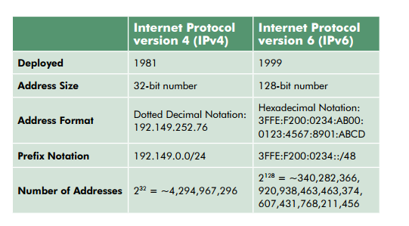
IPv4 and IPv6 Difference

Slide 5
Introduction
You can probably work with decimal numbers much easier than with the binary numbers needed by the computer.
Working with binary numbers is time-consuming & error-prone.

Slide 6
Octets
The 32-bit IP address is broken up into 4 octets, which are arranged into a dotted-decimal notation scheme.
An octet is a set of 8 bits
Example of an IP version 4:
172.64.126.52

Slide 7
Thinking in Binary
The binary system uses only 2 values “0 & 1” to represent numbers in positions representing increasing powers of 2.
We all are accustomed to thinking & working in the decimal system, which is based on the number 10.

Slide 8
Thinking in Binary (Cont.)
To most humans, the number 124 represents 100 + 20 + 4.
To the computer, this number is 1111100, which is 64 (2⁶) + 32 (2⁵) + 16 (2⁴) + 8 (2³) + 4 (2²) + 0 + 0

Slide 9
Each position in a binary number represents, right to left, a power of two beginning with 2⁰ & increasing by one power as it moves left: 2⁰, 2¹, 2², 2⁴, etc.

Slide 10
Converting to Decimal
You’ll need to convert binary to decimal & vice versa to compute subnets & hosts.
So, it’s time for a quick review lesson in binary-to-decimal conversion.
There are 8 bits in an octet & each bit can only be a 1 or a 0.

Slide 11
Converting to Decimal (Cont.)
What then do you suppose is the largest decimal number that can be expressed in an octet?
Eight 1’s (1111 1111)

Slide 12
Converting to Decimal (Cont.)
Now, for double the money, what is its equivalent decimal value?
2⁷
2⁶
2⁵
2⁴
2³
2²
2¹
2⁰
1
1
1
1
1
1
1
1
128
64
32
16
8
4
2
1
The binary number 1111 1111 converts into the decimal number:
128 + 64 + 32 + 16 + 8 + 4 + 2 + 1 = 255

Slide 13
Converting to Decimal (Cont.)
Therefore, the largest decimal number that can be stored in an IP address octet is 255.
The significance of this should become evident later in this presentation.

Slide 14
IP Address Classes
IP addresses are divided into 5 classes, each of which is designated with the alphabetic letters A to E.
Class D addresses are used for multicasting.
Class E addresses are reserved for testing & some mysterious future use.

Slide 15
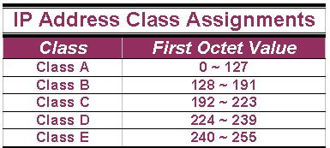
IP Address Classes (Cont.)
The 5 IP classes are split up based on the value in the 1st octet:

Slide 16
IP Address Classes (Cont.)
Using the ranges, you can determine the class of an address from its 1st octet value.
An address beginning with 120 is a Class A address, 155 is a Class B address & 220 is a Class C address.

Slide 17
Are You the Host or the Network?
The 32 bits of the IP address are divided into Network & Host portions, with the octets assigned as a part of one or the other.
Network & Host Representation
By IP Address Class
Class
Octet1
Octet2
Octet3
Octet4
Class A
Network
Host
Host
Host
Class B
Network
Network
Host
Host
Class C
Network
Network
Network
Host

Slide 18
Are You the Host or the Network? (Cont.)
Each Network is assigned a network address & every device or interface (such as a router port) on the network is assigned a host address.
There are only 2 specific rules that govern the value of the address.

Slide 19
Are You the Host or the Network? (Cont.)
A host address cannot be designated by all zeros or all ones.
These are special addresses that are reserved for special purposes.

Slide 20
Class A Addresses
Class A IP addresses use the 1st 8 bits (1st Octet) to designate the Network address.
The 1st bit which is always a 0, is used to indicate the address as a Class A address & the remaining 7 bits are used to designate the Network.
The other 3 octets contain the Host address.

Slide 21
Class A Addresses (Cont.)
There are 128 Class A Network Addresses, but because addresses with all zeros aren’t used & address 127 is a special purpose address, 126 Class A Networks are available.

Slide 22
Class A Addresses (Cont.)
There are 16,777,214 Host addresses available in a Class A address.
Rather than remembering this number exactly, you can use the following formula to compute the number of hosts available in any of the class addresses, where “^{n}” represents the number of bits in the host portion:
(2^{n} – 2) = Number of available hosts

Slide 23
Class A Addresses (Cont.)
For a Class A network, there are:
2²⁴ – 2 or 16,777,214 hosts.
Half of all IP addresses are Class A addresses.
You can use the same formula to determine the number of Networks in an address class.
Eg., a Class A address uses 7 bits to designate the network, so (2⁷ – 2) = 126 or there can be 126 Class A Networks.

Slide 24
Class B IP Addresses
Class B addresses use the 1st 16 bits (two octets) for the Network address.
The last 2 octets are used for the Host address.
The 1st 2 bit, which are always 10, designate the address as a Class B address & 14 bits are used to designate the Network. This leaves 16 bits (two octets) to designate the Hosts.

Slide 25
Class B IP Addresses (Cont.)
So how many Class B Networks can there be?
Using our formula, (2¹⁴ – 2), there can be 16,382 Class B Networks & each Network can have (2¹⁶ – 2) Hosts, or 65,534 Hosts.

Slide 26
Class C IP Addresses
Class C addresses use the 1st 24 bits (three octets) for the Network address & only the last octet for Host addresses.the 1st 3 bits of all class C addresses are set to 110, leaving 21 bits for the Network address, which means there can be 2,097,150 (2²¹ – 2) Class C Networks, but only 254 (2⁸ – 2) Hosts per Network.

Slide 27
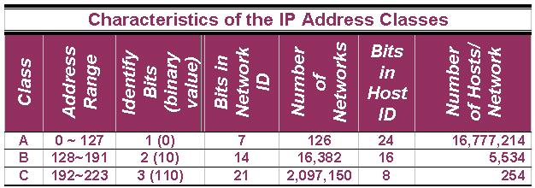

Slide 28
Special Addresses
A few addresses are set aside for specific purposes.
Network addresses that are all binary zeros, all binary ones & Network addresses beginning with 127 are special Network addresses.

Slide 29
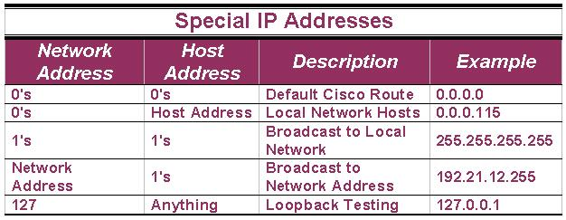
Special Addresses (Cont.)

Slide 30
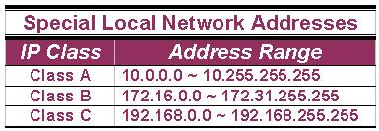
Special Addresses (Cont.)
A list of these addresses for each IP address class:

Slide 31
Subnet Mask
An IP address has 2 parts:
  The Network identification.
  The Host identification.
Frequently, the Network & Host portions of the address need to be separately extracted.
In most cases, if you know the address class, it’s easy to separate the 2 portions.

Slide 32
Subnet Mask (Cont.)
With the rapid growth of the internet & the ever-increasing demand for new addresses, the standard address class structure has been expanded by borrowing bits from the Host portion to allow for more Networks.
Under this addressing scheme, called Subnetting, separating the Network & Host requires a special process called Subnet Masking.

Slide 33
Subnet Mask (Cont.)
The subnet masking process was developed to identify & extract the Network part of the address.
A subnet mask, which contains a binary bit pattern of ones & zeros, is applied to an address to determine whether the address is on the local Network.
If it is not, the process of routing it to an outside network begins.

Slide 34
Subnet Mask (Cont.)
The function of a subnet mask is to determine whether an IP address exists on the local network or whether it must be routed outside the local network.
It is applied to a message’s destination address to extract the network address.
If the extracted network address matches the local network ID, the destination is located on the local network.

Slide 35
Subnet Mask (Cont.)
However, if they don’t match, the message must be routed outside the local network.
The process used to apply the subnet mask involves Boolean Algebra to filter out non-matching bits to identify the network address.

Slide 36
Boolean Algebra
Boolean Algebra is a process that applies binary logic to yield binary results.
Working with subnet masks, you need only 4 basic principles of Boolean Algebra:
  1 and 1 = 1
  1 and 0 = 0
  0 and 1 = 0
  0 and 0 = 0

Slide 37
Boolean Algebra (Cont.)
In another words, the only way you can get a result of a 1 is to combine 1 & 1. Everything else will end up as a 0.
The process of combining binary values with Boolean Algebra is called Anding.

Slide 38
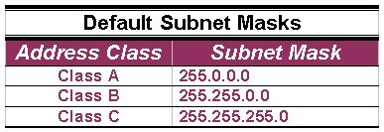
Default Standard Subnet Masks
There are default standard subnet masks for Class A, B and C addresses:

Slide 39
A Trial Separation
Subnet masks apply only to Class A, B or C IP addresses.
The subnet mask is like a filter that is applied to a message’s destination IP address.
Its objective is to determine if the local network is the destination network.

Slide 40
A Trial Separation (Cont.)
The subnet mask goes like this:
If a destination IP address is 206.175.162.21, we know that it is a Class C address & that its binary equivalent is: 11001110.10101111.10100010.00010101

Slide 41
A Trial Separation (Cont.)
We also know that the default standard Class C subnet mask is: 255.255.255.0 and that its binary equivalent is:
11111111.11111111.11111111.00000000

Slide 42
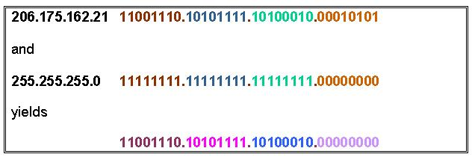
A Trial Separation (Cont.)
When these two binary numbers (the IP address & the subnet mask) are combined using Boolean Algebra, the Network ID of the destination network is the result:

Slide 43
A Trial Separation (Cont.)
The result is the IP address of the network which in this case is the same as the local network & means that the message is for a node on the local network.

Slide 44
Subnetting

Slide 45
Subnetting, Subnet & Subnet Mask
Subnetting, a subnet & a subnet mask are all different.
In fact, the 1st creates the 2nd & is identified by the 3rd.
Subnetting is the process of dividing a network & its IP addresses into segments, each of which is called a subnetwork or subnet.

Slide 46
Subnetting, Subnet & Subnet Mask (Cont.)
The subnet mask is the 32-bit number that the router uses to cover up the network address to show which bits are being used to identify the subnet.

Slide 47
Subnetting
A network has its own unique address, such as a Class B network with the address 172.20.0.0 which has all zeroes in the host portion of the address.
From the basic definitions of a Class B network & the default Class B subnet mask, you know that this network can be created as a single network that contains 65,534 individual hosts.

Slide 48
Subnetting (Cont.)
Through the use of subnetting, the network from the previous slide can be logically divided into subnets with fewer hosts on each subnetwork.
It does not improve the available shared bandwidth only, but it cuts down on the amount of broadcast traffic generated over the entire network as well.

Slide 49
Subnetting (Cont.)
The 2 primary benefits of subnetting are:
  Fewer IP addresses, often as few as one, are needed to provide addressing to a network & subnetting.
  Subnetting usually results in smaller routing tables in routers beyond the local internetwork.

Slide 50
Subnetting (Cont.)
Example of subnetting: when the network administrator divides the 172.20.0.0 network into 5 smaller networks – 172.20.1.0, 172.20.2.0, 172.20.3.0, 172.20.4.0 & 172.20.5.0 – the outside world stills sees the network as 172.20.0.0, but the internal routers now break the network addressing into the 5 smaller subnetworks.

Slide 51
Subnetting (Cont.)
In the example, only a single IP address is used to reference the network & instead of 5 network addresses, only one network reference is included in the routing tables of routers on other networks.

Slide 52
Borrowing Bits to Grow a Subnet

Slide 53
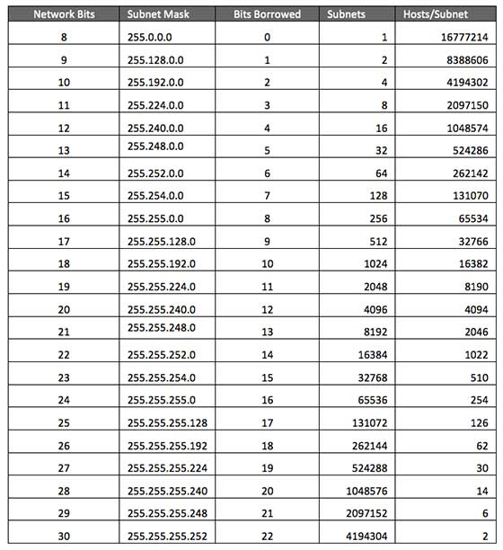
Class A Subnets

Slide 54
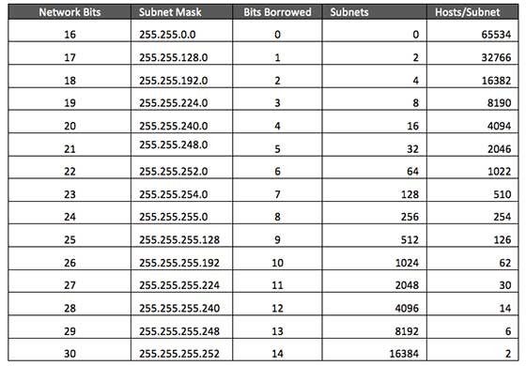
Class B Subnets

Slide 55
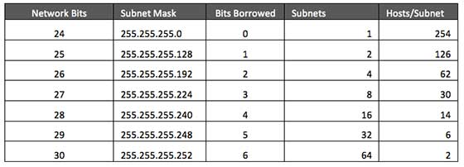
Class C Subnets

Slide 56
CIDR [ Classless Inter Domain Routing]
CIDR is a slash notation of subnet mask. CIDR tells us number of on bits in a network address.
Ex: Class A has default subnet mask 255.0.0.0. that means first octet of the subnet mask has all on bits. In slash notation it would be written as /8, means address has 8 bits on.

Slide 57
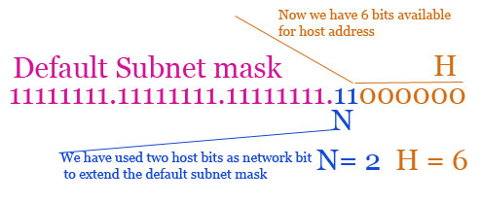
/26
CIDR /26 has subnet mask 255.255.255.192 and 192 is 11000000 in binary.
We used two host bits in network address.

Slide 58
N = 2
H = 6
Total subnets ( 2^{N} ) :- 2² = 4
Block size (256 - subnet mask) :- 256 - 192 = 64
Valid subnets ( Count blocks from 0) :- 0,64,128,192
Total hosts (2^{H}) :- 2⁶ = 64
Valid hosts per subnet ( Total host - 2 ) :- 64 - 2 = 62

Slide 59
