Slide 1
News Classification
Team Members:
Akshay Nimbalkar
Divyansh Kumar Singh
Harish Fegade

Slide 2
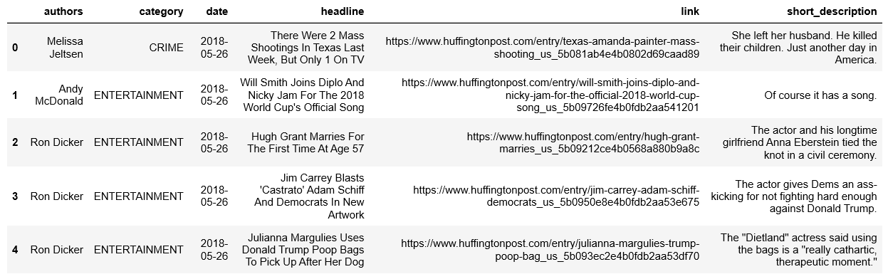
Understanding Data
DataSet dimensions | 200853 x 6
No. of Categorical Variables | 6
No. Numeric Variables | 0
No. of features with missing data | 3

Slide 3
Problem Statement
Problem Statement
Classify the news for given headline with its short description and author.

Slide 4
Workflow
Text preprocessing and feature engineering
Data Visualization
Model Building
NaiveBayes, SVM
Evaluation Metrics:
Accuracy, F1score

Slide 5
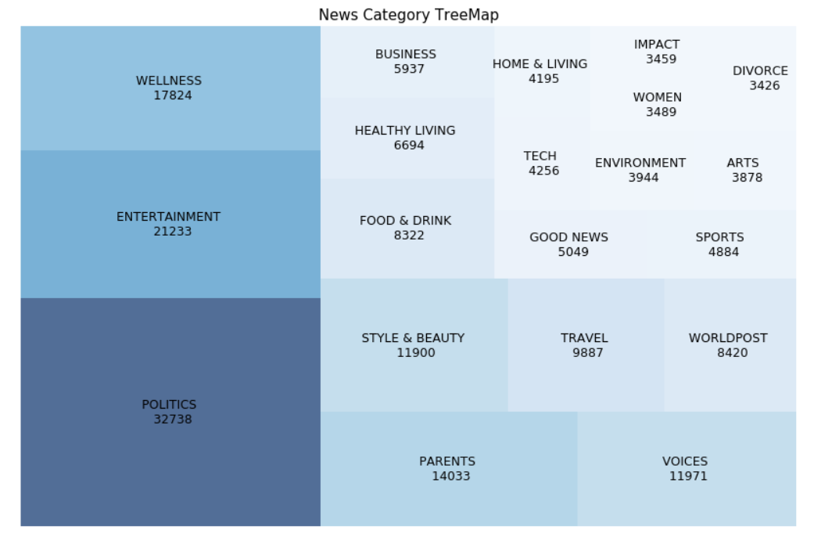
EDA

Slide 6
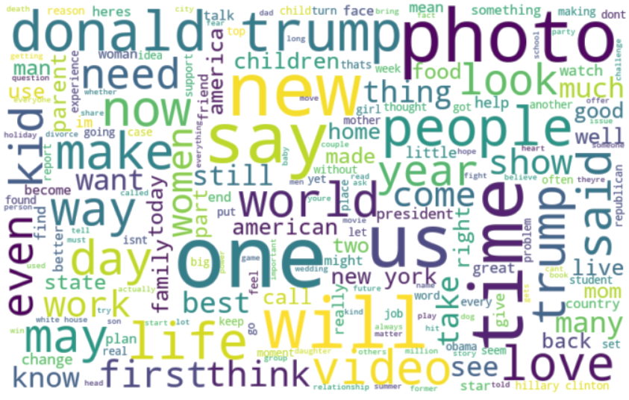
EDA

Slide 7
Model building – NaiveBayes
Iteration1: | 41 categories
Train Accuracy | 59.67%
Test Accuracy | 55.42%
F1-score
Iteration2: min_df=5 | 41 categories
Train Accuracy | 69.18
Test Accuracy | 58.65
F1-score | 0.55
Iteration3: Feature Engineering | 26 categories
Train Accuracy | 72.65
Test Accuracy | 64.17
F1-score | 0.63

Slide 8
NB Model Testing
News HeadLine | Category Predicted
Rapper Skinnyfromthe9 Handcuffed in Weed Bust | CRIME
Liverpool, Tottenham, Chelsea and Arsenal fans criticise Uefa for final ticket numbers | SPORTS
Drink craft beer, eat ancient grains and other ways to respond to the planet’s loss of biodiversity | FOOD & DRINK
Elon Musk pokes fun at Jeff Bezos' new moon lander spacecraft with lewd tweet | SCIENCE
How to reach Kedarnath Temple: a quick guide | TRAVEL
What we learnt from Prince Harry's body language - and how his parenting may differ from William's and Charles's | ENTERTAINMENT
White House takes on surprise medical bills in continued push to lower US health-care costs | POLITICS
India’s largest ever ‘eye in the sky’ will take on its neighbours | TRAVEL

Slide 9
THANK YOU

