Slide 1
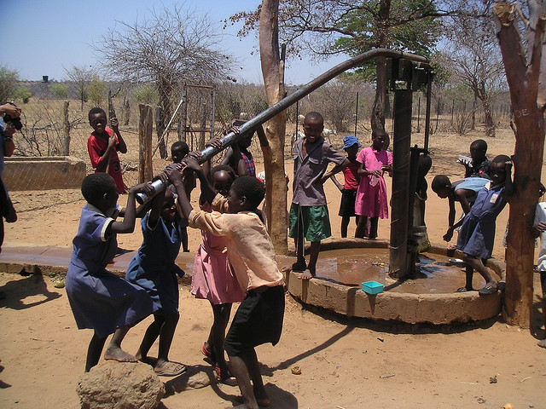
Pump it Up: Data Mining the Water Table
Team Members:
Akshay Nimbalkar
Divyansh Kumar Singh
Harish Fegade

Slide 2
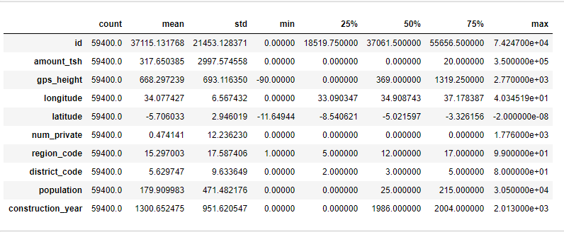
Understanding Data
DataSet dimensions | 59400 * 41
No. of Categorical Variables | 29
No. Numeric Variables | 12
No. of features with missing data | 7

Slide 3
Problem Statement
Problem Statement
Predict which pumps are functional, which need repairs, and which are faulty.

Slide 4
Workflow
Data Cleaning:
Mode Imputation,
Anomaly Detection
Data Visualization
Model Building
Decision Tree,
CatBoost
Feature Selection
Evaluation Metrics:
F1 Score, Accuracy, Precision, Recall, Confusion Matrix

Slide 5
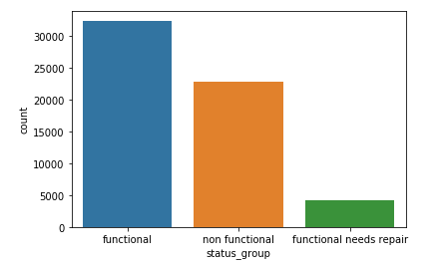
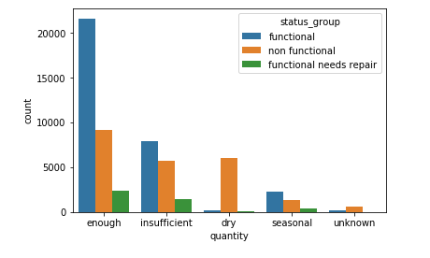
Count Plot

Slide 6
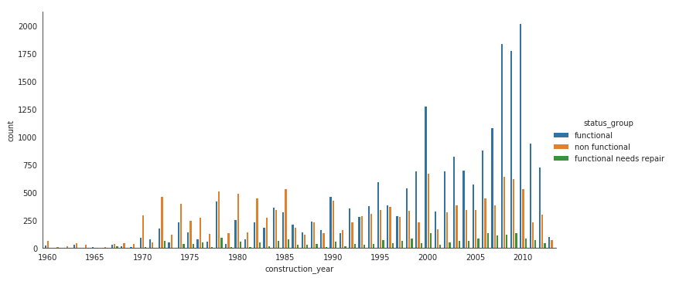
Status group and Construction year

Slide 7
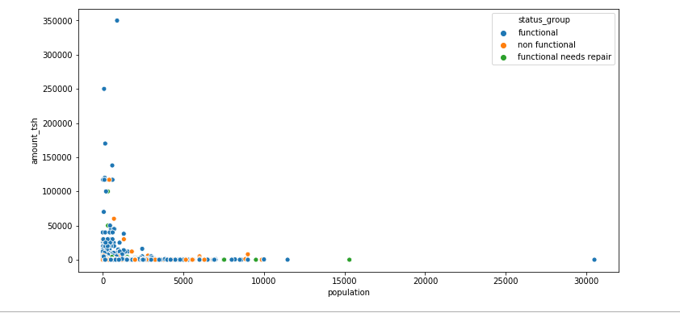
Population vs Amount of Water Available

Slide 8
Model building – Linear Regression
Iteration1: | Decision Tree
Accuracy test Accuracy train | 0.7208 0.7232
Precision | 0.73
Recall | 0.72
F1-Score | 0.70
Iteration2: | Catboost
Accuracy test Accurasy train | 0.8110 0.8689
Precision | 0.81
Recall | 0.80
F1-Score | 0.81
Iteration3: | Catboost with hyper parameter tuning
Accuracy test Accurasy train | 0.8663 0.8700
Precision | 0.86
Recall | 0.87
F1-Score | 0.76

