Slide 1

Advanced Customer Churn Prediction
Optimizing Retention with XGBoost & Class Weighting
Presenter: Ashwin C H

Slide 2




The Business Problem
Retail Reality
Data Challenge
Our Goal
Acquiring new customers takes 5x more budget than retention
Real-world dataset: 73% Stay vs 27% Leave
Identify at-risk users without majority class bias

Slide 3
Architecture Overview
Technology Stack
Key Innovation
Python
Pandas
Scikit-learn
XGBoost
Moved beyond basic algorithms to tuned XGBoost pipeline with intelligent class weighting
Pipeline Stages
Data Ingestion → Preprocessing → Advanced Modeling → Deployment

Slide 4
Why XGBoost?
Random Forest Failure
XGBoost Advantages
Extreme overfitting on tabular dataset
Superior tabular data performance
Built-in L1/L2 regularization
Prevents noise learning

Slide 5
Handling Class Imbalance
Final: Class Weights
Attempt 2: Downsampling
scale_pos_weight: ~2.77
Attempt 1: SMOTE
Result: 74% generic accuracy
Penalize missing churners 2.77× more
Result: 97% training accuracy
Removed valid data → Information loss
Created synthetic data → Overfitting

Slide 6
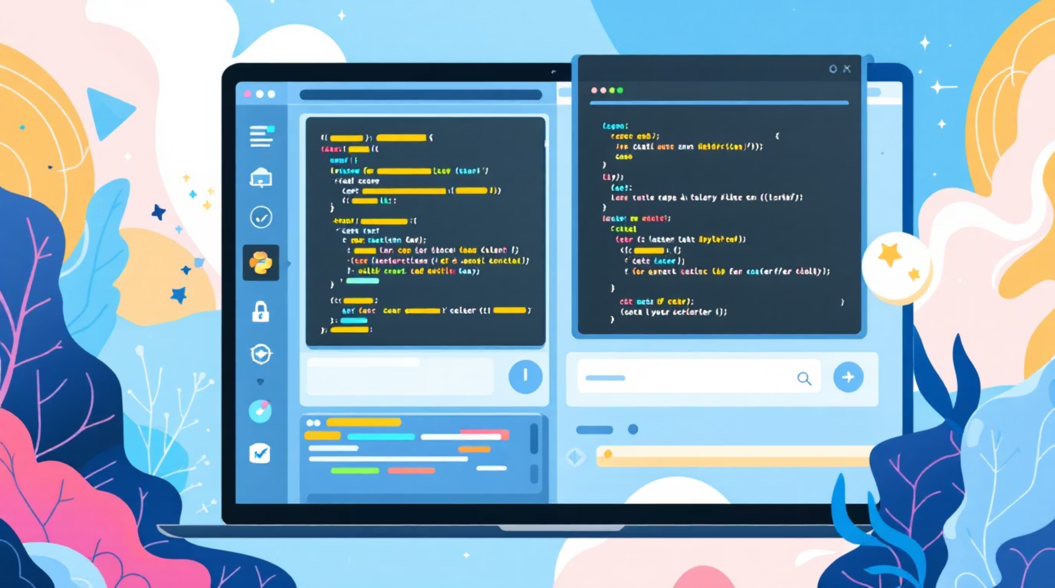
Hyperparameter Tuning
Method
GridSearchCV tested 36 unique combinations
Winning Parameters
Learning Rate: 0.1
Max Depth: 5
N Estimators: 100
Result
Automated search for optimal modeling sweet spot

Slide 7
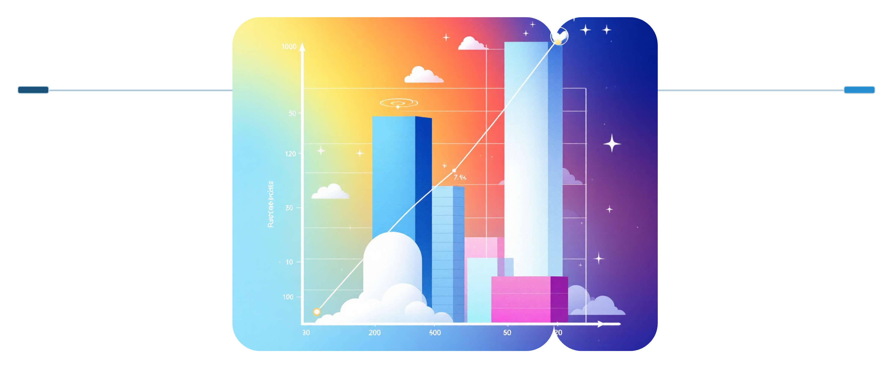
Fighting Overfitting
Before
After
Train 97% vs Test 78% ~19% gap
Train 92% vs Test 85% ~7% gap
The Problem
The Fix
Train: 97% vs Test: 78%
Limited max tree depth to 5
Applied subsampling (0.8)
~19% generalization gap
Outcome
Gap reduced to ~7%

Slide 8



Validation Strategy
Stratified K-Fold
Enforced Balance
Robust Results
3-fold cross validation
Every fold: 27% churners
Prevents lucky splits

Slide 9
Performance Metrics
76%
76%
53%
Accuracy
Churn Recall
Precision
Stable, robust performance
3 of 4 leaving customers
Acceptable trade-off
Business impact: Retention team can target right users before they leave

Slide 10
Deliverables & Next Steps
Production Ready
Future Roadmap
Trained Model (.pkl)
Encoding Rules
Evaluation Report
Feature engineering: Tenure → Years
Real-time Web API deployment
Continuous monitoring dashboard

