Slide 1

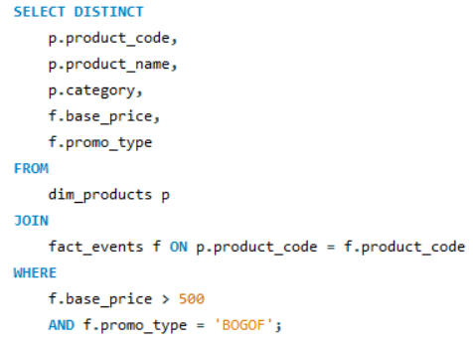

AD-HOC REQUESTS
list of products with a base price greater than 500 and that are featured in promo type of 'BOGOF’
(Buy One Get One)
SQL CODE:
OUTPUT:

Slide 2
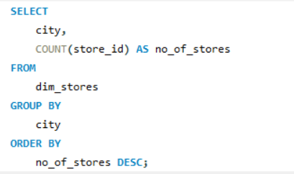
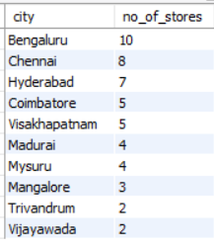
AD-HOC REQUESTS
2) Number of stores in each city
SQL CODE:
OUTPUT:

Slide 3
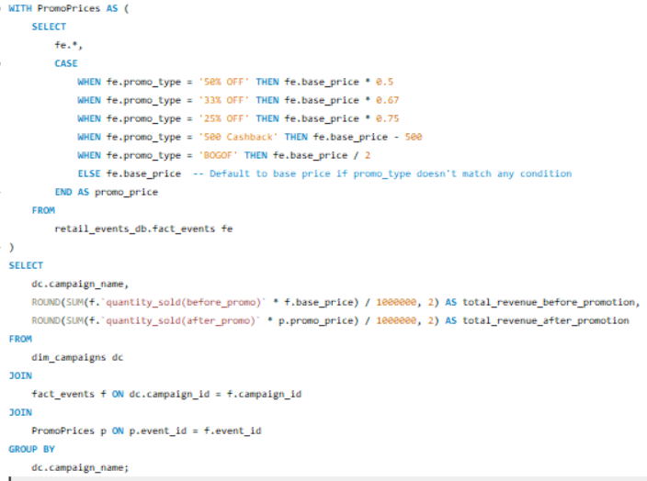

AD-HOC REQUESTS
3) each campaign along with the total revenue generated before and after the campaign
SQL CODE:
OUTPUT:

Slide 4
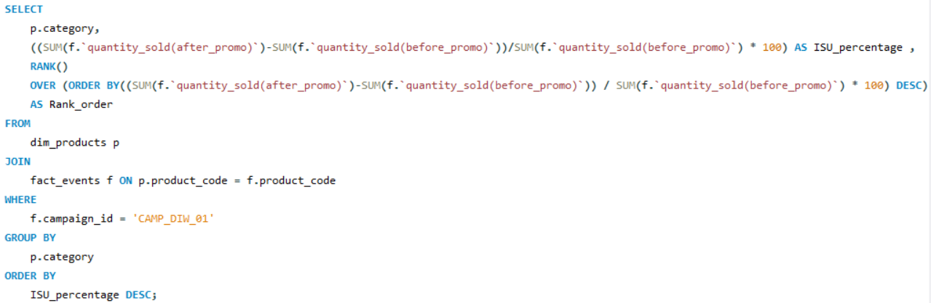
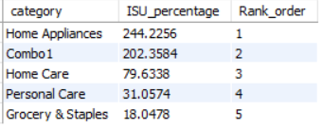
AD-HOC REQUESTS
4) Incremental Sold Quantity (ISU%) for each category during the Diwali campaign.
SQL CODE:
OUTPUT:

Slide 5
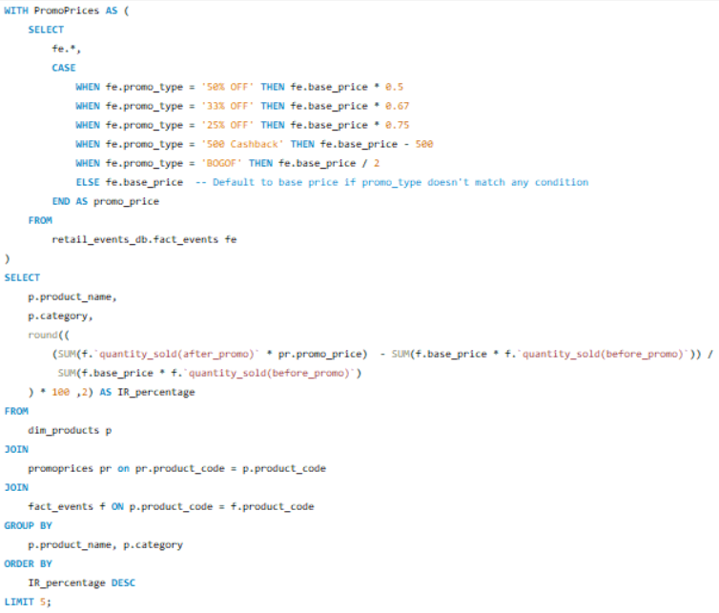
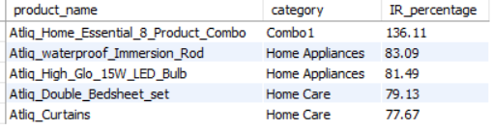
AD-HOC REQUESTS
5) Top 5 products, ranked by Incremental Revenue Percentage (IR%), across all campaigns.
SQL CODE:
OUTPUT:

