Slide 1
Mahindra Capstone Project
Geolocation Based Customer Analysis:
The idea is to explore how various factors like car make & model, time and type of service etc.
vary with location.
Market Segmentation:
Based on customer segments, predict the revenue that can be extracted from each segment over a
life of the car.
TEAM DARKHORSE : Dinesh, Sabeeha and Akshay.

Slide 2
Problem Statement-1 :
# Identifying the ownership pattern of cars throughout the country. This also captures the problem wherein information regarding the spending patterns can be identified.
! With this , we will have a basic understanding about location-wise utilization of specific brand and models of car, which will help us to target marketing campaigns and also spending patterns will be clear hence services could be suited to the particular spending pattern.
Problem Statement-2:
# Identify the type of order each state receives and present it as an interactive visualization.
! This could potentially give information about how Mahindra needs to be prepared to tackle various seasonal cases.
Notes:
Can we include some examples here?

Slide 3
Problem Statement 3 :
# Customer Lifetime value prediction - Based on Customer segments, predict the revenue that can be extracted from each segment over a life of the car.
! This would be beneficial to Mahindra First Choice Services to identify the various segments in the market. Also, these segmentations would allow for targeted marketing activities and sales promotions.
The dataset consist of three aspects:
1. Customer data: where the details of the customer like the car owned, state and place
of residence, order type, etc are present. Data dimension is of 534000 Customer entries
2. Invoice data: where information related to customer visits and transactions are recorded,
whether a customer has insurance claims, bifurcation of the amount paid, for what type of
service did the customer came for, etc
3. Material Inventory: where information related to what kind of service did the customer took and what kind of
material was used to service, Labor information and the cost for the service, Plant and plant
name where the customer took the service.

Slide 4
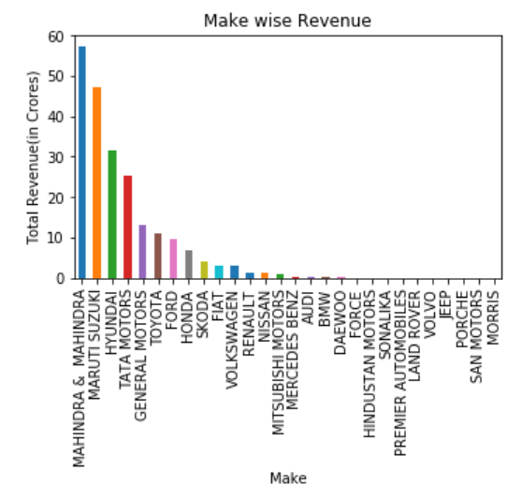
EDA :
Assumption : Expensive cars gives more revenue than the regularly used models.
Observation : Here, as we have seen that the regularly used car generates more revenue because they are used more extensively and thus needs periodic servicing and wear and tear as compared to expensive ones.

Slide 5
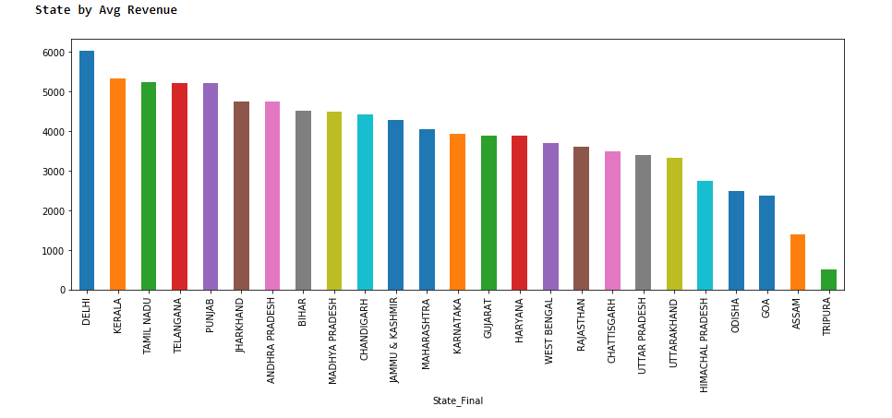
Here , as we can see Delhi generates comparatively high revenue then the other states followed by Kerala,
Tamil Nadu, Telangana and Punjab.

Slide 6
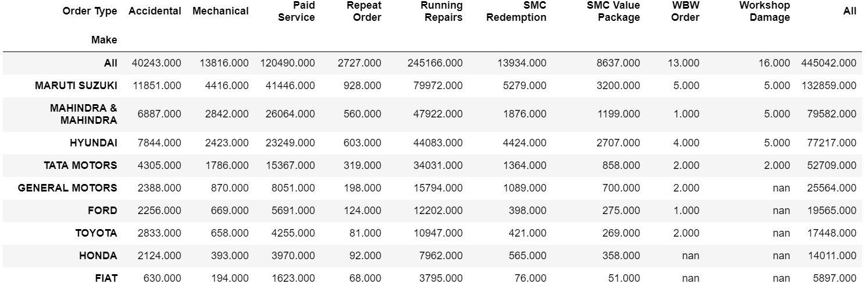
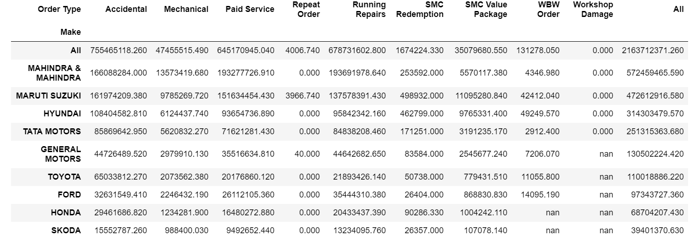

Slide 7
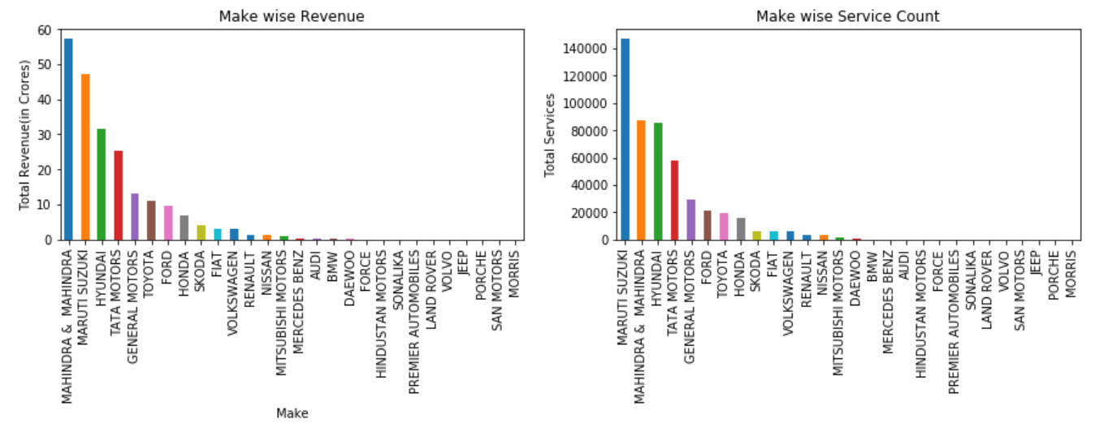
Actionable Insights :
Revenue generated from each brand with service count.

Slide 8
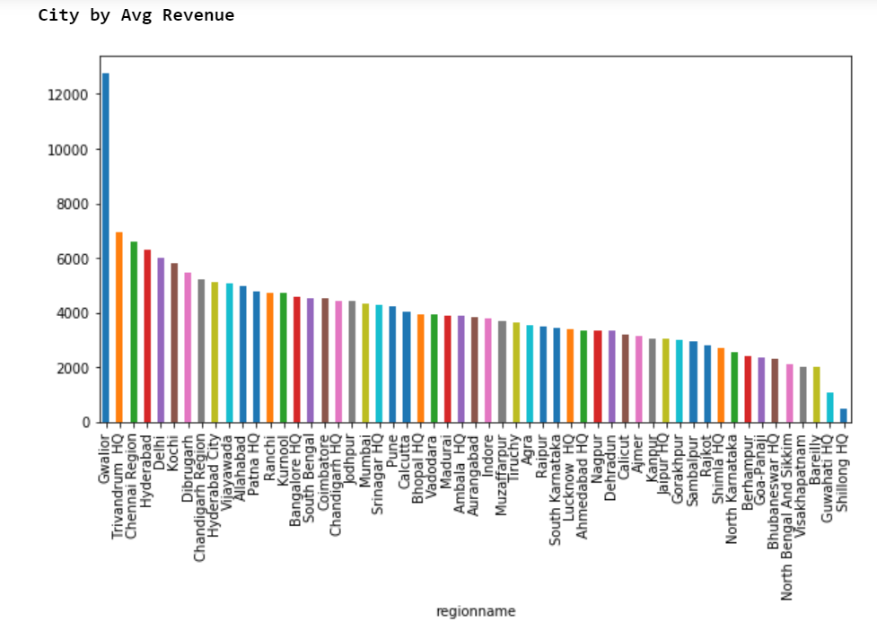
32% services are accidental cases and revenue generated from Gwalior is 94.83% from accidental cases

Slide 9
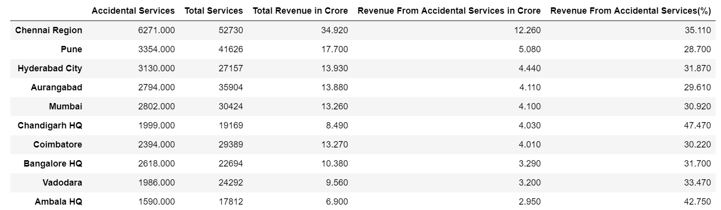
Top 10 Cities Accidental cases wise :

Slide 10
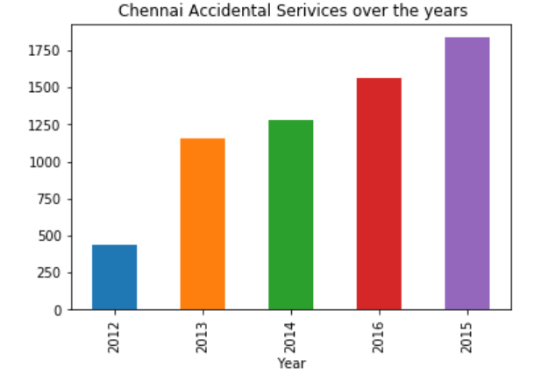
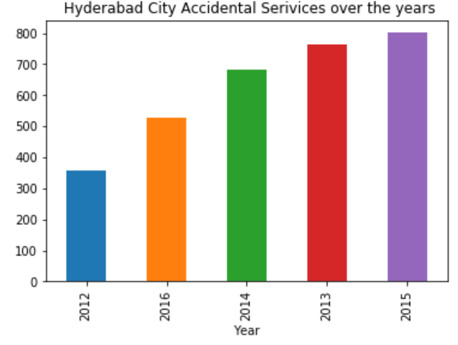
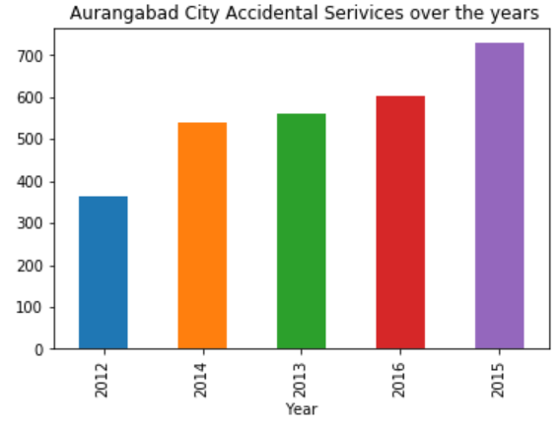
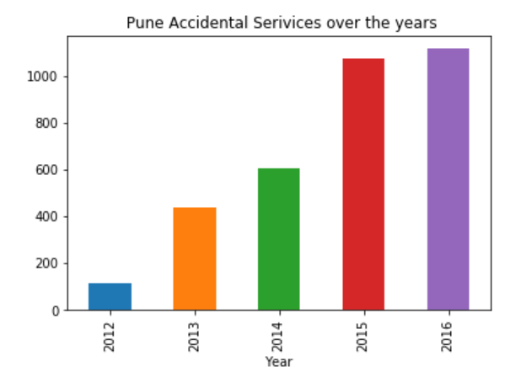
Top four Cities Accidental cases

Slide 11
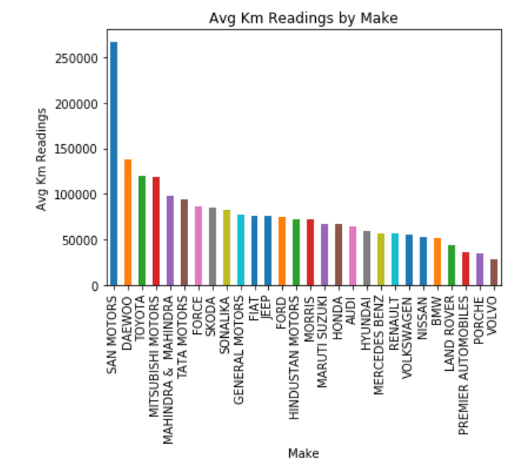
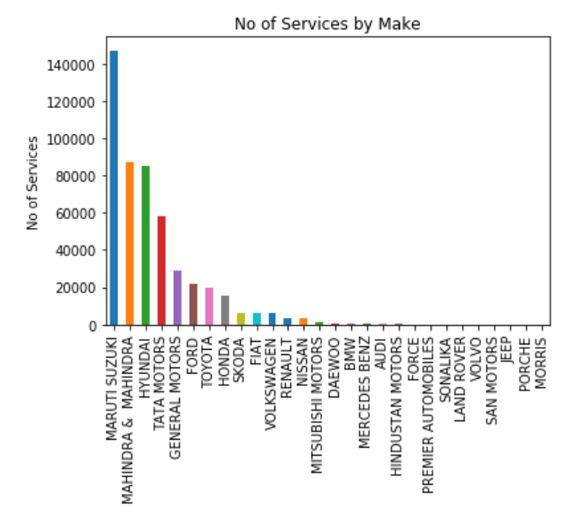
Each brand Avg. Distance covered compared to servicing required :

Slide 12
Plant Summary :
Screenshots\Plant_Duration.xlsx
In this, deep analysis on revenue generated, service duration and service count has been detailed for each plant.
With this, the company can evaluate efficiency of each plant and take business decision for the same.

Slide 13
Case Study for Mahindra :
As we already know,, company has over 335+ workshops present in 267+ towns & 24 states and has serviced over 10,50,000 cars with the goal of establishing countrywide network of over 400 workshops by March 2018.
After deep analysis about the data, we have came across multiple insights which will help the company to deal
with the anomalies in the business and to plan further revenue driven campaigns effectively.
We can see how the trend changes, what type of demand is increasing, and this correlation with different car companies and models might give a good insight and prediction on requirements for the future.
With a general prediction about upcoming business, the company can be ready for seasonal challenges.

Slide 14
As we already know the revenue generated from each plant, the company can shut the plants which do not
generate any value to the business. Also the ones which generate moderate value can be further analyzed
and with strategic actions, we can improve the productivity of that plant.
Here we got to know the ownership pattern of the customer, so now the company can target the marketing campaigns for specific model of vehicle location-wise and increase the success rate.
Also as we have spending patterns for each cities and state, we can increase the production of parts, improve the quality of services and be prepared for the seasonal demands faced every year to survive the market crisis.
As we can predict the LTV for upcoming customers , we can have a great foresight of business.

Slide 15
CEO Summary :
City-wise – Services performed by each plant
Citywise_Services_against_Plants.pptx
Here, we can see bar plots for services performed by each plant in that city.
With this, we will understand the count of active plants and also the ones which are not generating any value to the company which should be dealt with earliest to minimize the loss.

Slide 16
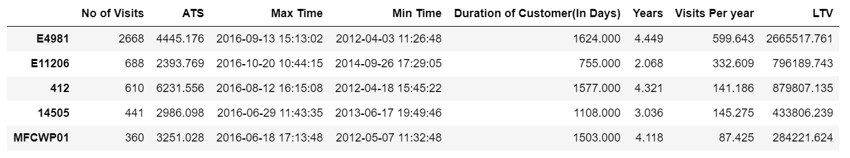
Here , we have Average transactions size per customer which will give us great insight to understand the spending pattern of customers from which services could be suited to the particular spending pattern.
Life Time Value(LTV) when modelled with Machine Learning algorithms will give us prediction about the value each
Customer will bring to the business and hence will help us to foresight the revenue generation.

