Slide 1

SQL Built-in Functions

Slide 2
SQL Built-in Function
Built in functions are functions that are shipped with MySQL
They can be categorized according to the data types that they operate on i.e. strings, date and numeric built in functions

Slide 3
SQL Built-in Function
There are different types of SQL built - in functions, which are mentioned below:
String
Numeric
Date
Bin
Cast

Slide 4
SQL Built-in Function
We use the following Employee table to understand the built-in function
ID | NAME | AGE | ADDRESS | SALARY
1 | Kellie | 32 | California | 2000
2 | Pete | 25 | Texas | 1500
3 | Popy | 23 | Boston | 2000
4 | Sam | 25 | Florida | 6500
5 | Jhon | 27 | Hawaii | 10000

Slide 5
NUMERIC Functions

Slide 6
Numeric Function - Syntax
The following syntax is used to perform any mathematical operation in any query
Syntax:
SELECT numerical_expression as OPERATION_NAME
[FROM table_name WHERE CONDITION] ;

Slide 7
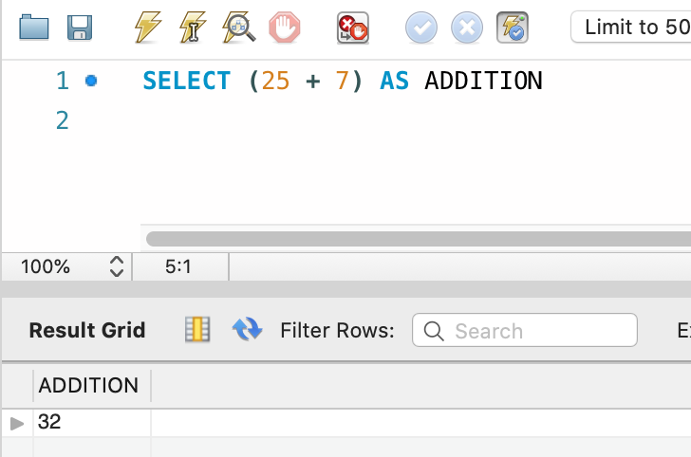
Numeric Function - Example - 1
The numerical_expression is used for a mathematical expression or any formula. Following is a simple example showing the usage of SQL Numeric Expressions
Syntax:
SELECT (25 + 7) AS ADDITION
Output:
ADDITION
32

Slide 8
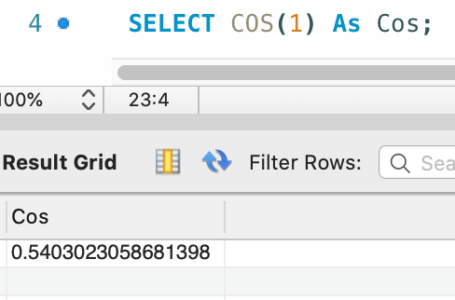
Numeric Function - Example - 2
The numerical_expression is used for a mathematical expression or any formula. Following is a simple example showing the usage of SQL Numeric Expressions
Syntax:
SELECT COS(1) As Cos;
Output:
Cos
0.5403023058681398

Slide 9
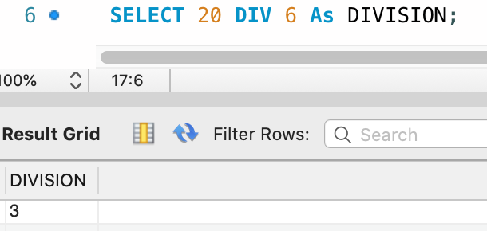
Numeric Function - Example - 3
The numerical_expression is used for a mathematical expression or any formula. Following is a simple example showing the usage of SQL Numeric Expressions
Syntax:
SELECT 20 DIV 6 As DIVISION;
Output:
DIVISION
3

Slide 10
More Numeric Functions
Following are the numeric functions defined in SQL
Functions | Meaning
ABS | It returns the absolute value of a number
ACOS | It returns the cosine of a number
ASIN | It returns the arc sine of a number
ATAN | It returns the arc sine of a number
CEIL | It returns the smallest integer value that is greater than or equal to a number
CEILING | It returns the smallest integer value that is greater than or equal to a number

Slide 11
More Numeric Functions
Functions | Meaning
COS | It returns the cosine of a number
COT | It returns the cotangent of a number
DEGREES | It converts a radian value into degrees
DIV | It is used for integer division
EXP | It returns e raised to the power of number
FLOOR | It returns the largest integer value that is less than or equal to a number

Slide 12
More Numeric Functions
Functions | Meaning
GREATEST | It returns the greatest value in a list of expressions
LEAST | It returns the smallest value in a list of expressions
LN | It returns the natural logarithm of a number
LOG10 | It returns the base-10 logarithm of a number
LOG2 | It returns the base-2 logarithm of a number
MOD | It returns the remainder of n divided by m

Slide 13
More Numeric Functions
Functions | Meaning
PI | It returns the value of PI displayed with 6 decimal places
POW | It returns m raised to the nth power
RADIANS | It converts a value in degrees to radians
RAND | It returns a random number
ROUND | It returns a number rounded to a certain number of decimal places
SIGN | It returns a value indicating the sign of a number

Slide 14
More Numeric Functions
Functions | Meaning
SIN | It returns the sine of a number
SQRT | It returns the square root of a number
TAN | It returns the tangent of a number
ATAN2 | It returns the arctangent of the x and y coordinates, as an angle and expressed in radians
TRUNCATE | This doesn’t work for SQL Server. It returns 7.53635 truncated to 2 places right of the decimal point

Slide 15
String Functions

Slide 16
More Numeric Functions
String functions are used to perform an operation on input string and return an output string
Following are the string functions defined in SQL
Functions | Meaning
ASCII | Return the ASCII code value of a character
CHAR | Convert an ASCII value to a character
CHARINDEX | Search for a substring inside a string starting from a specified location and return the position of the substring

Slide 17
More Numeric Functions
Functions | Meaning
CONCAT | Join two or more strings into one string
CONCAT_WS | Concatenate multiple strings with a separator into a single string
DIFFERENCE | Compare the SOUNDEX() values of two strings
FORMAT | Return a value formatted with the specified format and optional culture
LEFT | Extract a given a number of characters from a character string starting from the left

Slide 18
More Numeric Functions
Functions | Meaning
LEN | Return a number of characters of a character string
LOWER | Convert a string to lowercase
LTRIM | Return a new string from a specified string after removing all leading blanks
NCHAR | Return the Unicode character with the specified integer code, as defined by the Unicode standard
PATINDEX | Returns the starting position of the first occurrence of a pattern in a string

Slide 19
More Numeric Functions
Functions | Meaning
QUOTENAME | Returns a Unicode string with the delimiters added to make the input string a valid delimited identifier
REPLACE | Replace all occurrences of a substring, within a string, with another substring
REPLICATE | Return a string repeated a specified number of times
REVERSE | Return the reverse order of a character string
RIGHT | Extract a given a number of characters from a character string starting from the right

Slide 20
More Numeric Functions
Functions | Meaning
RTRIM | Return a new string from a specified string after removing all trailing blanks
REPLACE | Replace all occurrences of a substring, within a string, with another substring
SOUNDEX | Return a four-character (SOUNDEX) code of a string based on how it is spoken
SPACE | Returns a string of repeated spaces
STR | Returns character data converted from numeric data

Slide 21
More Numeric Functions
Functions | Meaning
STRING_AGG | Concatenate rows of strings with a specified separator into a new string
STRING_ESCAPE | Escapes special characters in a string and returns a new string with escaped characters
STRING_SPLIT | A table-valued function that splits a string into rows of substrings based on a specified separator
STUFF | Delete a part of a string and then insert another substring into the string starting at a specified position

Slide 22
More Numeric Functions
Functions | Meaning
SUBSTRING | Extract a substring within a string starting from a specified location with a specified length
TRANSLATE | Replace several single-characters, one-to-one translation in one operation
TRIM | Return a new string from a specified string after removing all leading and trailing blanks
UPPER | Convert a string to uppercase

Slide 23
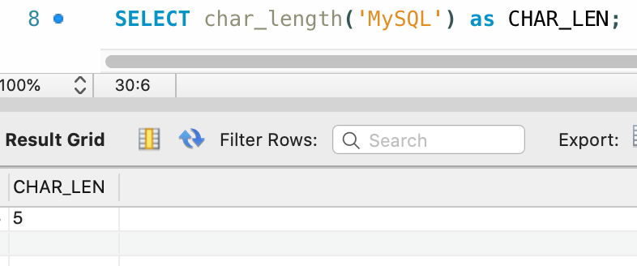
String Function - Example - 1
CHAR_LENGTH(): Doesn’t work for SQL Server. Use LEN() for SQL Server. This function is used to find the length of a word.
Syntax:
SELECT char_length('MySQL') as CHAR_LEN;
Output:
CHAR_LEN
5

Slide 24
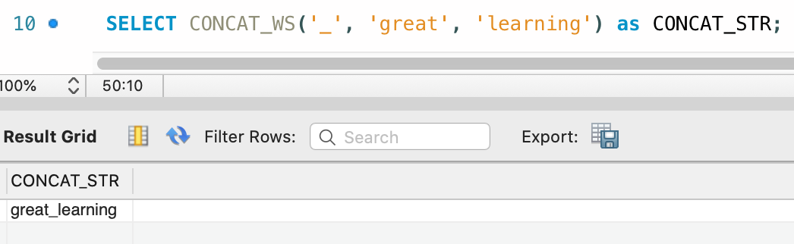
String Function - Example - 2
CONCAT_WS(): This function is used to add two words or strings with a symbol as concatenating symbol
Syntax:
SELECT CONCAT_WS('_', 'great', 'learning') as CONCAT_STR;
Output:
CONCAT_STR
great_learning

Slide 25
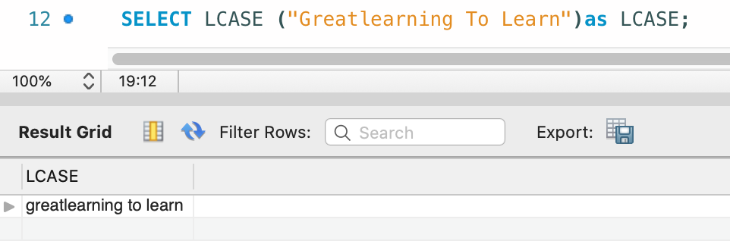
String Function - Example - 3
LCASE(): This function is used to convert the given string into lower case
Syntax:
SELECT LCASE ("Greatlearning To Learn")as LCASE;
Output:
LCASE
greatlearning to learn

Slide 26
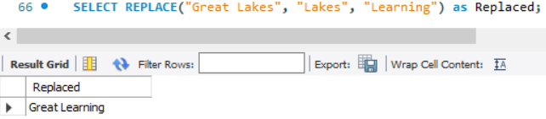
String Function - Example - 4
REPLACE(): This function replaces all occurrences of a substring within a string, with a new substring
Syntax:
SELECT REPLACE("Great Lakes", "Lakes", "Learning") as Replaced;
Output:
Replaced
Great Learning

Slide 27
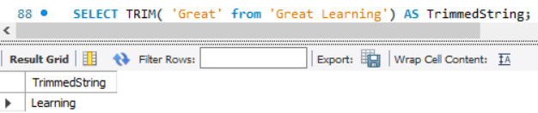
String Function - Example - 5
TRIM(): This function removes unwanted characters from a string
Syntax:
SELECT TRIM( 'Great' from 'Great Learning') AS TrimmedString;
Output:
TrimmedString
Learning

Slide 28
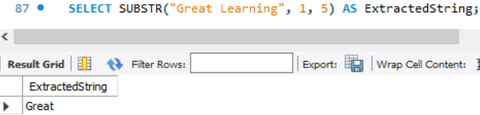
String Function - Example - 6
SUBSTR(): This function extracts a substring from a string
Syntax:
SELECT SUBSTR("Great Learning", 1, 5) AS ExtractedString;
Output:
ExtractedString
Great

Slide 29
DATE Function

Slide 30
Date Functions
The format of the date in table must be matched with the input date in order to insert. In various scenarios instead of date, datetime is used
In MySql the default date functions are:
Functions | Meaning
NOW | Returns the current date and time
CURDATE | Returns the current date
CURTIME | Returns the current time

Slide 31
Date Functions
Functions | Meaning
DATE | Extracts the date part of a date or date/time expression
EXTRACT | Returns a single part of a date/time
DATE_ADD | Adds a specified time interval to a date
DATE_SUB | Subtracts a specified time interval from a date
DATEDIFF | Returns the number of days between two dates
DATE_FORMAT | Displays date/time data in different formats

Slide 32
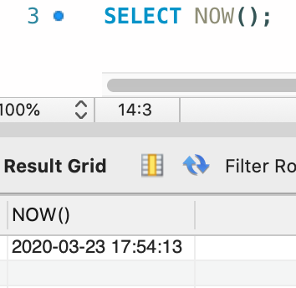
Date Function - Example - 1
NOW(): Returns the current date and time.
Syntax
SELECT NOW();
Output:
NOW()
2020-03-23 17:54:13

Slide 33
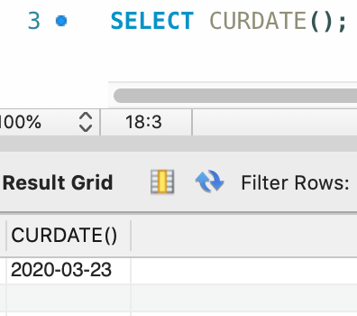
Date Function - Example - 2
CURDATE(): Returns the current date.
Syntax
SELECT CURDATE();
Output:
CURDATE()
2020-03-23

Slide 34
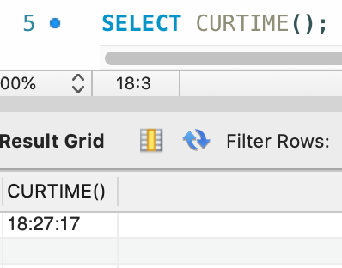
Date Function - Example - 3
CURTIME(): Returns the current time
Syntax
SELECT CURTIME();
Output:
CURTIME()
18:27:17

Slide 35
BIN Function

Slide 36
BIN Function - Syntax
MySQL BIN() returns the corresponding string representation of the binary value of a BIGINT number
Syntax:
BIN(num1)
Argument:
Name | Description
num1 | A number whose binary value is to be retrieved

Slide 37
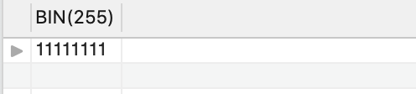
BIN Function - Example
The following MySQL statement returns the string representation of 255, i.e. '11111111'
Syntax:
Select BIN(255);
Output:

Slide 38
CAST Function

Slide 39
CAST Function - Syntax
The CAST() function converts a value (of any type) into the specified datatype
Syntax:
CAST(value AS datatype)
Argument:
Parameter | Description
value | Required. The value to convert
datatype | Required. The datatype to convert to

Slide 40
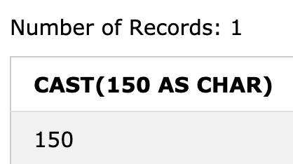
CAST Function - Example - 1
Converting a value to a CHAR data type
Syntax:
SELECT CAST(150 AS CHAR);
Output:

Slide 41
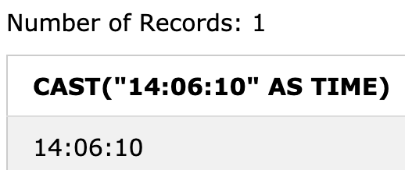
CAST Function - Example - 2
Converting a value to a TIME datatype
Syntax:
SELECT CAST("14:06:10" AS TIME);
Output:

Slide 42
COALESCE Function

Slide 43
COALESCE Function - Syntax
The COALESCE() function returns the first non-null value in a list
Syntax:
COALESCE(val1, val2, ...., val_n)
Parameter Values:
Parameter | Description
val1, val2, val_n | Required. The values to test

Slide 44
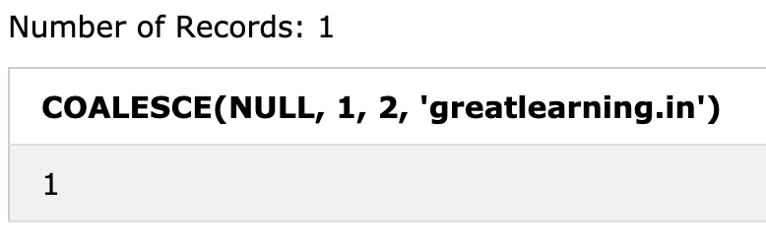
COALESCE Function - Example
Return the first non-null value in a list
SELECT COALESCE(NULL, 1, 2, 'greatlearning.in');
Output:
The first value after the NULL value is ‘1’ , so the output is 1

Slide 45
Sorting Query Result

Slide 46
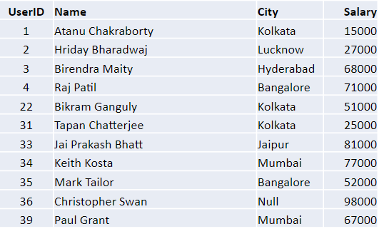
Sorting Query Results
Consider the following table for the study:

Slide 47
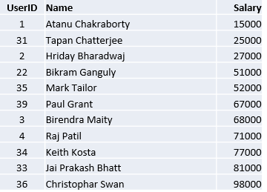
Sorting Query Results
The order by clause causes the tuples in the result of a query to appear in sorted order
Let us write a query which will show the users according to the ascending order of their salary.
SELECT UserID, Name, Salary FROM tblUser ORDER BY Salary
Output:
By default, the order by clause lists items in ascending order.

Slide 48
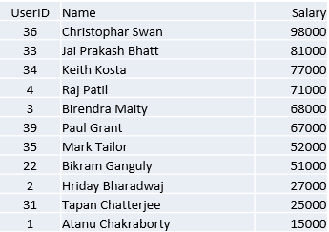
Sorting Query Results
To specify the sort order we used: desc for descending order or asc for ascending order
Now let us see an example to show the users according to the descending order of their salary
SELECT UserID, Name, Salary FROM tblUser ORDER BY Salary desc
Output:

Slide 49
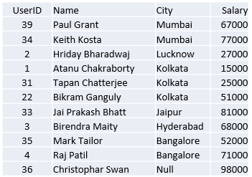
Sorting Query Results
Furthermore ordering can be performed on multiple attributes.
Suppose we wish to order the entire tblUser relation in ascending order of City and then descending order of amount. Then we express this query in SQL as follows.
SELECT UserID, Name, Salary FROM tblUser ORDER BY City desc, Salary asc
Output:

Slide 50
Thank You

Slide 51
Agenda
Aggregate Function
COUNT
SUM
AVG
MIN
MAX
Aggregate with Group by
Aggregate with Having clause
Having without Group by

Slide 52
Aggregate Functions
Aggregate Functions are all about performing calculations on multiple rows of a single column of a table and returning a single value
The ISO standard defines five (5) aggregate functions namely
COUNT
SUM
AVG
MIN
MAX

Slide 53
Why Use Aggregate Functions?
Aggregate functions allow us to easily produce summarized data from our database
For instance, from our company database , management may require following reports:
Minimum Salary of a particular department
Highest paid employee details
Average salary of HR department

Slide 54
Create Table
Before we go through each of the function one by one. Let’s first have a sample data table we’ll use to demonstrate the usage
CREATE TABLE employee (month INT, emp_id INT, emp_name VARCHAR(15), dept_name VARCHAR(15), salary INT );
INSERT INTO employee VALUES
(1, 101, "Oliver", "HR", 9000),
(1, 102, "George", "IT", 8000),
(3, 103, "Harry", "HR", 20000),
(6, 104, "Jack", "IT", 110123),
(6, 105, "Jacob", "SALES", 3000),
(12,106, "Noah", "SALES", 101000),
(12,107, "Charlie", "IT", 123456),
(Null, 108, "Robert", "IT", 30400);

Slide 55
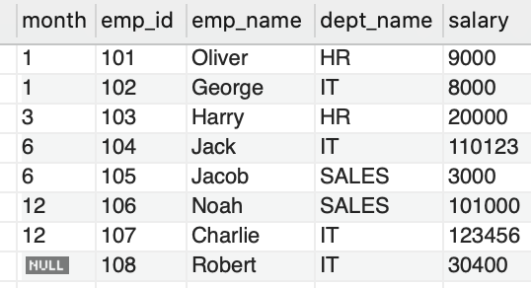
Create Table
The employee table created looks as follows:

Slide 56
COUNT

Slide 57
COUNT Function - Syntax
If you want to count total records matching a condition, then call the COUNT function to get the number
Syntax:
SELECT COUNT([DISTINCT] field_name)FROM target_table[WHERE test_expr];
The COUNT(DISTINCT field_name) returns the number of distinct rows that do not contain NULL values as the result of the expression.

Slide 58
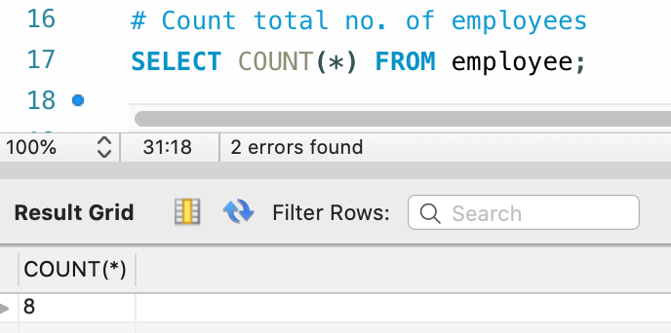
COUNT Function - Example
If you want to count the total number of employees, you can use the count function as follows
SELECT COUNT(*) FROM employee;
Output:
The total number of employees is 8

Slide 59
SUM

Slide 60
SUM Function - Syntax
The SUM function gets total a set of values
Syntax:
SELECT SUM(field_name)FROM target_table[WHERE test_expr];
This is the column or expression that will be summed

Slide 61
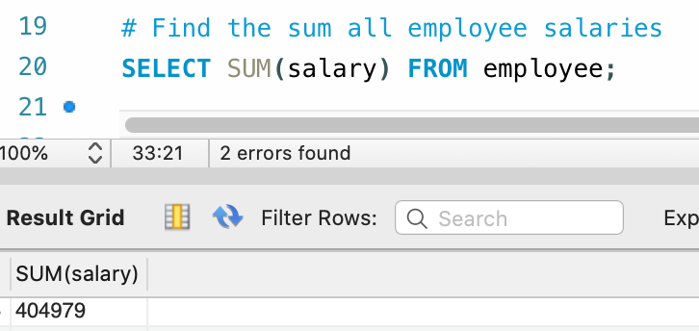
SUM Function - Example
Below is the query to find the sum of all employee salaries using sum() function
SELECT SUM(salary) FROM employee;
Output:
The total sum of salary of all the employees is 404979

Slide 62
AVERAGE (AVG)

Slide 63
AVG Function - Syntax
The AVG function returns the average of a set of values
Syntax:
SELECT AVG(field_name) FROM target_table [WHERE test_expr];
This is the column or expression that will be averaged

Slide 64
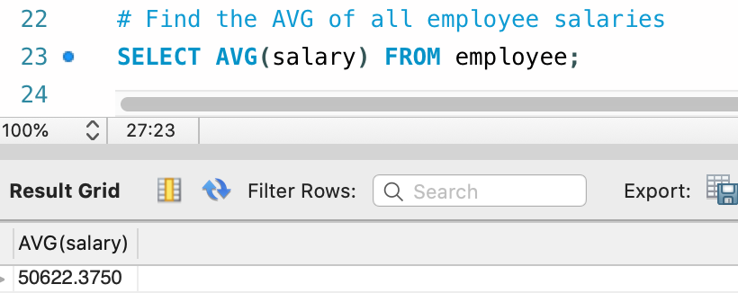
AVG Function - Example
Find the average of all employee salaries, using the AVG function as follows
SELECT AVG(salary) FROM employee;
Output:
The average salary of all employees is 50622.3750

Slide 65
MINIMUM (MIN)

Slide 66
MIN Function - Syntax
The MIN function returns the minimum from a set of value
Syntax:
SELECT MIN(field_name)FROM target_table [WHERE test_expr];
This is the column or expression that will give the minimum value of specific column

Slide 67
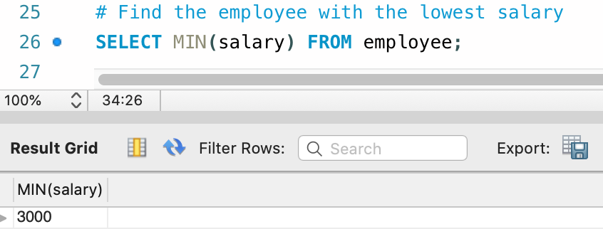
MIN Function - Example
Find the lowest salary received by an employe using the MIN function as follows
SELECT MIN(salary) FROM employee;
Output:
The minimum salary of the employee is 3000

Slide 68
MAXIMUM (MAX)

Slide 69
MAX Function - Syntax
The MAX function returns the maximum from a set of values
Syntax:
SELECT MAX(field_name)FROM target_table[WHERE test_expr];
This is the column or expression that will give the maximum value

Slide 70
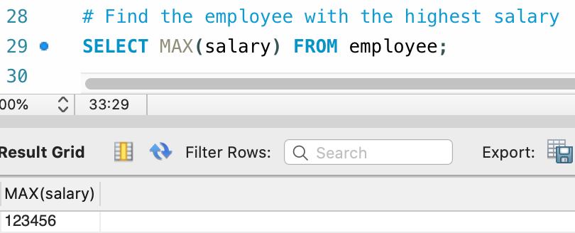
MAX Function - Example
Find the highest salary received by an employee using the MAX function as follows
SELECT MAX(salary) FROM employee;
Output:
The maximum salary of the employee is 123456

Slide 71

The aggregate function discussed so far returns zero when no matching rows exist in the table

Slide 72
Grouped Queries

Slide 73
Group by Function - Syntax
The GROUP BY statement groups rows that have the same values into summary rows
Syntax:
SELECT statements... GROUP BY column_name1[,column_name2,...] [HAVING condition];
"[HAVING condition]" is optional; it is used to restrict the rows affected by the GROUP BY clause
‘GROUP BY” column_name1" is the clause that performs the grouping based on column_name1.
"[,column_name2,...]" is optional; represents other column names when the grouping is done on more than one column.

Slide 74
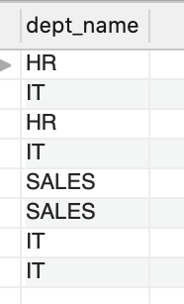
Grouping using Single Column
Execute a simple query that returns all the department entries from the empl table
SELECT dept_name from employee;
Output:
Gives the single group of dept_name column

Slide 75
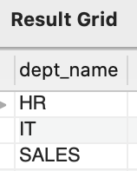
Grouping using Single Column
A GROUPBY function to display unique departments in the office:
SELECT dept FROM empl GROUP BY dept;
Output:
There are 3 unique departments, namely HR, IT, and SALES

Slide 76
Aggregation with Group by Clause

Slide 77
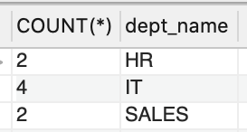
Count Aggregation - Group By
Count the number of employees, in each department, using the Group By clause along with the count aggregate function as follows
SELECT COUNT(*), dept_name FROM employee GROUP BY dept_name;
Output:
Out of 8 employees, 2 employees belong to HR department, 4 belongs to IT department and 2 employees belongs to SALES department

Slide 78
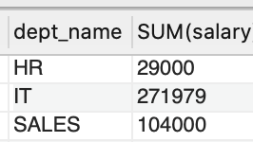
SUM Aggregation - Group By
Use the sum function to find the sum of salaries in each department as follows
SELECT dept_name, SUM(salary) FROM employee GROUP BY dept_name;
Output:

Slide 79
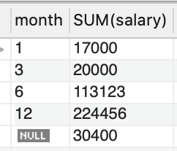
SUM Aggregation - Group By
Find the month-wise sum of salaries using the sum function as follows
SELECT month, SUM(salary) FROM employee GROUP BY month;
Output:

Slide 80
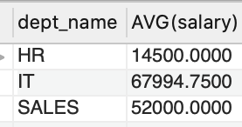
AVG Aggregation - Group By
Find the average of salaries in each department, using AVG function as follows
SELECT dept_name, AVG(salary) FROM employee GROUP BY dept_name;
Output:

Slide 81
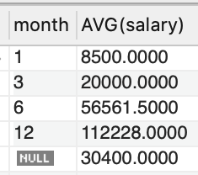
AVG Aggregation - Group By
Find the month-wise average of salaries by using the AVG function as follows
SELECT month, AVG(salary) FROM employee GROUP BY month;
Output:

Slide 82
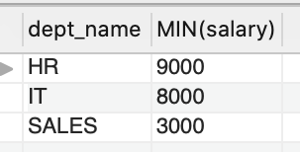
MIN Aggregation - Group By
Find the lowest salary in each department, by using the MIN function as follows
SELECT dept_name, MIN(salary) FROM employee GROUP BY dept_name;
Output:

Slide 83
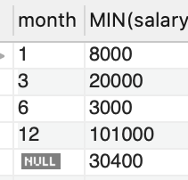
MIN Aggregation - Group By
Find the month-wise minimum salary, by using the MIN function as follows
SELECT month, MIN(salary) FROM employee GROUP BY month;
Output:

Slide 84
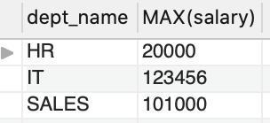
MAX Aggregation - Group By
Find the highest salaries in each department using the MAX function as follows
SELECT dept_name, MAX(salary) FROM employee GROUP BY dept_name;
Output:

Slide 85
Multiple Grouping Columns

Slide 86
Create Table
Let’s first have a sample data table we’ll use to demonstrate the usage
CREATE TABLE employee1 (joining_month INT, emp_id INT,
emp_name VARCHAR(15), dept_name VARCHAR(15), salary INT );
INSERT INTO employee1 VALUES
(1, 101, "Oliver", "HR", 9000),
(1, 102, "George", "IT", 8000),
(1, 103, "Harry", "HR", 20000),
(3, 104, "Jack", "IT", 110123),
(6, 105, "Jacob", "SALES", 3000),
(6,106, "Noah", "SALES", 101000),
(3,107, "Charlie", "IT", 123456),
(Null, 108, "Robert", "IT", 30400);

Slide 87
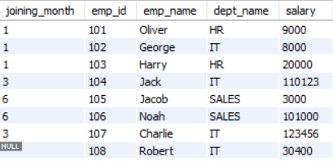
Create Table
The employee1 table created looks as follows:

Slide 88
Multiple Grouping Columns
A GROUP BY clause can contain two or more columns- or, in other words, a grouping can consist of two or more columns

Slide 89
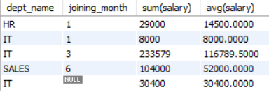
Multiple Grouping Columns
Get sum of salaries and as well as average of all employees in each dept as per the joining month
SELECT dept_name, joining_month, SUM(salary), AVG(salary) FROM employee1 GROUP BY dept_name, joining_month;
Output:
Here we are grouping salary data by using multiple columns : dept & joining month

Slide 90



All grouping columns that are given in the select list must be included in the group by clause in only_full_group_by mode
Select dept_name, joining_month, sum(salary) From employee1 group by dept_name;
Select dept_name, joining_month, sum(salary) From employee1 group by dept_name , joining_month;
SELECT list is not in GROUP BY clause and contains nonaggregated column 'company.employee.joining_month' which is not functionally dependent on columns in GROUP BY clause; this is incompatible with sql_mode=only_full_group_by

Slide 91
Group by functions should not be included in the group-by clause
Select dept_name, joining_month, sum(salary) From employee1 group by sum(salary);
Select dept_name, joining_month, sum(salary) From employee1 group by dept_name, joining_month;
Error Code: 1056. Can't group on 'sum(salary)'

Slide 92
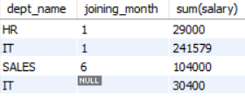
Comparison Conditions cannot be included in the group by clause as they cannot act on grouped result set
Select dept_name, joining_month, sum(salary) From employee1 group by sum(salary) > 10000;
Select dept_name, joining_month, sum(salary) From employee1 group by dept_name, joining_month > 10000;
Error Code: 1111. Invalid use of group function

Slide 93
Some other Restriction on Grouped Queries
WHERE clause with conditions can be issued before the group-by clause in order to filter the records and then apply Group By feature
But , WHERE clause should always mention before the GROUP BY
Grouping columns should have less unique values.
Grouping columns should be primary business entities and facts and should not contain transactional data.
Ex: dept , month – are less unique and summarizing the results are easy for grouping on these columns

Slide 94
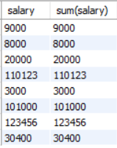
Some other Restriction on Grouped Queries
No Summarized Results
Accurate Summary Results
Select salary, sum(salary) From employee1 group by salary;
Select dept_name, joining_month, sum(salary) From employee1 group by dept_name, joining_month ;

Slide 95
Null Values in Grouping Columns

Slide 96
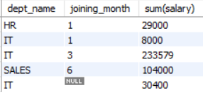
Null Values In Grouping Columns
If joining month of few employees is unknown and NULL exists in the joining_month column, then the salary is still calculated to show aggregate summary of salaries for those NULL values of the joining_month column
Select dept_name , joining_month , sum(salary) From employee1 group by dept_name , joining_month;
Output:
Shows the aggregate summary of salaries for those NULL values of the month.

Slide 97
Aggregation With Having Clause

Slide 98

Aggregation with Having Clause
Find the department where the collective salary is more than 35000 each using aggregation with having clause as below:
Select joining_month, dept_name , sum(salary) From employee1 group by joining_month, dept_name having sum(salary) > 35000;
Output:

Slide 99
Restriction on Grouped Search Condition

Slide 100
Restriction on Grouped Search Condition
Having clause is used along with group-by clause in order to apply conditions for the grouped result set
Having clause should be enclosed with grouped functions on columns that are issued in the Select query

Slide 101
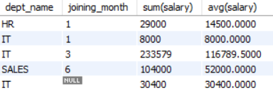
Restriction on Grouped Search Condition
Conditions in having clause should always have at least one grouping function for comparison since it acts on grouped result set.
Select dept_name, joining_month, sum(salary), avg(salary) From employee1
group by dept_name , joining_month having sum(salary) is not null;
Output:

Slide 102
Null values and Grouped Search Condition

Slide 103
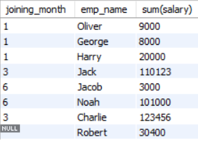
Null Values and Grouped Search Condition
If you want to find full salary details of employee along with the name and month they have joined, where the salary is not a null value
Select joining_month, emp_name , sum(salary) From employee1 group by joining_month having sum(salary) is not null;
Output:
salary details of employee along with the name and month they have joined, where the salary is not a null value

Slide 104
Having Without Group by

Slide 105

Having without Group by
Print one high level summary report of salary that is paid to all employees but not less than 299999. It benefits to quickly review on sum of salaries paid for all the employees in the company is exceeding 299999
Select sum(salary) From employee1 having sum(salary) > 299999;
Output:
The sum salary is 404979

Slide 106
Thank You

