Slide 1
Content
Introduction to Snake Game
Reinforcement Learning
Neural Networks
A.I. Snake Game

Slide 2
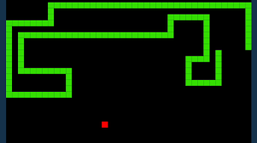
Snake Game
The goal of the game is to guide the snake to eat the food that appears randomly.
As the snake consumes food its length increases.
The snake shouldn't collide with itself or with the borders or it's Game OVER.

Slide 3
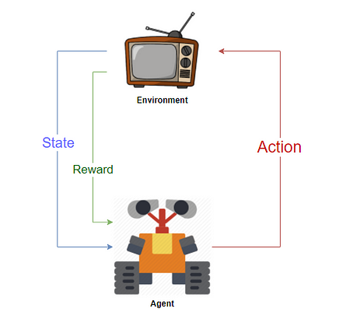
Reinforcement Learning
Agent is regarded for right behaviour/move
Agent is given a penalty for the wrong behaviour/move

Slide 4
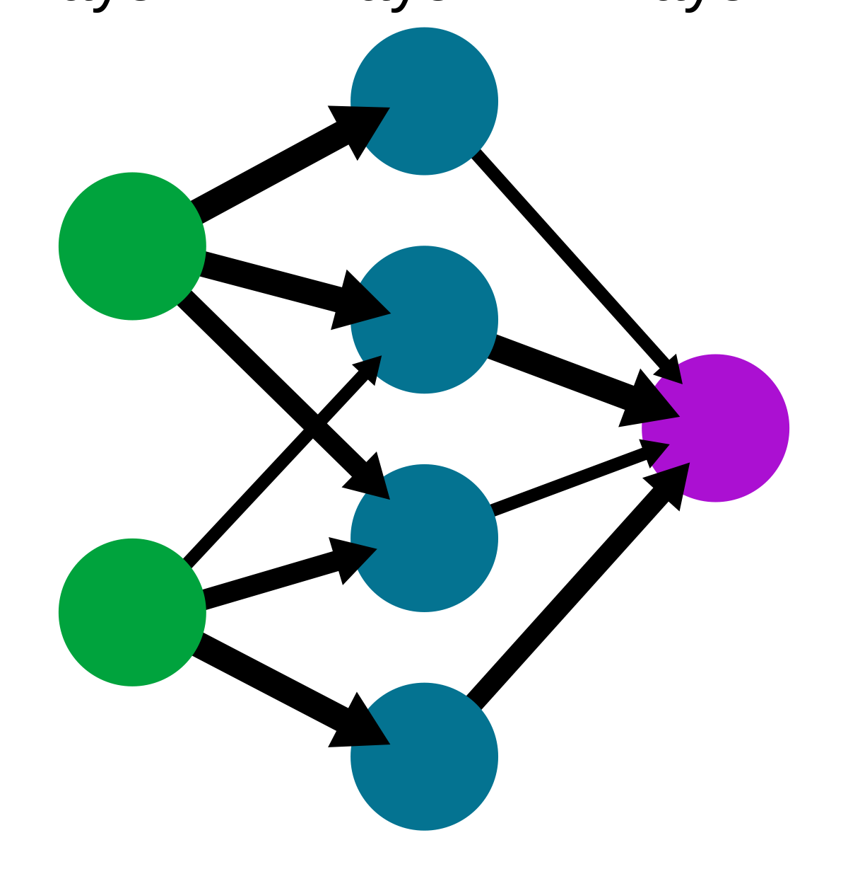
Neural Networks
Called Deep Learning
Uses interconnected nodes or neurons in a layered structure that resembles the human brain.
They can recognize hidden patterns and correlations in raw data, cluster and classify it, and – over time – continuously learn and improve.

Slide 5
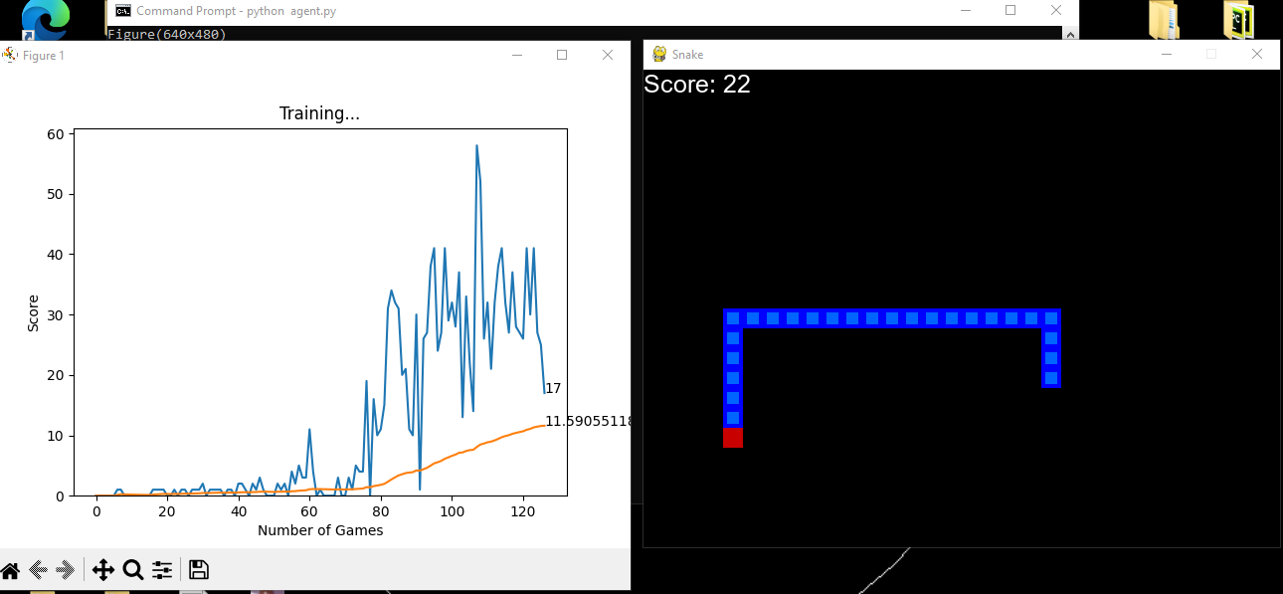
A.I. Snake Game
-The Agent will play the game
-Reinforcement Learning
-Neural Network
-Reward for eating the food
-Penalty for self eat/ boundary hit

Slide 6
Benefits
Training Intelligent Agents
Real-World Applications
Adaptability
Applications of A.I.
Engaging

