Slide 1
Travel planner agent
IBM AICTE PROJECT
Presented By:
Student name : Akshita Kumawat
College Name : Govt. Mahila Engineering College Ajmer
Department : Information Technology

Slide 2
OUTLINE
Problem Statement
Technology used
Wow factor
End users
Result
Conclusion
Git-hub Link
Future scope
IBM Certifications

Slide 3
Problem Statement
Planning travel can be time-consuming and overwhelming, especially when users must manually search for destinations, accommodations, transportation, and activities across multiple platforms. The Travel Planner Agent aims to simplify this process by providing a conversational AI assistant that helps users plan personalized trips efficiently. It assists in destination selection, itinerary creation, budget estimation, hotel and transport suggestions, and activity recommendations—all through an intuitive, chat-based interface. The agent uses user preferences, travel dates, and budget constraints to suggest optimal travel plans. This solution reduces planning time, improves travel experiences, and makes trip management more accessible, especially for non-tech-savvy users.

Slide 4
Technology used
IBM cloud lite services
Natural Language Processing (NLP)
Retrieval Augmented Generation (RAG)
IBM Granite model

Slide 5
IBM cloud services used
IBM Cloud Watsonx AI Studio
IBM Cloud Watsonx AI runtime
IBM Cloud Agent Lab
IBM Granite foundation model

Slide 6
Wow factors
This agent will dramatically simplify trip planning by eliminating the need for multiple apps and searches. It delivers a seamless, all-in-one experience that helps users discover destinations, manage budgets, and build smart itineraries in minutes. Whether for solo trips, group vacations, or business travel, this chatbot ensures personalized, hassle-free travel planning.
Unique features:
Smart destination suggestions based on user preferences and seasonality
Real-time recommendations for flights, hotels, and local activities
Budget estimator that adjusts options based on user constraints
Dynamic itinerary builder with drag-and-drop day planning
Local insights and travel tips powered by user ratings and AI
Calendar sync and reminder integration for trip timelines

Slide 7
End users
Academic Researchers
Research Institutions and Universities
Industry R&D Teams
Educators

Slide 8
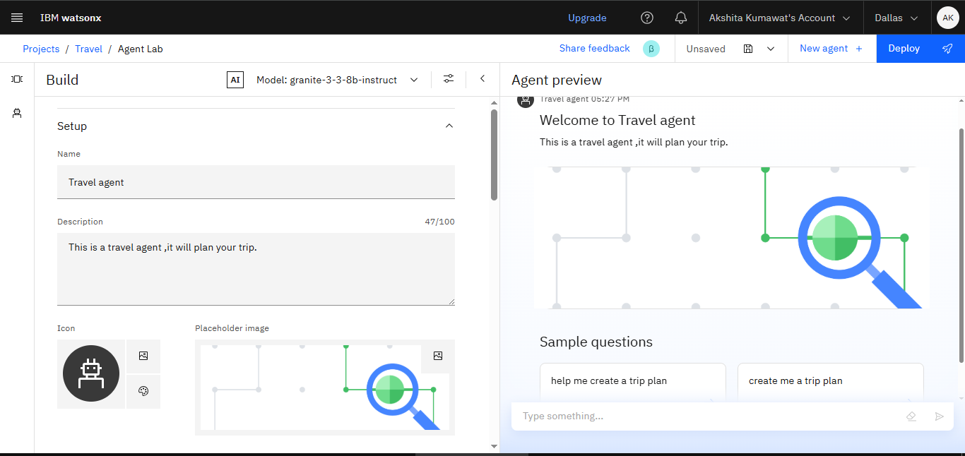
Results

Slide 9
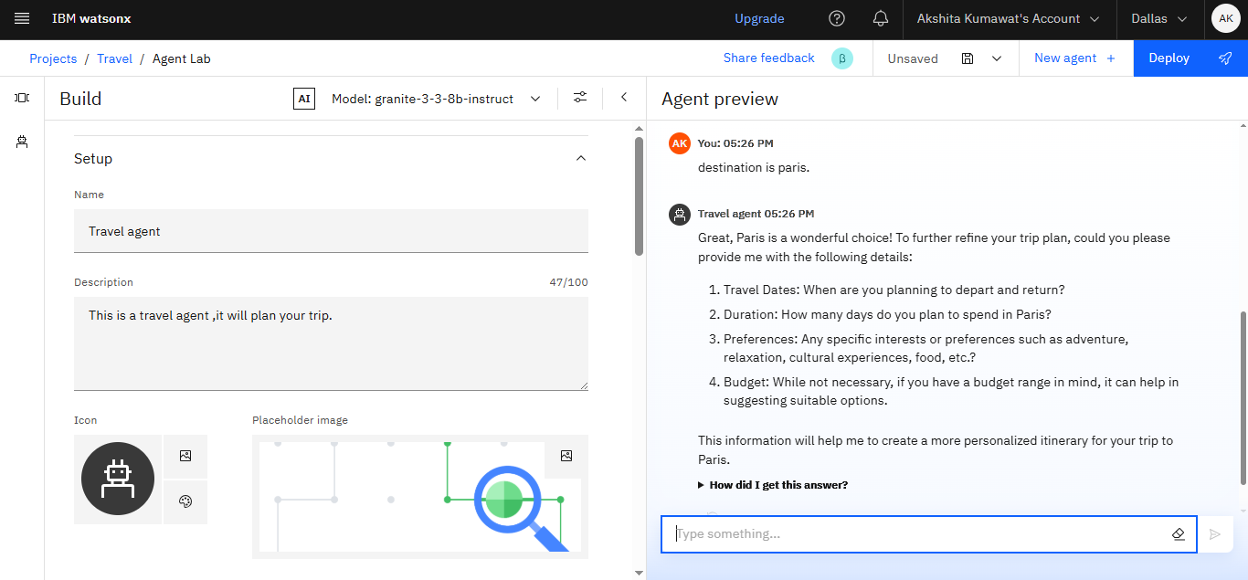
Results

Slide 10
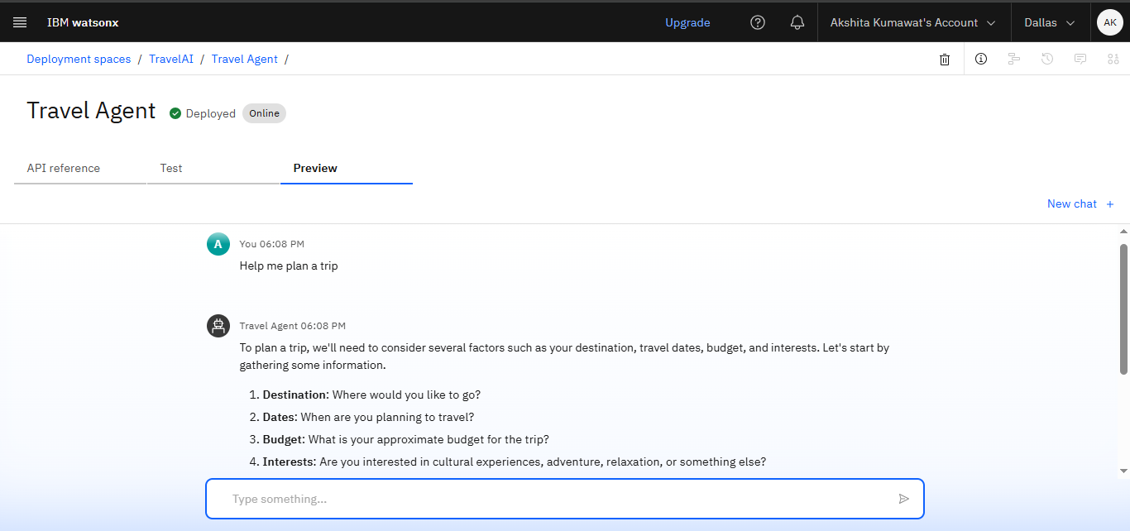
Results
Deployed AI Agent

Slide 11
Conclusion
Summary & Effectiveness
The Travel Planner Agent successfully delivers personalized travel planning based on user inputs like destination, budget, and travel dates.
The solution proved effective in offering structured suggestions including places to visit, stay options, transportation, and activities.
Challenges
Dialog skill logic required precise entity recognition to avoid fallback or incorrect suggestions.
Limited real-time adaptability without integration of external travel APIs or ML-based recommendations.

Slide 12
GitHub Link
https://github.com/Akshikmt/Travel-Planner.git

Slide 13
Future scope
The current rule-based chatbot can be enhanced further to increase intelligence, scalability, and user engagement.
Planned Enhancements
API Integration: Connect with real-time APIs for flights, hotels, weather, and maps to enhance travel suggestions.
Personalized Profiles: Allow users to save preferences and receive tailored itineraries based on past travel history.
User Experience Expansion
Multilingual Support: Add regional and international language support to assist a global user base.
WhatsApp/Email Integration: Deliver travel itineraries and updates directly via messaging services using Twilio API.

Slide 14
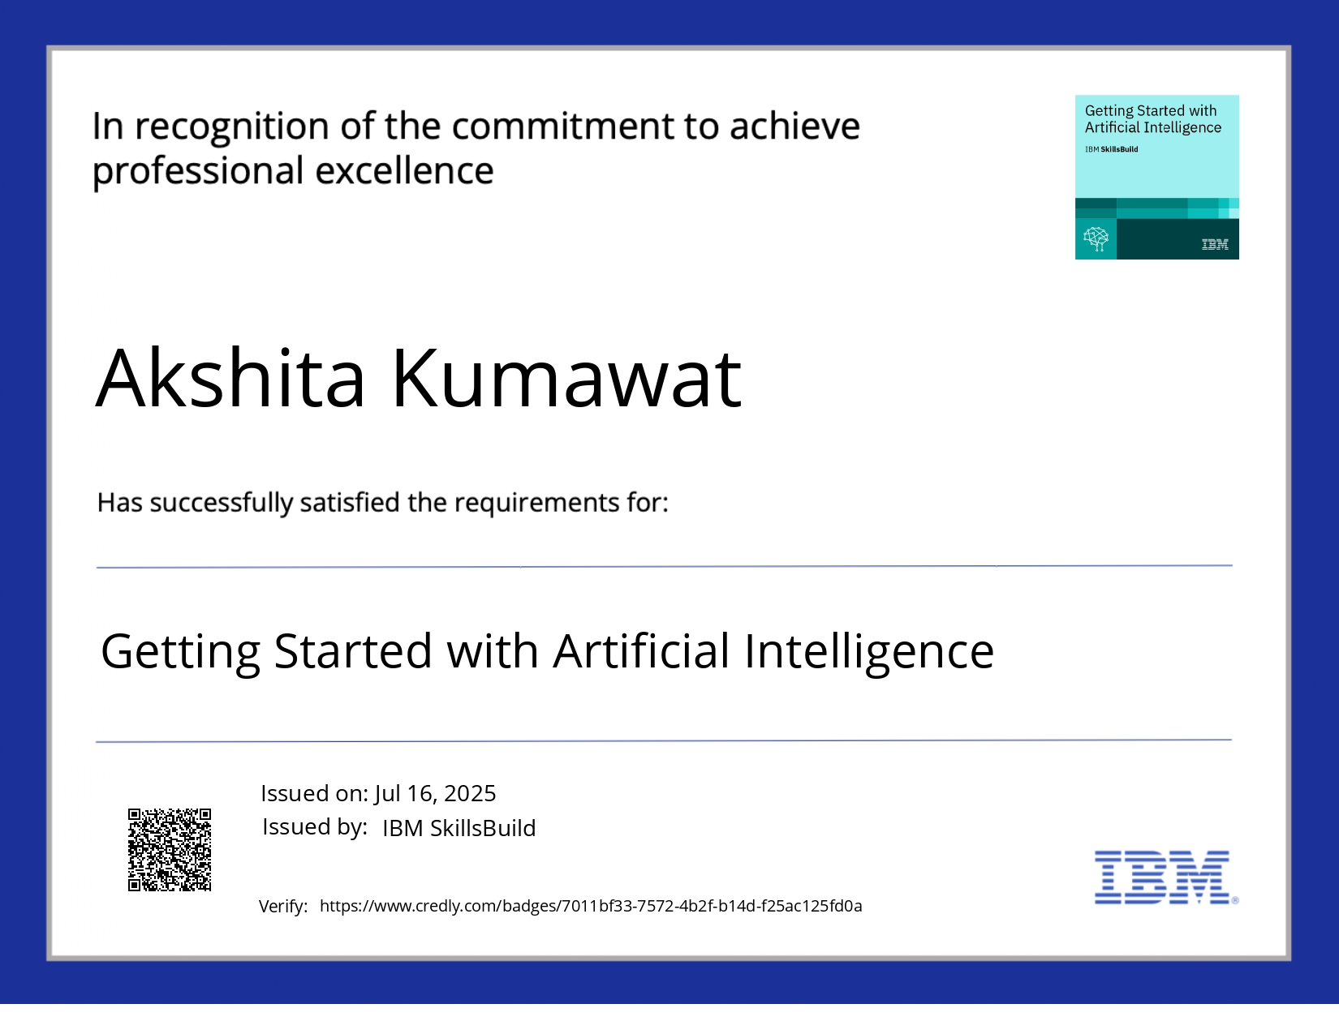
IBM Certifications

Slide 15
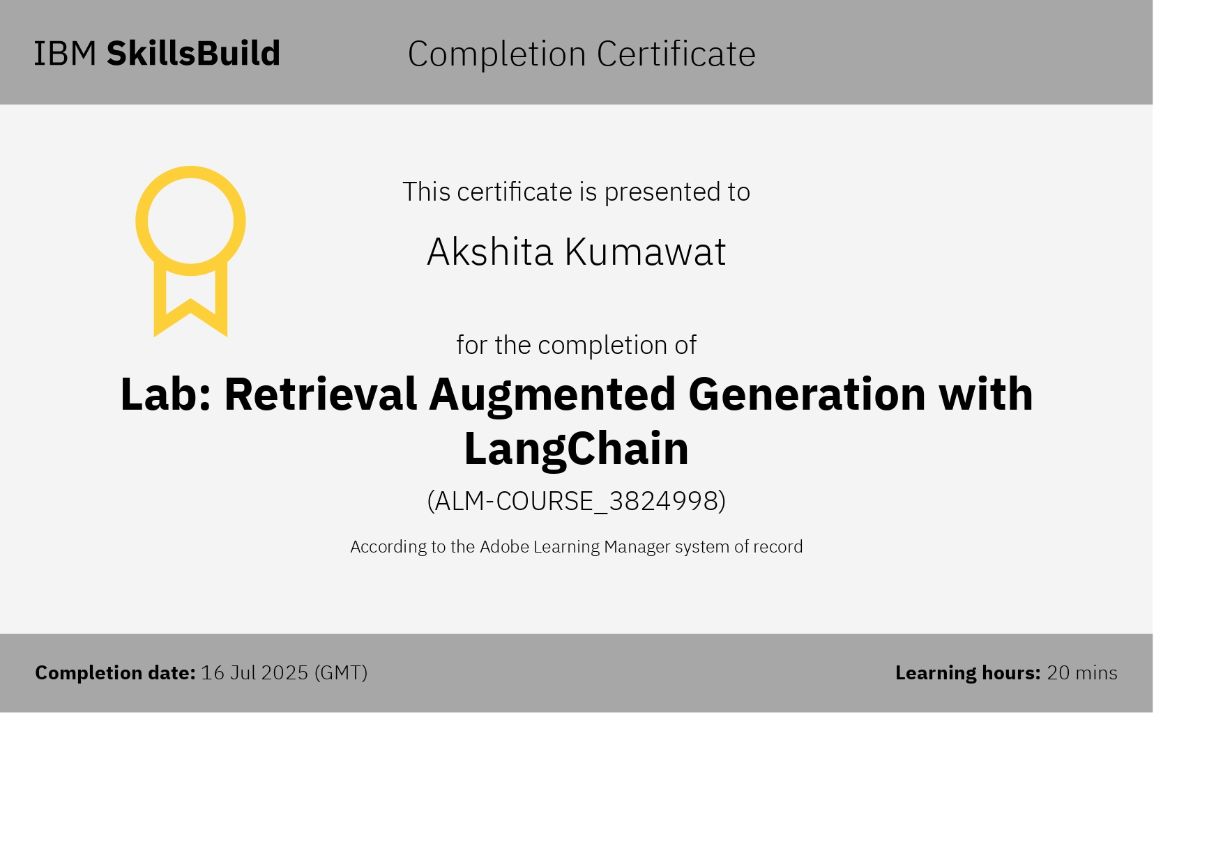

Slide 16
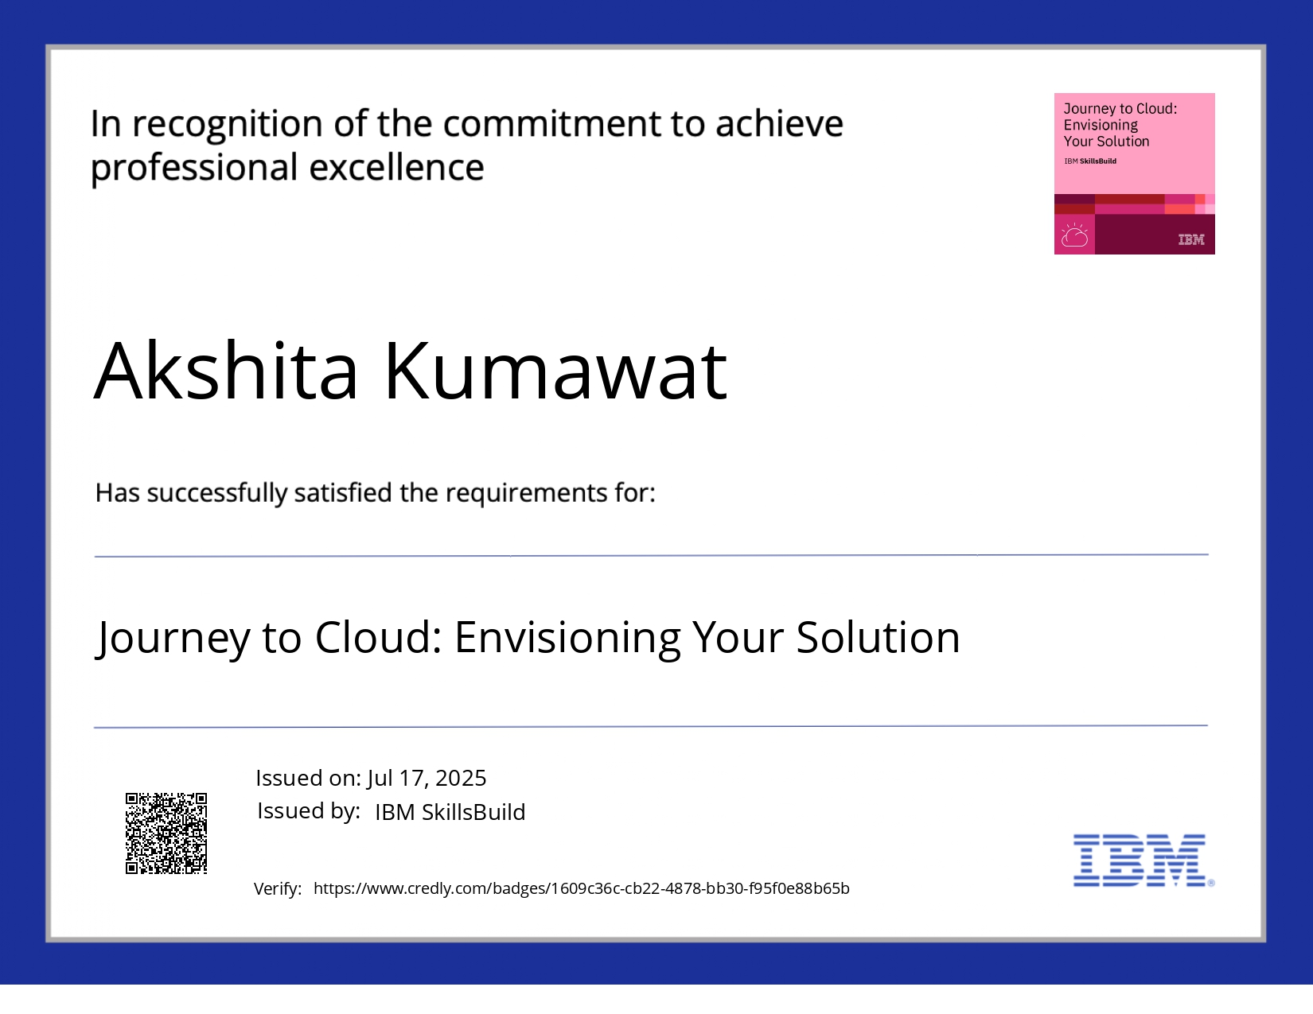

Slide 17
THANK YOU

