Slide 1


My Bank Application Review
Module – 4 Deposits
Team: Revenue Rulers

Slide 2
Contents
Introduction
ER Diagram
Code Review
Requirement Analysis
Architecture/Data Flow Diagram

Slide 3
Introduction
My Bank Application is a part of a whole Internet Banking Ecosystem.
We Would be showcasing our contribution with respect to Deposits.
Each Member is assigned with a common task of displaying Deposits.
We also have functionality like apply, search and a FD Calculator developed by Individual members of the team.

Slide 4
Requirement Analysis
User Authentication
View All Deposits
Avail/ Apply Deposits
Calculate Maturity

Slide 5
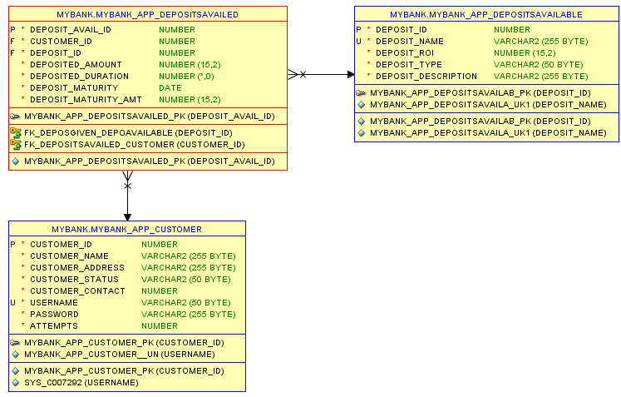
ER Diagram

Slide 6
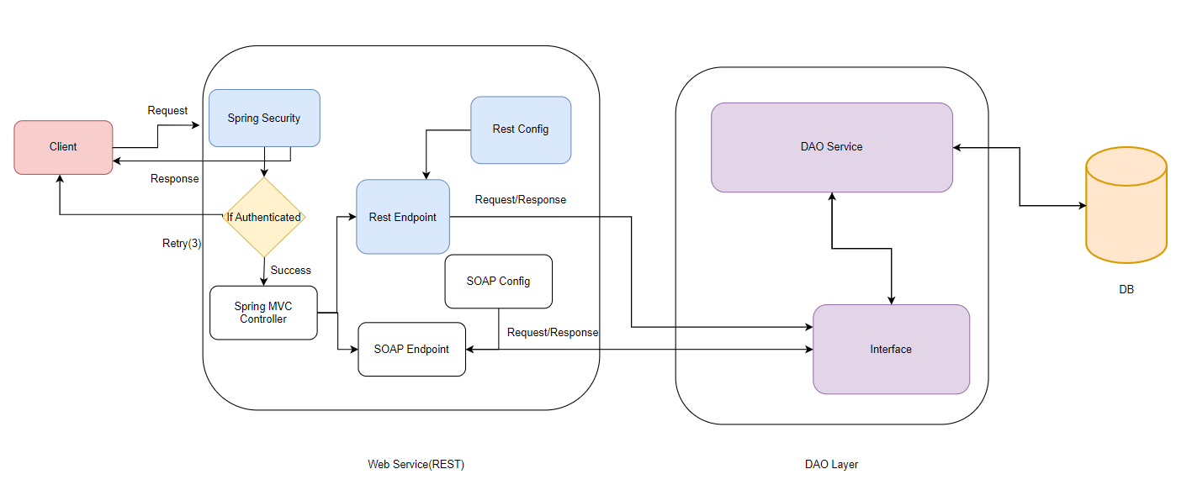
Architecture

Slide 7
Code Review
GitHub Link:DLTE-JavaFullStack-ShreyasShettyB2024/DLTE-Project/DLTE-MyBank-BackEnd at main · shreyasshettyb/DLTE-JavaFullStack-ShreyasShettyB2024 (github.com)

Slide 8

Thank You

