Slide 1
Framework for Efficient Analysis of Operational Research Algorithms
FEAORA – IDP Project
Supervisor: Miray Közen
Examiner: Prof. Dr. Stefan Minner
Akshit Malhotra
Anshul Vij

Slide 2
FEAORA
Framework to analyze OR algorithms
Directly plug Mosel model and perform batch experiments
Randomized input support
Input permutation for test case generation
Results saved in user friendly excel format
Visualization support for various charts and Google Maps
Results along with input configurations are saved in one excel file
Cross Platform Support, tested on Windows and Mac

Slide 3
FEAORA Process
Import & Parse Mosel Code
Input Modeling
Test Instance Generation
Execution and Saving
Visualization

Slide 4
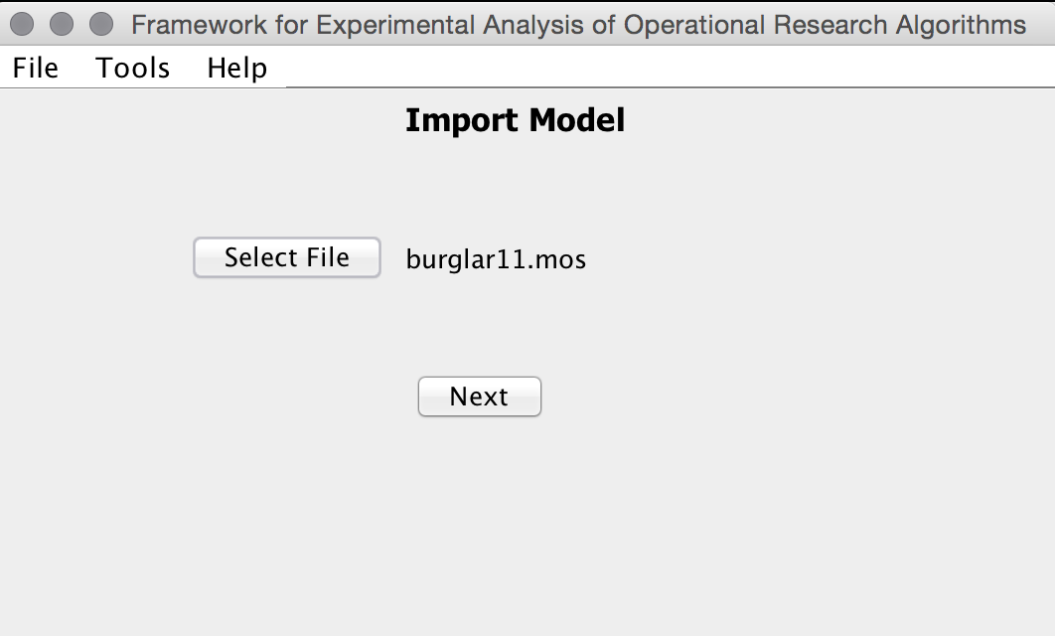
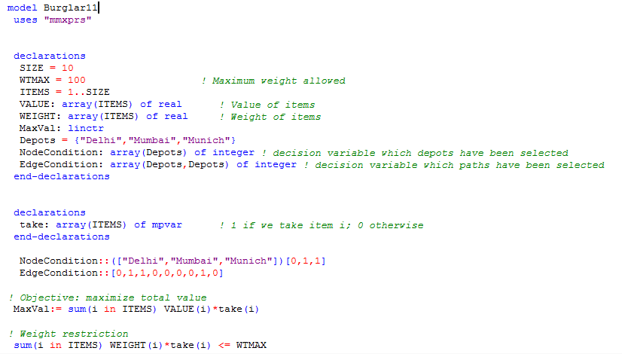
Model Import

Slide 5
Model Import
Filtering Module
Pre processing
Symbol Parsing
UI Updating
Tokenizer

Slide 6
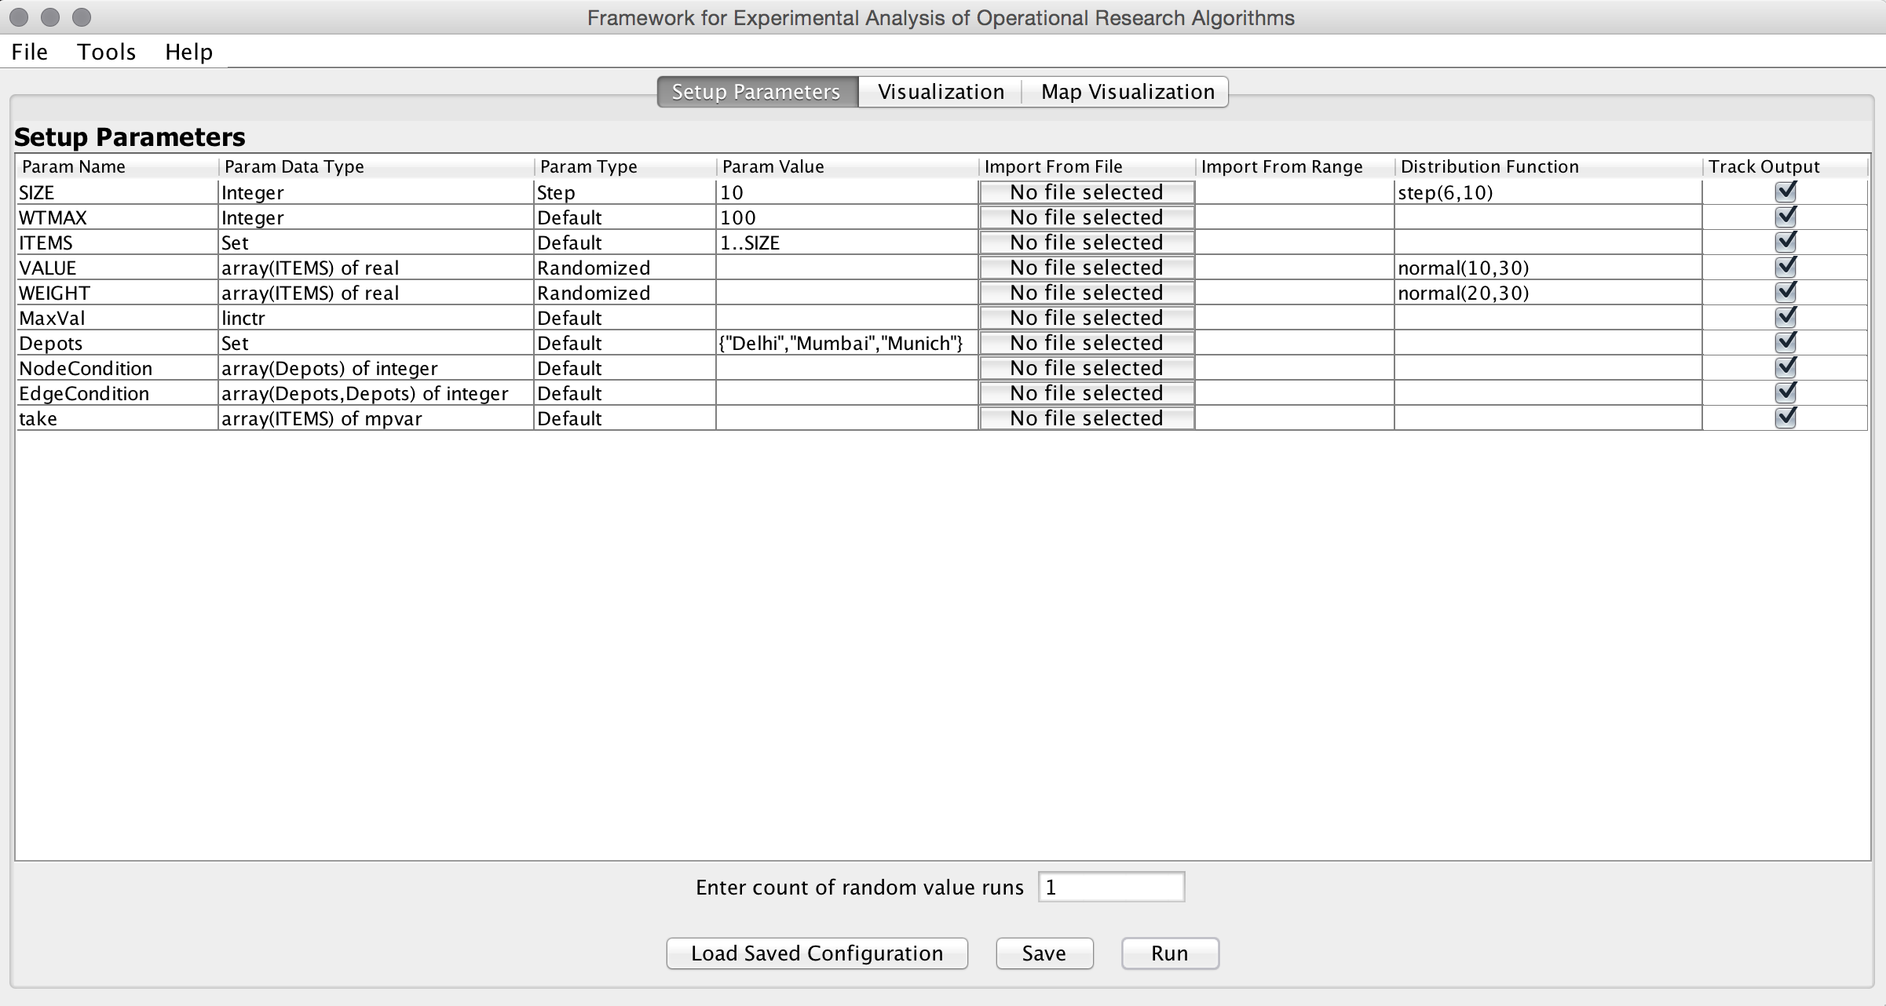
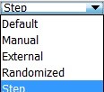
Input Modeling
Distribution functions
Normal
Exponential
Uniform
Logistic
Gamma

Slide 7
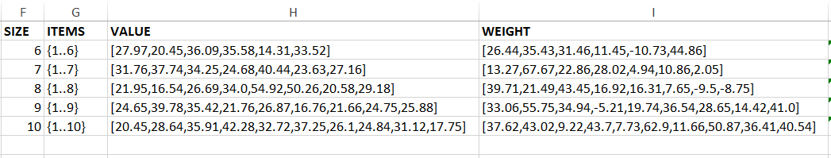
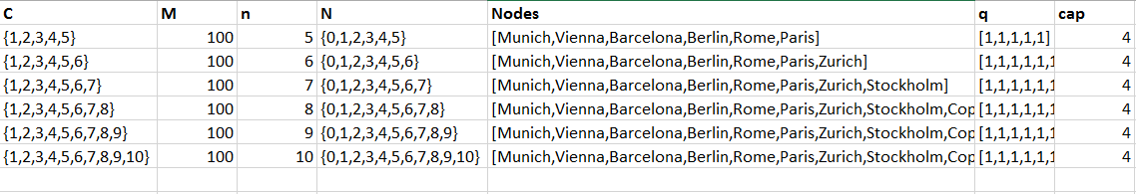
Test Instance Generation

Slide 8
Model Execution
Model Parser
Test Case
Original Mosel
Model Execution & Saving
Tracked Variables

Slide 9
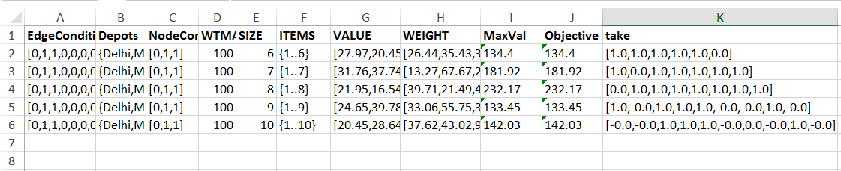
Model Saving

Slide 10
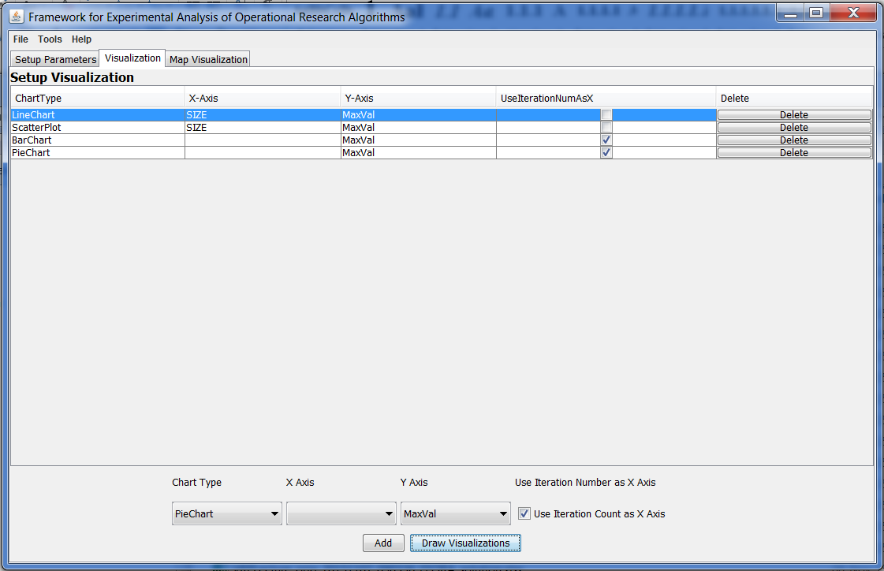
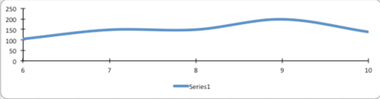
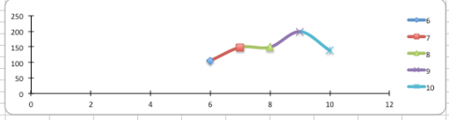
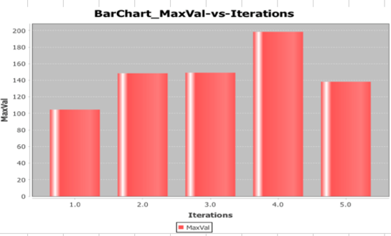
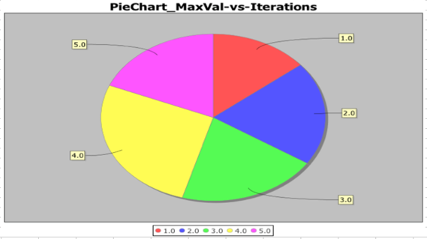
Chart Visualization

Slide 11
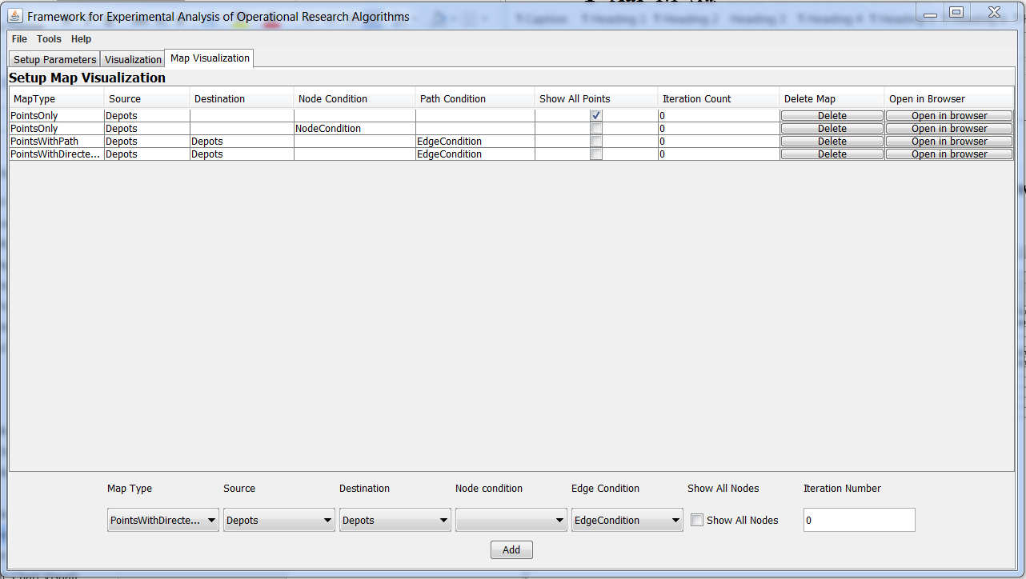
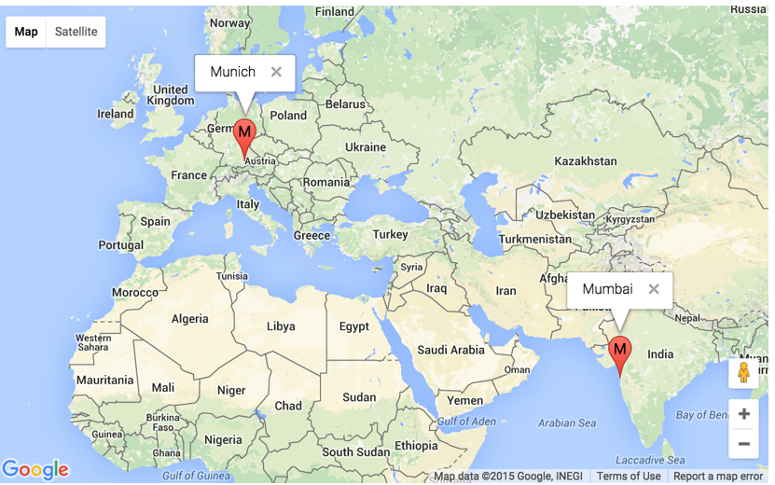
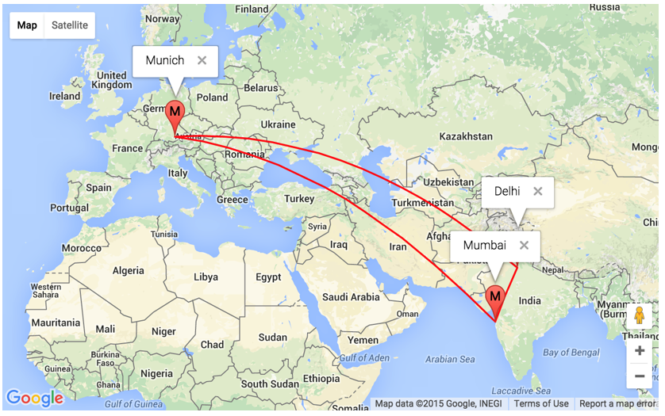
Map Visualization

Slide 12
Demo
Knapsack Problem demonstrating randomized input and chart visualization.
Vehicle Routing Problem demonstrating step input and map visualization.

Slide 13
FEAORA vs OREX-J
Categories | FEAORA | OREX-J
Programming language | Mosel | Java
Implementation Effort | Low | High
Input Modeling | GUI support | Implement own logic
Problem Solver | Used with FICO Xpress | User need to add solver
Results Storage | Excel | SQL DB
Visualizations | Charts + Maps | No built-in support

Slide 14
Future Work
Adding new variables from the tool
External file parsing for input modeling
Add more probability distribution functions
Multi threaded execution of test instances
More advanced visualizations like graphs

Slide 15
Thank you

