Slide 1
Welcome to the world of simulators!!!
Lab 9 · ChampSim and caches

Slide 2
Buffer Slide
• Doubts from last week's lab? Ask them now.
• Outlab: status and doubts (TA update).
• The tasks are not graded. Do them anyway: the lab exam builds on them.
• The last hour is the lab exam.

Slide 3

Buffer Slide
• Outlab 7 + 8 is coming soon.
• Ask and answer more questions today: we have too many chocolates.

Slide 4
Plan for this lab
• Part 1: ChampSim, a cache simulator
• Part 2: The cache hierarchy: how a request travels
• Part 3: Replacement policies
• Part 4: ChampSim under the hood → Tasks 1–3
• Lab exam (last hour)

Slide 5
Part 1
ChampSim
• What it is
• Traces
• Its folders
• Building and configuring

Slide 6
ChampSim
• ChampSim is a simulator of a CPU core and its caches.
• Architects use simulators to test an idea, such as a new cache policy, without building a chip.
• ChampSim runs on Linux and needs only g++, make and python3.
• To install it at home: git clone --branch 2022-01 https://github.com/ChampSim/ChampSim.git

Slide 7
ChampSim replays traces
$ ls /opt/CS231_Traces
602.gcc_s-2226B.champsimtrace.xz 605.mcf_s-994B.champsimtrace.xz
603.bwaves_s-891B.champsimtrace.xz soplex_66B.trace.xz
• ChampSim does not run your program. It replays a trace: the list of instructions a real program executed, with the addresses each one read or wrote.
• The trace never changes, so any change in the result comes from the processor you configured.
• We use four SPEC CPU programs. The lab machines keep them in /opt/CS231_Traces.
• The lab makefile finds a trace by name: trace=soplex picks *soplex*.xz.

Slide 8
Exploring ChampSim: Building
Champsim/
├── champsim_config.json
├── config.sh
├── Makefile (generated)
├── inc/
│ └── cache.h
├── src/
│ ├── cache.cc
│ └── main.cc
├── replacement/
│ ├── lru/lru.cc
│ └── srrip/srrip.cc
├── prefetcher/
├── branch/
└── bin/
└── champsim (built)
• If you built before, run make clean first.
• Step 1: ./config.sh champsim_config.json reads the JSON and writes the Makefile.
• Step 2: make compiles the simulator into bin/.
This is the canonical way to build ChampSim. Run both steps again every time you change the JSON.

Slide 9
Exploring ChampSim: The configuration
Champsim/
├── champsim_config.json
├── config.sh
├── Makefile (generated)
├── inc/
│ └── cache.h
├── src/
│ ├── cache.cc
│ └── main.cc
├── replacement/
│ ├── lru/lru.cc
│ └── srrip/srrip.cc
├── prefetcher/
├── branch/
└── bin/
└── champsim (built)
• champsim_config.json describes the processor you simulate.
• You set cache sizes, latencies, queue sizes and policies here.

Slide 10
Exploring ChampSim: The simulator code
Champsim/
├── champsim_config.json
├── config.sh
├── Makefile (generated)
├── inc/
│ └── cache.h
├── src/
│ ├── cache.cc
│ └── main.cc
├── replacement/
│ ├── lru/lru.cc
│ └── srrip/srrip.cc
├── prefetcher/
├── branch/
└── bin/
└── champsim (built)
• src/cache.cc decides what a cache does with each request.
• src/main.cc holds the main loop and prints the statistics.
• inc/cache.h declares the CACHE class.

Slide 11
Exploring ChampSim: Replacement policies
Champsim/
├── champsim_config.json
├── config.sh
├── Makefile (generated)
├── inc/
│ └── cache.h
├── src/
│ ├── cache.cc
│ └── main.cc
├── replacement/
│ ├── lru/lru.cc
│ └── srrip/srrip.cc
├── prefetcher/
├── branch/
└── bin/
└── champsim (built)
• replacement/ has one folder per replacement policy.
• The JSON names the folder that each cache uses.
• We explain replacement policies in Part 3.

Slide 12
Exploring ChampSim: The binary
Champsim/
├── champsim_config.json
├── config.sh
├── Makefile (generated)
├── inc/
│ └── cache.h
├── src/
│ ├── cache.cc
│ └── main.cc
├── replacement/
│ ├── lru/lru.cc
│ └── srrip/srrip.cc
├── prefetcher/
├── branch/
└── bin/
└── champsim (built)
• make writes the simulator to bin/.
• The file name comes from executable_name in the JSON.

Slide 13
The whole configuration file
{
"executable_name": "bin/champsim",
"block_size": 64,
"num_cores": 1,
"ooo_cpu": [ { ..., "branch_predictor": "bimodal" } ],
"L1I": { "sets": 64, "ways": 8, ..., "replacement": "lru" },
"L1D": { "sets": 64, "ways": 12, ..., "replacement": "lru" },
"L2C": { "sets": 1024, "ways": 8, ..., "replacement": "lru" },
"ITLB": { ... }, "DTLB": { ... }, "STLB": { ... },
"LLC": { "sets": 2048, "ways": 16, ..., "replacement": "lru" },
"physical_memory": { ... },
"virtual_memory": { ... }
}
• The file has one block per part of the processor. We only touch the cache blocks.
• Each cache block can name its own replacement policy. A block without that line uses lru.
• The given file writes the line only for the LLC. For the tasks, the makefile sets it in the L2C block.

Slide 14
One cache block
"LLC": {
"sets": 2048,
"ways": 16,
"rq_size": 32,
"wq_size": 32,
"mshr_size": 64,
"latency": 20,
"max_read": 1,
"max_write": 1,
"prefetcher": "no",
"replacement": "lru"
}
• sets and ways give the shape of the cache.
• latency is the number of cycles a hit takes.
• rq_size, wq_size and mshr_size are buffer sizes. Part 2 explains them.
• max_read and max_write limit the requests handled per cycle.
• replacement names a folder under replacement/.

Slide 15
Running ChampSim
$ ./bin/champsim --warmup_instructions 1000000 \
--simulation_instructions 10000000 \
/opt/CS231_Traces/soplex_66B.trace.xz
• The warm-up instructions fill the caches. ChampSim throws away their statistics.
• The simulation instructions are the ones that count. This part is the region of interest (ROI).
• At the end, the simulation prints its statistics for the ROI: the IPC, and the hits and misses of every cache.
• Use 1M + 10M to check that something works, and 20M + 25M for real numbers.

Slide 16
We cover the general concepts first,
then map them to ChampSim.

Slide 17
Part 2
The cache hierarchy
• Levels and addresses
• Tracing a load
• Packets and request types
• Tracing a store
• Queues and MSHRs
• Metrics

Slide 18
The cache hierarchy
• Each level is bigger and slower than the one above it.
• The L1 is split into the L1I for instructions and the L1D for data.
• When a level misses, it sends a request to the level below.
• The numbers in the boxes are hit latencies in cycles, taken from the JSON.
Core
L1I · 32 KB
L1D · 48 KB · 5
L2C · 512 KB · 10
LLC · 2 MB · 20
DRAM

Slide 19
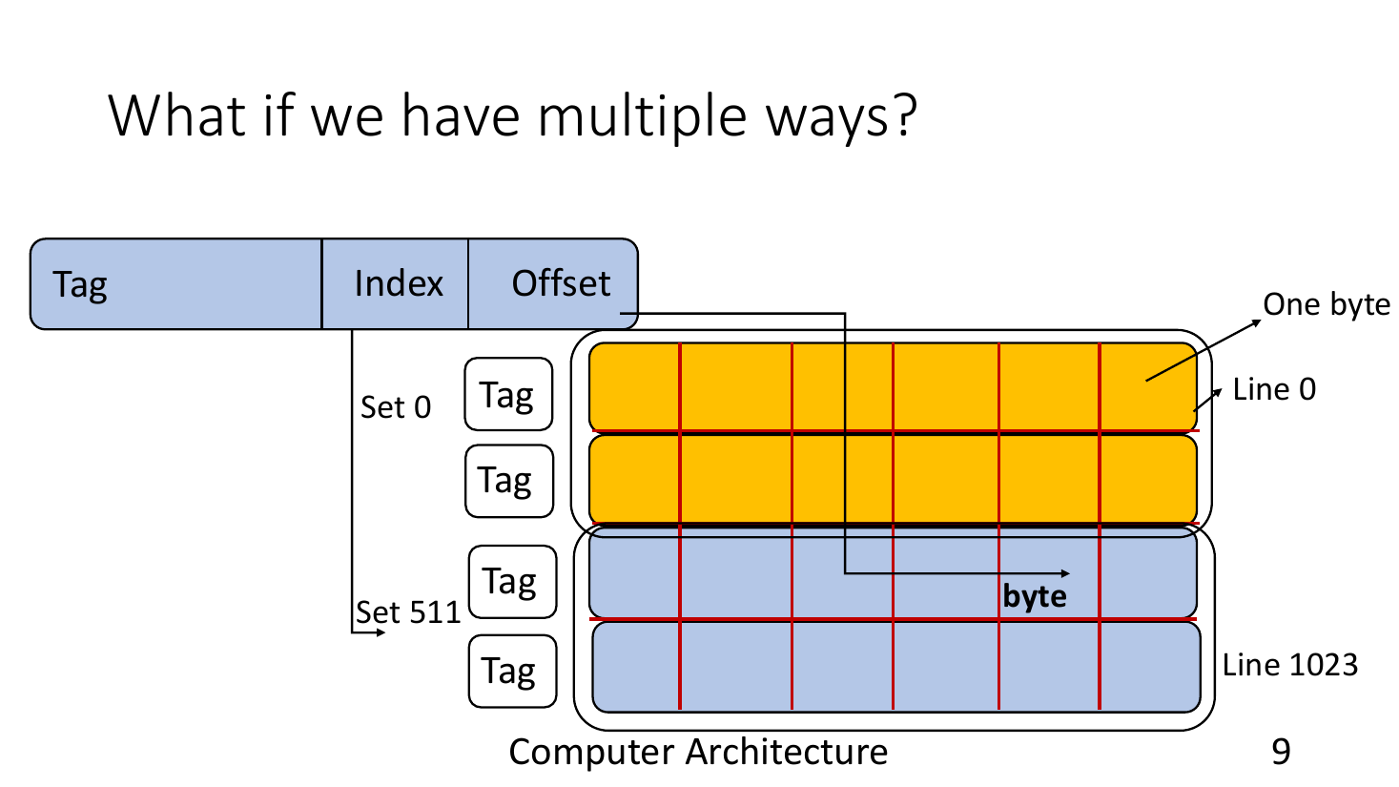
Recap: sets and ways
Notes:
Image: CS305 (Prof. Biswabandan Panda), Caches-II/III.

Slide 20
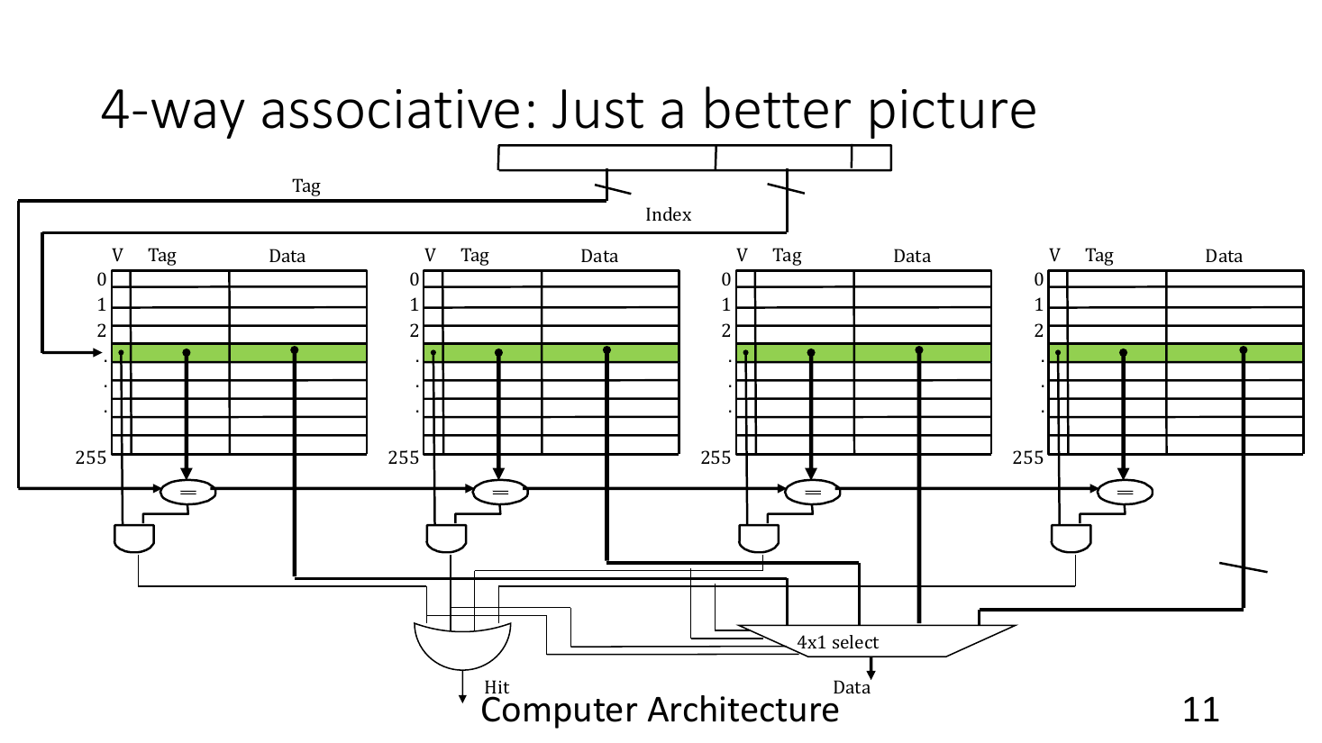
Recap: a 4-way set-associative cache
Notes:
Image: CS305 (Prof. Biswabandan Panda), Caches-II/III.

Slide 21
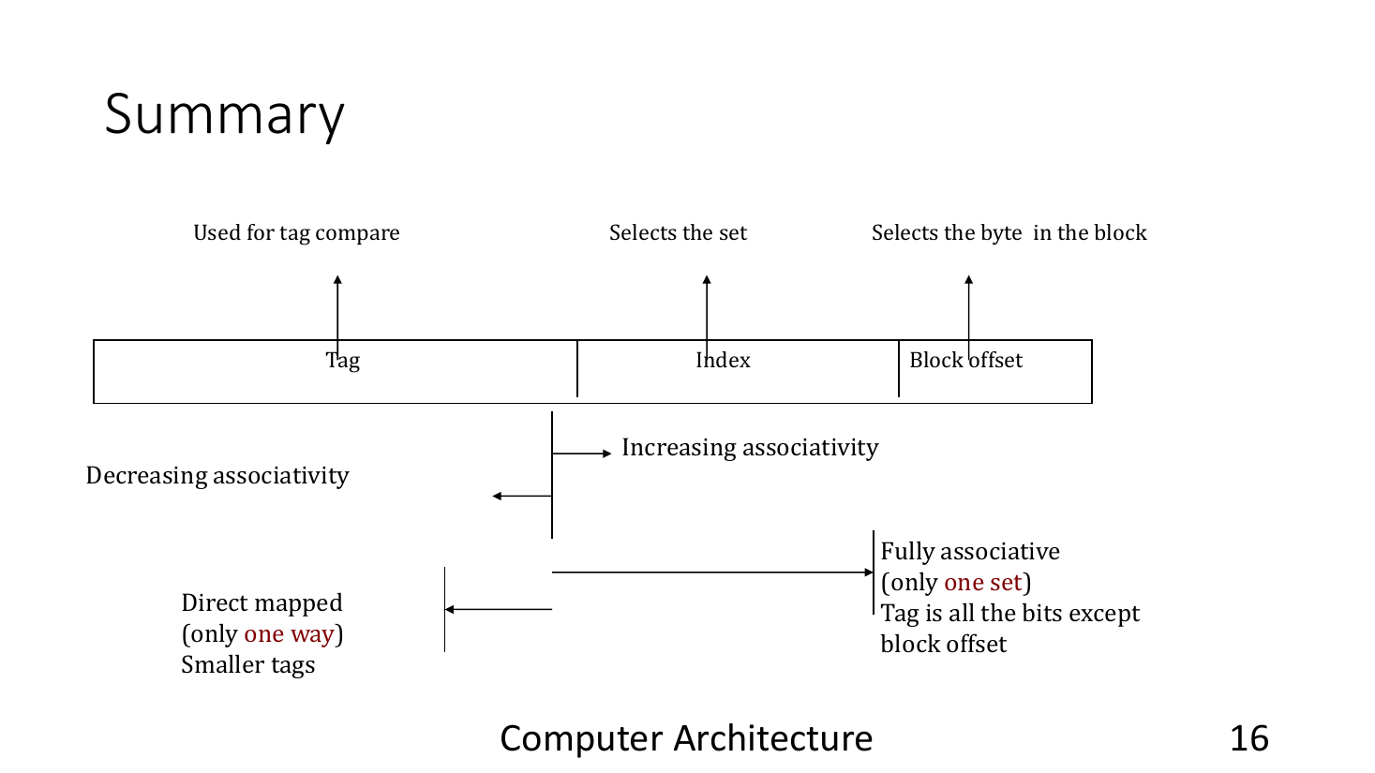
Recap: tag, index, offset
Notes:
Image: CS305 (Prof. Biswabandan Panda), Caches-II/III.

Slide 22
Recap: the bits of an address
• Lines are 64 bytes, so the low 6 bits are the offset inside the line.
• The next bits are the index. They pick the set: log₂(sets) bits.
• The rest of the address is the tag. It tells apart the lines that share a set.
• In our configuration:
  – L1D: 48 KB, 12 ways → 64 sets → 6 index bits
  – LLC: 2 MB, 16 ways → 2048 sets → 11 index bits

Slide 23
Practice: find the set
• The core loads from address 0x1234ABC0.
• Which byte of the line, which set and which tag does it use in the L1D?
• Which set does it use in the LLC?
H: Write the address in binary. Cut off 6 bits for the offset, then the index bits.

Slide 24
Practice: answer
• 0x1234ABC0 = …0100 1010 1011 1100 0000 in binary.
• Offset = low 6 bits = 0.
• L1D index = next 6 bits = 101111 = 47. Tag = address >> 12 = 0x1234A.
• LLC index = next 11 bits = 01010101111 = 687. Tag = address >> 17 = 0x91A.

Slide 25
Tracing a demand load
Core
• We follow one load, R1, for line A.
• Line A is in the LLC, but not in the L1D or the L2C.
• RQ and MSHR are two kinds of buffer. We explain them later.
• The numbers on the left are hit latencies in cycles.
R1 · LOAD
RQ
WQ
MSHR
+5
L1D
RQ
WQ
MSHR
+10
L2C
RQ
WQ
MSHR
+20
LLC
A
DRAM
Q: What does it mean for a line to "reside" in the LLC?
Q: What could each buffer be for?

Slide 26
R1 enters the L1D
Core
• The core sends R1 to the L1D.
• R1 waits in the L1D read queue (RQ).
RQ
WQ
MSHR
+5
L1D
R1
RQ
WQ
MSHR
+10
L2C
RQ
WQ
MSHR
+20
LLC
A
DRAM

Slide 27
L1D lookup: miss
Core
tag
index: 6
offset: 6
64 sets in the L1D
RQ
WQ
MSHR
✗
+5
L1D
R1
• We read the index bits to find the set.
• Then we compare the tag bits with the tag of every valid way in that set.
• No tag matches, so it is a miss!
• R1 moves to an MSHR, and the L1D sends R1' down to the L2C.
R1'
RQ
WQ
MSHR
+10
L2C
RQ
WQ
MSHR
+20
LLC
A
DRAM

Slide 28
R1' enters the L2C
Core
• R1' waits in the L2C read queue.
RQ
WQ
MSHR
+5
L1D
R1
RQ
WQ
MSHR
+10
L2C
R1'
RQ
WQ
MSHR
+20
LLC
A
DRAM

Slide 29
L2C lookup: miss
Core
tag
index: 10
offset: 6
1024 sets in the L2C
RQ
WQ
MSHR
+5
L1D
R1
• The L2C does the same lookup in its own sets.
• No tag matches here either: miss!
• R1' moves to an L2C MSHR, and the L2C sends R1'' down to the LLC.
RQ
WQ
MSHR
✗
+10
L2C
R1'
R1''
RQ
WQ
MSHR
+20
LLC
A
DRAM

Slide 30
R1'' enters the LLC
Core
• R1'' waits in the LLC read queue.
RQ
WQ
MSHR
+5
L1D
R1
RQ
WQ
MSHR
+10
L2C
R1'
RQ
WQ
MSHR
+20
LLC
A
R1''
DRAM

Slide 31
LLC lookup: hit
Core
tag
index: 11
offset: 6
2048 sets in the LLC
RQ
WQ
MSHR
+5
L1D
R1
• The LLC finds a matching tag in the set: hit!
• The LLC sends the data up to the L2C.
RQ
WQ
MSHR
+10
L2C
R1'
data
RQ
WQ
MSHR
✓
+20
LLC
A
DRAM

Slide 32
The data reaches the L2C
Core
• The response finds the MSHR entry that waits for line A.
• That entry is now ready to fill.
RQ
WQ
MSHR
+5
L1D
R1
RQ
WQ
MSHR
+10
L2C
R1' ✓
RQ
WQ
MSHR
+20
LLC
A
DRAM

Slide 33
The L2C fills the line
Core
• The L2C writes line A into the set.
• It frees the MSHR entry and sends the data up to the L1D.
RQ
WQ
MSHR
+5
L1D
R1
data
RQ
WQ
MSHR
+10
L2C
A
RQ
WQ
MSHR
+20
LLC
A
DRAM

Slide 34
The data reaches the L1D
Core
• The L1D MSHR entry for line A is now ready.
RQ
WQ
MSHR
+5
L1D
R1 ✓
RQ
WQ
MSHR
+10
L2C
A
RQ
WQ
MSHR
+20
LLC
A
DRAM

Slide 35
The L1D fills the line
Core
• The L1D writes line A and frees its MSHR entry.
• The core gets its data, and R1 is done.
• The lookups alone take at least 5 + 10 + 20 = 35 cycles.
data
RQ
WQ
MSHR
+5
L1D
A
RQ
WQ
MSHR
+10
L2C
A
RQ
WQ
MSHR
+20
LLC
A
DRAM

Slide 36
Packets
• Caches talk to each other with messages called packets.
• A cache sends a request down when it misses.
• The level below sends a response back up with the data.
• In ChampSim the response is the same packet, with the data filled in.

Slide 37
What a request carries
• address: the line we want. It gives the set and the tag.
• type: the kind of request (next slide).
• ip: the address of the instruction that made the access.
• cpu, instr_id: who waits for the data.
• to_return: the caches to answer.

Slide 38
What a response carries
• address and type: the same as in the request.
• data: the line itself.
• The cache sends the response to every cache listed in to_return.

Slide 39
Types of requests
• LOAD: the program reads data. A load that the program asks for is a demand load.
• RFO (read for ownership): the program writes data. The cache must read the line first.
• WRITEBACK: the cache sends a modified line down when it evicts it.
• PREFETCH: a guess at what the program will need soon. It is off in this lab.
• TRANSLATION: page-table reads. You will see them in the OS course.

Slide 40
Before we trace a store
Q: I want to store to an address whose line is not in the L1D.
Q: What will happen?

Slide 41
Tracing a store
Core
• We follow one store, R2, to line B.
• Line B is in the L2C, but not in the L1D.
• Each packet now shows its type: LOAD, RFO or WRITEBACK.
R2 · store
RQ
WQ
MSHR
+5
L1D
RQ
WQ
MSHR
+10
L2C
B
RQ
WQ
MSHR
+20
LLC
DRAM
Q: What does it mean for a line to "reside" in the L2C?

Slide 42
R2 enters the L1D
Core
• Stores enter the L1D through its write queue (WQ).
RQ
WQ
MSHR
+5
L1D
R2
RQ
WQ
MSHR
+10
L2C
B
RQ
WQ
MSHR
+20
LLC
DRAM

Slide 43
L1D lookup: miss
Core
• Line B is not in the L1D: miss!
• The L1D must read line B before it can change it.
• R2 takes an MSHR, and the L1D sends R2' (RFO) down.
RQ
WQ
MSHR
✗
+5
L1D
R2 RFO
R2' RFO
RQ
WQ
MSHR
+10
L2C
B
RQ
WQ
MSHR
+20
LLC
DRAM

Slide 44
L2C lookup: hit
Core
• R2' arrives in the L2C read queue.
• The L2C has line B: hit! It sends B up.
RQ
WQ
MSHR
+5
L1D
R2 RFO
data
RQ
WQ
MSHR
✓
+10
L2C
B
R2' RFO
RQ
WQ
MSHR
+20
LLC
DRAM

Slide 45
The L1D fills B and marks it dirty
Core
• The L1D writes line B and applies the store.
• Line B now differs from the copy in the L2C, so we call it dirty (red).
RQ
WQ
MSHR
+5
L1D
B
RQ
WQ
MSHR
+10
L2C
B
RQ
WQ
MSHR
+20
LLC
DRAM

Slide 46
Dirty lines
• A dirty line holds the only up-to-date copy of its data.
• When the cache evicts it, it must send it to the level below.
Q: If a clean line has to leave the cache, do I even need to send it to the level below?

Slide 47

* In an exclusive hierarchy the level below keeps no copy, so clean lines are sent down too.

Slide 48
Evicting B: a writeback
Core
• Later, the L1D evicts line B.
• R3 (WRITEBACK) carries line B down to the L2C.
• R3 enters the L2C write queue, which holds writebacks.
RQ
WQ
MSHR
+5
L1D
R3 WB
RQ
WQ
MSHR
+10
L2C
B
R3 WB
RQ
WQ
MSHR
+20
LLC
DRAM

Slide 49
Queues
• RQ (read queue): loads and RFOs wait here to be served.
• WQ (write queue): at the L1D, stores from the core wait here.
• Writeback queue: dirty lines from the level above wait here. ChampSim uses the WQ for this too.
Q: Which cache level does not need a writeback queue?

Slide 50
MSHR
• A miss can take hundreds of cycles to return.
• If it waited in the RQ, every request behind it would wait too.
• So the cache moves it to an MSHR (miss status holding register) and serves the next request.
• A second miss to the same line joins the existing MSHR entry. (* Think about the massive benefits of this.)
• Any other miss gets a new entry.
Q: What happens if all MSHRs are full?

Slide 51


Slide 52
Metrics
• Miss rate = misses / accesses.
  – The fraction of accesses that this cache could not serve.
• MPKI = misses per 1000 instructions.
  – Misses measured against the work the program does.
• Average miss latency = cycles from a miss until its data arrives.
  – ChampSim counts from when the request entered the queue until the fill, at that level only.
• LLC, soplex, 1M + 10M:
  – 286 951 misses of 504 999 accesses: miss rate 56.8%, MPKI 28.7, average miss latency 426 cycles
AMAT = hit time
+ miss rate × miss penalty
Average memory access time

Slide 53
Which metric?
• The miss rate depends on how many accesses reach the cache.
• MPKI compares the misses with the work the program does.
• The miss latency tells you how much each miss costs.
Q: I optimize a program P. Its miss rate increases but its MPKI decreases. Does that make sense?

Slide 54
Metrics at every level
CPU 0 cumulative IPC: 0.317071 instructions: 10000000 cycles: 31538718
cpu0_L1D TOTAL ACCESS: 1489120 HIT: 1048653 MISS: 440467
cpu0_L1D AVERAGE MISS LATENCY: 305.874 cycles
cpu0_L2C TOTAL ACCESS: 630218 HIT: 274097 MISS: 356121
cpu0_L2C AVERAGE MISS LATENCY: 364.649 cycles
LLC TOTAL ACCESS: 504999 HIT: 218048 MISS: 286951
LLC AVERAGE MISS LATENCY: 426.488 cycles
• We can compute the same metrics at every cache level.
• Each level only sees the misses of the level above it.
Q: Why are the L2C and LLC miss rates so much higher than the L1D miss rate?

Slide 55
Metrics at every level: computed
← back to Metrics
Level | Accesses | Misses | Miss rate | MPKI | Avg miss latency
L1D | 1 489 120 | 440 467 | 29.6% | 44.0 | 306 cycles
L2C | 630 218 | 356 121 | 56.5% | 35.6 | 365 cycles
LLC | 504 999 | 286 951 | 56.8% | 28.7 | 426 cycles
• As seen by the core, 286 951 of 1 489 120 accesses go all the way to DRAM: 19.3%.
• Fewer misses usually mean fewer cycles.
Q: Fewer misses: did the programmer or compiler change the program, or did the hardware improve? In the first case IPC can go either way. In the second case IPC goes up.

Slide 56
Branch statistics
CPU 0 Branch Prediction Accuracy: 92.9366% MPKI: 16.5733 Average ROB Occupancy at Mispredict: 31.4444
Branch type MPKI
BRANCH_DIRECT_JUMP: 0.0051
BRANCH_INDIRECT: 0.0004
BRANCH_CONDITIONAL: 16.5589
BRANCH_DIRECT_CALL: 0.003
BRANCH_INDIRECT_CALL: 0.0013
BRANCH_RETURN: 0.0046
• Accuracy: the fraction of branches whose direction and target were predicted correctly.
• MPKI: mispredictions per 1000 instructions. The rows below split it by branch type; they add up to it.
• Conditional branches (if, loop exits) cause almost all mispredictions. Direct jumps and calls have their target in the instruction; indirect ones read it from a register or memory; a return goes back to its caller.
• Ignore the ROB occupancy number.

Slide 57
Part 3
Replacement policies
• Sets and ways
• Choosing a victim
• LRU

Slide 58
Recall: set-associative caches
• We covered sets, ways and the bits of an address at the start of Part 2.
• The next two slides repeat the key pictures.
→ Recap: sets and ways
→ Recap: the bits of an address

Slide 59
Recall: sets and ways
Notes:
Image: CS305 (Prof. Biswabandan Panda), Caches-II/III.

Slide 60
Recall: a 4-way set-associative cache
Notes:
Image: CS305 (Prof. Biswabandan Panda), Caches-II/III.

Slide 61
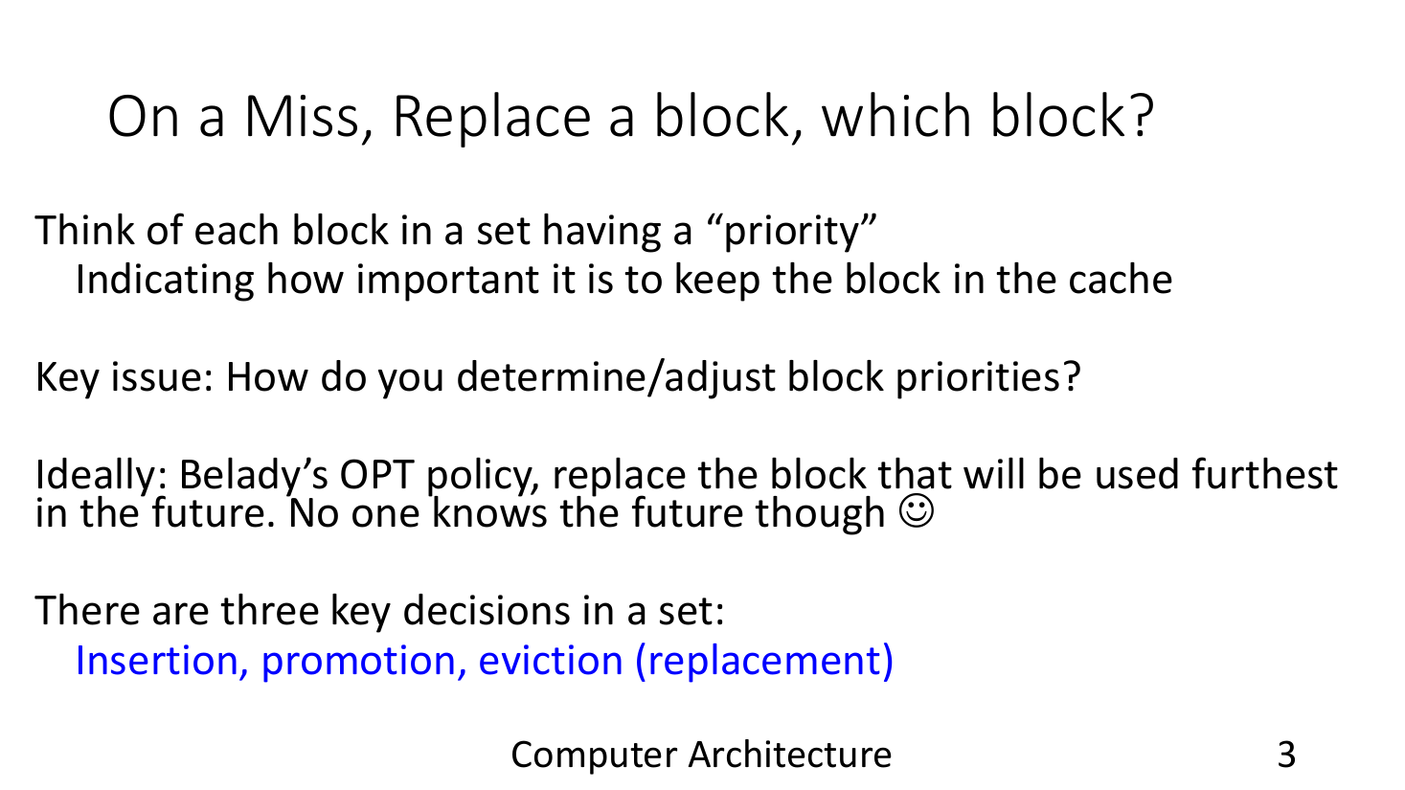
Which line do we replace?
Notes:
Image: CS305 (Prof. Biswabandan Panda), Caches-II/III.

Slide 62
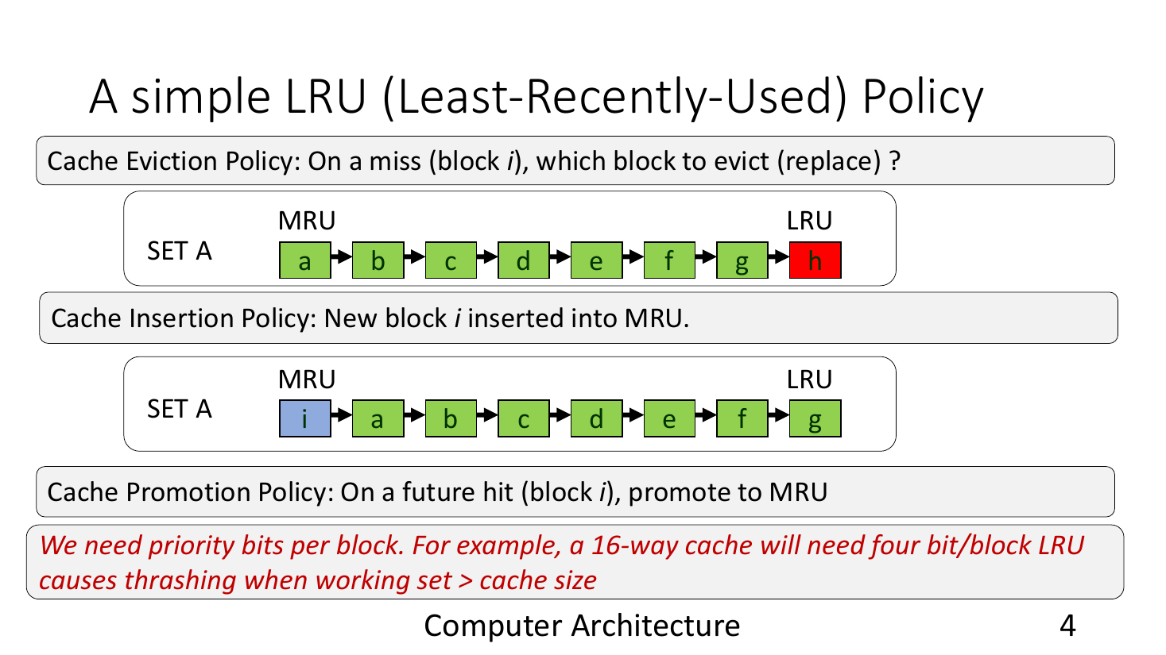
LRU
Notes:
Image: CS305 (Prof. Biswabandan Panda), Caches-II/III.

Slide 63
Replacement policies
• A set has a fixed number of ways. When a new line arrives and the set is full, one line must leave.
• A replacement policy decides three things:
  – Insertion: where a new line starts.
  – Promotion: what a hit does to a line.
  – Eviction: which line leaves.
• Programs tend to reuse the data they used recently. LRU bets on this: the line that has not been used for the longest time is the least likely to be needed soon.
• So LRU inserts and promotes a line as the most recent, and evicts the least recent.
• An L1 has only a few cycles per access, so its policy must be cheap. Lower levels can afford more state.
• There are many replacement policies. We discuss a few of them. A policy can also choose to keep no copy at all (bypassing, see the extra slides).

Slide 64
Review: you can now answer
• What are request and response packets, and what information do they carry?
• Why do caches need an RQ, a WQ and MSHRs?
• What are LOAD, RFO and WRITEBACK requests?
• Why does a full set need a replacement policy?
• What does LRU insert, promote and evict?
• What do miss rate, MPKI and miss latency measure?

Slide 65
Part 4
ChampSim under the hood
• The main loop and the output
• cache.cc: the read path
• Task 1
• Replacement code
• Tasks 2 and 3
• Reference: the write path

Slide 66
How ChampSim runs
// main.cc:414 (trimmed)
while (simulation not complete) {
for (auto op : operables) // cores, caches, DRAM
op->_operate(); // one cycle each
// read the next instructions from the trace
ooo_cpu[i]->init_instruction(traces[i]->get());
if (num_retired > warmup_instructions)
finish_warmup(); // reset the statistics
}
// then print_roi_stats() for every cache
• Open 09_inlab/Champsim and follow along.
• ChampSim builds the caches and cores from the JSON.
• In every cycle, each part runs one step.
• The warm-up runs first, then the counted instructions.

Slide 67
The output
$ ./bin/champsim --warmup_instructions 1000000 --simulation_instructions 10000000 /opt/CS231_Traces/soplex_66B.trace.xz
Warmup complete CPU 0 instructions: 1000002 cycles: 267780
Region of Interest Statistics
CPU 0 cumulative IPC: 0.317071 instructions: 10000000 cycles: 31538718
cpu0_L1D TOTAL ACCESS: 1489120 HIT: 1048653 MISS: 440467
cpu0_L1D LOAD ACCESS: 977101 HIT: 596896 MISS: 380205
cpu0_L1D RFO ACCESS: 502094 HIT: 442134 MISS: 59960
cpu0_L2C TOTAL ACCESS: 630218 HIT: 274097 MISS: 356121
cpu0_L2C WRITEBACK ACCESS: 189522 HIT: 189474 MISS: 48
LLC TOTAL ACCESS: 504999 HIT: 218048 MISS: 286951
LLC LOAD ACCESS: 305667 HIT: 57893 MISS: 247774
LLC RFO ACCESS: 50325 HIT: 11224 MISS: 39101
LLC WRITEBACK ACCESS: 148931 HIT: 148895 MISS: 36
LLC AVERAGE MISS LATENCY: 426.488 cycles
CPU 0 Branch Prediction Accuracy: 92.9366% MPKI: 16.5733
BRANCH_CONDITIONAL: 16.5589
H: We will demystify what these terms and outputs mean. IPC = instructions per cycle: higher is better.

Slide 68
What the output rows count
cpu0_L1D TOTAL ACCESS: 1489120 HIT: 1048653 MISS: 440467
cpu0_L1D LOAD ACCESS: 977101 HIT: 596896 MISS: 380205
cpu0_L1D RFO ACCESS: 502094 HIT: 442134 MISS: 59960
cpu0_L1D WRITEBACK ACCESS: 0 HIT: 0 MISS: 0
cpu0_L1D TRANSLATION ACCESS: 9925 HIT: 9623 MISS: 302
cpu0_L2C LOAD ACCESS: 380439 HIT: 74768 MISS: 305671
cpu0_L2C WRITEBACK ACCESS: 189522 HIT: 189474 MISS: 48
• TOTAL adds up the rows below it.
• LOAD: at the L1D, the program's loads. At the L2C, the load misses of the L1D and of the L1I, so the rows do not map one to one.
• RFO: at the L1D, every store, hit or miss. Below it, the RFO misses of the level above.
• WRITEBACK: dirty lines from the level above. Always 0 at the L1D.
• TRANSLATION: page-table reads, which also pass through the L1D. PREFETCH rows stay 0: prefetching is off.

Slide 69
The CACHE class (inc/cache.h)
class CACHE : public champsim::operable, ... {
public:
const std::string NAME; // "cpu0_L1D", "cpu0_L2C", "LLC"
const uint32_t NUM_SET, NUM_WAY, ...; // the shape, from the JSON
// line (set, way) is block[set * NUM_WAY + way]
std::vector<BLOCK> block{NUM_SET * NUM_WAY};
champsim::delay_queue<PACKET> RQ, PQ, VAPQ, WQ; // read, prefetch, write queues
std::list<PACKET> MSHR; // outstanding misses
uint64_t sim_access[..][..], sim_hit[..][..], sim_miss[..][..];
void operate() override; // one cycle
void handle_fill(); void handle_writeback(); void handle_read(); ...
};
H: Every cache in the hierarchy is one CACHE object. Everything in cache.cc works on these members.

Slide 70
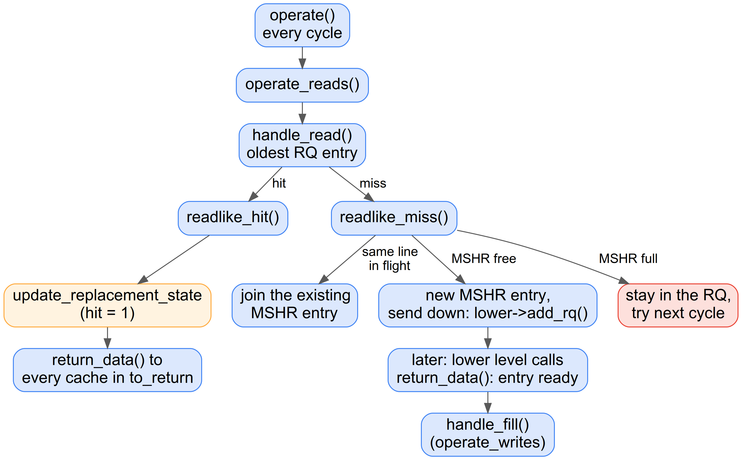
The read path in cache.cc

Slide 71
cache.cc: operate
• In every cycle, ChampSim calls operate() on each cache. It first handles fills and writebacks, then reads.
void CACHE::operate() {
operate_writes(); // handle_fill, handle_writeback
operate_reads(); // handle_read, handle_prefetch
}

Slide 72
cache.cc: handle_read
• handle_read takes the oldest request from the RQ. On a hit it calls readlike_hit; on a miss it calls readlike_miss.
void CACHE::handle_read() // cache.cc:122

Slide 73
cache.cc: readlike_miss
• readlike_miss joins the miss to an MSHR entry for the same line. If there is none, it allocates one and sends a request down.
bool CACHE::readlike_miss(PACKET& handle_pkt) // cache.cc:220

Slide 74
cache.cc: return_data
• The lower level calls return_data when the data comes back. It marks the matching MSHR entry as ready.
void CACHE::return_data(PACKET* packet) // cache.cc:655

Slide 75
cache.cc: handle_fill
• handle_fill takes a ready MSHR entry, writes the line into the set and answers the level above.
void CACHE::handle_fill() // cache.cc:34

Slide 76
handle_read
void CACHE::handle_read() {
while (reads_available_this_cycle > 0) { // bandwidth: max_read
if (!RQ.has_ready()) return;
PACKET& handle_pkt = RQ.front(); // oldest request
uint32_t set = get_set(handle_pkt.address);
uint32_t way = get_way(handle_pkt.address, set); // NUM_WAY if absent
if (way < NUM_WAY) // HIT
readlike_hit(set, way, handle_pkt);
else if (!readlike_miss(handle_pkt)) // MISS
return; // no MSHR free: try next cycle
RQ.pop_front();
reads_available_this_cycle--;
}
}
• get_way returns NUM_WAY when the line is not in the set.
• A miss that cannot get an MSHR stays in the RQ.

Slide 77
Hit: readlike_hit
void CACHE::readlike_hit(set, way, PACKET& handle_pkt) {
BLOCK& hit_block = block[set * NUM_WAY + way];
handle_pkt.data = hit_block.data;
// tell the replacement policy about the hit
impl_replacement_update_state(..., set, way, ..., /*hit*/ 1);
sim_hit[cpu][type]++; sim_access[cpu][type]++;
for (auto ret : handle_pkt.to_return) // send the response up
ret->return_data(&handle_pkt);
}
• We copy the data into the packet.
• impl_replacement_update_state tells the replacement policy that this line was hit.
• We count the hit.
• return_data hands the packet to every cache in to_return.

Slide 78
Miss: readlike_miss
bool CACHE::readlike_miss(PACKET& handle_pkt) {
auto mshr_entry = find in MSHR (same address);
if (mshr_entry != MSHR.end()) { // miss already in flight
merge handle_pkt.to_return into mshr_entry;
} else {
if (MSHR.size() == MSHR_SIZE) return false; // MSHR full
if (lower level RQ is full) return false;
// fill_level can skip the entry: then this level keeps no copy
MSHR.insert(std::end(MSHR), handle_pkt); // new entry
handle_pkt.to_return = {this}; // answer me
lower_level->add_rq(&handle_pkt); // send it down
}
return true;
}
• If the same line is already missing, we join that entry.
• Otherwise we allocate an entry and send a request down.
• When we return false, the packet stays in the RQ.

Slide 79
Servicing the miss: handle_fill
void CACHE::handle_fill() {
while (writes_available_this_cycle > 0) { // bandwidth: max_write
auto fill_mshr = MSHR.begin();
if (fill_mshr not ready) return; // data not back yet
uint32_t set = get_set(fill_mshr->address);
way = first invalid way in the set;
if (way == NUM_WAY) // set is full
way = impl_replacement_find_victim(...);
if (!filllike_miss(set, way, *fill_mshr)) return;
for (auto ret : fill_mshr->to_return) // send the response up
ret->return_data(&(*fill_mshr));
MSHR.erase(fill_mshr);
writes_available_this_cycle--;
}
}
• We use an empty way first.
• Only a full set asks the policy for a victim.
• Then every waiting cache gets the data.

Slide 80
Filling the line: filllike_miss
bool CACHE::filllike_miss(set, way, PACKET& handle_pkt) {
BLOCK& fill_block = block[set * NUM_WAY + way];
if (fill_block.dirty) { // victim was modified
PACKET writeback_packet; ... type = WRITEBACK;
if (lower_level->add_wq(&writeback_packet) == -2)
return false; // lower WQ full
}
fill_block.valid = true;
fill_block.dirty = (type == WRITEBACK || (type == RFO && to_return.empty()));
fill_block.address = handle_pkt.address; ... // copy the rest
impl_replacement_update_state(..., set, way, ..., /*hit*/ 0);
sim_miss[cpu][type]++; sim_access[cpu][type]++;
return true;
}
• A dirty victim goes down as a writeback first.
• The new line is dirty if it carries a store.
• We tell the policy about the fill.

Slide 81
It's inlab (1) time

Slide 82
Task 1: count events in the L2C
• Count the read hits in each way of the L2C.
• Optional: count the misses in each set and print the largest count.
• A read is a request that comes through the RQ: LOAD and RFO. TRANSLATION reads also count, but we do not teach them.
• Edit the copies in task1/: cache.h, cache.cc and main.cc. Then run make task1 and make check-task1.
Q: Where is the cache's state declared?
Q: Where is a read hit detected? Where is a miss counted?
Q: Where are the statistics printed?

Slide 83
You are replaceable
• Each policy is a folder: replacement/<name>/<name>.cc.
• The file defines four functions of CACHE:
  – initialize_replacement(): once, at the start
  – find_victim(...): returns the way to evict
  – update_replacement_state(...): runs on every hit and every fill
  – replacement_final_stats(): once, at the end
• Set "replacement": "<name>" in the JSON and rebuild.

Slide 84
Where the policy is called
• readlike_hit → update_replacement_state(hit = 1)
• handle_fill → find_victim, only if the set is full
• filllike_miss → update_replacement_state(hit = 0)
• Stores and writebacks call them in the same way.
• Prefetchers also call them. We switch prefetching off in this lab.

Slide 85
It's inlab (2) time

Slide 86
Task 2: from an idea to code
• This task shows how to turn an existing idea into code.
• The idea: LRU keeps the lines of a set in order of last use.
• A hit or a fill moves a line to the front (most recent).
• Eviction takes the line at the back (least recent).
Notes:
Image: CS305 (Prof. Biswabandan Panda), Caches-II/III.

Slide 87
Idea → code: the order of a set
std::map<CACHE*, std::vector<uint32_t>> lruBits; // one age per line
void CACHE::initialize_replacement() {
lruBits[this] = std::vector<uint32_t>(NUM_SET * NUM_WAY, 0);
}
• We store the order as an age for every line.
• Age NUM_WAY - 1 is the most recent line; age 0 is the least recent.
• Each cache that uses the policy gets its own vector.

Slide 88
Idea → code: eviction
uint32_t CACHE::find_victim(..., uint32_t set, ...) {
for (uint32_t i = 0; i < NUM_WAY; i++)
if (lruBits[this][set * NUM_WAY + i] == 0) // least recent
return i;
}
• The idea says: evict the line at the back.
• In code, we return the way whose age is 0.

Slide 89
Idea → code: insertion and promotion
void CACHE::update_replacement_state(..., set, way, ..., type, hit) {
if (hit && type == WRITEBACK) return; // not a real use
uint32_t currVal = lruBits[this][set * NUM_WAY + way];
for (uint32_t i = 0; i < NUM_WAY; i++) // newer lines age by 1
if (lruBits[this][set * NUM_WAY + i] > currVal)
lruBits[this][set * NUM_WAY + i]--;
lruBits[this][set * NUM_WAY + way] = NUM_WAY - 1; // most recent
}
• The idea says: move the line to the front.
• In code, every line that was newer than it ages by one.
• Then the line gets the age NUM_WAY - 1.
• A fill (hit = 0) is the insertion, and a hit (hit = 1) is the promotion.

Slide 90
Debugging: follow one set
// at the end of update_replacement_state (needs #include <iostream>)
if (warmup_complete[cpu] && set == 5) { // one set, after the warm-up
std::cout << NAME << " set 5 " << (hit ? "hit " : "fill") << " way " << way
<< " line " << std::hex << (full_addr >> 6) << std::dec << " ages:";
for (uint32_t i = 0; i < NUM_WAY; i++)
std::cout << " " << lruBits[this][set * NUM_WAY + i];
std::cout << std::endl;
}
• Print from inside the policy to watch it work. Print one set only, or the output floods.
• Run the binary yourself and filter: Champsim/bin/mylru --warmup_instructions 1000000 --simulation_instructions 3000000 /opt/CS231_Traces/soplex_66B.trace.xz | grep 'set 5' | head
• To track one packet instead, test its line: (full_addr >> 6) == 0x49d2405.

Slide 91
Debugging: what you see
cpu0_L2C set 5 fill way 6 line 3276c05 ages: 5 2 6 4 1 3 7 0
cpu0_L2C set 5 fill way 7 line 49d2405 ages: 4 1 5 3 0 2 6 7
cpu0_L2C set 5 hit way 3 line 20d7c05 ages: 3 1 4 7 0 2 5 6
cpu0_L2C set 5 hit way 0 line 748405 ages: 7 1 3 6 0 2 4 5
• The L2C has 8 ways, so ages go from 0 to 7.
• Each hit or fill moves its way to age 7, and the lines that were newer age by one.
• After the first fill, way 7 has age 0: the next fill goes exactly there.
• Remove the print before make check: printing slows the run a lot.

Slide 92


Slide 93
How we check your policy
• make check builds your policy at the L2C and runs 1M + 5M instructions on the traces where a wrong policy gives different numbers.
• It compares your IPC and your L2C MPKI with our solution's. Both must match exactly.
• L2C MPKI = L2C misses per 1000 simulated instructions. The makefile computes it for you.
• If either is further off, it prints both your values and ours.
Q: Think like an autograder checking your L2C policy against ours: which of IPC, L2C MPKI and L1D AMAT would you compare, in what combination, and why?
Q: Suppose the autograder only checks "IPC within 5% of ours". At which level (L1D, L2C or LLC) would that still catch a wrong policy, and why?

Slide 94
How good is a policy?
• Checking that a policy is correct is one question. Judging whether it is good is another.
• Say two correct policies give different numbers at the L2C.
Q: Which numbers do you look at to decide which policy is better, and in what order: MPKI, miss rate, or AMAT / average miss latency?
Q: (*) How will the LLC statistics look when you change only the L2C policy?

Slide 95


Slide 96
It's inlab (3) time

Slide 97
Task 3: replacement by instruction
• Each line was brought in by one instruction, identified by its ip.
• Some instructions bring in lines that the program reuses. Others do not.
• We keep a counter per instruction: +1 on a hit, −1 on a miss.
• We evict the line whose instruction has the lowest counter.
Q: How will you store this data?
Q: Where will you update it?
Q: Where will you use it to choose a victim?
H: A line remembers the instruction that brought it in: current_set[i].ip.
H: Hits and fills both arrive in update_replacement_state; the hit argument tells them apart.

Slide 98
Summary
• ChampSim replays a trace on a configured core and caches, and reports IPC and cache statistics.
• A miss travels down through the RQ and MSHR of each level; the data comes back up and fills each level.
• Stores read the line first (RFO), mark it dirty, and write it back when it is evicted.
• Miss rate, MPKI and miss latency measure a cache from different angles.
• A replacement policy decides insertion, promotion and eviction. LRU evicts the least recently used line.
• In cache.cc, handle_read, readlike_hit, readlike_miss and handle_fill implement the read path.

Slide 99
Lab exam

Slide 100
Part X
Extra: bypassing
• What it is
• When it helps
• In ChampSim

Slide 101
Bypassing
• Some lines are used once and never again, for example an array that the program reads from start to end.
• Storing such a line evicts a line that might have been reused.
• So a policy may bypass the cache: the data goes up to the level above, but this cache keeps no copy.
• In ChampSim, find_victim bypasses by returning NUM_WAY instead of a way.
• ChampSim allows this only at the LLC, and never for a WRITEBACK, which must be stored somewhere.
Q: Which of our traces would benefit from bypassing, and how could a policy detect such lines?

Slide 102
Part R
Reference: the write path (view later)
• operate_writes()
• handle_writeback()
• Why a filled line is dirty

Slide 103
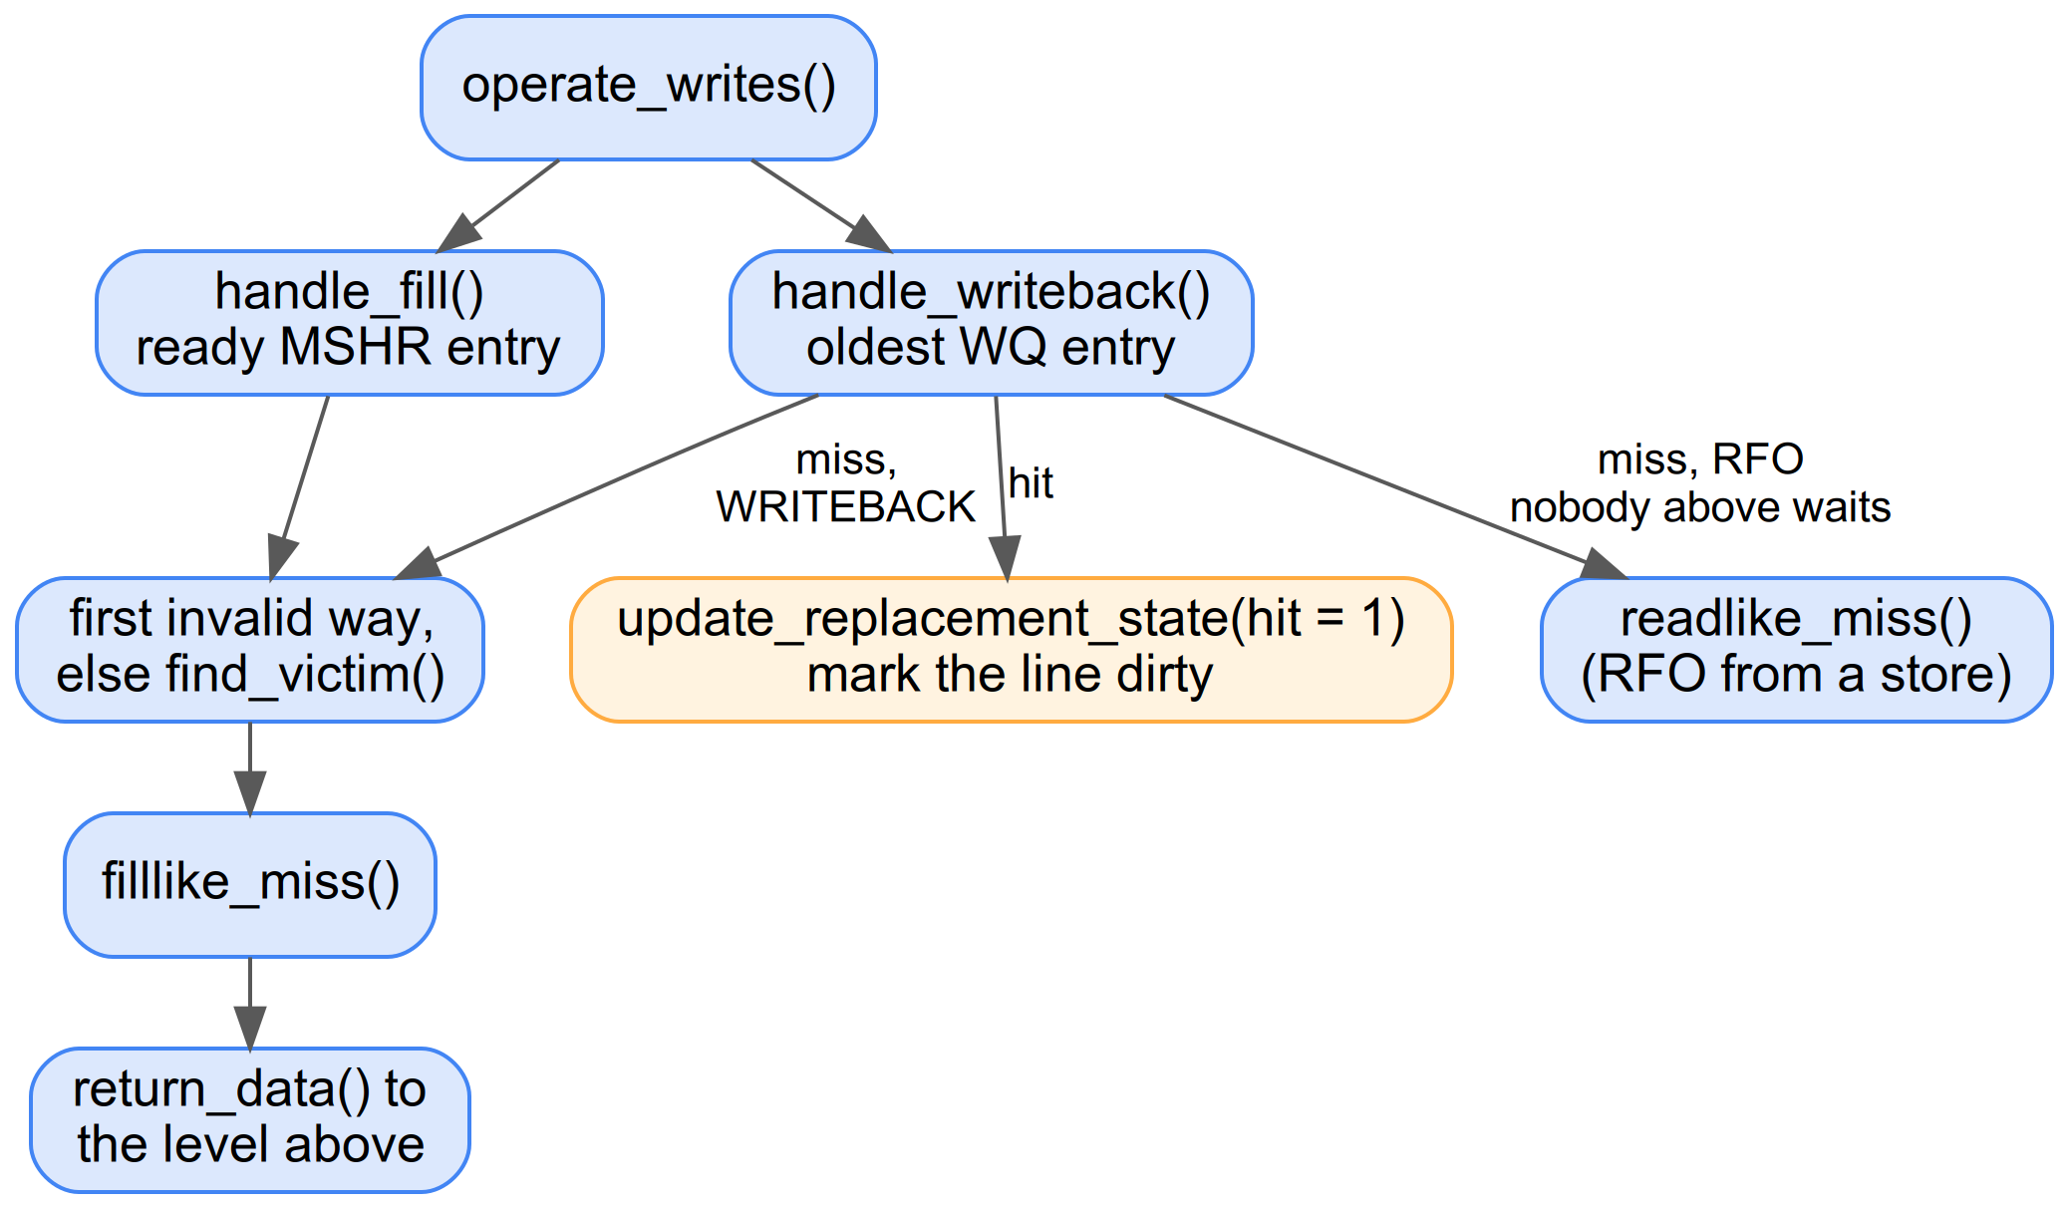
The write path (REFERENCE, view later)

Slide 104
handle_writeback (REFERENCE, view later)
void CACHE::handle_writeback() {
while (writes_available_this_cycle > 0) {
if (!WQ.has_ready()) return;
PACKET& handle_pkt = WQ.front(); // oldest store or writeback
uint32_t set = get_set(handle_pkt.address);
uint32_t way = get_way(handle_pkt.address, set);
if (way < NUM_WAY) { // HIT
impl_replacement_update_state(..., set, way, ..., /*hit*/ 1);
block[set * NUM_WAY + way].dirty = 1; // the line now holds new data
} else if (handle_pkt.type == RFO && handle_pkt.to_return.empty()) {
if (!readlike_miss(handle_pkt)) return; // store miss: read the line first
} else {
way = first invalid way, else find_victim(...);
if (!filllike_miss(set, way, handle_pkt)) return; // writeback miss: store it
}
WQ.pop_front();
writes_available_this_cycle--;
}
}

Slide 105
handle_writeback, step by step (REFERENCE, view later)
• Hit: we tell the policy about the hit and mark the line dirty.
• Store miss (an RFO whose to_return is empty): the store came from the core at this level, so we read the line first through readlike_miss.
• Writeback miss: the level above sent a dirty line we do not have. We pick a way and store it with filllike_miss.
• Like handle_read, it stops when the per-cycle limit max_write is used up.

Slide 106
Why a filled line is dirty (REFERENCE, view later)
• fill_block.dirty = (type == WRITEBACK || (type == RFO && to_return.empty()));
• A WRITEBACK fill stores data that is newer than the level below, so the line is dirty.
• An RFO with an empty to_return started at this level from a store. The store writes into the line, so it is dirty.
• An RFO from the level above has a non-empty to_return. The store happens up there, so this copy stays clean.

